Slide 1
Efficiently updating Customizable Contraction Hierarchies (CCH)

Slide 2
Content
Streaming update for CCH
Building CCH index structure
Build up the SS-Graph
Updating all indices
How? => Debug pseudo code
Retrieving shortest paths

Slide 3
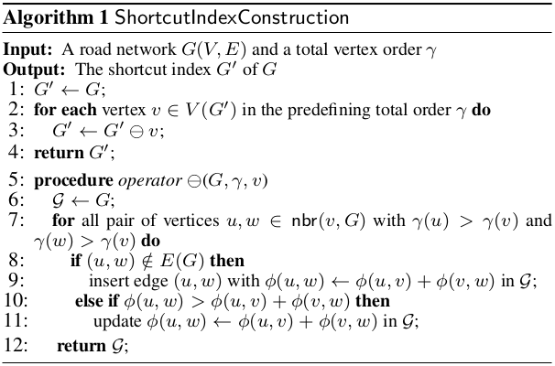
v₈
2
v₉
1
v₆
2
1
2
2
v₅
4
v₇
4
v₀
2
3
1
1
v₃
1
v₄
1
v₁
v₁₀
2
2
2
2
v₂

Slide 4
1
3
4
v₈
2
v₉
1
v₆
2
1
2
2
10
5
11
v₅
4
v₇
4
v₀
2
3
1
1
6
9
7
2
v₃
1
v₄
1
v₁
v₁₀
2
2
2
2
8
v₂

Slide 5
1
3
4
v₈
2
v₉
1
v₆
4
2
1
2
2
10
5
11
v₅
4
v₇
4
v₀
2
3
1
1
6
9
7
2
v₃
1
v₄
1
v₁
v₁₀
2
2
2
2
8
v₂

Slide 6
1
3
4
v₈
2
v₉
1
v₆
4
2
1
2
2
10
5
11
v₅
4
v₇
4
v₀
2
3
1
1
6
9
7
2
v₃
1
v₄
1
v₁
v₁₀
2
2
2
2
8
v₂
3

Slide 7
1
3
5
4
v₈
2
v₉
1
v₆
4
2
1
2
2
10
5
11
v₅
4
v₇
4
v₀
2
3
1
1
6
9
7
2
v₃
1
v₄
1
v₁
v₁₀
2
2
2
2
8
v₂
3

Slide 8
1
3
5
4
v₈
2
v₉
1
v₆
4
2
1
2
2
10
5
11
v₅
4
v₇
4
v₀
8
2
3
1
1
6
9
7
2
v₃
1
v₄
1
v₁
v₁₀
2
2
2
2
8
v₂
3

Slide 9
1
3
5
4
v₈
2
v₉
1
v₆
4
2
1
2
2
10
5
11
v₅
4
v₇
4
v₀
8
2
3
1
1
6
9
7
2
v₃
1
v₄
1
v₁
v₁₀
2
2
2
2
8
v₂
4
3

Slide 10
1
3
5
4
v₈
2
v₉
1
v₆
4
2
1
2
2
10
5
11
v₅
4
v₇
4
v₀
8
2
3
2
1
1
6
9
7
2
v₃
1
v₄
1
v₁
v₁₀
2
2
2
2
8
v₂
4
3

Slide 11
1
3
5
4
v₈
2
v₉
1
v₆
4
2
1
2
2
10
5
11
v₅
4
v₇
4
v₀
8
2
3
2
1
1
6
9
7
2
v₃
1
v₄
1
v₁
v₁₀
2
2
2
2
8
v₂
4
3

Slide 12
1
3
5
4
v₈
2
v₉
1
v₆
4
2
1
2
2
10
5
11
v₅
4
v₇
4
v₀
5
2
3
2
1
1
6
9
7
2
v₃
1
v₄
1
v₁
v₁₀
2
2
2
2
8
v₂
4
3

Slide 13
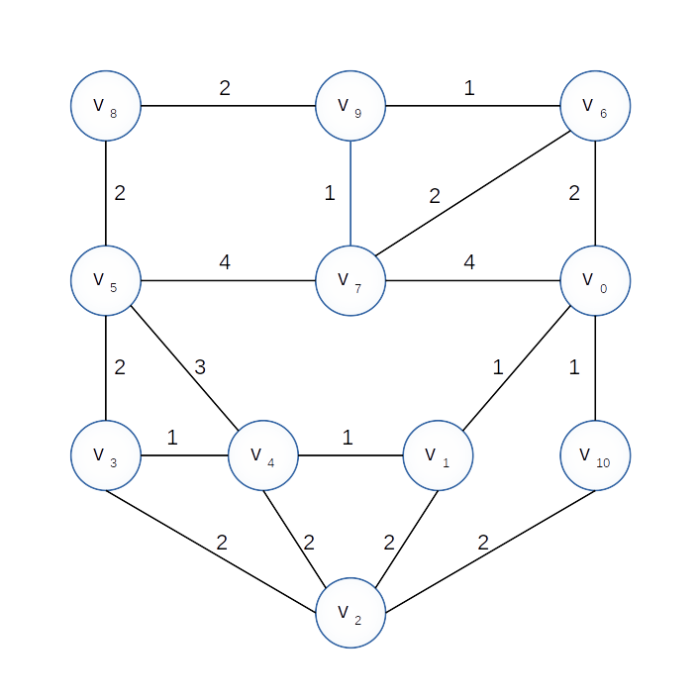
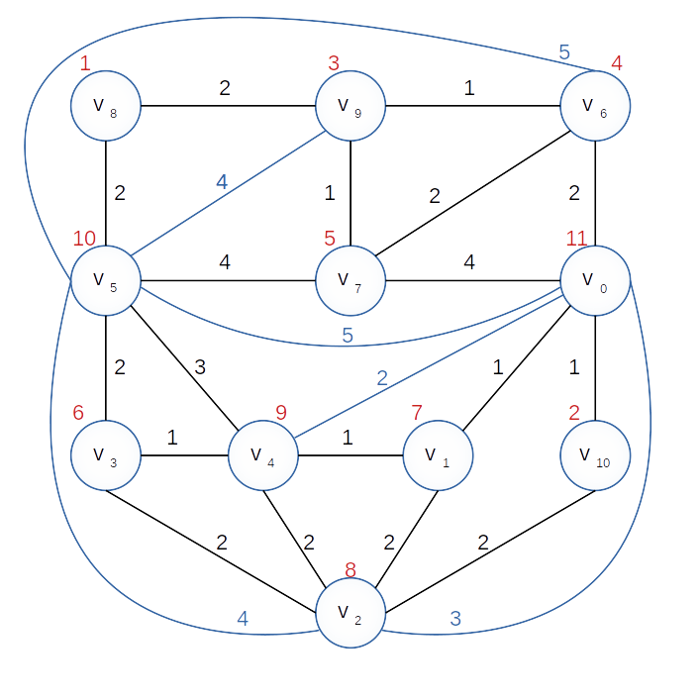
What do we have now?
Graph G
Shortcut index G‘

Slide 14
Build the SS-Graph
Shortcut index G‘
v5, v0
5

Slide 15
Build the SS-Graph
Shortcut index G‘
v5, v0
5
R₁
v7, v5
v7, v0
4
4

Slide 16
Build the SS-Graph
Shortcut index G‘
v5, v0
5
R₁
R₂
v7, v5
v7, v0
v4, v5
v4, v0
4
4
3
2

Slide 17
Build the SS-Graph
Shortcut index G‘
v5, v0
5
R₁
R₂
v7, v5
v7, v0
v4, v5
v4, v0
4
4
3
2
R₃
v6, v7
v6, v5
2
5

Slide 18
Build the SS-Graph
Shortcut index G‘
v5, v0
5
R₁
R₂
v7, v5
v7, v0
v4, v5
v4, v0
4
4
3
2
R₃
R₄
v6, v7
v6, v5
v6, v0
2
5
2

Slide 19
Build the SS-Graph
Shortcut index G‘
v5, v0
5
R₁
R₂
v7, v5
v7, v0
v4, v5
v4, v0
4
4
3
2
R₃
R₄
R₅
v6, v7
v6, v5
v6, v0
2
5
2

Slide 20
And so on …

Slide 21
Build the SS-Graph
Shortcut index G‘
v5, v0
5
R₁
R₂
v7, v5
v7, v0
v4, v5
v4, v0
4
4
3
2
R₃
R₄
R₅
R₆
v6, v7
v6, v5
v6, v0
v2, v5
v0,v2
2
5
2
4
3

Slide 22
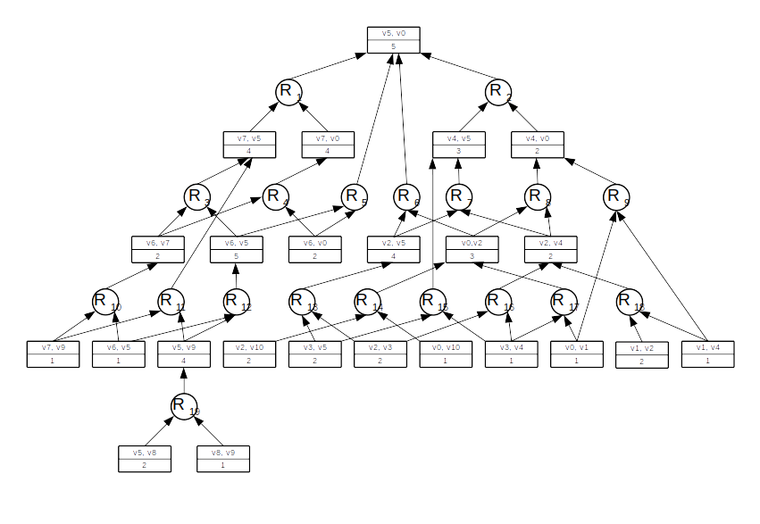
Final SS-Graph

Slide 23
What do we have?
The Graph G
The Shortcut Index G‘
The Shortcut Support Index or SS-Graph G*

Slide 24
What now?
5
1
3
4
v₈
2
v₉
1
v₆
4
2
1
2
2
10
5
11
v₅
4
v₇
4
v₀
5
2
3
2
1
1
6
9
7
2
v₃
1
v₄
1
v₁
v₁₀
2
2
2
2
8
v₂
4
3

Slide 25
What now?
5
1
3
4
v₈
2 → 1
v₉
1
v₆
Weight decrease (v₈ v₉) = 2 → 1
Implies further weight changes
Let’s use G* to find out which
4
2
1
2
2
10
5
11
v₅
4
v₇
4
v₀
5
2
3
2
1
1
6
9
7
2
v₃
1
v₄
1
v₁
v₁₀
2
2
2
2
8
v₂
4
3

Slide 26
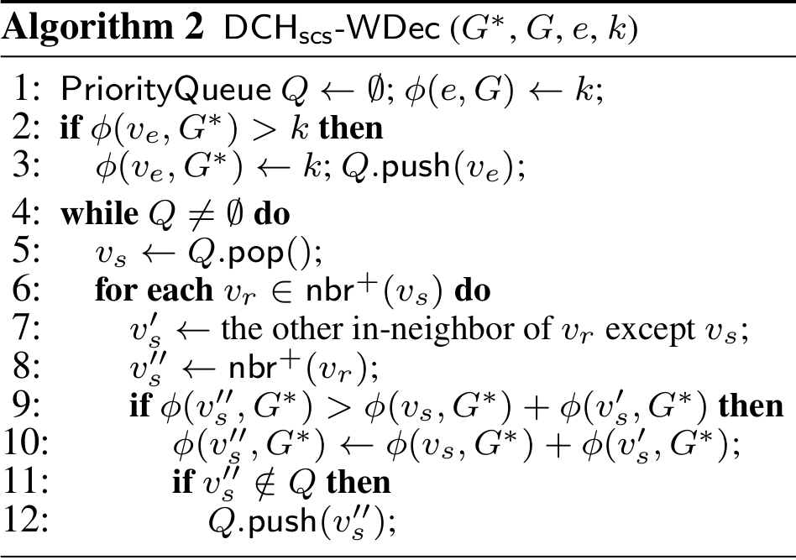
v5, v0
5
R₁
v7, v5
v7, v0
4
4
R₃
R₄
R₅
v6, v7
v6, v5
v6, v0
2
5
2
R₁₀
R₁₁
R₁₂
v7, v9
v6, v5
v5, v9
1
1
4
R₁₉
v5, v8
v8, v9
2
2 → 1

Slide 27
v5, v0
5
R₁
v7, v5
v7, v0
4
4
R₃
R₄
R₅
v6, v7
v6, v5
v6, v0
2
5
2
R₁₀
R₁₁
R₁₂
v7, v9
v6, v5
v5, v9
1
1
4
R₁₉
v5, v8
v8, v9
2
1

Slide 28
v5, v0
5
R₁
v7, v5
v7, v0
4
4
R₃
R₄
R₅
v6, v7
v6, v5
v6, v0
2
5
2
R₁₀
R₁₁
R₁₂
v7, v9
v6, v5
v5, v9
1
1
4
R₁₉
v5, v8
v8, v9
2
1

Slide 29
v5, v0
5
R₁
v7, v5
v7, v0
4
4
R₃
R₄
R₅
v6, v7
v6, v5
v6, v0
2
5
2
R₁₀
R₁₁
R₁₂
v7, v9
v6, v5
v5, v9
1
1
4
R₁₉
v5, v8
v8, v9
2
1

Slide 30
v5, v0
5
R₁
v7, v5
v7, v0
4
4
R₃
R₄
R₅
v6, v7
v6, v5
v6, v0
2
5
2
R₁₀
R₁₁
R₁₂
v7, v9
v6, v5
v5, v9
1
1
4 → 3
R₁₉
v5, v8
v8, v9
2
1

Slide 31
v5, v0
5
R₁
v7, v5
v7, v0
4
4
R₃
R₄
R₅
v6, v7
v6, v5
v6, v0
2
5
2
R₁₀
R₁₁
R₁₂
v7, v9
v6, v5
v5, v9
1
1
3
R₁₉
v5, v8
v8, v9
2
1

Slide 32
v5, v0
5
R₁
v7, v5
v7, v0
4
4
R₃
R₄
R₅
v6, v7
v6, v5
v6, v0
2
5 → 4
2
R₁₀
R₁₁
R₁₂
v7, v9
v6, v5
v5, v9
1
1
3
R₁₉
v5, v8
v8, v9
2
1

Slide 33
v5, v0
5
R₁
v7, v5
v7, v0
4
4
R₃
R₄
R₅
v6, v7
v6, v5
v6, v0
2
4
2
R₁₀
R₁₁
R₁₂
v7, v9
v6, v5
v5, v9
1
1
3
R₁₉
v5, v8
v8, v9
2
1

Slide 34
v5, v0
5
R₁
v7, v5
v7, v0
4
4
R₃
R₄
R₅
v6, v7
v6, v5
v6, v0
2
4
2
R₁₀
R₁₁
R₁₂
v7, v9
v6, v5
v5, v9
1
1
3
R₁₉
v5, v8
v8, v9
2
1

Slide 35
5 → 4
v5, v0
1
3
4
5
2 → 1
v₈
v₉
1
v₆
R₁
v7, v5
v7, v0
4 → 3
4
4
2
1
2
2
R₃
R₄
R₅
10
5
11
v₅
4
v₇
4
v₀
v6, v7
v6, v5
v6, v0
2
4
2
5
R₁₀
R₁₁
R₁₂
2
3
2
1
1
6
9
7
2
v7, v9
v6, v5
v5, v9
v₃
1
v₄
1
v₁
v₁₀
1
1
3
R₁₉
2
2
2
2
v5, v8
v8, v9
8
2
1
v₂
4
3

Slide 36
Weight Increase
1
3
5
4
v₈
2
v₉
1 → 2
v₆
Weight decrease (v₉ v₆) = 2 → 1
Implies further weight changes
Let’s use G* to find out which
4
2
1
2
2
10
5
11
v₅
4
v₇
4
v₀
5
2
3
2
1
1
6
9
7
2
v₃
1
v₄
1
v₁
v₁₀
2
2
2
2
8
v₂
4
3

Slide 37
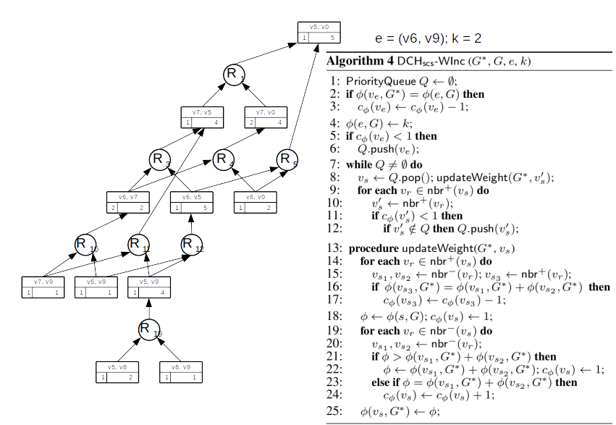

Slide 38
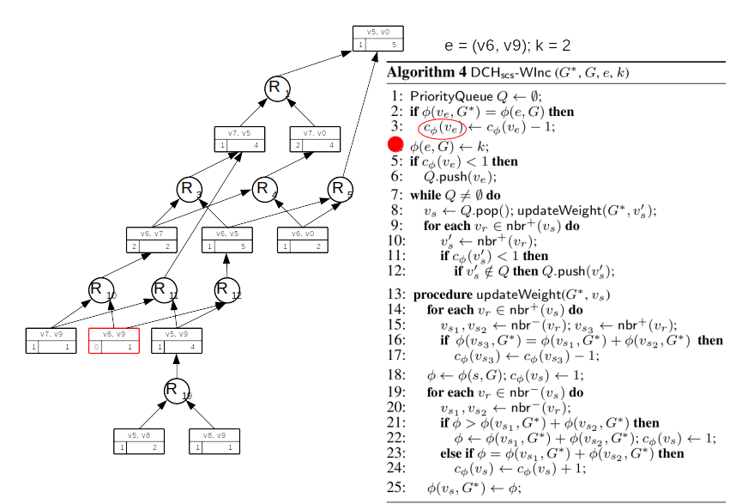

Slide 39
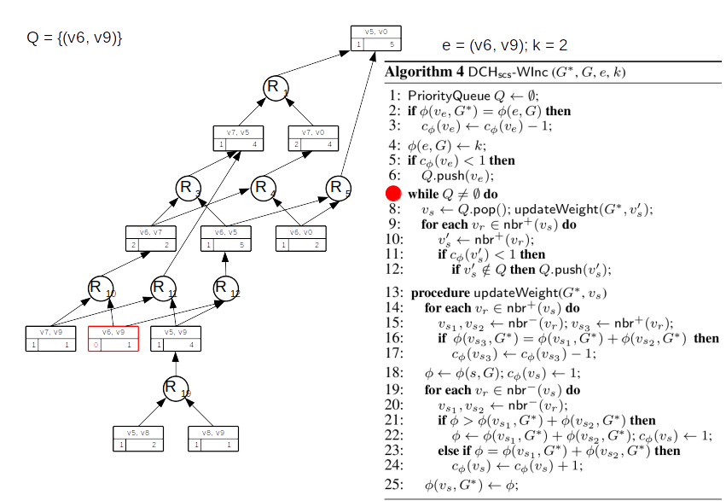

Slide 40
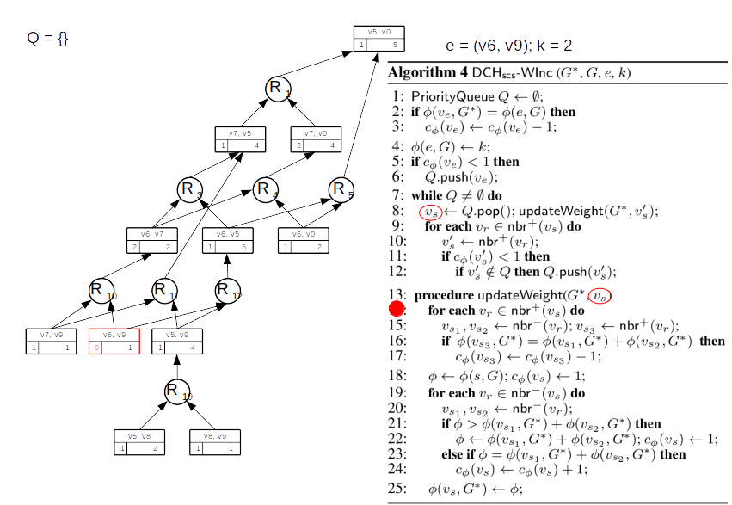

Slide 41
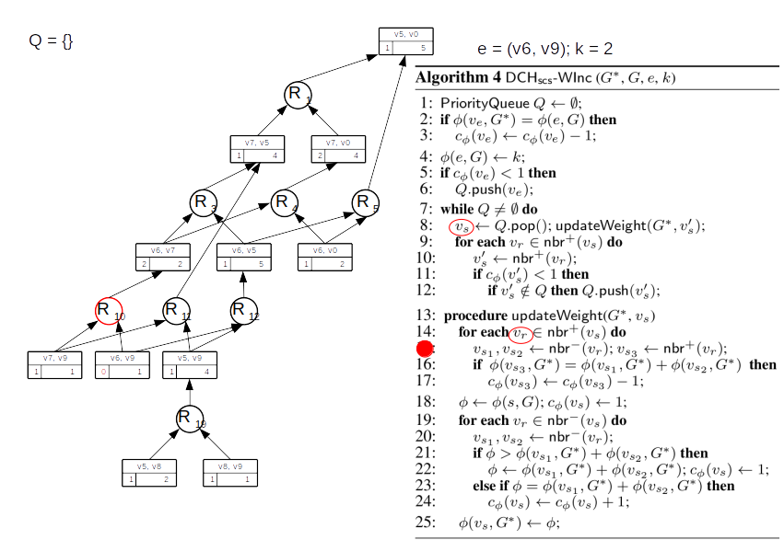

Slide 42
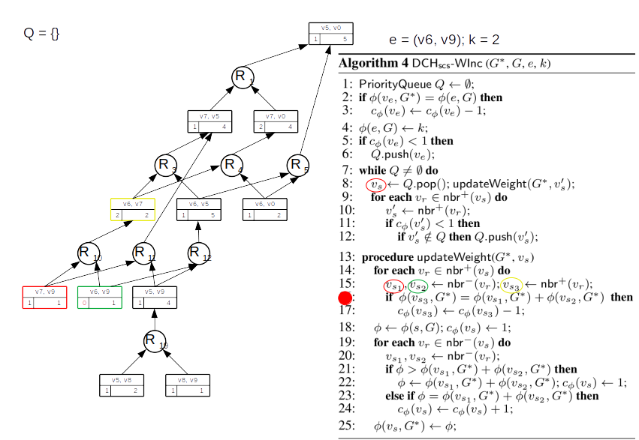

Slide 43
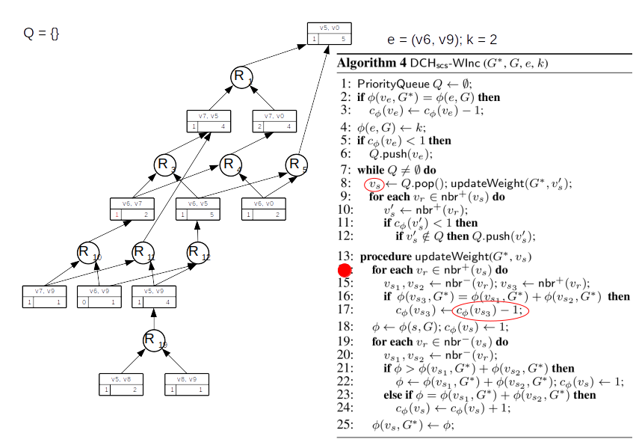

Slide 44


Slide 45
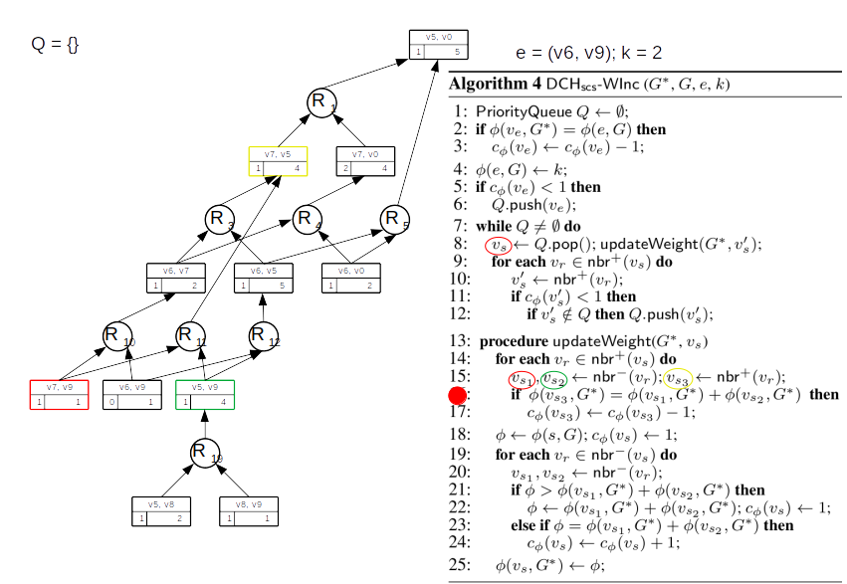

Slide 46
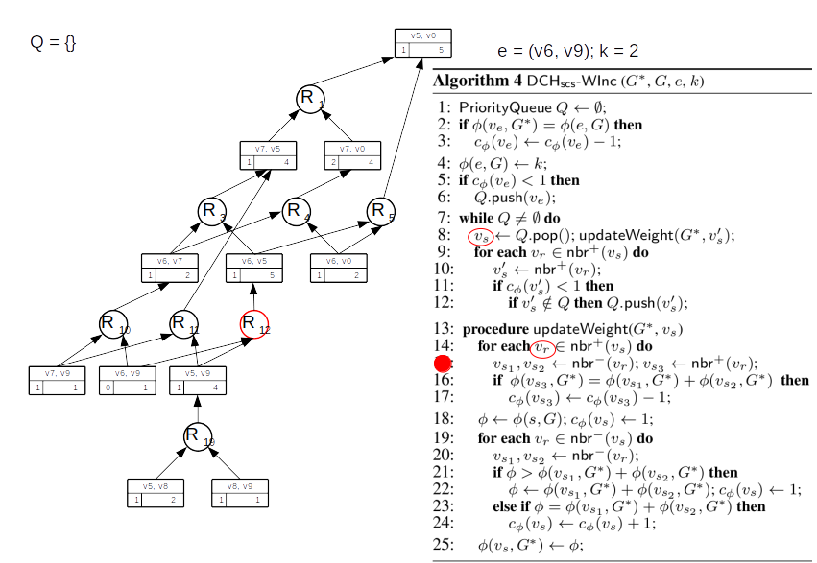

Slide 47
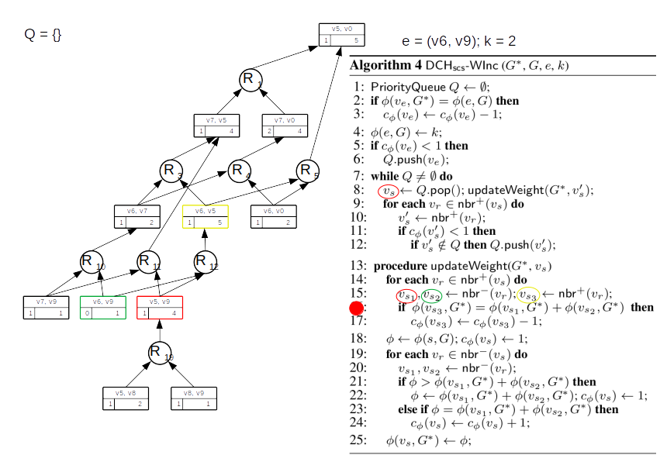

Slide 48
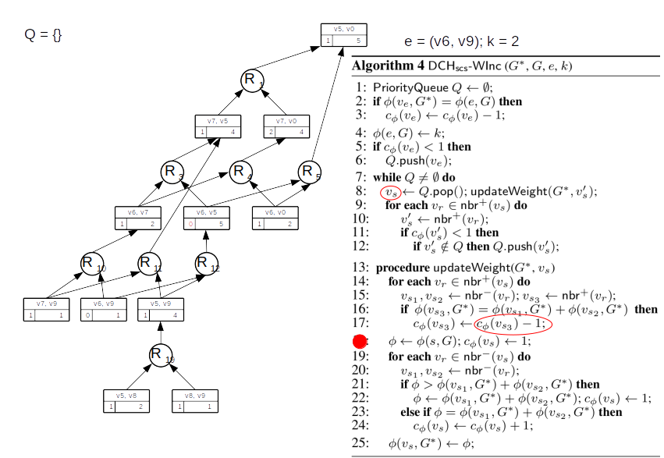

Slide 49
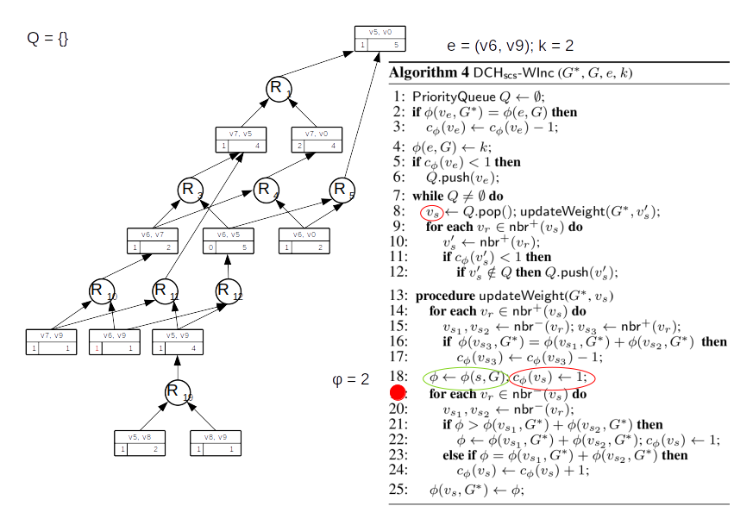

Slide 50
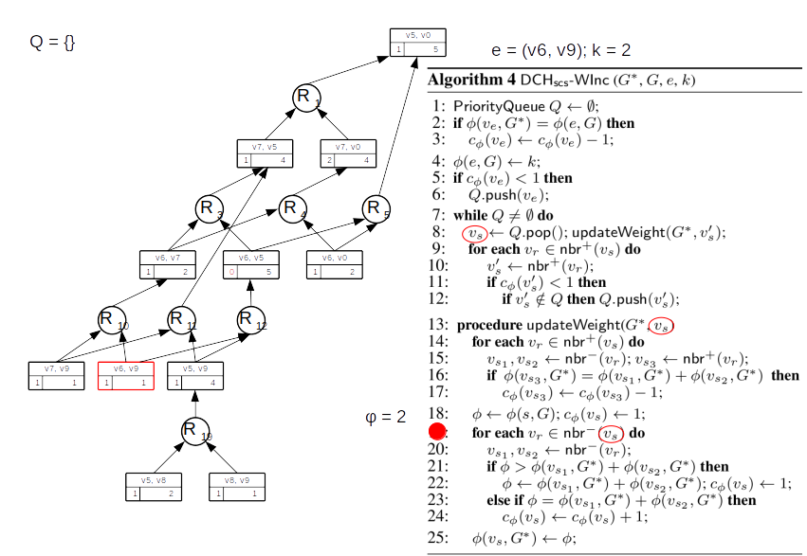

Slide 51
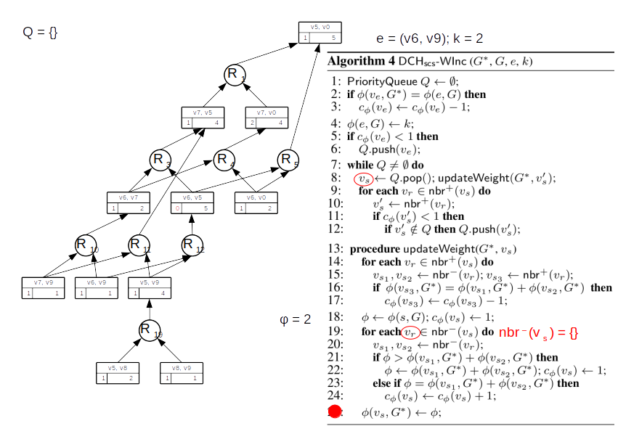

Slide 52
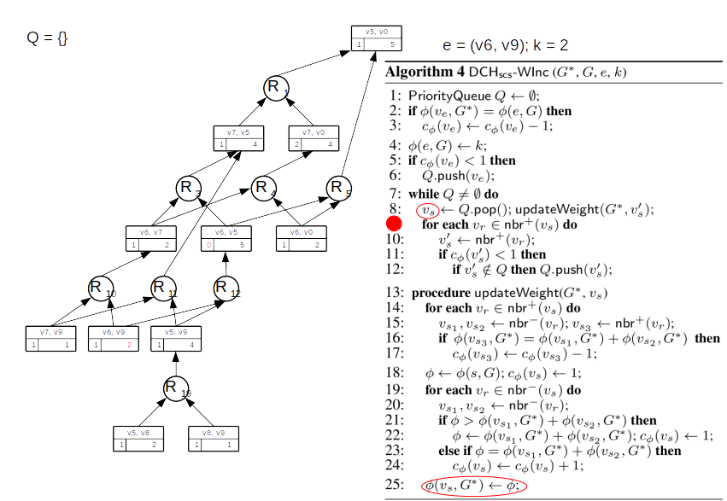

Slide 53
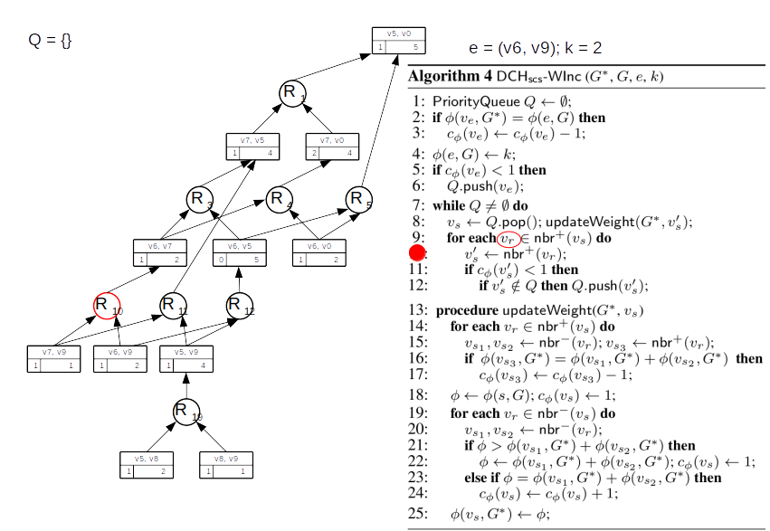

Slide 54
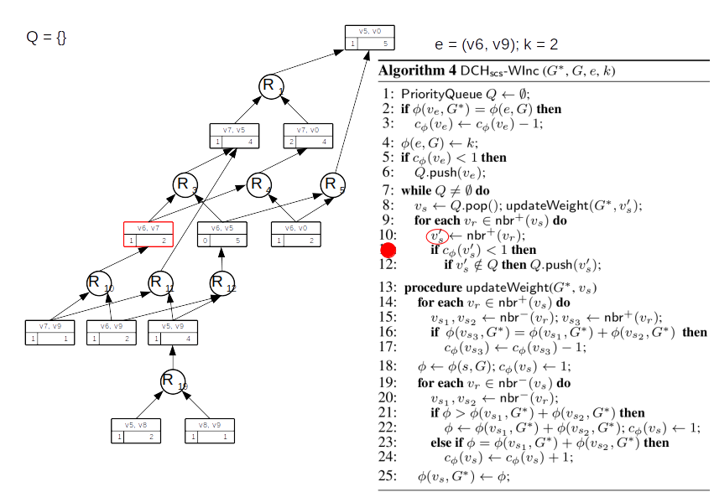

Slide 55
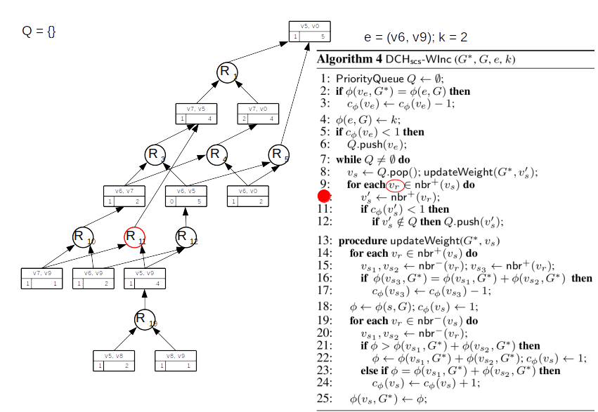

Slide 56
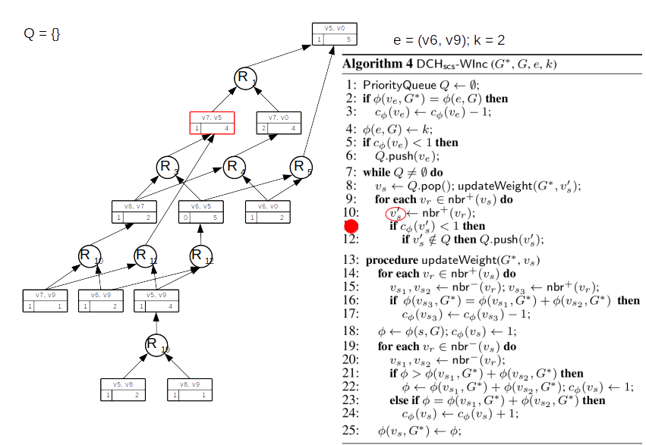

Slide 57
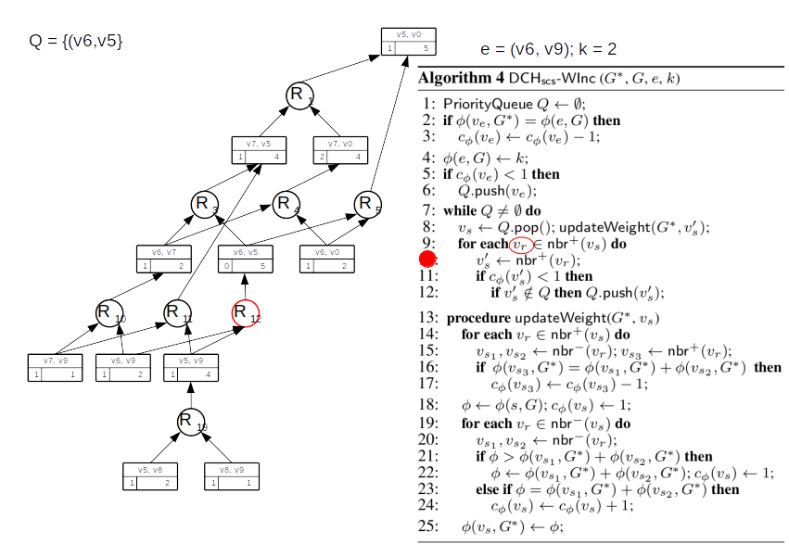

Slide 58
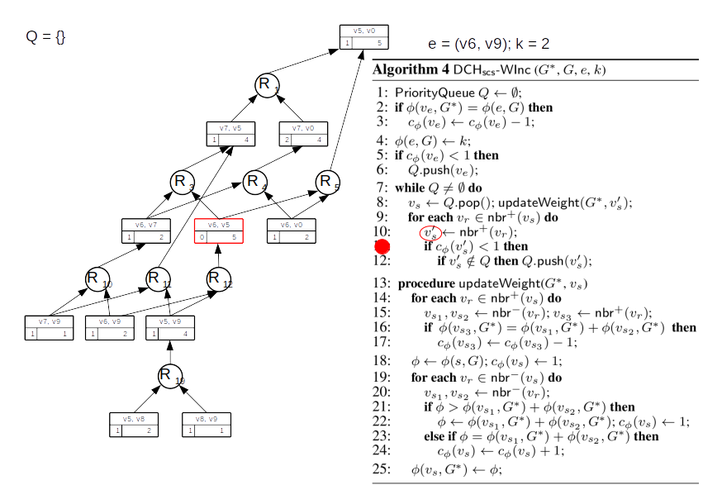

Slide 59
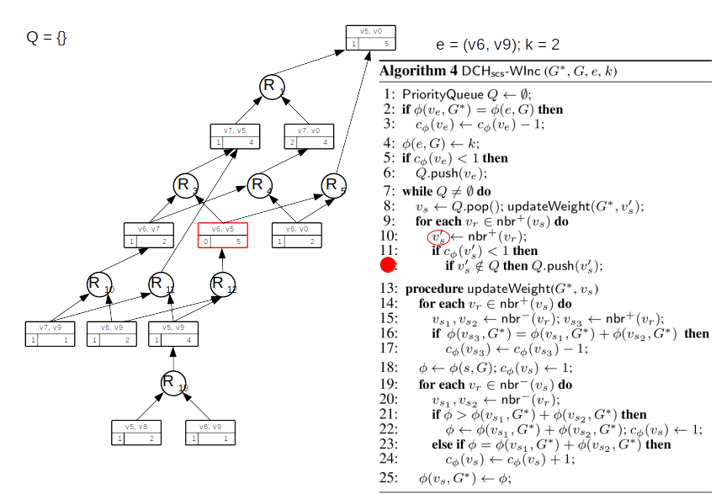

Slide 60
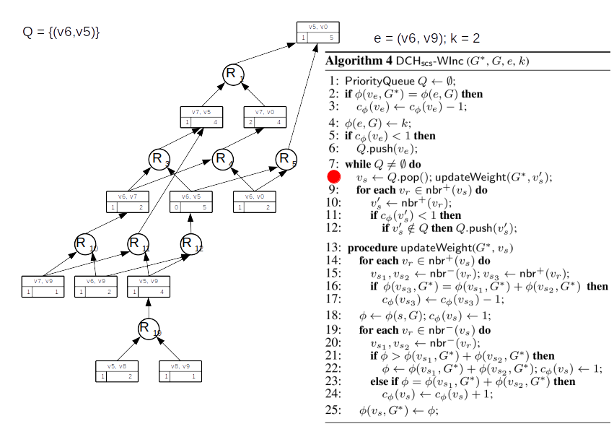

Slide 61
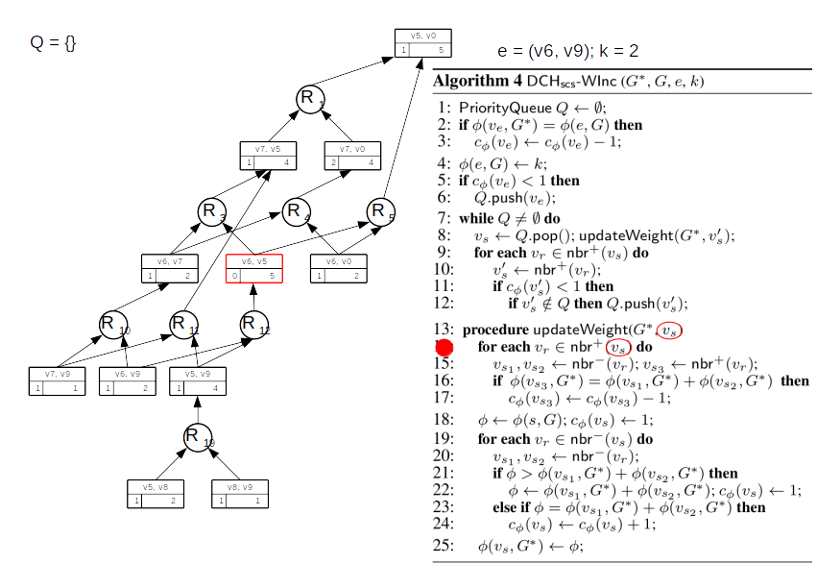

Slide 62
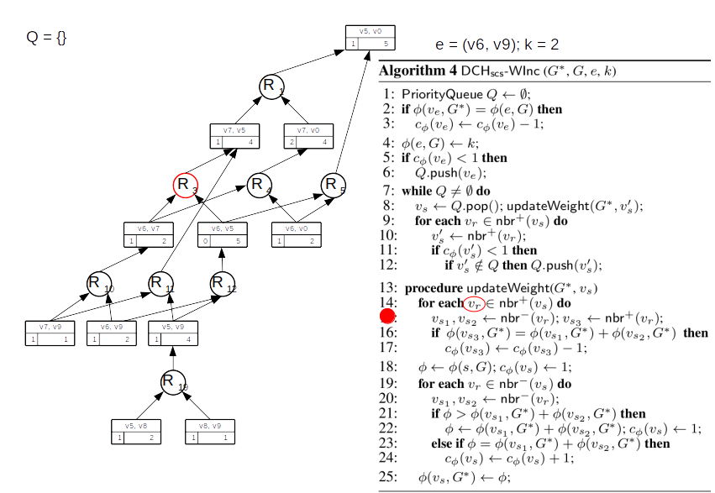

Slide 63
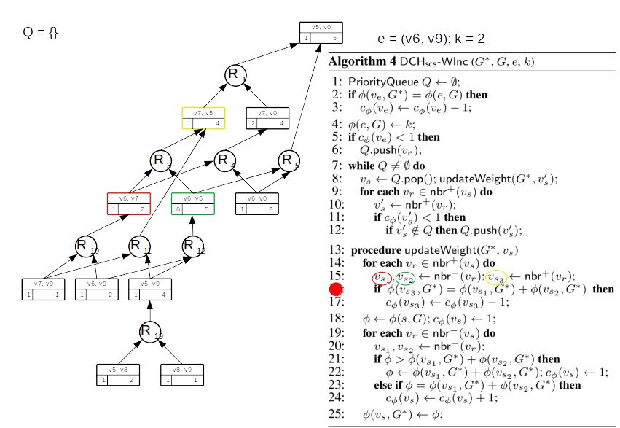

Slide 64
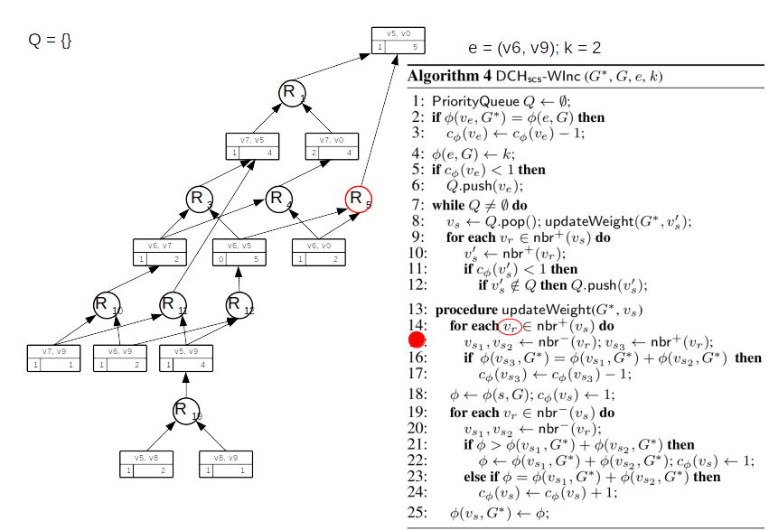

Slide 65
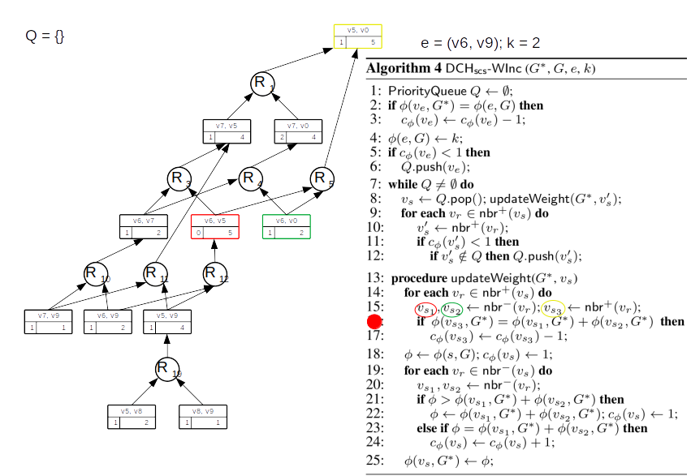

Slide 66
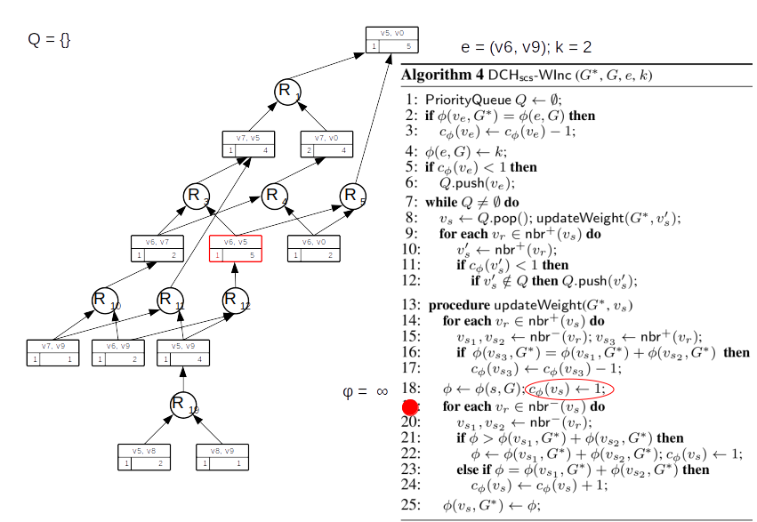

Slide 67
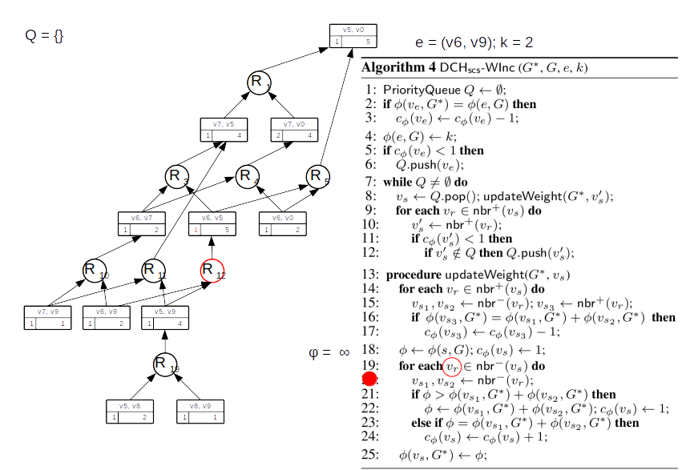

Slide 68
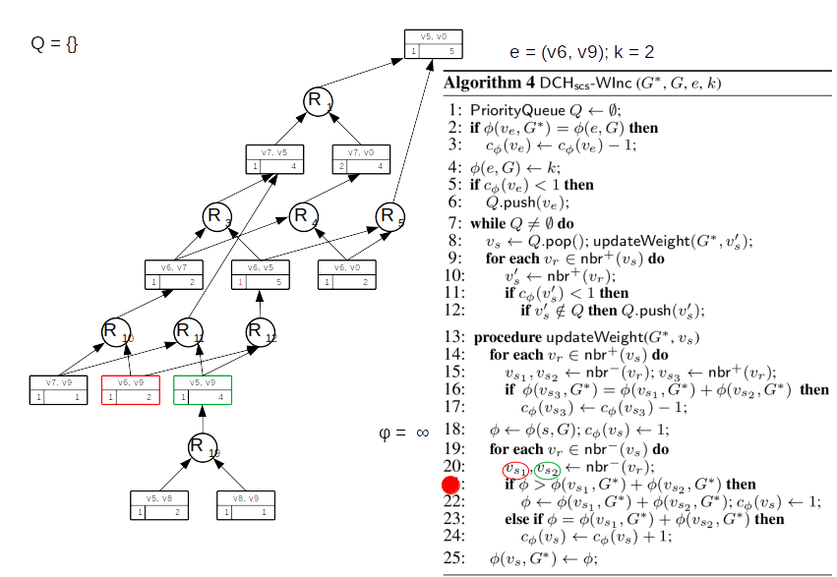

Slide 69
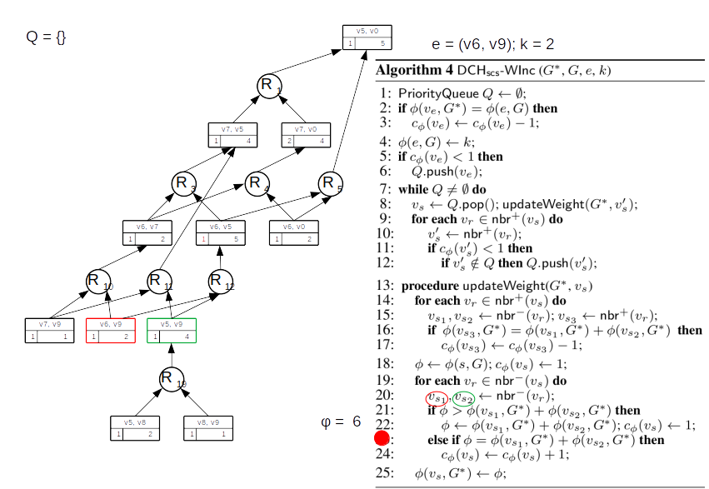

Slide 70
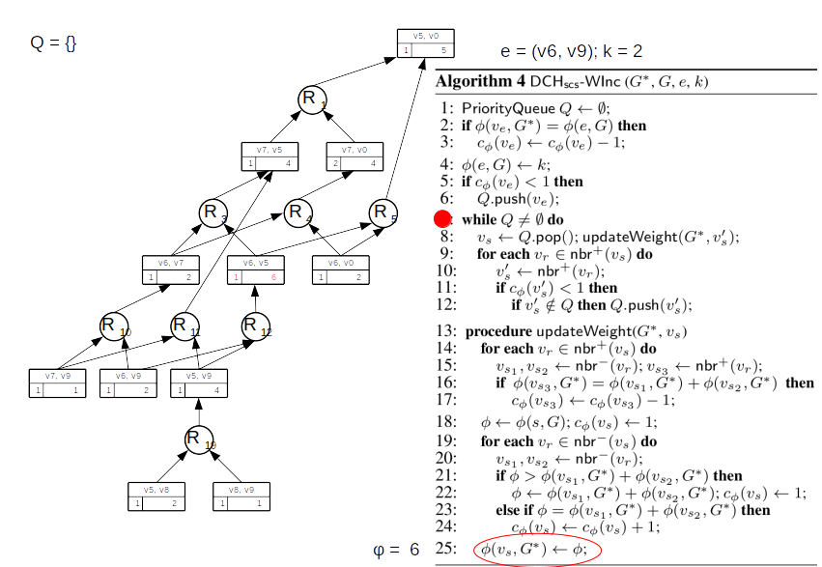

Slide 71
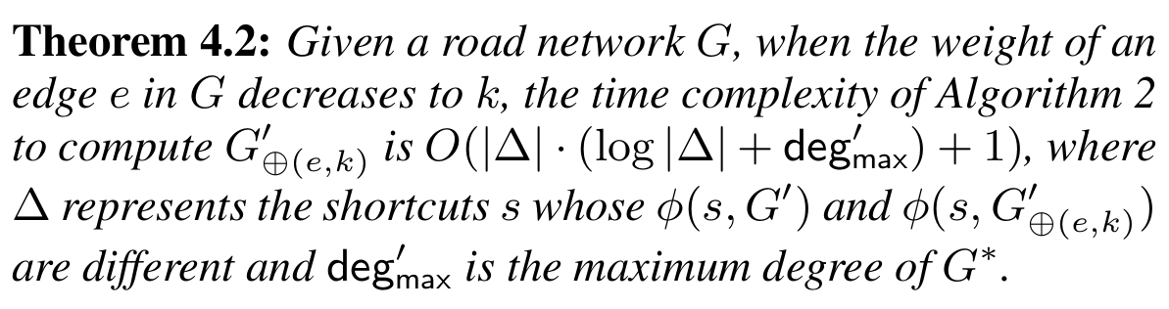
Theoretical Guarantees Decrease

Slide 72
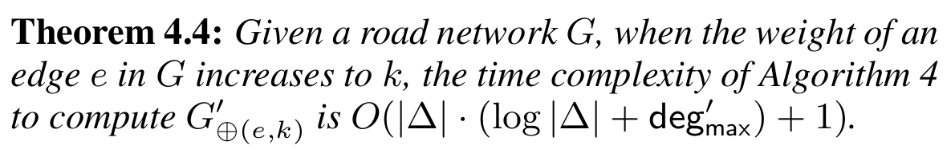
Theoretical Guarantees Increase

Slide 73
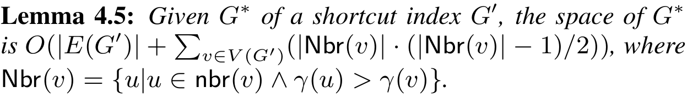
Space Complexity

Slide 74
Experimental Results
Weight increase ~ 2 – 3 faster than DCH
Weight decrease ~ 2 – 3 faster than DCH
Space consumption 12.7 times higher than DCH
  Solution → Do not materialize G*!
Should be worth

Slide 75

The Sloppiness
DCH_{vcs} →CH or CCH ?
Reinvent the wheel → CCH
Left out “obviously” for “brevity”
Non – Materialized
Long Pager version
Where is the code?

Slide 76
Reference
Dian Ouyang, Long Yuan, Lu Qin, Lijun Chang,
Ying Zhang, and Xuemin Lin.
Efficient shortest path index maintenance on dynamic road networks with theoretical guarantees.
Proceedings of the VLDB Endowment, 13(5):602–615, jan 2020.2

