Slide 1






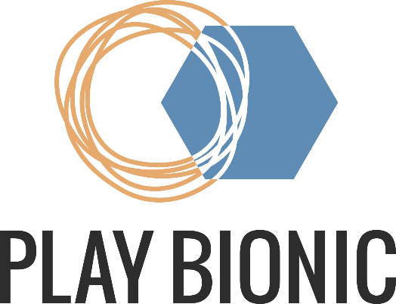





Preparations Software Stack
GIT
Install Git (git-scm.com)
Install Git LFS (git-lfs.com)
Unity (unity.com)
Install Unity HUB
Install Unity 6000.0.36f1 or newer via Unity HUB
Python
Install Python 3.10 or newer (MS Store)
Install Visual Studio Code or another IDE (MS Store)
www.playbionic.org

Slide 2
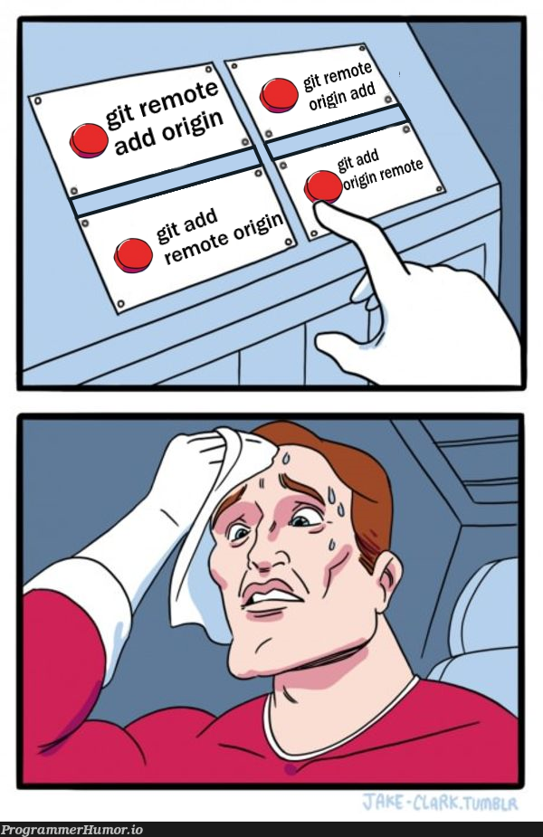
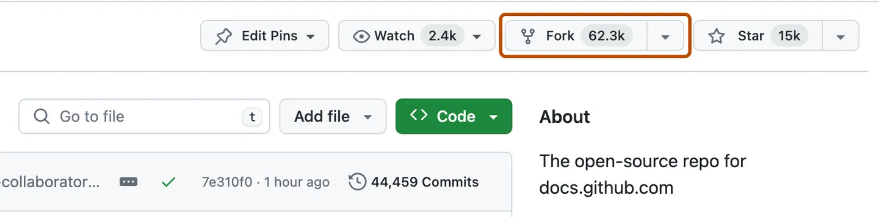
Preparations Get Git Repository
REPO URL
https://github.com/MariusKlug/mind-and-body-UIs-hackathon.git
Either clone (& change remote origin)
git clone https://github.com/MariusKlug/mind-and-body-UIs-hackathon.git
git remote set-url origin https://gitlab.com/KodeKlout/my-repository.git
Or fork to your github account
www.playbionic.org
Notes:
We recommend to use git, not only for easier collaborative work but also in case you need to undo changes!

Slide 3
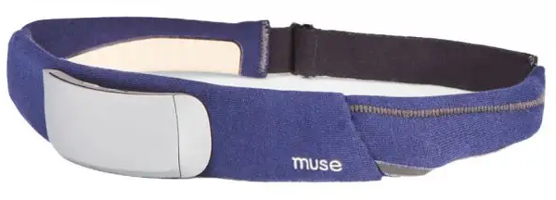
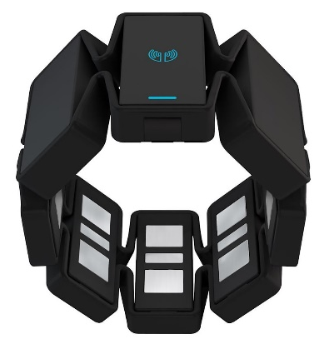

Preparations Hardware Stack
Muse S (Brain, EEG)
IXRSuite.exe establishes the BT connection and provides various LSL data streams containing raw EEG data well as processed “brain power”.
MyoArmband (Arm, EMG)
MyoArmbandBridge.exe encapsulates the BT connectivity. Communication to the MyoArmband happens via API, which provides 8-electrode EMG data, IMU-based orientation data and allows the armband to vibrate.
Polar Belt (Heart, ECG)
Python Script main.py establishes the BT connection and provides various LSL data streams containing raw ECG data as well as processed hearth rate and LF/HF ratio.
www.playbionic.org
Notes:
Why so complicated?
Unity does not support the full .net framework and therefore bluetooth devices can not directly be accessed
All of Marius‘ processing was already done in Python and we think it‘s easier to keep it there
You will find the name of the processed data streams in the readme.md
Pair & try to connect all three bluetooth devices with your laptop once. This is required for automatic future connections.

Slide 4
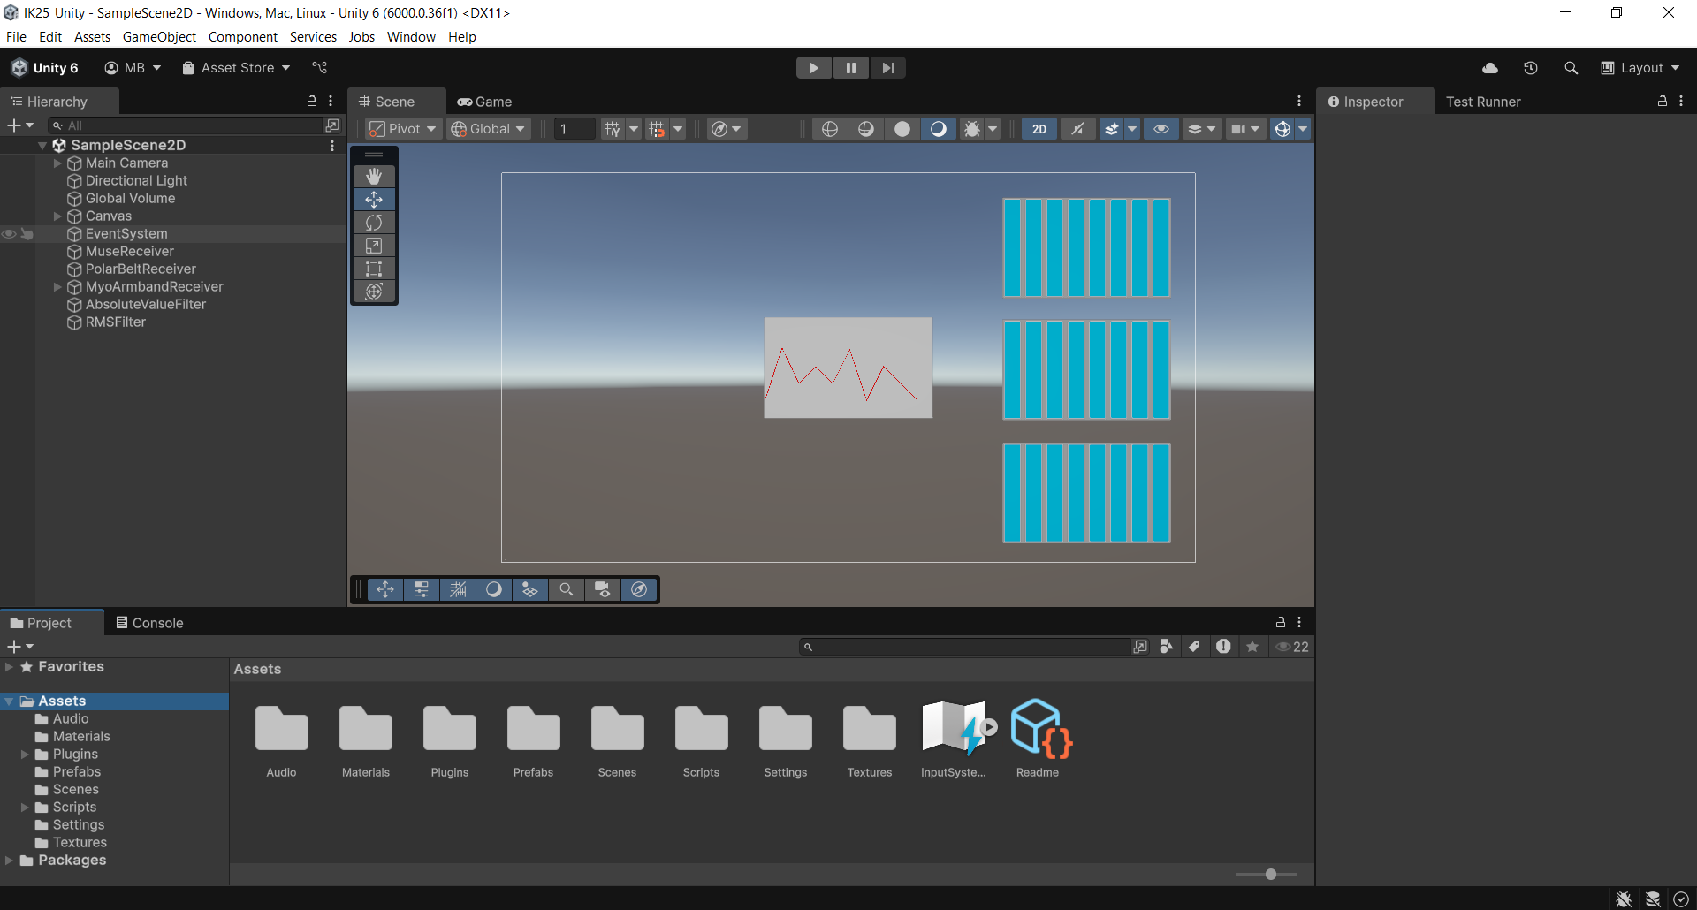
Unity Fundamentals Editor
Scene Hierarchy
Scene
Object
Inspector
Debug
Console
Project Folder
www.playbionic.org

Slide 5
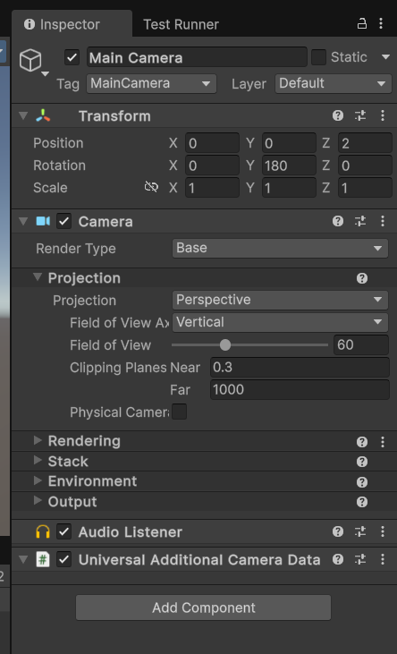
Unity Fundamentals GameObjects
GameObject Name
Transform Component (mandatory)
Further components
(including self-made)
www.playbionic.org
Notes:
When using in a 2D canvas, instead of the Transform component, a RectTransform component is used. This however derives from Transform

Slide 6
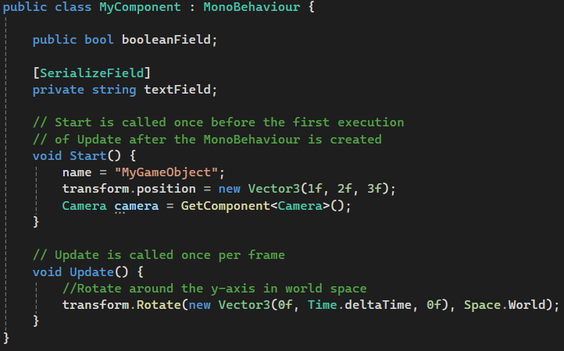
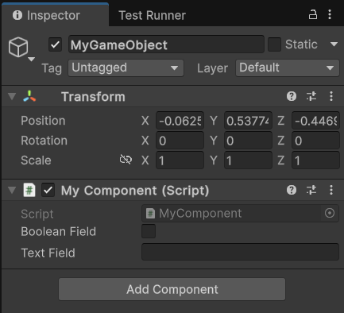
Unity Fundamentals Components
Part of the GameObject Life Cycle
www.playbionic.org
Notes:
Fields in the inspector can also contain classes that are a derivate of MonoBehaviour!

Slide 7
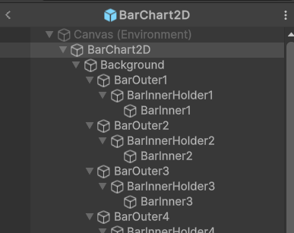

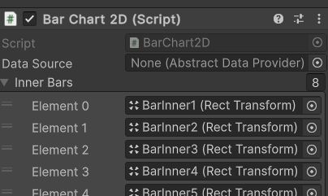
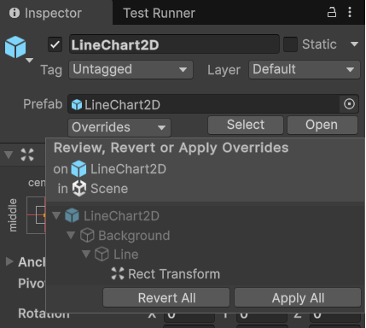
Unity Fundamentals Prefabs
“Blueprints” of Unity
A Prefab consists of a hierarchy of GameObjects
which in turn contain Components
Inspector fields of the Components can be assigned within the scope of the prefab.
Prefabs added to a scene can be overridden, changes can be reverted.
Prefabs can be instantiated at runtime.
www.playbionic.org

Slide 8
Repository Walk Through Overview
Unity Project (C#)
“Assets/Plugins” contains
IXRSuite.exe
MyoArmbandAPI/Bridge.exe
VS Code Project (Python)
Python Script main.py
www.playbionic.org

Slide 9
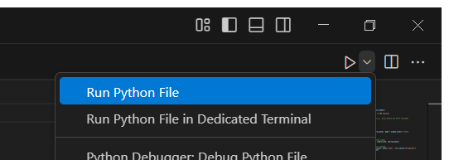
Repository Walk Through VS Code
Polar Belt Python Script
Open the project in VS Code
Create a virtual Python environment (VENV) CTRL+SHIFT+P-> Python: Create Environment
Install lib dependencies Terminal: pip install -r /path/to/requirements.txt
Open & run main.py
www.playbionic.org
Notes:
The polar belt needs to be attached to your body in order to turn on. Only then you will be able to connect.

Slide 10
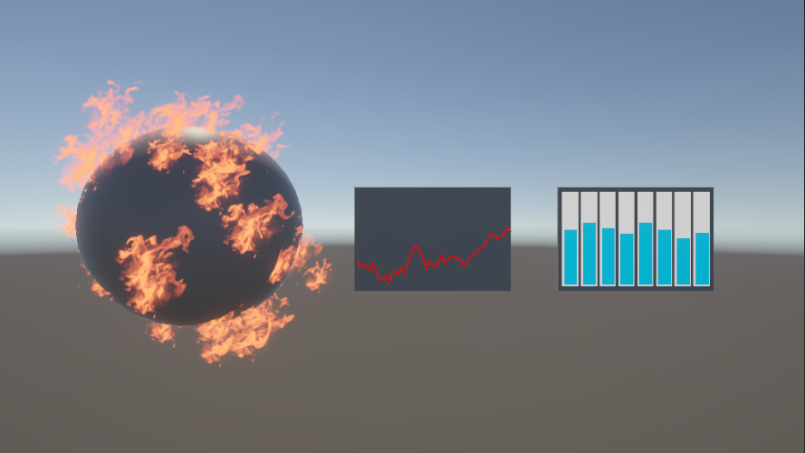

Repository Walk Through Unity
Sample Prefabs
Four Prefabs
Burning Sphere
Line Chart
Bar Chart
Heartbeat
One Interface to serve them all
Data Receivers provide data samples as float[]
Prefabs receive data samples as float[]
www.playbionic.org

Slide 11
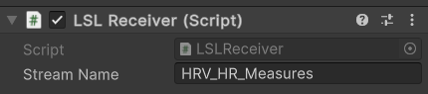
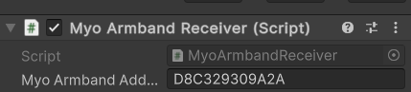
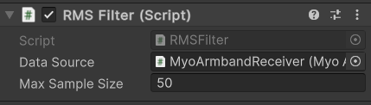
Repository Walk Through Unity
Data Receiver Components
You can Receive data from an LSL stream …
… or by using the MyoArmband Receiver
It is also possible to chain the data processing by adding an Absolute or RMS Filter
www.playbionic.org
Notes:
Chaining is a nice demonstration of how to deal with the Armband data.
However we only implemented two filters and they can not be re-chained during runtime (yet), would be easy to change.

Slide 12
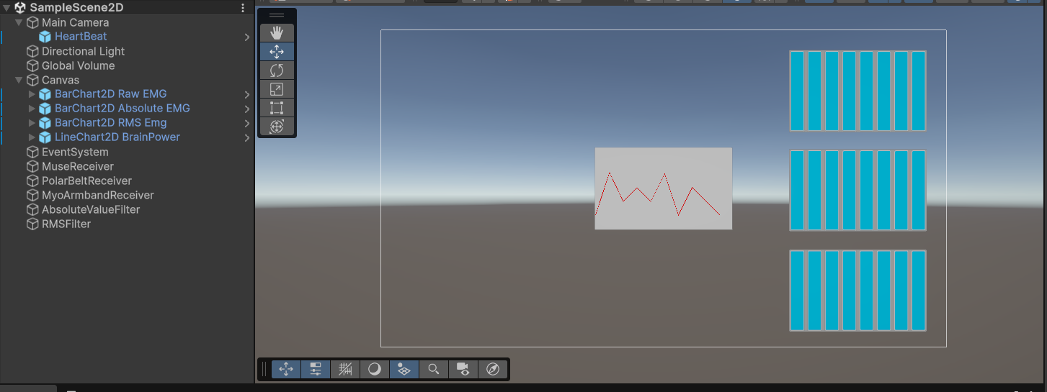
Repository Walk Through Unity
2D Sample Scene
www.playbionic.org
Notes:
2D bar chart scales flawlessly with it‘s border, all other charts DONT!
I used a canvas, however according to the docs this is not necessary.
You can see the prefabs (in blue)

Slide 13
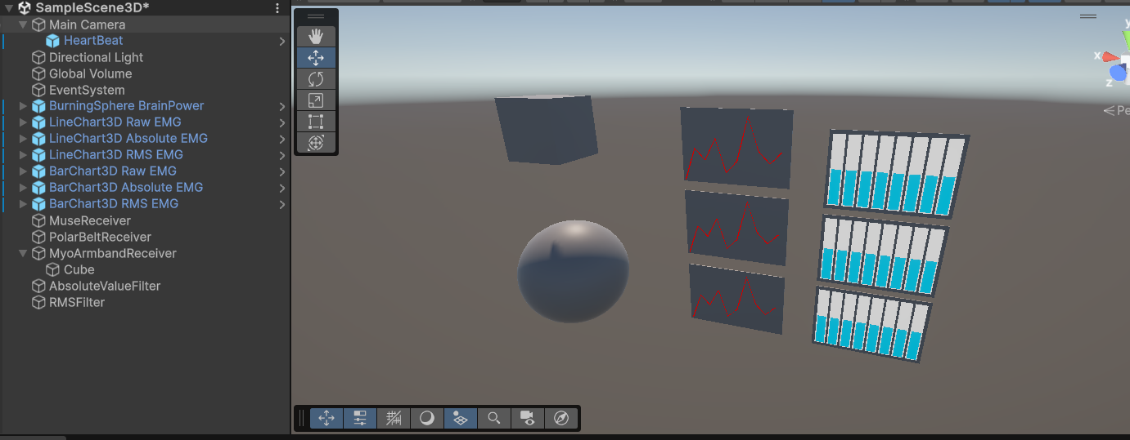
Repository Walk Through Unity
3D Sample Scene
www.playbionic.org
Notes:
(CUBE) only in the 3D scene
The MyoArmbandReceiver Transform component receives the orientation of the MyoArmband.

