Slide 1
Marketing of political parties in Germany
W07 Case Study

Slide 2
Marketing agency for political parties as addressee
The scenario at hand is that the federal election in Germany in 2017 just finished and the six largest parties assess their performance. Because of dissatisfaction by all parties and their desire to extend their political reach, they hire a marketing agency.
We embody the marketing agency in this presentation and the addressee are the parties as our clients.
To increase efficiency in capital spending for marketing measures for the upcoming election, we only want to invest in marketing measures in areas of Germany in which the respective clients came off badly in last election.

Slide 3






The biggest political parties in Germany are the main target group of the agency
CDU | SPD | Die Linke | FDP | AFD | Bündnis 90/Die Grünen
Central right | Central left | Left wing | Central | Right wing | Left wing
Conservative | Social democratic | Socialist | Liberal | Nationalism | Sustainability

Slide 4
Building the model based on the parameter correlation of structural data and election results
We looked at the available structural data in order to get an overview over the different constituencies and their inhabitants. Consequently, we correlated the data with the election results in 2017 to derive profiles for a “typical” voter of the biggest parties.
Knowing the voters profiles allows to target the inhabitants of relevant constituencies more precisely with specific measures, which therefore leads to a higher efficiency in the marketing process.

Slide 5
Analysis of the most important variables for each party: Example CDU
We propose three different methods to get the variables that best explain the variability of our targets variables, the votes in each party. We will use the information obtained from them to get the most important variables to each party in order to raise more votes.
Correlation Matrix
Lasso Regression
Best Subset
As an example we show the analysis for the CDU party.

Slide 6
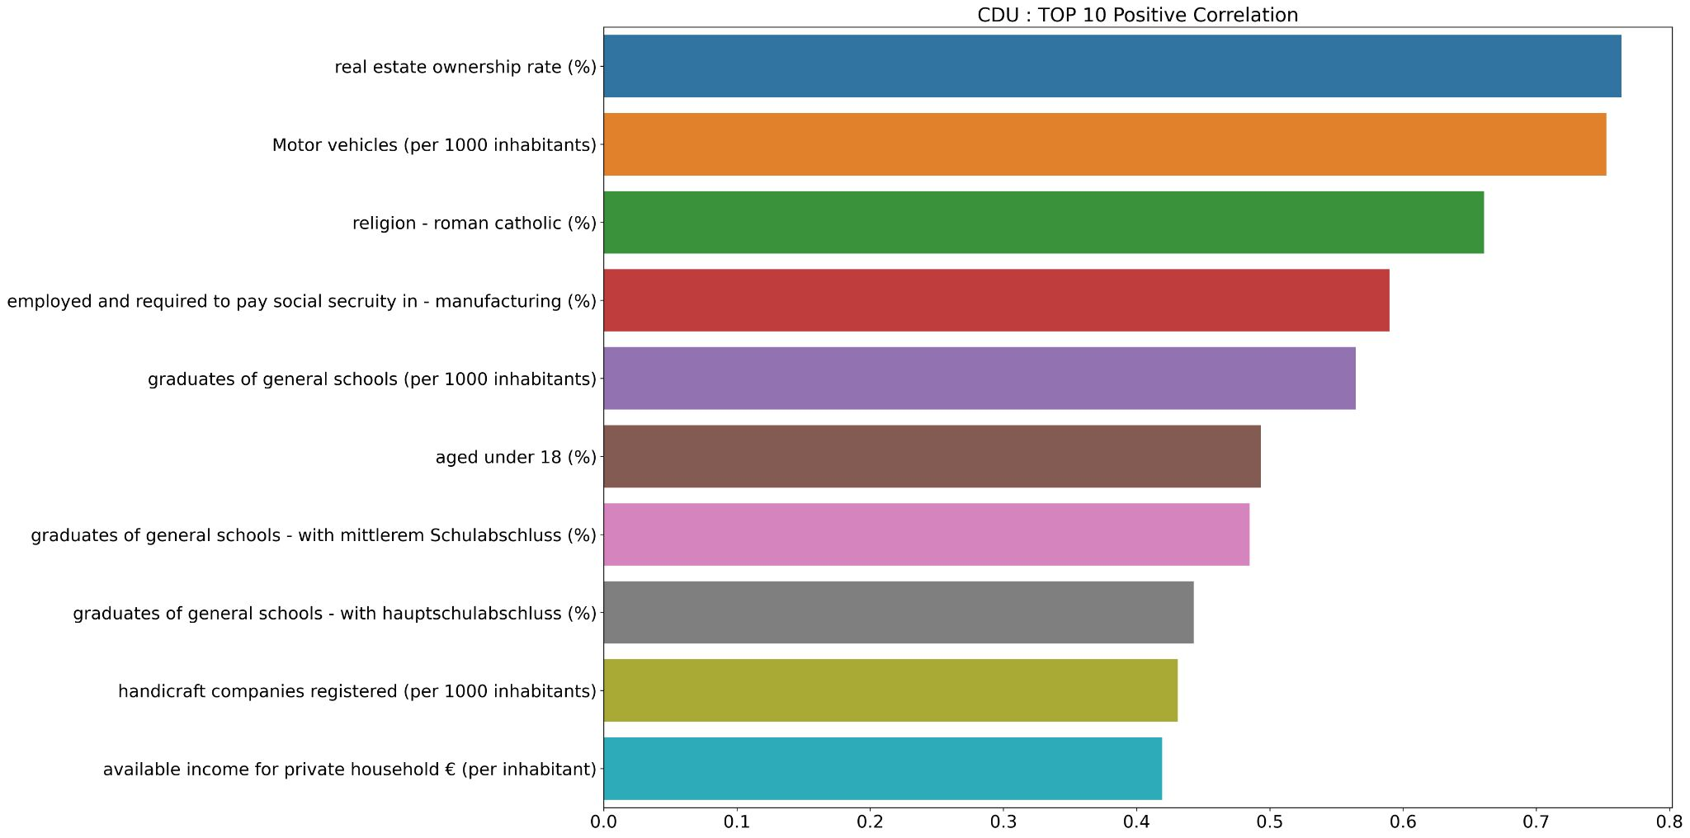
Analysis Example: CDU
Positive Correlation

Slide 7
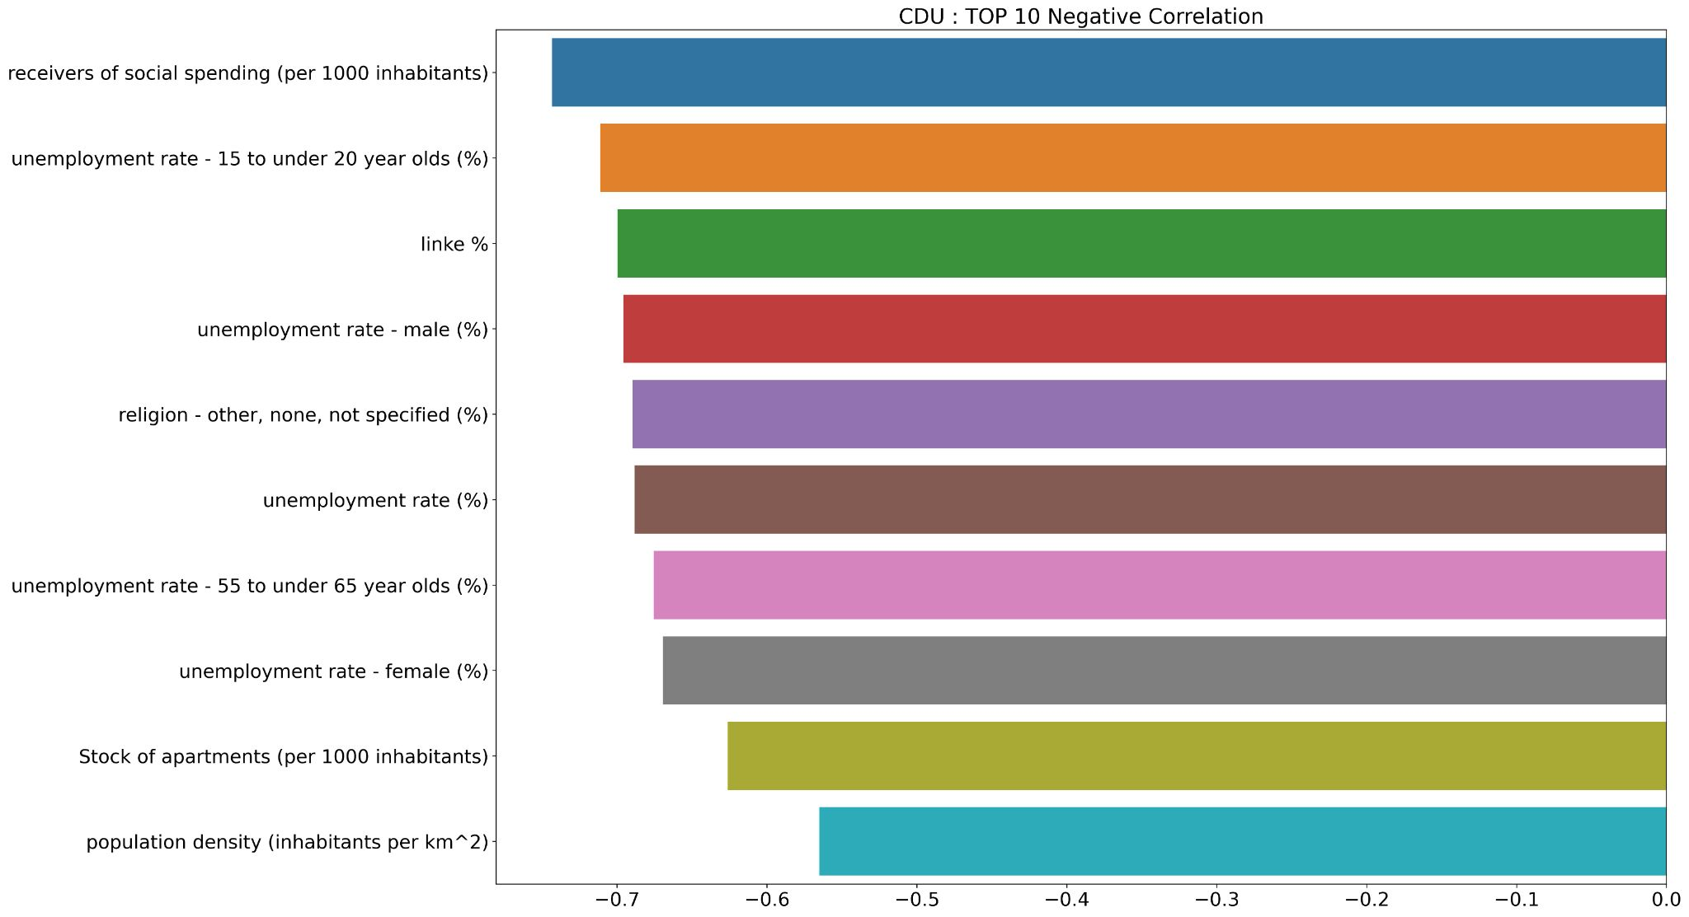
Analysis Example: CDU
Negative Correlation

Slide 8
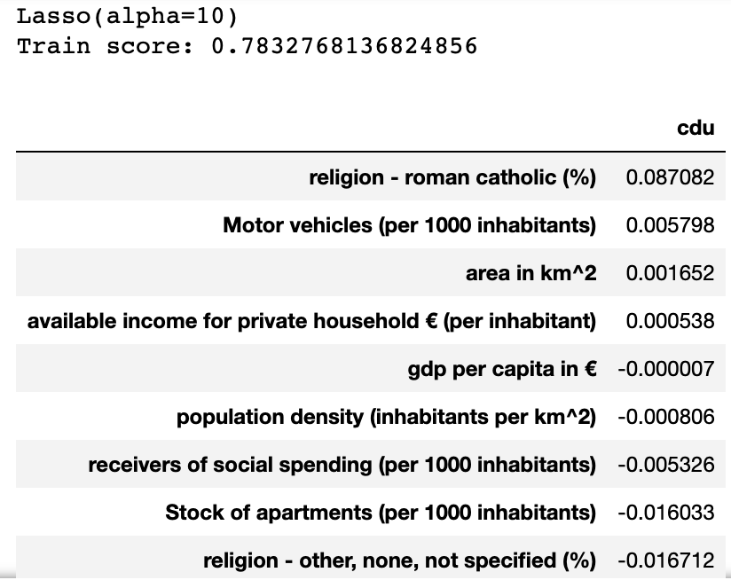
Analysis Example: CDU
Lasso Regression
By doing a Lasso Regression with a relatively high value of alpha will take to zero the coefficients of the least important variables and keeps does that best explain the variability of our target variable.

Slide 9
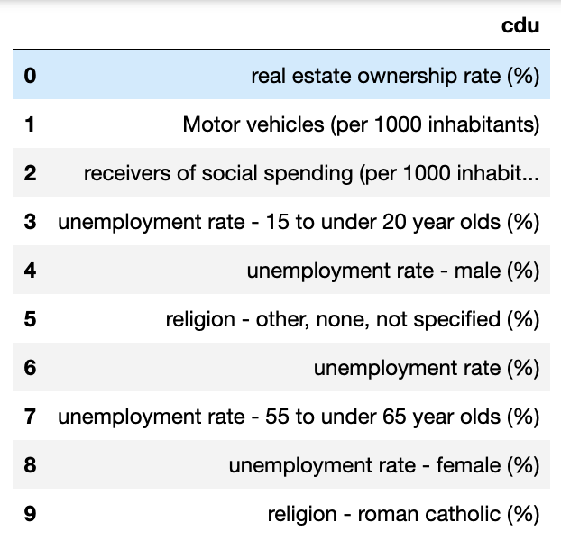
Analysis Example: CDU
Best Subset (StepWise)
Similar to the idea of the Lasso regression, this method leaves the variables with the highest p-value of the test that its coefficient of the linear regression its zero.

Slide 10
Profiles from the parties linear associations
CDU | SPD | Die Linke | FDP | AFD | Bündnis 90/Die Grünen
A lot of children in the constituency |  |  | Aged 18-24 | Aged >60 | Aged 18-34 & young parents
Roman catholic | Evangelical | Not religious or not specified | Inhabitants with migration & foreigners | Inhabitants without migration | Inhabitants with migration & foreigners
Net payers of social security | Unemployed/ Receivers of social spending | Unemployed/ Receivers of social spending | Higher education & entrepreneurial | Lower education | Urban & Higher available income
Real estate ownership/ Higher available income/ Motor vehicles |  | No real estate / No available income / No motor vehicles | Higher available income & high gdp per capita | Low available income & low gdp per capita

Slide 11
The comparison of expected voting results show a discrepancy towards the actual outcome

Slide 12
Derived from predicted voting results, marketing measures are specifically applied in areas with lacking votes

Slide 13
Marketing measures to target different voter profiles
Social media engagement
Targets younger demographic
Political talk shows
Targets mid to older demographic
Booths in cities
Targets all demographics
Billboard signs
Targets all demographics
Radio and Television spots
Targets mid to older demographic
Newspaper advertisements
Targets older demographic

Slide 14
References
https://www.bundeswahlleiter.de/bundestagswahlen/2017/ergebnisse.html
https://www.bundeswahlleiter.de/bundestagswahlen/2017/strukturdaten.html
https://www.wuv.de/specials/agile_marktforschung/10_gebote_fuer_political_marketing

