Slide 1
Marius Rusu, Julia Sommer
Windows Subsystem for Linux
Proseminar virtualisierte Systeme
Aufgabensteller: Prof. Dr. Dieter Kranzlmüller
Betreuer: Daniel Kolb
Datum des Vortrags: 30.6.2018

Slide 2
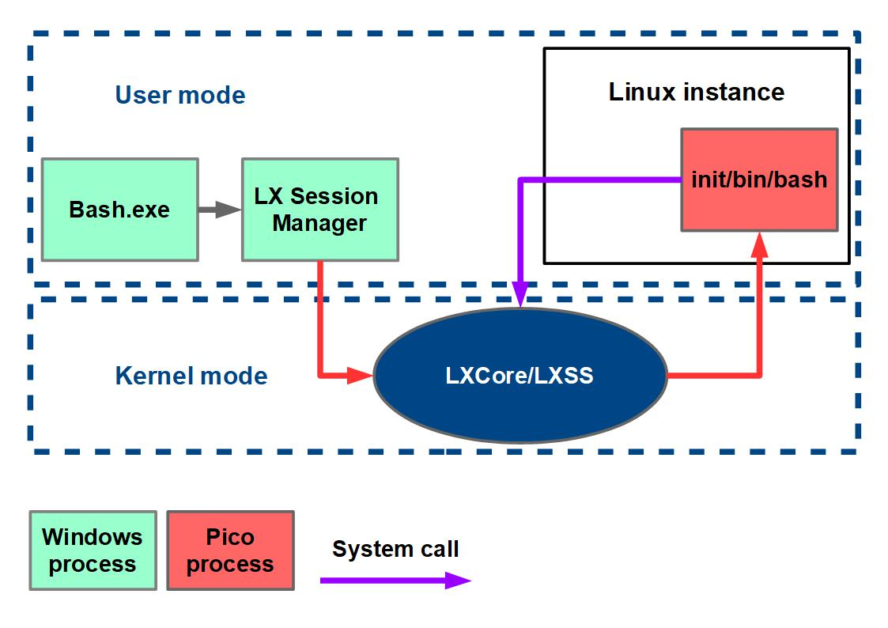
Basic Architecture
Text hinzufügen
WSL - Marius Rusu, Julia Sommer - 30.6.2018
2

Slide 3
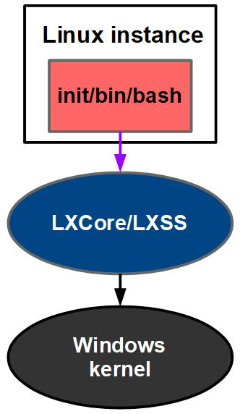
Implementation
Linux instance
Unique per user
Standard Linux shell
Wrapped in Pico processes
Pico process
Windows process address space
OS services removed
System calls served by LXCore/LXSS
LXCore/LXSS
Linux-compatible kernel interface
Translation from Linux system calls to Windows system calls
WSL - Marius Rusu, Julia Sommer - 30.6.2018
3

Slide 4
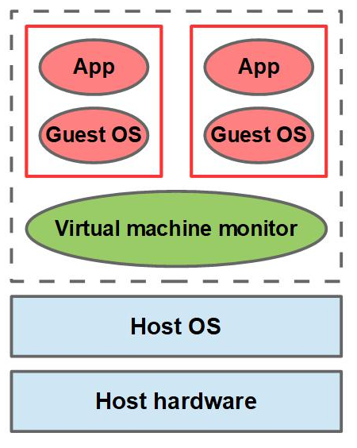
Virtual Machine
Virtual Machine
Running different guest OS
Fully isolated from host OS
Hypervisor: VMM
Virtual machine monitor (VMM)
Hosting virtual machines
Coordinating hardware access
Handling traps
Traps
Privileged operations
Emulated by VMM
WSL - Marius Rusu, Julia Sommer - 30.6.2018
4

