Slide 1

POL 2012: Theories and Models in Political Economy
Inequality
Espen Moe
Department of Sociology and Political Science
espen.moe@ntnu.no, #9587, 73592230

Slide 2
Announcements
Seminar: Thursday Nov 16
«Exam» seminar.
Prepare questions
Any parts of the syllabus that you want me to talk about?

Slide 3
Inequality
One of The topics of the day
Observation: the wealthiest accumulating wealth far more rapidly than the rest
Share of total income keeps rising
Gini coefficient keeps rising
US: 1% of the people 25% of the income; 1% of the people 40% of the wealth
The system is rigged (Stiglitz)!
(Against regular people!)
Finance is a regular sector, like every other. Financial interest is as biased as any other vested interest!
What’s good for General Motors is good for the USA?
Piketty’s book, Capital in the 21st Century, catches the Zeitgeist
Embraced by the left
Consequences?
Erosion of social cohesion, reduction in trust and legitimacy
Decrease in economic growth?
Social mobility?
From meritocracy to plutocracy?
Protest parties and democratic degeneration
Riots? Revolution?

Slide 4
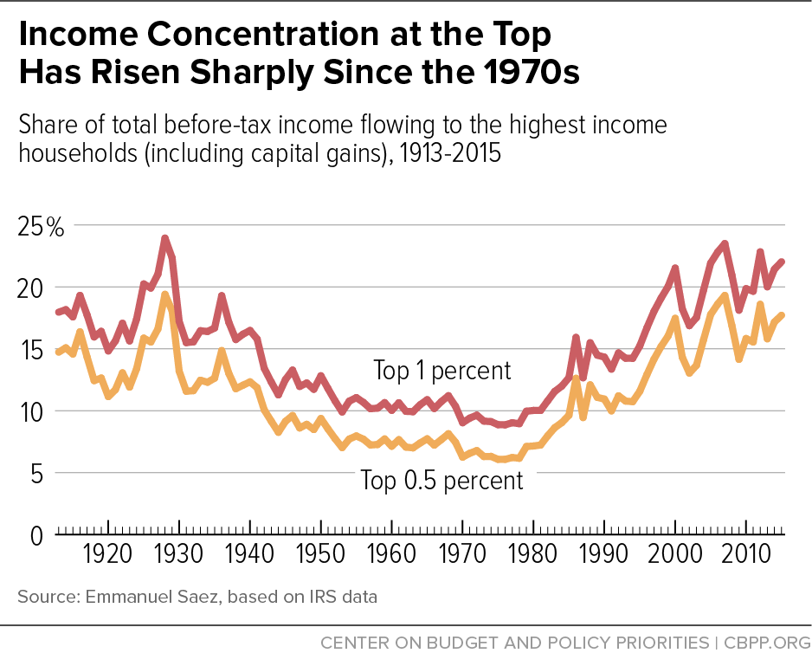

Slide 5
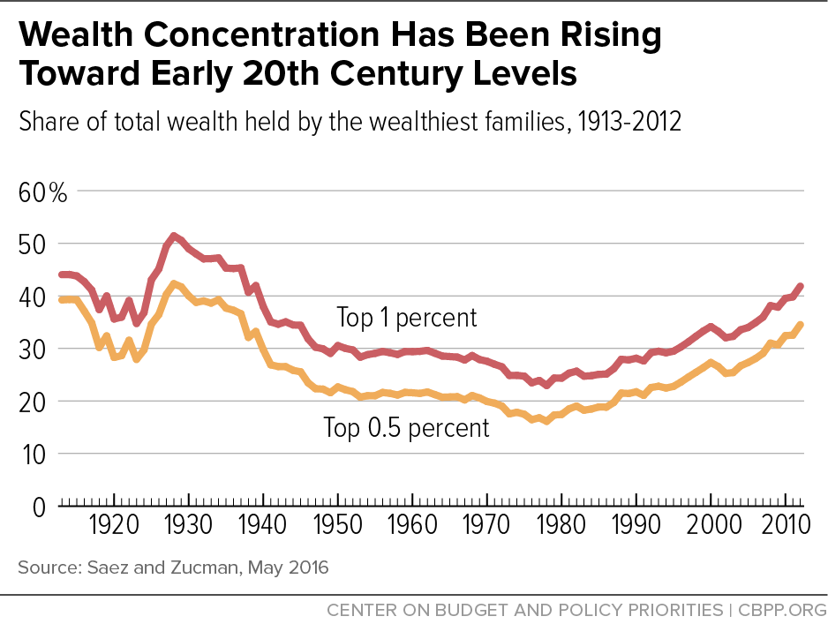

Slide 6
Causes?
Financial bubble
ICTs as final Schumpeterian wave?
Globalization
Worldwide marketplace
Winners are big winners, losers are big losers…
Race to the bottom
Globalized media (including social media)
Stars → global superstars
Politics
Tax policy, tax rates on capital gains
Race to the bottom, tax competition between countries
Manipulation of the financial system
Enabled by regulations lobbied for by the financial sector

Slide 7
Piketty
https://www.ted.com/talks/thomas_piketty_new_thoughts_on_capital_in_the_twenty_first_century
Theory of the long-run tendency of capitalism
Marx and Solow [= neoclassical growth theory]
r > g
(And g will drop rather than rise)
Wealth creation threatening capitalism
Taxes: Race to the bottom
Taxes in the 1970s much higher
Income and wealth taxes need to become far more progressive
Wars almost progressive function
Inflation and taxes as redistributive measures
State needs money…
Income inequality much lower between 1930 and 1970.
Neoliberalism, 1980s→ inequality back to levels not seen since 1920s

Slide 8
Criticism
Goes (2016) IMF paper: no empirical support
Plausible claim, but no rigorous testing of the claim, just some loose correlations of very aggregated data
Causation?
Savings are not stable, but affected by changes in r – g.
Observed increases in income inequality largely uncorrelated with changes in r – g.
→ Must have other causes instead.
Rising inequality of labor income rather than r – g.
Implication? Wealth tax no good. Progressive income tax better...
Implication? Tax system not the right way to deal with the problem?

Slide 9
Criticism: Acemoglu & Robinson
Forgotten about institutions!
No systematic role of institutions and political factors in the formation of inequality
No endogeneous evolution of institutional factors
Why did Marx(‘s laws) fail?
Ignored the endogeneous evolution of tehcnology
Ignored the role of institutions and politics in shaping markets, prices, the path of technology
Grand theory w little reference to the changing nature of institutions and technology.
Need for context and historical knowledge!
Increase in inequality (US, since the 1970s)
Changes in supply and demand for skills
Labor market institutions
Rise in the capital share, but primarily because of housing and the increased prices of real estate
r > g not unimportant (does lead to more inequality), but many other variables quantitatively more important

Slide 10
Schumpeterian criticism
Along the lines of Acemoglu and Robinson
Piketty would be right in a world without technological change
(Marx would be right in a world without technological change)
Concentration of capital
Monopoly capitalism
Schumpeterian twist
The world constantly changes!
New technology → new industries → new entrepreneurs → new wealth → new groups rising to the top
Capital may concentrate, but in the old industries. But it is in the new industries that the action is!
Never the overlap between economic and political elites that A&R worry about
And which would cause the concentration of capital (and wealth) that Piketty worries about
(But if Piketty is empirically correct, then it doesn’t matter if he is theoretically wrong…)

Slide 11
Stiglitz’ criticism
Two forms of capital: one which increases productivity, one which is captured economic rent
Former is good, latter is bad.
Financial capital reduces productive capital
Losses are socialized, profits privatized
«Socialism with American characteristics»
Too-big-to-fail, too-big-to-be-restructured banks
Politically too powerful
Lobbying efforts worked well
Deregulate
Taxpayers paying for the cleanup
Institutions are never neutral
For all practical purposes created a system that systematically favors finance
Urban land rent
For regular people as well: Investing in real estate, not productive economic activities

Slide 12
The size of the pie rather than the distribution of the pie?
Familiar neoclassical argument
Stiglitz:
Growing inequality as the flip side of shrinking opportunity
Symptom of an economy in regress
Distortions undermining the efficiency of the economy
Monopoly power, special taxes for special interests
Incentive: become a banker (or a lawyer)
Lopsided distribution of wealth → propensity to spend on common needs goes down
Privatization of benefits

Slide 13
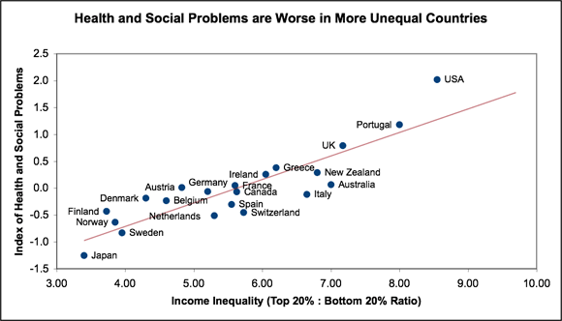
Notes:
http://inequality.org/inequality-health/

Slide 14
Response from Piketty
Institutions ARE important.
Is the reason why tax regimes were changed in the first place!
Institutions changed in the 1980s. Now they favor finance!
But A&R’s take on institutions is «too abstract, imprecise and ahistorical»
Institutions «arise out of unequal societies and out of conflict»
«Concrete institutions…need to be reinvented again again.»
(But more interested in political shocks than institutions?)
r > g is important no matter what
But it is obviously not the only thing that is important
Fall in g will likely lead to a fall in r as well
Correlations aren’t everything…
A&R regressions not very convincing
Wealth better indicator than income
Story is plausible and consistent with the historical record in so many countries.
Data: ≈only wars and revolutions have mitigated the walk towards more concentrated wealth. Problem no matter what!

Slide 15
Conclusions
Piketty is the beginning of the discussion, not the end…
One of the hottest topics of the day
Strong sense that something has gone wrong somewhere
And that we don’t have the tools to deal with it
Data showing inequality rising (and rising)
In itself an important observation
Is it a problem?
Economic growth captured by the 1% (or even 0.1%...)
Lowering economic growth overall?
Democracies under siege
Protest parties
Social tension, rise of nationalism(?)
Erosion of trust, legitimacy and cohesion

