Slide 1

ShareMyRPC
Decentralize Infura using Raiden
@vdwijden

Slide 2
Problem
Running a node is costly
Providing the JSON-RPC interface is voluntary
  Estimate gas
  Send transactions
  Subscribe of filter for events
Most Dapps rely on infura for their RPC calls
@vdwijden

Slide 3
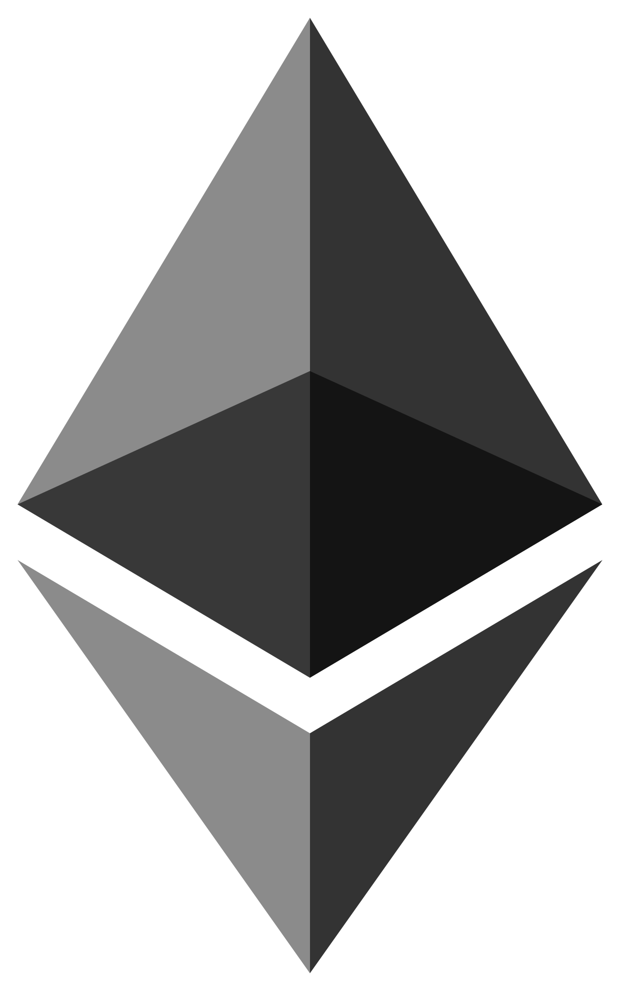
Solution
ShareMyRPC
Go-Ethereum
ethclient
Server
JSON-RPC
raiden
raiden
REST
REST
Raiden
Node
Raiden
Node
@vdwijden

Slide 4
My Contribution
Golang package for interaction with Raiden
  Provides easy interfaces for golang developers
Wrapper around go-ethereum’s ethclient
  Automatically sends payments with JSON-RPC requests
  Different actions can have different values attached
  Can be used as drop-in replacement for ethclient
Small changes to go-ethereum (~22LoC)
  On incoming RPC-request the server waits for raiden payment
Demo app that executes some commands
@vdwijden

Slide 5
Raiden package
Uses the Raiden REST API
Provides access to most useful functions
Can be easily imported by other golang projects
Standard golang error handling builtin
Makes working with Raiden a breeze
Outline
NewRaiden(url)
GetTokenList()
JoinNetwork(token, funds)
OpenChannel(peer, token, deposit, timeout)
QueryChannel(token, peer)
DepositToken(token, peer, amount)
PayToken(token, peer, amount)
PaymentHistory(token, peer)
@vdwijden

Slide 6
Thank you for your
attention
@vdwijden

