Slide 1
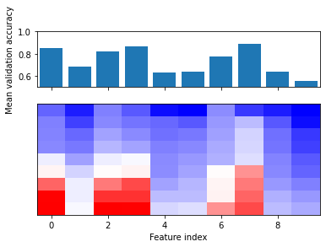
CANCER
10 features
569 samples
357/212 split
Explained variance | # Components required
0.5 | 1
0.75 | 1
0.9 | 1
0.95 | 1
0.99 | 2

Slide 2
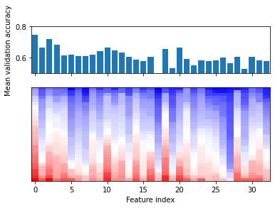
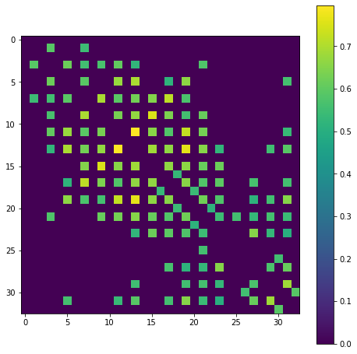
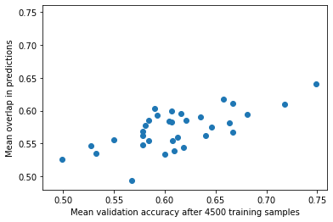
Ionosphere
33 features
351 samples
126/225 split

Slide 3
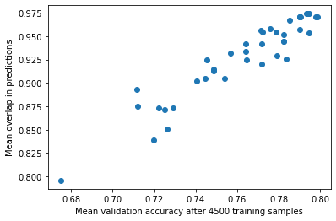
SPECTF
Data on cardiac Single Proton Emission Computed Tomography (SPECT) images. The database of 267 SPECT image sets (patients) was processed to extract features that summarize the original SPECT images
44 features
267 samples
55/212 split
Many overlapping predictions so dataset lends itself well to PCA
Explained variance | # Components required
0.5 | 2
0.75 | 7
0.9 | 16
0.95 | 23
0.99 | 37

Slide 4
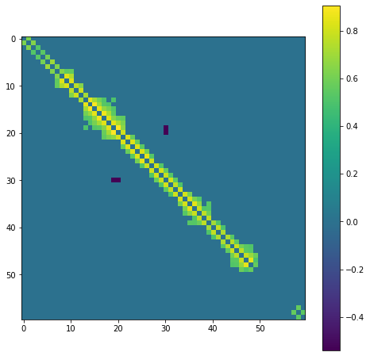
SONAR or MNIST
60 features
207 samples
97/111 split
~85% Accuracy*
Detecting either metal or rock based on sonar signals
Each feature represents the energy within a particular frequency band integrated over time
64 features
5620 samples
~Equal split across 10 classes
~97% accuracy*
Explained variance | # Components required
0.5 | 2
0.75 | 6
0.9 | 12
0.95 | 17
0.99 | 29
Handwritten digit MNIST
Original images divided into nonoverlapping 4x4 blocks
Number of “on” pixels counted and returned as feature.
* As reported on the UCI database website for each dataset

Slide 5
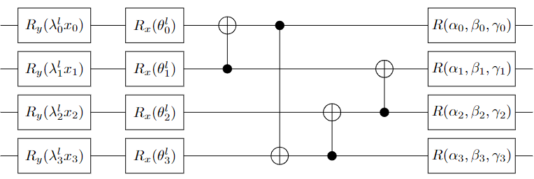
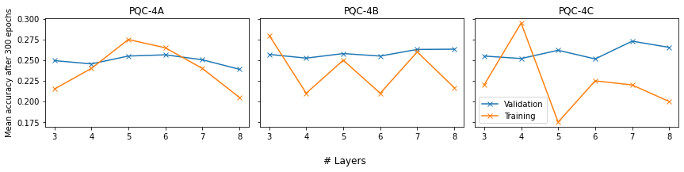
Synthetic – Proposal 1
Repeat L layers with index l
To generate data:
Measure Pauli Z observable on final qubit of PQC on the right
If <Z> > ½^(#qubits/2): +1 label,
Elif <Z> < - ½^(#qubits/2): -1 label
Lambda initialized in range [0.1, 1.9]
All other free parameters (denoted with Greek symbols) initialized in range [-pi/2, pi/2]
Step size and offset of CNOT ring random every layer
1 block of 10 qubits

Slide 6
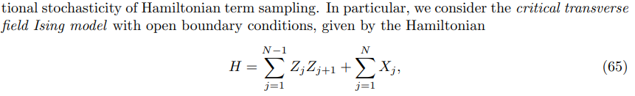
Synthetic – Proposal 2 & 3
Proposal 2:
A layer of single qubit rotations followed by a brickwork pattern of random/parameterized 2 qubit gates with sufficient depth to ensure full qubit connectivity
Proposal 3:
Some kind of Ising model, e.g.

