Slide 1
Asynchronous intuition
How to avoid problems and ask a valid question
Mariusz Krzanowski

Slide 2
Purpose
Help us start thinking outside the box
See where to look for traps.
Change our counterintuitive knowledge about asynchronous programming.
Make us better software developers, by learning new stuff.

Slide 3
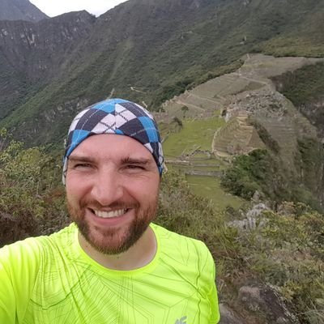

About ME
Employed in IT since 1999
Developer / Architect / Team Leader
Now: Senior Software Developer @ SoftwareONE
Experienced in many technologies
.NET, SQL, SharePoint, BizTalk, Google Cloud, Android, SCCM Active Directory, Web Development …
I like to share my knowledge with others
You can meet me at Warszawska Grupa .NET (WG-NET)
I got chance to present on Warszawskie Dni Informatyki

Slide 4
Agenda
Warmup - async or no async that’s the question
More work requires less time
Action block and never executed tasks
Concurrent dictionary and factory problem
Slim Semaphore deadlock

Slide 5
Agenda
Warmup - async or no async that’s the question
More work requires less time
Action block and never executed tasks
Concurrent dictionary and factory problem
Slim Semaphore deadlock
A lot of code

Slide 6
Our crew
Core stuff
Supporters
Thread and Task
Async and await
Action Block
Semaphore Slim
Concurrent Dictionary
Interlocked Increment
Manual Reset Event
Task Completion Source
Cancellation Token Source
Concurrent Queue

Slide 7
How to understand async today?
var task= DoSomethingAsync();
// time await task;
await DoSomethingAsync();
≡

Slide 8
Show me the code
Console.Clear();
Console.WriteLine(Resources.OptionsToChoose);
var chosenOption = ReadChosenOption();
if ("Q" == chosenOption)
{
return;
}

Slide 9
Manual Reset Event
Blocks all thread waiting. When it is signaled all threads can enter protected section.
Start line
Synchronizations point for multiple thread.

Slide 11
Summary
Read carefully documentations.
Samples are samples not a final solution.
Using await does not guarantee an atomic operation.
Each thread can be paused for a moment.
Challenge implemented code by doing thought experiments.

Slide 12






Q & A

Slide 13

Where can you find me?
Web
https://lastboardingcall.pl
https://mrmatrix.net
GitHub
https://github.com/MariuszKrzanowski
YouTube
Mariusz Krzanowski `mrmatrix.net`
Tweeter
@KrzanowskiM
Meetups
Warszawska Grupa .NET
Mariusz Krzanowski

Slide 14
Thank you

Slide 15
Where can you find me?
Web
https://lastboardingcall.pl
https://mrmatrix.net
GitHub
https://github.com/MariuszKrzanowski
YouTube
Mariusz Krzanowski `mrmatrix.net`
Tweeter
@KrzanowskiM
Meetups
Warszawska Grupa .NET
Mariusz Krzanowski

