Slide 1
Traps in distributed systems
A stich in time saves nine
Mariusz Krzanowski

Slide 2


About ME
Employed in IT since 1999
Developer / Architect / Team Leader
Now: Senior Software Developer @ Demant Technology Centre
Experienced in many technologies
.NET, SQL, SharePoint, BizTalk, Google Cloud, Android, SCCM Active Directory, Web Development …………… 20 years is long time ☺
I like to share my knowledge with others – you can meet me at Warszawska Grupa .NET (WG-NET)

Slide 3
Goals of the presentation
To know the existing traps of distributed systems before designing them.
To better understand distributed systems.

Slide 4
Agenda - Traps in:
In scope
OUT OF scope
Time
Virtualization
Consistency
Communication
Deployment
Security

Slide 5
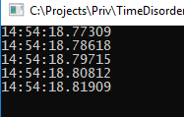
Time order
var t1 = DateTime.UtcNow;
Thread.Sleep(10);
var t2 = DateTime.UtcNow;
Thread.Sleep(10);
var t3 = DateTime.UtcNow;
Thread.Sleep(10);
var t4 = DateTime.UtcNow;
Thread.Sleep(10);
var t5 = DateTime.UtcNow;
Console.WriteLine($"{t1:HH:mm:ss.fffff}");
Console.WriteLine($"{t2:HH:mm:ss.fffff}");
Console.WriteLine($"{t3:HH:mm:ss.fffff}");
Console.WriteLine($"{t4:HH:mm:ss.fffff}");
Console.WriteLine($"{t5:HH:mm:ss.fffff}");

Slide 6
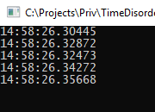
Time order
var t1 = DateTime.UtcNow;
Thread.Sleep(10);
var t2 = DateTime.UtcNow;
Thread.Sleep(10);
var t3 = DateTime.UtcNow;
Thread.Sleep(10);
var t4 = DateTime.UtcNow;
Thread.Sleep(10);
var t5 = DateTime.UtcNow;
Console.WriteLine($"{t1:HH:mm:ss.fffff}");
Console.WriteLine($"{t2:HH:mm:ss.fffff}");
Console.WriteLine($"{t3:HH:mm:ss.fffff}");
Console.WriteLine($"{t4:HH:mm:ss.fffff}");
Console.WriteLine($"{t5:HH:mm:ss.fffff}");

Slide 7
Time order
var t1 = DateTime.UtcNow;
Thread.Sleep(10);
var t2 = DateTime.UtcNow;
Thread.Sleep(10);
var t3 = DateTime.UtcNow;
Thread.Sleep(10);
var t4 = DateTime.UtcNow;
Thread.Sleep(10);
var t5 = DateTime.UtcNow;
Console.WriteLine($"{t1:HH:mm:ss.fffff}");
Console.WriteLine($"{t2:HH:mm:ss.fffff}");
Console.WriteLine($"{t3:HH:mm:ss.fffff}");
Console.WriteLine($"{t4:HH:mm:ss.fffff}");
Console.WriteLine($"{t5:HH:mm:ss.fffff}");

Slide 8





wrong Time order – Why?
Build-in RTC are not accurate
Time synchronization latency varies
Multiple network devices in synchronization path

Slide 9
WRONG Time order – Why?
Build-in RTC are not accurate
Time synchronization latency varies
Multiple network devices in synchronization path
NOTE! Do not use time only to sequence events.

Slide 10
Stop The WORLD
var t1 = System.DateTime.UtcNow;
Thread.Sleep(TimeSpan.FromSeconds(1));
var t2 = System.DateTime.UtcNow;
Console.WriteLine($"{t2-t1:c}");
Console.ReadLine();

Slide 11
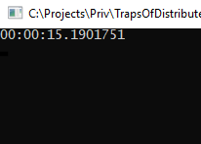
Stop The WORLD
var t1 = System.DateTime.UtcNow;
Thread.Sleep(TimeSpan.FromSeconds(1));
var t2 = System.DateTime.UtcNow;
Console.WriteLine($"{t2-t1:c}");
Console.ReadLine();

Slide 12

In cloud everything is virtual
Virtual Machines
IAAS PAAS SAAS FAAS
Host of virtual machines

Slide 13
In cloud everything is virtual
Virtual Machines
IAAS PAAS SAAS FAAS
Host of virtual machines
There is always risk that:
host could be restarted
guest process could be paused

Slide 14



Sticky session
LOAD
BALANCER
FRONT
END
Goal:
Load balancer sends all traffic from a single client to single server.
Load balancer can be distributed – e.g. Windows NLB service.

Slide 15
Sticky session
LOAD
BALANCER
FRONT
END
Traps:
Front-end server is unresponsive
Multiple clients are directed to single machine
Clients are accessing server farm via NAT
Sticky token timeout. Two processes running in parallel:
clean-up on 1st server
new process on 2nd

Slide 16


Brain split
The problem is not with the host, but the infrastructure
Switch, router is disabled
Shared communication channel is overloaded

Slide 17
Brain split
Both sides think the other side is dead.
Problems to be solved:
How to handle new client requests?
How to merge potential conflicts, when connection is restored?

Slide 18
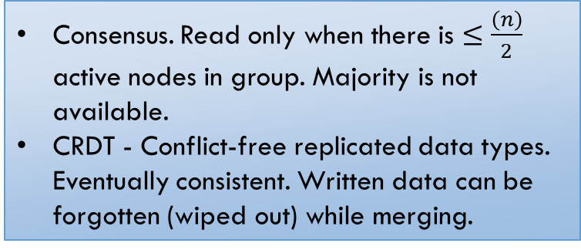
Brain split
Both sides think the other side is dead.
Problems to be solved:
How to handle new client requests?
How to merge potential conflicts, when connection is restored?
Consensus. Read only when there is $≤\frac{\left(n\right)}{2}$ active nodes in group. Majority is not available.
CRDT - Conflict-free replicated data types. Eventually consistent. Written data can be forgotten (wiped out) while merging.

Slide 19
what you wrote is not what you WILL read
Scenario:
Create new Group in Active Directory.
Get the group from AD to verify that it was created.
Add Alice and Bob to the newly created group.
Expected result:
Group is created. Alice and Bob are assigned to group.
Reported error:
Group not found in step 3 ☹

Slide 20




what you wrote is not what you WILL read
Asynchronous replication
Create Group
Active Directory Farm

Slide 21
what you wrote is not what you WILL read
Get Group
Active Directory Farm

Slide 22

what you wrote is not what you WILL read
Replication can take up to 15 minutes
Can be stopped on conflicted objects. Manual actions must be taken
Geo-distributed replication
Add user to Group
Active Directory Farm

Slide 23
what you wrote is not what you WILL read
Replication can take up to 15 minutes
Can be stopped on conflicted objects. Manual actions must be taken
Geo-distributed replication
Add user to Group
Real live example:
Messages store in Azure Queues are shown with a delay on the portal. Replication can be one of the reasons for that.
Active Directory Farm

Slide 24
Eventual Consistency
NOTE! System is never fully consistent when multiple processes are involved. Even communication with a single database fully supporting ACID is consistent only at the end.

Slide 25
Case study
CREATE TABLE [dbo].[SqlCommitDemo](
[id] [int] NOT NULL PRIMARY KEY,
[data] [varchar](100) NOT NULL,
) ON [PRIMARY]
Single table
Single command
Single transaction
INSERT INTO [dbo].[SqlCommitDemo]
([id],[data])
VALUES (@id,@data)

Slide 26
(1) Create and open a connection
using (var con = new SqlConnection(Settings.Default.SqlConnection))
{
con.Open();
using (var trx = con.BeginTransaction())
{
using (var cmd = new SqlCommand(Resources.TestScript, con, trx))
{
cmd.Parameters.AddWithValue("@id", id);
cmd.Parameters.AddWithValue("@data", data);
cmd.ExecuteNonQuery();
}
trx.Commit();
}
}

Slide 27
(2) Begin transaction
using (var con = new SqlConnection(Settings.Default.SqlConnection))
{
con.Open();
using (var trx = con.BeginTransaction())
{
using (var cmd = new SqlCommand(Resources.TestScript, con, trx))
{
cmd.Parameters.AddWithValue("@id", id);
cmd.Parameters.AddWithValue("@data", data);
cmd.ExecuteNonQuery();
}
trx.Commit();
}
}

Slide 28
(3) Execute set of commands
using (var con = new SqlConnection(Settings.Default.SqlConnection))
{
con.Open();
using (var trx = con.BeginTransaction())
{
using (var cmd = new SqlCommand(Resources.TestScript, con, trx))
{
cmd.Parameters.AddWithValue("@id", id);
cmd.Parameters.AddWithValue("@data", data);
cmd.ExecuteNonQuery();
}
trx.Commit();
}
}
INSERT INTO [dbo].[SqlCommitDemo] ([id],[data])
VALUES (@id,@data)

Slide 29
(4) Commit transaction
using (var con = new SqlConnection(Settings.Default.SqlConnection))
{
con.Open();
using (var trx = con.BeginTransaction())
{
using (var cmd = new SqlCommand(Resources.TestScript, con, trx))
{
cmd.Parameters.AddWithValue("@id", id);
cmd.Parameters.AddWithValue("@data", data);
cmd.ExecuteNonQuery();
}
trx.Commit();
}
}

Slide 30


TEST - RESULTS
Test | Commit Results
Insert 1st
Insert 2nd
Insert 3rd

Slide 31
Quiz
Test | Commit Results
Insert 1st
Insert 2nd
Insert 3rd
How many records are stored in the database?

Slide 32
Answer
Test | Commit Results
Insert 1st
Insert 2nd
Insert 3rd
How many records are stored in the database?
Answer: Database has at least 1 record.

Slide 33

Client
Database
BEGIN TRANSACTION
ACK
INSERT OPERATION
ACK
COMMIT TRANSACTION
ACK

Slide 34
Client
Database
BEGIN TRANSACTION
ACK
INSERT OPERATION
ACK
SQL Exception
e.g. deadlock victim

Slide 35
Client
Database
BEGIN TRANSACTION
ACK
INSERT OPERATION
ACK
COMMIT TRANSACTION
Exception
Transaction Timeout

Slide 36
Client
Database
BEGIN TRANSACTION
ACK
INSERT OPERATION
ACK
COMMIT TRANSACTION
Information MUST be saved
in the database log before a response is sent. It cannot be rollbacked.
ACK
Exception
Transaction Timeout

Slide 37
Eventual Consistency - Conclusions
System using single database sometimes is not consistent. Keeping consistency in distributed multi-database systems is more difficult.
Each communication can be broken.
Request or response packets can be lost.
Simple retry does not solve all the problems.

Slide 38
Messages not in order
- Knock – knock
- Message not in order
- Who is there?

Slide 39


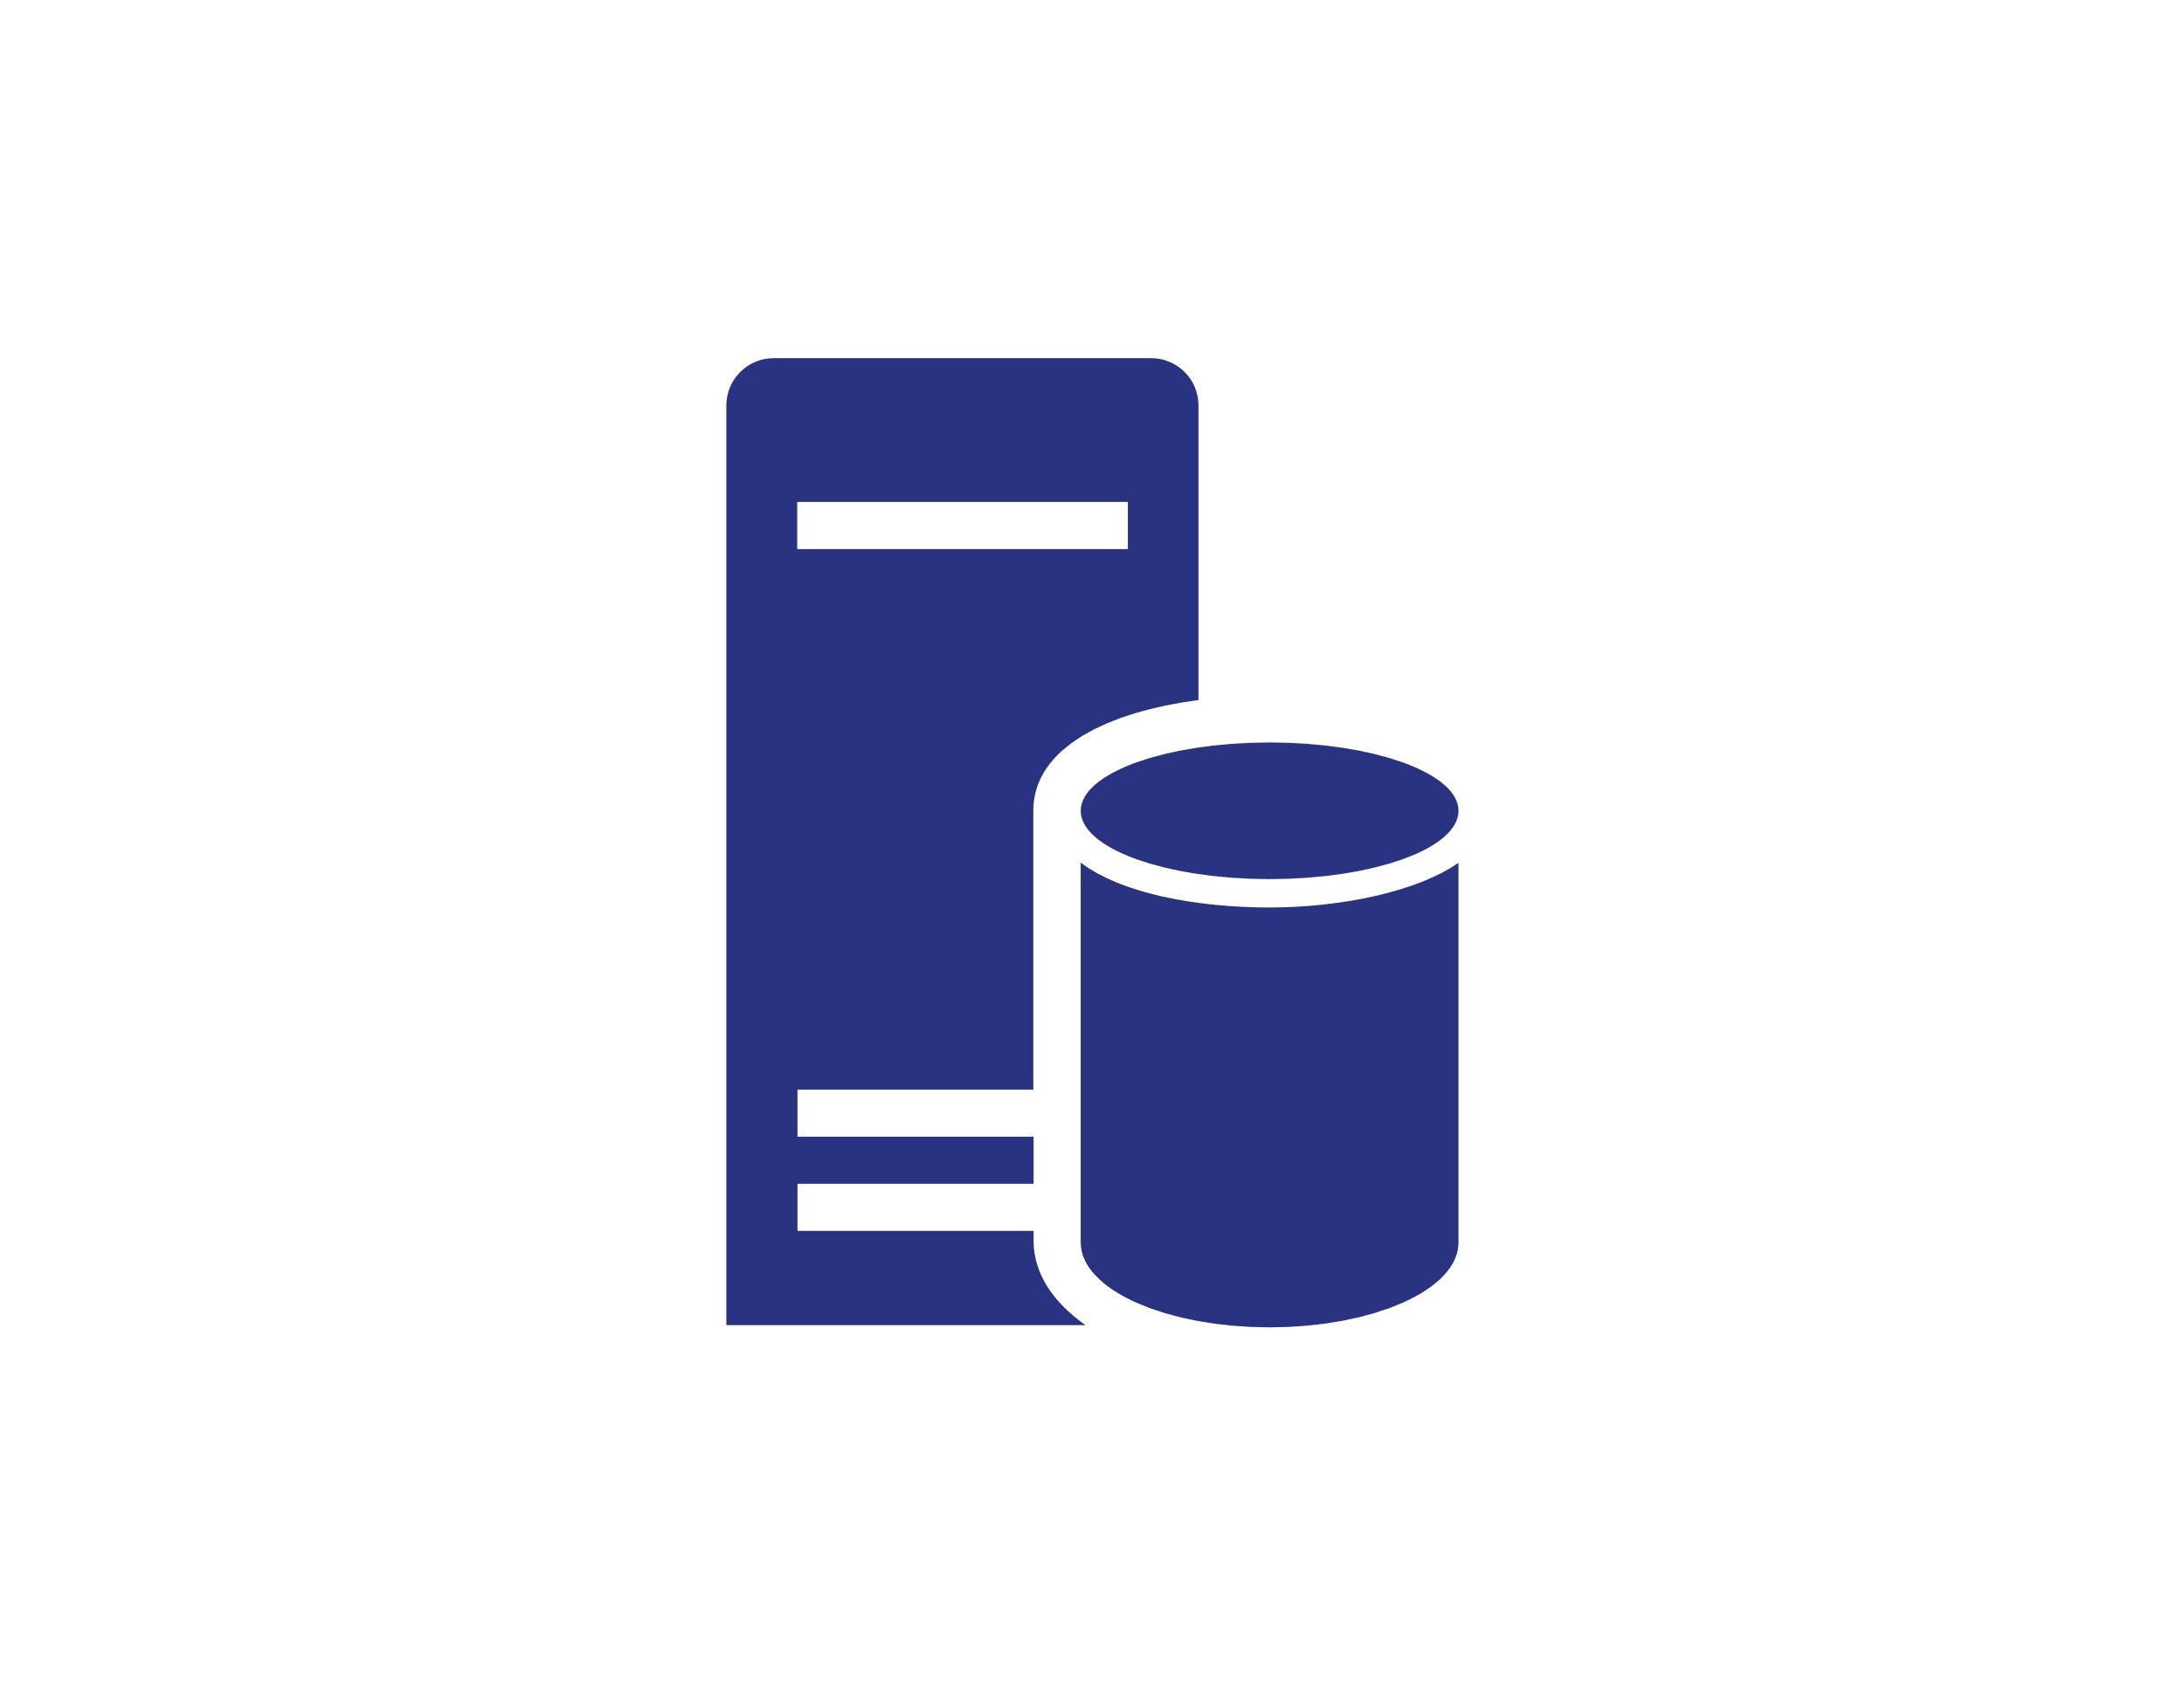
Messages not in order
Servers have different processing speeds.
Timeout/error can return message back to the queue
Network latency can deliver messages in different moments
Be careful of server responses not being in order. Create correlation id to match responses.

Slide 40
Messages not in order
Servers have different processing speeds.
Timeout/error can return message back to the queue
Network latency can deliver messages in different moments
Be careful of server responses not being in order. Create correlation id to match responses.
Real live example:
User double click a button in the browser. First received response can be an error ‘record already exists’.

Slide 41
Delivery of exactly one message
It is a myth. Network is not reliable.
There are frameworks which emulate delivery of exactly one message. They implement this behavior:
by hiding usage of at least one message delivery pattern.
by involving Distributed Transaction Coordinator.

Slide 42
Delivery of exactly one message
It is a myth. Network is not reliable.
There are frameworks which emulate delivery of exactly one message. They implement this behavior:
by hiding usage of at least one message delivery pattern.
by involving Distributed Transaction Coordinator.
When you must deliver exactly one message, you have to build retry and de-duplication mechanism yourself.
Keep in mind messages can be delivered not in order.

Slide 43
JSON everywhere
Continuous serialization/deserialization process.
Compressed data consumes processor time and memory. 1MB JSON compressed to 4kB still requires 1MB of RAM.
Allocated memory must be released by Garbage Collector.

Slide 44
JSON everywhere
Continuous serialization/deserialization process.
Compressed data consumes processor time and memory. 1MB JSON compressed to 4kB still requires 1MB of RAM.
Allocated memory must be released by Garbage Collector.
Consider binary formatters.
Redesign your data model.
Zero Formatter – to minimize allocation.

Slide 45
Resource asymmetry
When sharing multiple resources like disks, computing power, network bandwidth.
Heavy load on processor or disk of single virtual machine can impact other virtual machines.
Overloaded network, can make your services unavailable.

Slide 46
Resource asymmetry
When sharing multiple resources like disks, computing power, network bandwidth.
Heavy load on processor or disk of single virtual machine can impact other virtual machines.
Overloaded network, can make your services unavailable.
Real live example: Data scientist overloaded physical host by heavy disk load. All virtual machines running on this host became almost unresponsive.

Slide 47
Domino effect
What is the maximum throughput of your system?
What happens when the system is overloaded?

Slide 48
Domino effect
What is the maximum throughput of your system?
What happens when the system is overloaded?
503 Service Unavailable is not a solution for web application. Multiple requests of a browser are sent during a single page load.
A wise retry policy must be implemented at the client side.
Consider switching off less important systems.

Slide 49
Extreme – the only valid option
Reactive processing
Batch processing

Slide 50
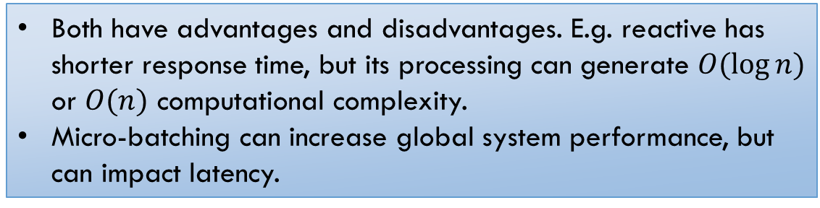
Extreme – the only valid option
Reactive processing
Batch processing
Both have advantages and disadvantages. E.g. reactive has shorter response time, but its processing can generate $O(\log{n})$ or $O(n)$ computational complexity.
Micro-batching can increase global system performance, but can impact latency.

Slide 51


Reliability
Cloud provider
Your local network provider
Is your local network prepared for increased traffic? QoS.
Sticky session and NAT problem. Limited port numbers to be used on client side.
What is the cost of losing local connection?
Is your system deployed in multiple zones?
What is your backup plan?

Slide 52
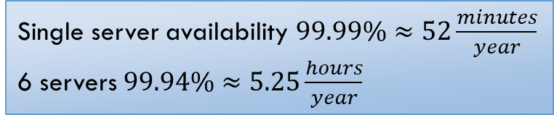
Reliability – point of failure
Single server availability $99.99\%≈52\frac{minutes}{year}$
6 servers $99.94\%≈5.25\frac{hours}{year}$

Slide 53
Reliability – point of failure
Single server availability $99.99\%≈52\frac{minutes}{year}$
6 servers $99.94\%≈5.25\frac{hours}{year}$
Fast failover mechanism is required. Each node must be duplicated. See Circuit Breaker approach used by Netflix.

Slide 54


Reliability – human error
Do you remember to renew all your Security Certificates?
Have you defined disaster recovery plan?
Do you control your costs generated at your Cloud Provider?

Slide 55
Reliability – human error
Do you remember to renew all your Security Certificates?
Have you defined disaster recovery plan?
Do you control your costs generated at your Cloud Provider?
Business is not aware of SSL certificates validity.
Cloud resources must be monitored.
Usage forecast must be reported to business in advance. Remember about corporate procedures slowing down execution.

Slide 56
Big bang deployment
Pros
Cons
All clients have the newest version.
No need to maintain the old version.
When the failure occurs?
You will get more disappointed users
Your support/OPS will be overloaded by duplicated bug reports.

Slide 57
Big bang deployment
Pros
Cons
All clients have the newest version.
No need to maintain the old version.
When the failure occurs?
You will get more disappointed users
Your support/OPS will be overloaded by duplicated bug reports.
Consider Canary Tests.
Select a small group of end users for bringing a new release.
Design how to switch on/off features for selected users.

Slide 58
New release (Web Server)
In the 24/7 distributed systems, there is no place for content replace.
Deprecated version must be kept for a while.
Consider that web browser has its own caching strategy.
Consider that while a new version is being deployed, client application can download subcomponents prepared for previously released version.

Slide 59

New release (Mobile application)
Real live example: Maps.me - over 1 millions downloads
Map of European country contains about 300 MB of data.
Single release cost $300∙{10}^{6}∙{10}^{6}$ = 300 $∙{10}^{12}≈300TB$ to be transmitted to all clients.
$10 \frac{GB}{s}$ average throughput $≈$ 1 hours to update all devices
$1 \frac{GB}{s}$ average throughput $≈$ 10 hours to update all devices
What will happen when an application has more downloads ?
4G network? 300 MB can be a killer for your clients budget. (Limits in New Zeeland, Australia, Galapagos)

Slide 60

Processing time
CPU ~ 1ns
Memory ~100 us
Local Network ~1ms
External Network ~50ms
Second side of the world ~0.5s
When you add host restarts we can talk about minutes
Scale factor ${10}^{9}$. Distributed system works well when workflows can be run in parallel. No synchronization points are involved.

Slide 61
Summary
Distributed programming has benefits when the solution requires large scale.
Distributed systems are not a universal solution when your system is slow.
If your application unable to work on a single machine it will die on servers farm.
FAAS, PAAS is serverless, but logically only. The real server farm infrastructure hosts them.

Slide 62
Additional resources
Udi Dahan - NServiceBus
Petabridge – Akka.NET
Netflix – Chaos Engineering
Martin Kleppmann

Slide 63

Where you can find me?
Web
https://lastboardingcall.pl
https://mrmatrix.net
GitHub
https://github.com/MariuszKrzanowski
Tweeter
@KrzanowskiM
Meetups
Warszawska Grupa .NET
Mariusz Krzanowski

Slide 64
Q & A

Slide 65
Thank you
☺

Slide 66
Where you can find me?
Web
https://lastboardingcall.pl
https://mrmatrix.net
GitHub
https://github.com/MariuszKrzanowski
Tweeter
@KrzanowskiM
Meetups
Warszawska Grupa .NET
Mariusz Krzanowski

