Slide 1

Banking Customer
Churn Analysis
Prepared By:
Mariya Babu

Slide 2
Introduction
Customer Churn : Customers leaving the bank.
Loss of revenue and increased acquisition costs.
Difficult to identify customers who are likely to leave.
Analyze customer data and identify key factors influencing churn.
Predict at-risk customers and improve retention strategies.

Slide 3
Dataset Overview
Dataset from https://mavenanalytics.io/
10,000 customers at a European bank.
13 variables for analysis
1. Customer Info: Age, Gender, Geography
2. Account Info: Balance, Tenure, Products,Salary
3. Behavior: Active Status, Credit Card Score and availability
4. Target: Churn (Exited / Not Exited)

Slide 4
Tech Stack
Language : Python
Data Manipulation: Numpy,Pandas
Visualization : Seaborn, Matplotlib

Slide 5
Data Handling
Missing values
-Applied mean amputation for numerical values.
-Removed the column Surname as it is not necessary
for analysis.
Duplicates
-Removed the duplicates.
Removed unwanted symbols.
Changed the datatypes.
Formatted column headers and standardized the column values.

Slide 6
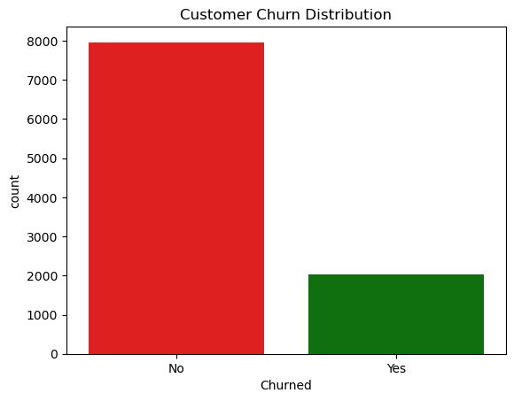
Visualization
Customer Churn Distribution
Non-churned(~80%) customers are higher than churned customers(~20%).

Slide 7
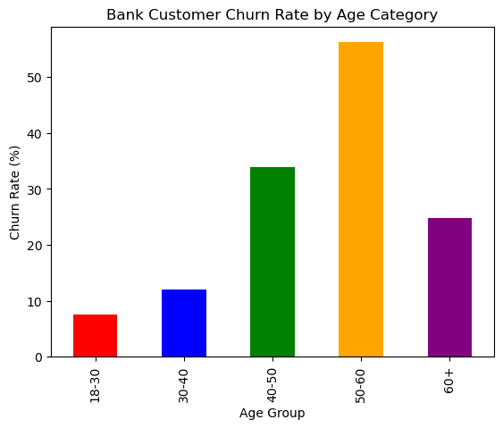
Visualization
Churn Rate by Age
Older or senior customers typically show a higher churn rate.
Lower Churn in Middle-Aged Customers and younger customers.

Slide 8
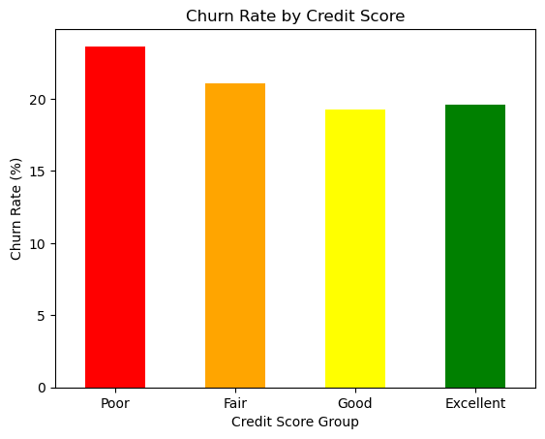
Visualization
Churn Rate by Credit Score
Customers with low credit scores tend to show higher churn rates .

Slide 9
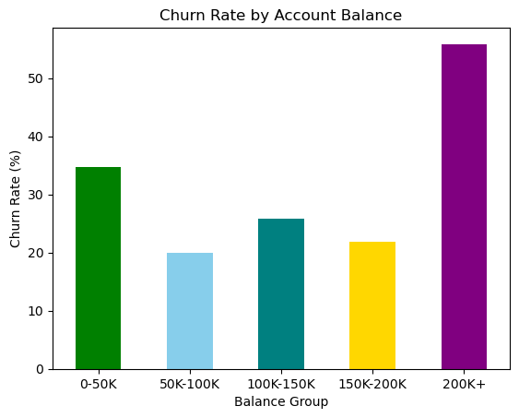
Visualization
Churn Rate by Account Balance
High churn rate in customer group with high and low account balance.
Relatively low in middle group.

Slide 10
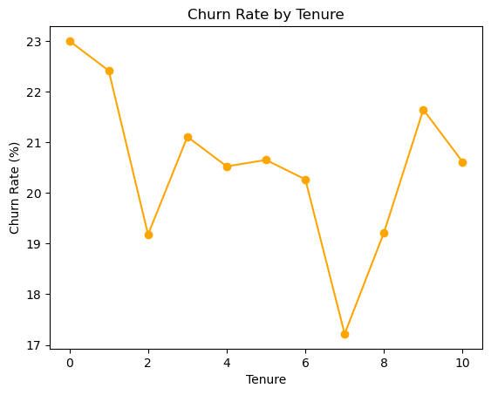
Visualization
Churn Rate by Tenure
Higher Churn at Early Tenure (0–1 Years)
Drop in Churn After Initial Years.
Stable Churn in Mid Tenure (3–6 Years).
Lowest Churn at Tenure 7.
Slight Increase Again in Later Years (8–9)

Slide 11
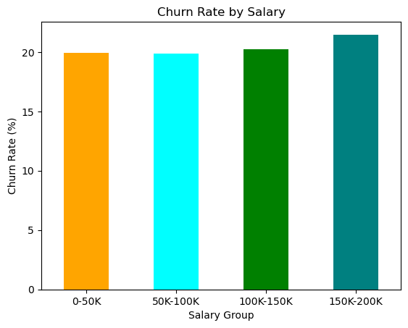
Visualization
Churn Rate by Salary
Minimal Variation Across Salary Groups.
Weak predictor.

Slide 12
Visualization
Churn Rate by Salary
Minimal Variation Across Salary Groups.
Weak predictor.

Slide 13
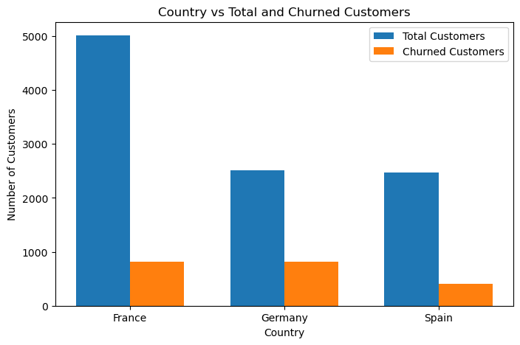
Visualization
Country Vs Total & Churned Customers
France has highest number of customers.
Relatively high churned customers in Germany.

Slide 14
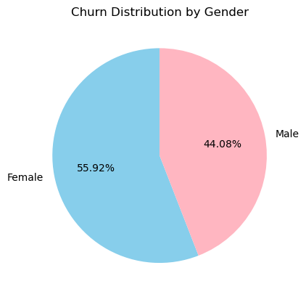
Visualization
Churn Distribution By Gender
Higher churn among Female customers.

Slide 15
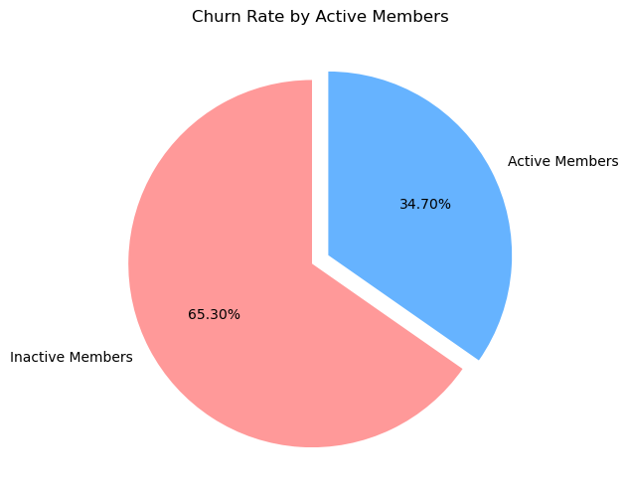
Visualization
Churn Distribution on Active and Inactive Customers
Inactive members have a significantly higher churn rate compared to active members.

Slide 16
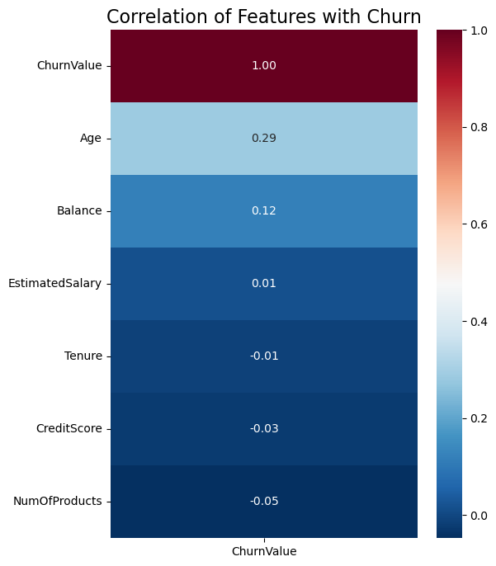
Visualization
Feature Correlation Map
(HeatMap)
Age and Account balance shows strong positive correlation with churn.
Salary doesn't show that much dependencies on churn.
Credit score and number of products shows negative correlation on churn rate.

Slide 17
Key Insights
Age : Churn rate is higher among olderor senior customers.
Credit score : Customers with low credit scores tend to show higher churn rates.
Account Balance : Customers having both high and low account balance shows higher churn rate.
Tenure : High churn rate in early stagges.
Salary : Churn is not dependent on the salary.
Geography: Germany is having higher churn rate.
Gender : Female customers tends to churn more compared to males.
Inactive customers churn more compared to active ones.

Slide 18
Business Recommendations
Increase customer engagement Launch targeted campaigns for inactive customers
Focus on high-value customers Provide personalized offers and premium services
Improve customer experience Strengthen support and resolve complaints faster
Use data-driven strategies Continuously monitor churn trends and customer behavior
Implement predictive analytics Identify at-risk customers early and take proactive actions

Slide 19
THANK YOU

