Slide 1
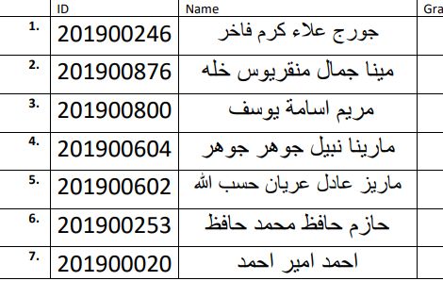
CNN

Slide 2
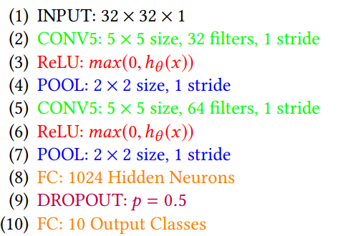
1-Architecture used in the Paper
An Architecture Combining Convolutional Neural Network (CNN) and Support Vector Machine (SVM) for Image Classification
CNN using SoftMax

Slide 3
2- Dataset details
MNIST[10] is an established standard handwritten digit classification dataset. It is a 10- class classification problem having 60,000 training examples. (png)
Dataset link: https://intuitive-robotics.tistory.com/54
Each image in 28x28 pixel
10 classes [0,1,2,3,4,5,6,7,8,9]

Slide 4
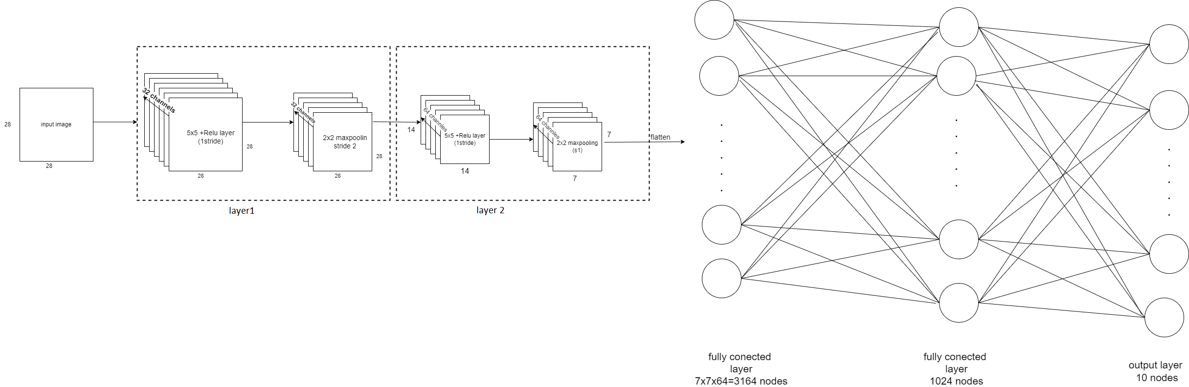
3- Implementation details
CNN then a fully connected layers then classifications
• The ratio used for training, validation, and testing:
▪ Training: 60% of dataset = 36,000 samples (PNG).
▪ Validation: 20% of dataset = 12,000 samples (PNG).
▪ Testing: 20% of dataset = 12,000 samples (PNG).

Slide 5
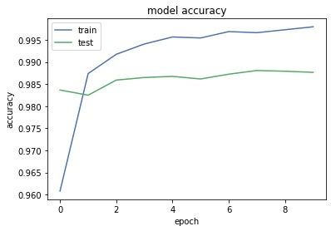
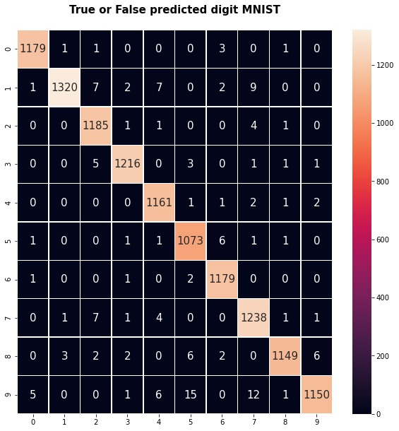
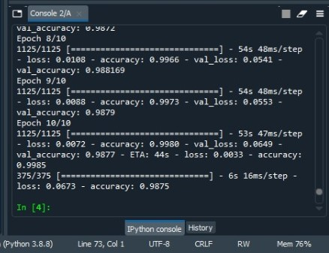
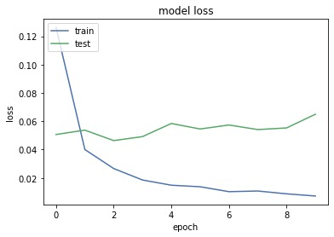
4- Results and visualizations
CNN-SoftMax training accuracy =99% validation accuracy=98.77% testing accuracy=98%

