Slide 1
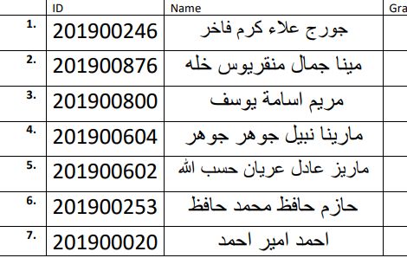
CNN

Slide 2
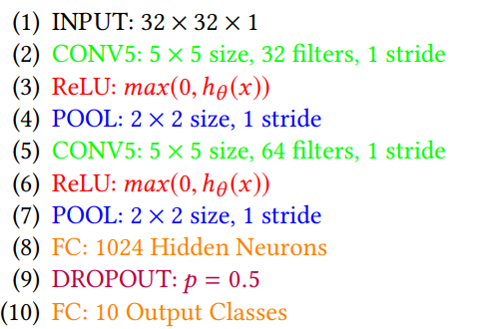
1-Architecture used in the Paper
An Architecture Combining Convolutional Neural Network (CNN) and Support Vector Machine (SVM) for Image Classification
CNN using SoftMax

Slide 3
2- Dataset details
Arabic Letters data set 13,440. (png)
Dataset link: https://intuitive-robotics.tistory.com/54
Each image in 32x32 pixel
28 classes [1,2,3,……,28]

Slide 4
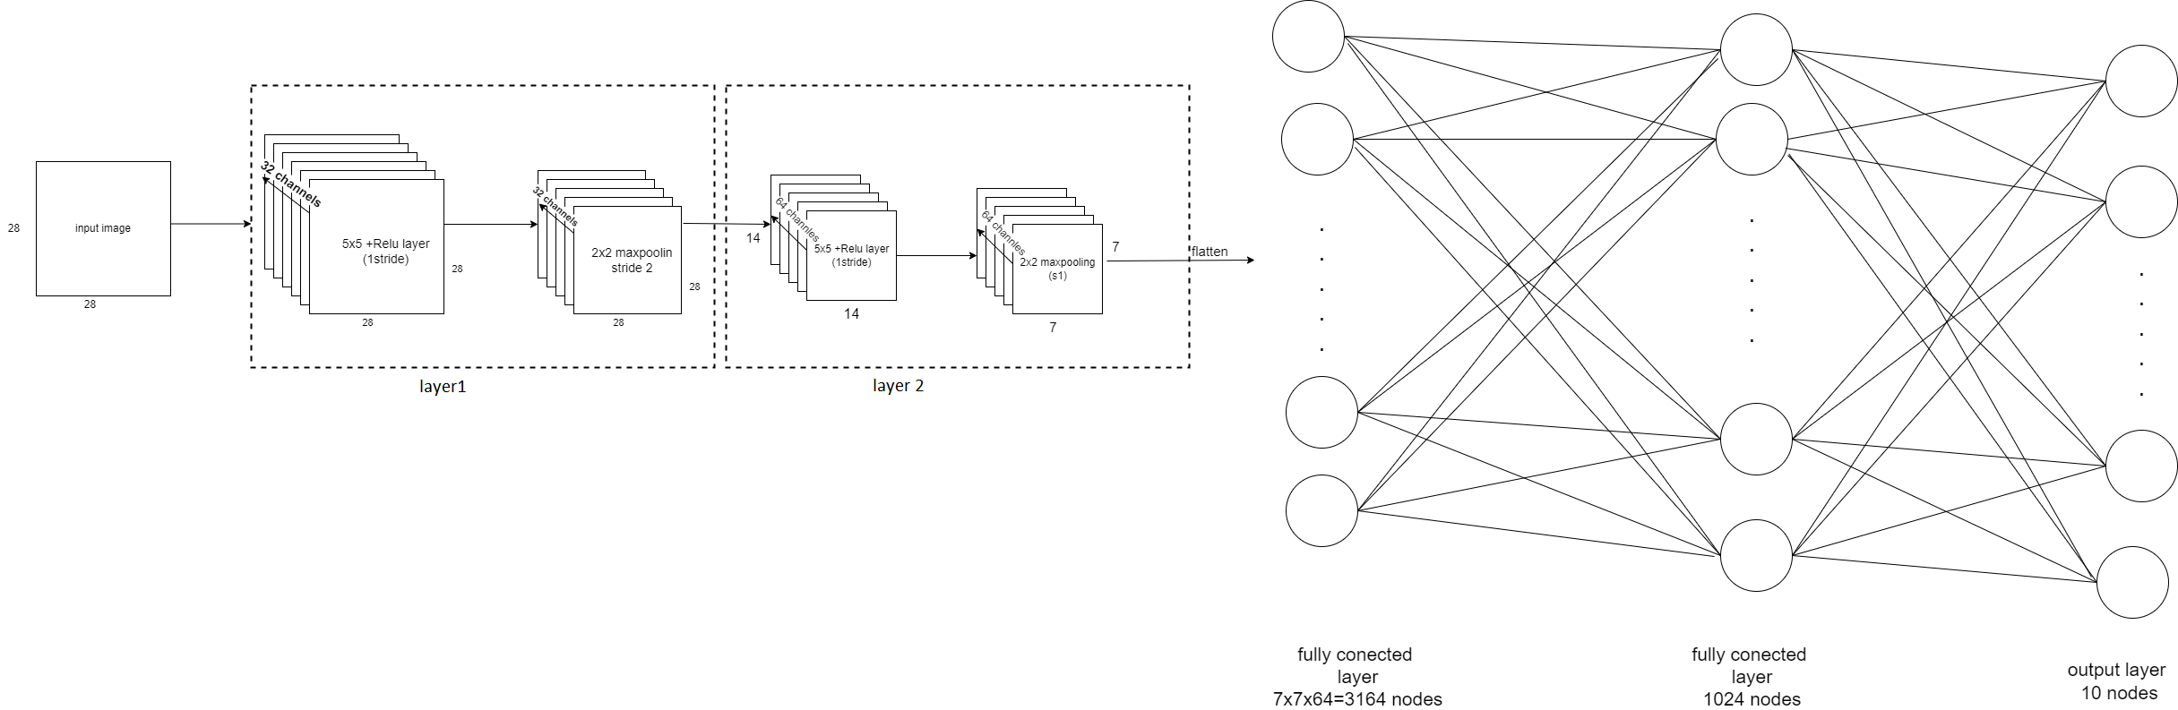
3- Implementation details
CNN then a fully connected layers then classifications
• The ratio used for training, validation, and testing:
▪ Training: 60% of dataset = 36,000 samples (PNG).
▪ Validation: 20% of dataset = 12,000 samples (PNG).
▪ Testing: 20% of dataset = 12,000 samples (PNG).

Slide 5
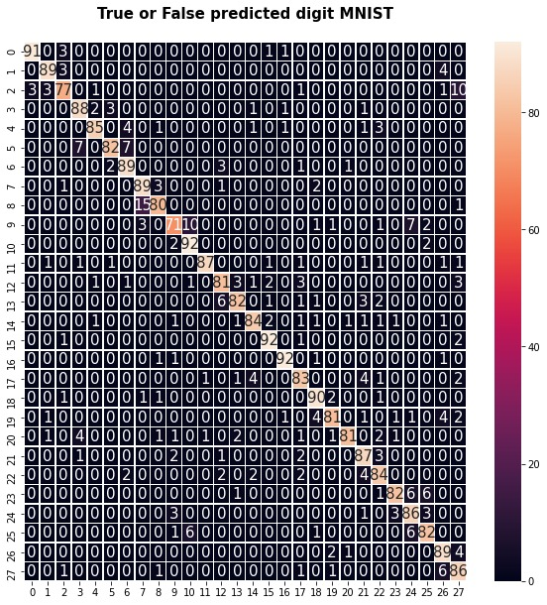
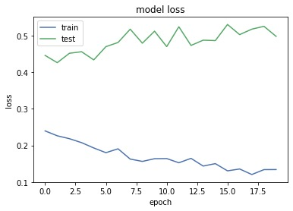
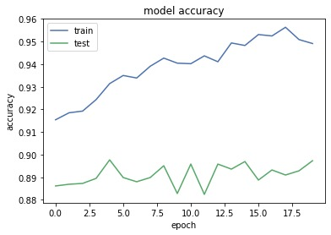
4- Results and visualizations
CNN-SoftMax training accuracy =94% validation accuracy=90% testing accuracy=88%

