Slide 1


From Business modeling to database design

Slide 2
Today’s Topics
We will look at different types of data models and how logical data models are transformed into physical data models.
Focus will be on design principles and central properties for database tables.
You will learn how to forward engineer a database from graphical database modeling in MySQL Workbench.

Slide 3
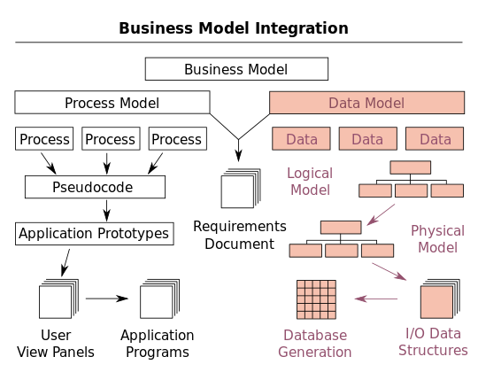
Database design – it starts with business modeling
Let’s go back to your January activity with Palle for a moment …
Domain model
Use cases (user stories)
E/R model
Relational model
Tables / SQL

Slide 4
Data models at several levels
Data models transform from logical into physical form:
Conceptual model
Presentation of data in end user terminology and context
Technology free
Domain model (business focus), E/R model (persistence focus)
Logical model
Can partly be understood by end-users
Relies on technology, but doesn’t show it directly
Relational model, network, hierarchical, OO models
Physical model
Close to the physical representation of the database
Technology specific, e.g. MySQL (SQL scripts)
Disk usage, security, etc.
Notes:
Fysiske modeller:
Oracle og Sybase relationel db
O2 OO DB
IMS hiearkisk db
IDMS netværksdb
mongoDB noSql

Slide 5
A Domain Model is Conceptual, not a Software Artifact
From Palle’s slides
Conceptual Class:
Software Artifacts:
SalesDatabase
Sale
amount item
vs.
Sale
Double amount; Item item;
void print()

Slide 6
Let’s try!
From Palle’s slides
This school has many students, distributed into classes, each student goes in one class. Each class has many hours in various subjects, and these subjects are held in many different rooms. This school has several teachers who teach more classes ………
RED - possible domain classes
GREEN – associations between classes
PURPLE – could tell about multiplicity

Slide 7
From Palle’s slides
Exercise
Think of your local Pizza shop.
They offer a lot of products, chosen from a menu. Typically, you can then select additional accessories, eg. extra cheese, extra ham, pineapples or other.
Ordering is done either by phone or on a website.
The customer can select the food picked up or to be brought out. Payment is made either online when ordering or with Credit Card or cash on pickup.
Create a domain model

Slide 8
From Palle’s slides
Pizza-shop. | C
Products | C
menu | C
additional accessories | A
extra cheese | A
extra ham | A
pineapples | A
Ordering | C
phone | A
website | A
Customer | C
food | Synonym
Payment | C
Credit Card | A
Cash | A
“brought out” | A
”pick up” | A

Slide 9
Domain Model Pizzashop
From Palle’s slides
Pizzashop
Menu
Product
1
has
1
1
m
Add. Accessories
Chosen from
m
consists of
m
Customer
Order
(Address)
(phone no.)
1
place
m
phone
Website
Brought out.
1
Payed by
1
Payment
cash
Credit card
online

Slide 10
Database design
Later this semester, you will work in project groups of 4-5 students.
Make a suggestion of
which database tables you will need to represent the project groups
which columns these tables should contain

Slide 11
Demo –MySQL Workbench modeling
Forward engineering:
Start with model -> use tool to generate database
Instructions at:
https://dev.mysql.com/doc/workbench/en/wb-getting-started-tutorial-creating-a-model.html

Slide 12
Database Design / Modeling
MySQL Workbench provides capabilities for creating and manipulating database models, including:
Create and manipulate a model graphically
Reverse engineer a live database to a model
Forward engineer a model to a script or live database
Create and edit tables and insert data
https://dev.mysql.com/doc/workbench/en/wb-data-modeling.html
Exporting EER Models to PNG and PDF allows sharing for presentations.

Slide 13
Naming Principles
Table names are like class names:
Upper case first letter
Singular
no_ - use LargeandSmallLetters
Column names are:
Lower case first letter
Singular
no_ - use smallAndLargeLetters
Notes:
How about the database of classical models?

Slide 14
Simple Data Types
Numeric data types :
INTEGER, INT, SMALLINT, TINYINT, MEDIUMINT, BIGINT
FLOAT, DOUBLE
Number in parenthesis “INT(11)” indicates display size when printed in Workbench
Text comes in two fundamental types:
CHAR and VARCHAR. Use VARCHAR!
Number in parenthesis “VARCHAR(20)” indicates maximum length– if nothing is specified it can be up till 65535 characters.
VARCHAR uses storage according to concrete content
CHAR uses storage as indicated in parenthesis and can be up till 255 characters

Slide 15
Date Types
The DATE type is used for values with a date part, but no time part. MySQL retrieves and displays DATE values in 'YYYY-MM-DD' format.
The supported range is '1000-01-01' to '9999-12-31'.
The DATETIME type is used for values that contain both date and time parts. MySQL retrieves and displays DATETIME values in 'YYYY-MM-DD HH:MM:SS' format.
The supported range is '1000-01-01 00:00:00' to '9999-12-31 23:59:59'.
The TIMESTAMP data type is used for values that contain both date and time parts.
TIMESTAMP has a range of '1970-01-01 00:00:01' UTC to '2038-01-19 03:14:07' UTC

Slide 16
Unique Columns
If you declare a column unique, there cannot be two rows with the same value
Emails and phone numbers are often unique
Notice– even though a column is declared as unique there can be null values in several rows

Slide 17
Not Null & Default Value
A column can be declared to never to contain any null values in any rows
You can specify a default value for a column
You can combine not null with a default value

Slide 18
Key
A key is a unique column that cannot be null
The databasecreates an index for keys which make it much faster to retrieve a row based on its key.
Example:
select *
from student
where email= “cph-rg54@cphbusiness.dk”
Sometimes a key is composite
Example:
CREATE TABLE orderdetails (
orderNumber int(11) NOT NULL,
productCode varchar(15) NOT NULL,
quantityOrdered int(11) NOT NULL,
priceEach decimal(10,2) NOT NULL,
orderLineNumber smallint(6) NOT NULL,
PRIMARY KEY (orderNumber,productCode)
)

Slide 19
Primary Key
A primary key is a key chosen for identification of rows in a table
You should not change a primary key over time.
This means that phone numbers and email adresses are poor primary keys

Slide 20
Foreign Key
A foreign key is a column that has a value which exists as primary keys in a (other) table
Example: The office table in the classicmodels database has primary key “officeCode”. In the table employees, there is a column which represents the office that the employee belongs to. This column is a foreign key.
Notice: Since more employees can belong to the same office, the foreign key is not unique in the employees table. Also, freelancers do not belong to an office and therefore the foreign key might also be null.

Slide 21
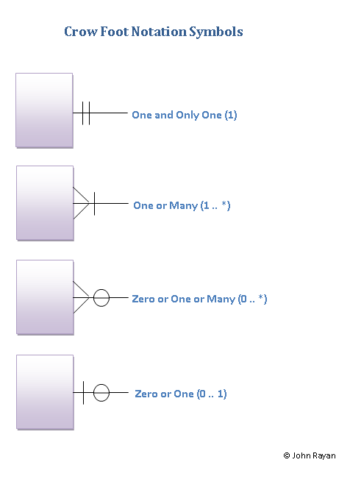
Relationship Between Tables
Primary and foreign keys are used to make relations between tables
There are different types of relationships:
Multiplicyet / Cardinality
1-1 Example - marriage
1-Mange Example – ownership (most frequent relation)
Mange-Mange Example – project participation
Modality / Mandatory or optional
Can any of the”1” above be 0?

Slide 22
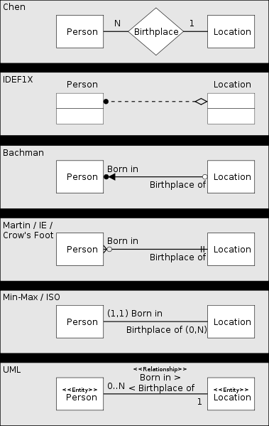
Different notations
Source wikipedia:
Various methods to represent the same one to many relationship:

Slide 23
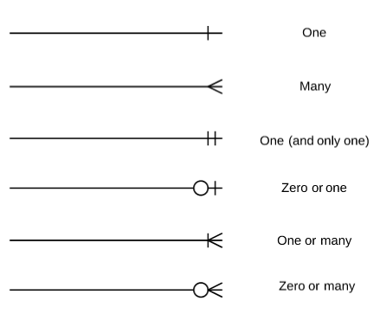
E/R Model - crow foot multiplicity notation
Notation style for multiplicity
23

Slide 24
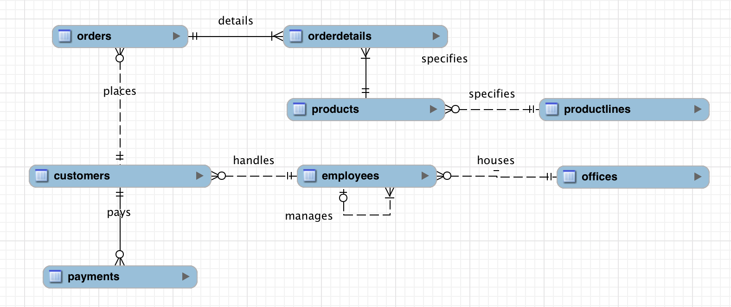
Relationship - 1

Slide 25
Relationship - 2
0-M relation reads:
Each product is specified by a product line
Each product line specifies more product (or none)

Slide 26
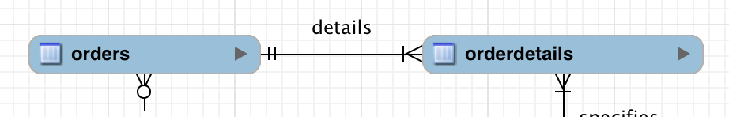
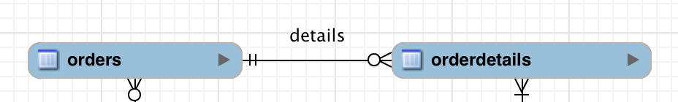
Relationship 3
Watch out for 1-M relationship compared to 0-M relationship when one is a weak entity
You need to create at least one detail when the order is created. Often the order is created first, and details afterwards .
You could instead use this model instead in the database:
And let the application make sure that all orders have at least one order detail (transaction handling).

Slide 27
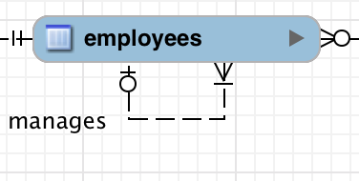
Relationship 4
In the model a relationship refers to the same table:
Is this correctly modelled?

Slide 28
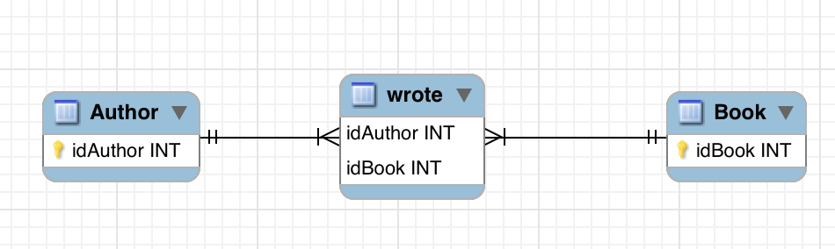
Many to Many Relationship
A library database has a table for authors and a table for books.
An author can write many books and a book can be written by many authors.
The relationship “wrote” is a many-to-many multiplicity, but it cannot be done without an extra mapping table in the database:

Slide 29
Database Design Exercise (work in pairs)
Make a model of the library as specified by the file ”library-system.pdf”
The model must be drawn in MySQL workbench. and hereafter created as a database.
Insert a borrower and a few materials into the database. Let the borrower borrow one material and let him/her make two reservations.
Make a SQL statement that can show a borrower’s name and the material title of all his/hers reservations

Slide 30
Extra: Reverse Engineering Exercise
Diagrams can be made based on an existing database.
Useful when:
You don’t have the model already
You have changed the database, but not the model
Be careful with 0/1 – M relationships – it is not certain that it is done properly when you reverse engineer a database into a model
Exercise
Make a reverse engineering of classicmodels database
See: https://dev.mysql.com/doc/workbench/en/wb-reverse-engineer-live.html
Adjust the diagram so it makes the most sense (= because a useful artifact)

