Slide 1

Truck Platooning
Mechatronic System Engineering Project
Guided by Prof. Dr. Stefan Henkler
Summer 2021
Team 1

Slide 2
Agenda
Motivation
CONSENS Method
Software Model
Cognitive Operator
Implementation
Learning Outcomes

Slide 3

1. Motivation
Problem
Solution

Slide 4
Problem
Source: OECD/ITF. ITF Transport Outlook 2017. Technical report, OECD, 2017
Source: icct

Slide 5
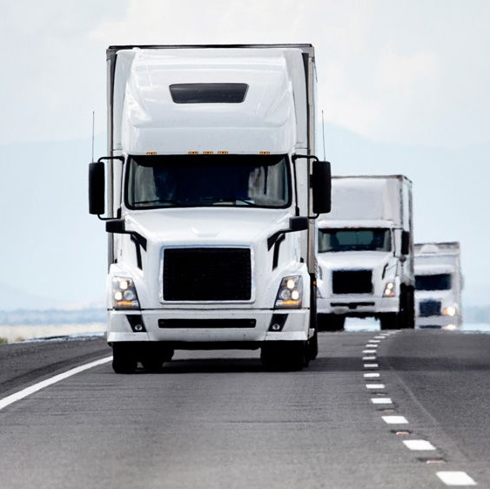
Solution
Fewer traffic collisions.
Shorter commutes during peak periods.
Some systems have failed due to remote computer hacking.
Fuel economy due to reduced air resistance
On longer highway trips, vehicles are unattended whilst in following mode.
Potential Disadvantages
Potential Benefits
Platooning

Slide 6




Information and Communication Technology in Transportation Systems
Automated Highway Systems
Connected Personal Rapid Transit
V2V/V2X-enabled Automation
On-Board Automation
Connectivity
Intelligent Infrastructure
Collision Avoidance and Mitigation
Automated Parking
Adaptive Cruise Control
Traffic Jam Assist
Automated Vehicle-Enabling
Infrastructure (Standardized Signage, Lane Markings, Digital Maps, etc.)
V2V-based Cooperative Automation
GNSS/Cloud-enabled Automation
Platooning, CACC
Coordinated Platooning
Remote Traffic Monitoring
Roadside Weather Stations
Adaptive Signal Control
Incident Detection and Response
Dynamic Message Signs
Reconfigurable Lanes
Smart Parking
GNSS Navigation
Embedded Cellular Voice and Data connection
Ride-sharing Systems
Infotainment
Telematics
Automated Tolling
Probe Vehicle Data for System Administration
Emergency Vehicle Signal Preemption
Transit Vehicle Signal Priority
V2I-enabled Warnings and Messages
Source: A. Spulber. Impact of Automated Vehicle Technologies on Driver Skills. Connected Auto, Fall 2016:46–57, Nov. 2016.

Slide 7

2. CONSENS Method
Environment Model
Requirement
Functions
Active Structure
Application Scenario

Slide 8
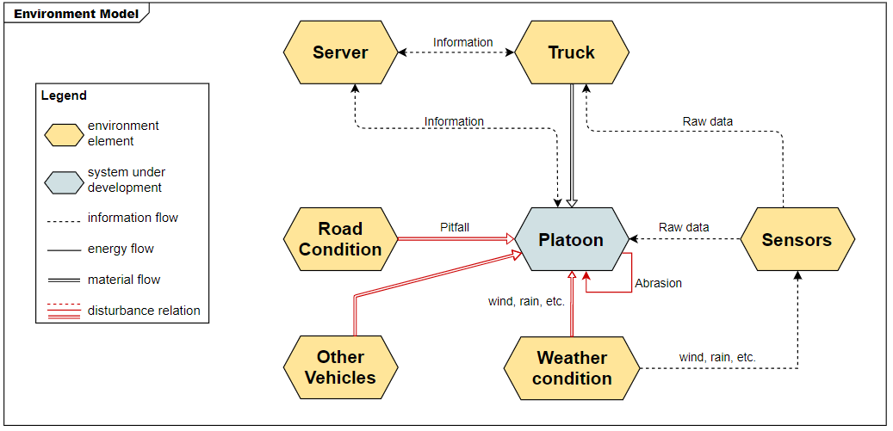
Environment Model

Slide 9
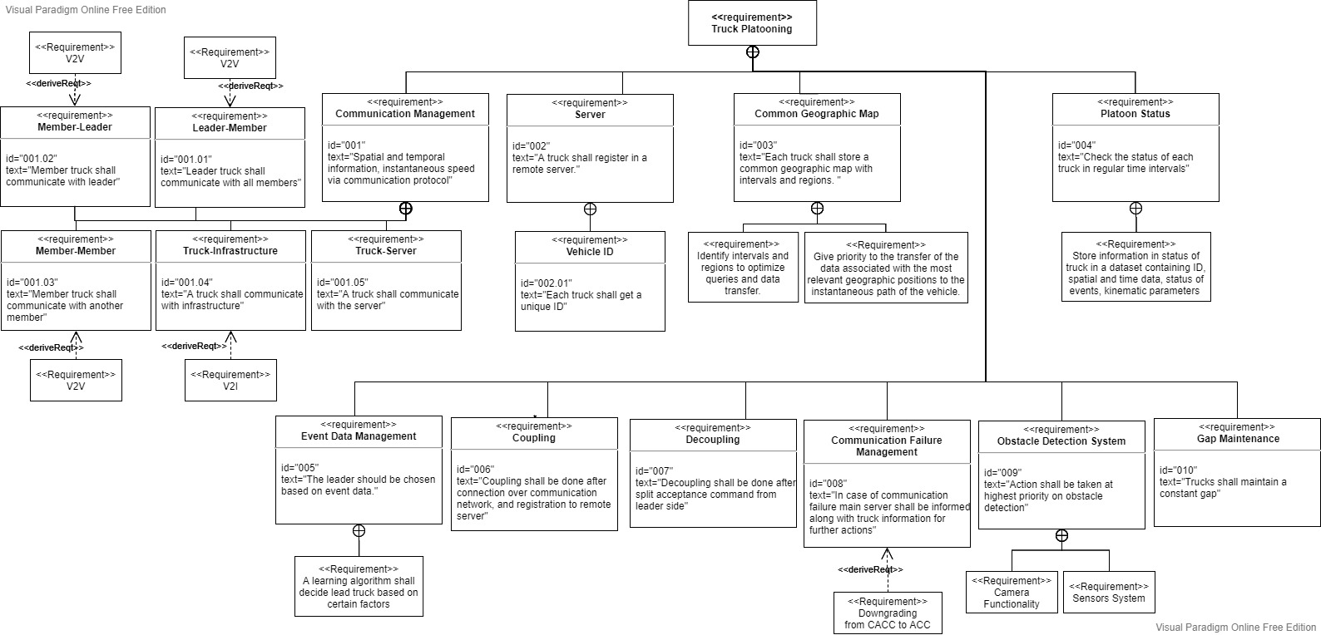
Requirement

Slide 10
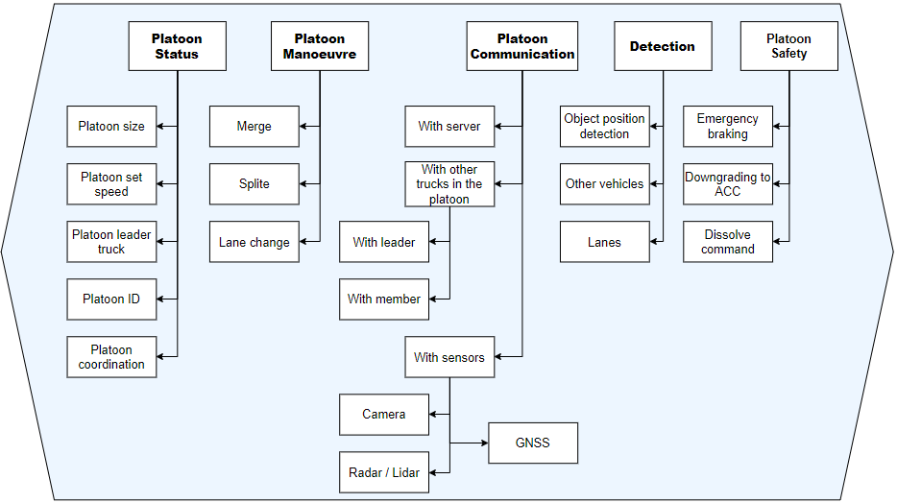
Function Hierarchy

Slide 11
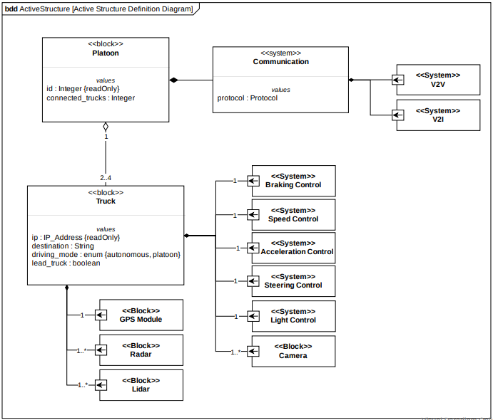
Active Structure

Slide 12
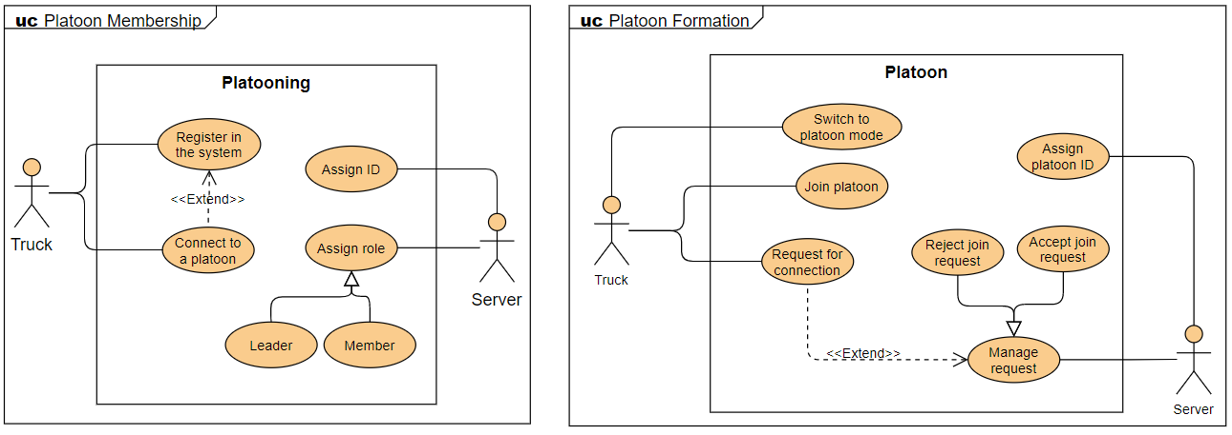
Application Scenario

Slide 13
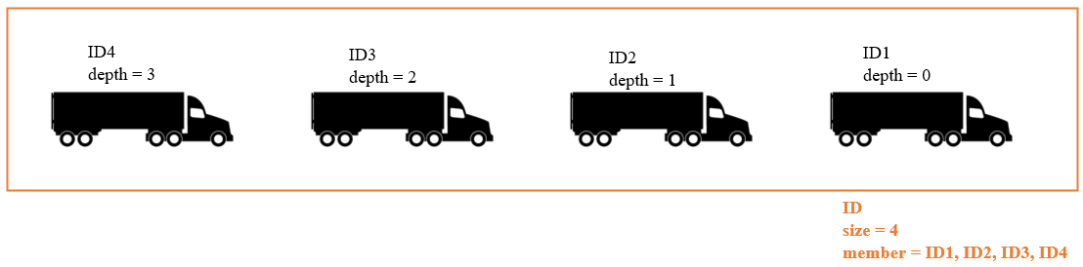
Variables
Variables are assigned by registration
Vehicle ID: unique string → Static
Platoon ID: unique string → Static
Platoon size: > 1 && < 5 → Dynamic
Platoon depth: > 0 → Dynamic
Platoon members: all vehicle IDs in a platoon → Dynamic

Slide 14
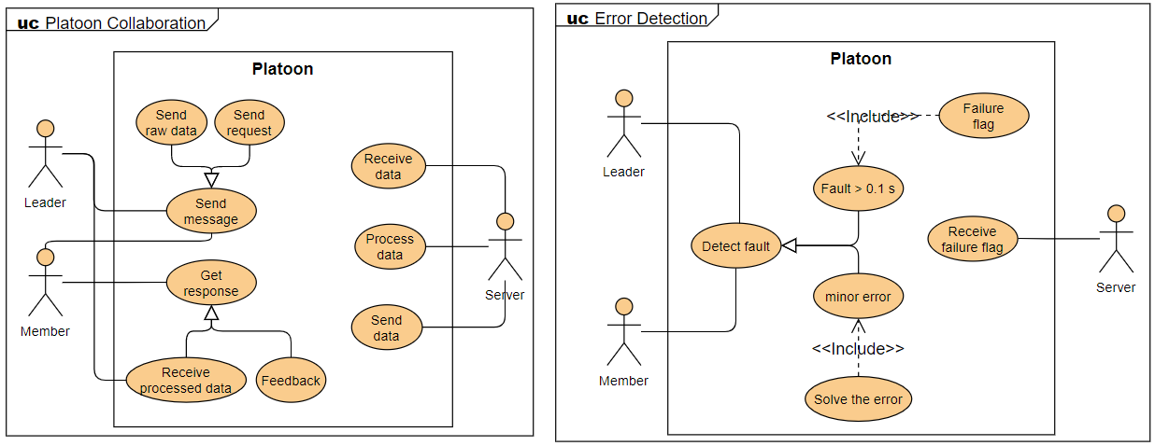
Application Scenario

Slide 15

Communication Failures
Effect of communication failure on CACC controller: Failure to receive data for 0.1s generates the communication failure flag in CACC controller.
- Downgrading from CACC to ACC is a solution.
The leader wants to leave but due to communication failure, no response is received from followers to take over the platoon leader role.
- As a result, the platoon leader breaks-up the platoon by using a DISSOLVE command.

Slide 16
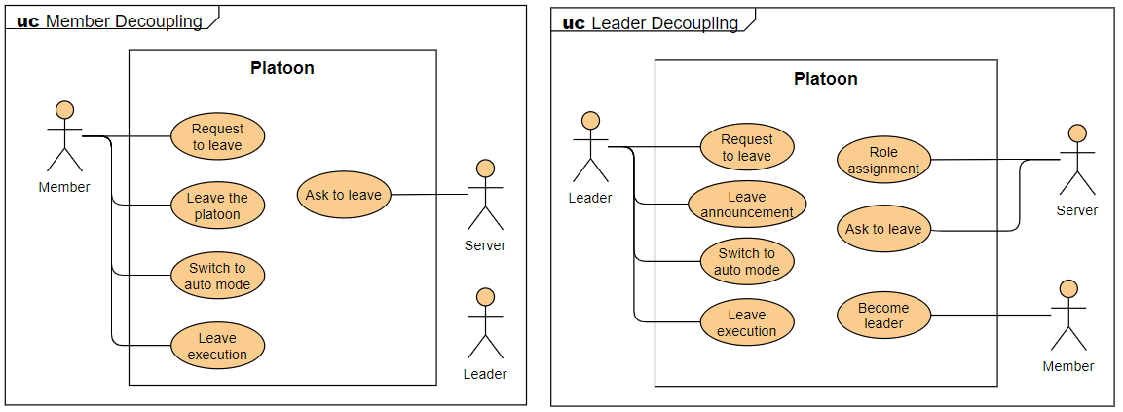
Application Scenario

Slide 17
Scenarios
Leader leaves the platoon:
Leave announcement: assign leader role to the second vehicle
Leave execution: Split + Lane Change +Merge
Follower leaves the platoon:
Leave request/response
Leave execution: Split + Lane Change + Merge

Slide 18

3. Software Model
MUML Techniques
Architecture
Communication
Behavior

Slide 19
MUML Techniques
Modeling of the Structure
Component Diagram
Modeling of the Behavior
Real-Time State-charts
Formal Verification
UPPAAL

Slide 20
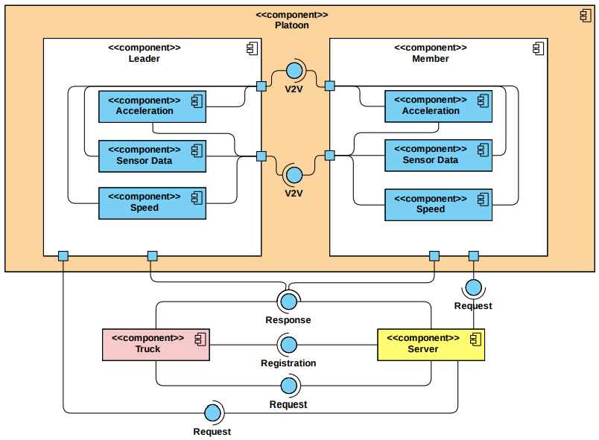
Component Diagram

Slide 21
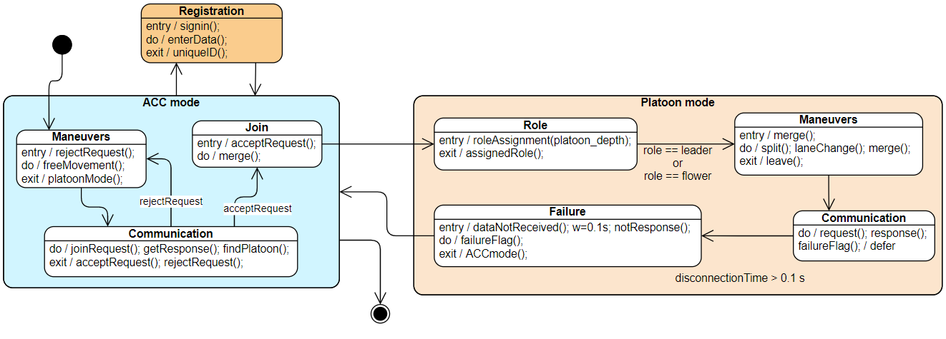
Real-Time State-Charts

Slide 22
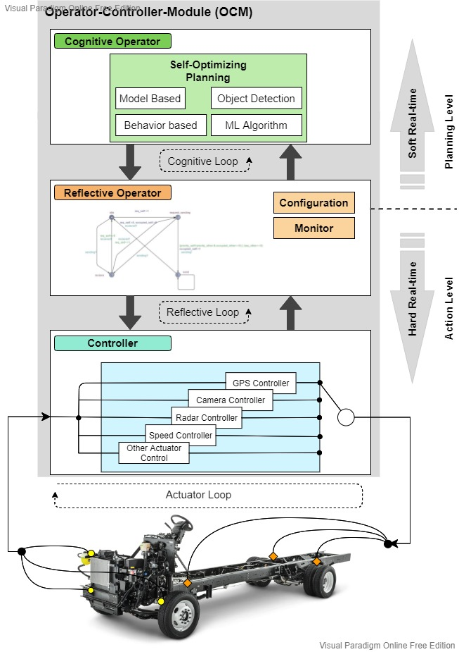
Architecture
OCM Model

Slide 23




Communication
GNSS
V2I
V2I
V2V
Camera
Radar / Lidar

Slide 24
Micro-Commands
 | Micro-command | Description | Sender / Receiver
1 | MERGE_REQ (U) | Asking to merge into a platoon | A vehicle in ACC mode to a platoon leader
2 | MERGE_ACCEPT (U) | Accepting merge request | The platoon leader in reply to MERGE_REQ
3 | MERGE_REJECT (U) | Rejecting merge request | The platoon leader in reply to MERGE_REQ
4 | MERGE_DONE (U) | Notifying the merge completion | Old vehicle in ACC mode to the platoon leader
5 | SPLIT_REQ (U) | Split the platoon into two parts | Platoon leader to a member
6 | SPLIT_ACCEPT (U) | Accepting split request | Member to the platoon leader in reply to SPLIT_REQ
7 | SPLIT_REJECT (U) | Rejecting split request | Member to the platoon leader in reply to SPLIT_REQ
8 | SPLIT_DONE (U) | Notifying the split completion | Member to the platoon leader
9 | LEAVE_REQ (U) | Member, asking to leave the platoon | Member to the platoon leader
10 | LEAVE_ACCEPT (U) | Accepting leave request | Platoon leader to the member in reply to LEAVE_REQ
11 | LEAVE_REJECT (U) | Rejecting leave request | Platoon leader to the member in reply to LEAVE_REQ
12 | NEW_LEADER (U) | Assigning a new leader role | Current platoon leader to the second member
13 | DISSOLVE (M) | Accepting the new platoon leader role | The second member to the current platoon leader
14 | CHANGE_PL (U or M) | Announcing the new platoon leader | Current platoon leader to all its members
15 | ACK (U) | Acknowledging the message reception | The receiving entity to the sending entity
Micro-Commands used in platoon management protocol.
U: Unicast, M: Multicast, B: Broadcast

Slide 25
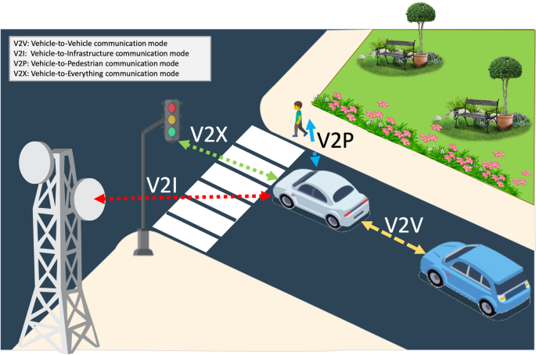
Protocol
V2X
V2V
V2I
V2P
Source: A tutorial survey on vehicle-to-vehicle communications

Slide 26
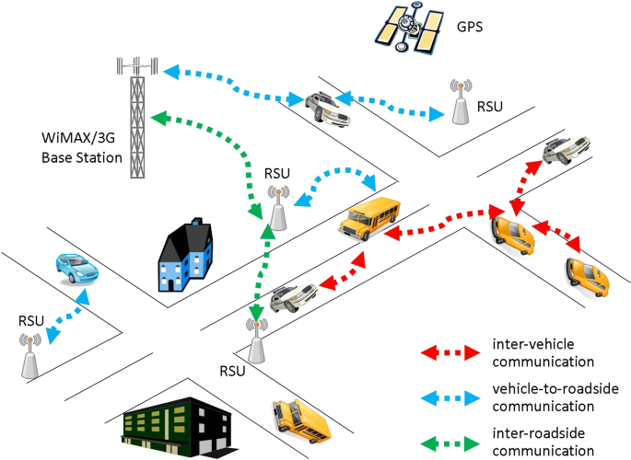
Protocol
VANET
Vehicular ad hoc networks
Source: A tutorial survey on vehicle-to-vehicle communications

Slide 27
Control Behavior
Maneuvers are coordinated by a structured exchange of messages among relevant neighboring vehicles or Road-Side Units (RSUs).
Can happen at any points, only allow one maneuver at a time.
Merge: Merge request + Merge response + Merge execution
Split: Split request + Split response + Split execution
Lane change
All complex maneuvers are the combinations of these three.

Slide 28
Cognitive Operator
Clustering Algorithm
Unlabeled dataset of 30 trucks.
k-means based on maximum match of route and speed profile.
Formed clusters as platoons.
Assigned leader role to truck nearest to centroid in each cluster and follower role to others.

Slide 29
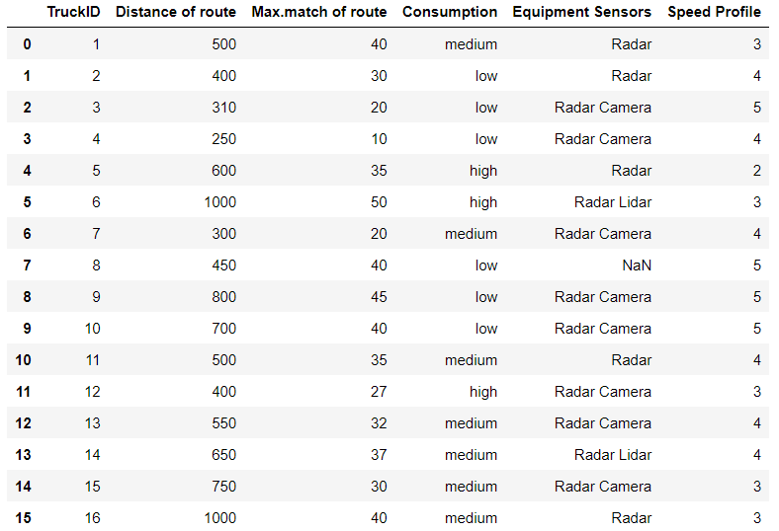
Cognitive Operator
Initial Dataset

Slide 30
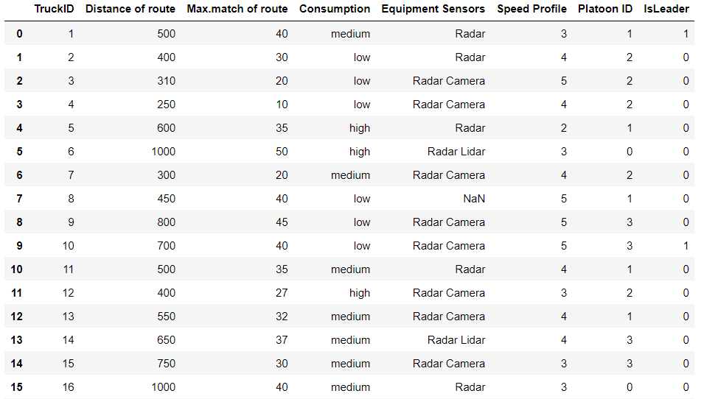
Cognitive Operator
Results in IsLeader column after applied algorithm.

Slide 31
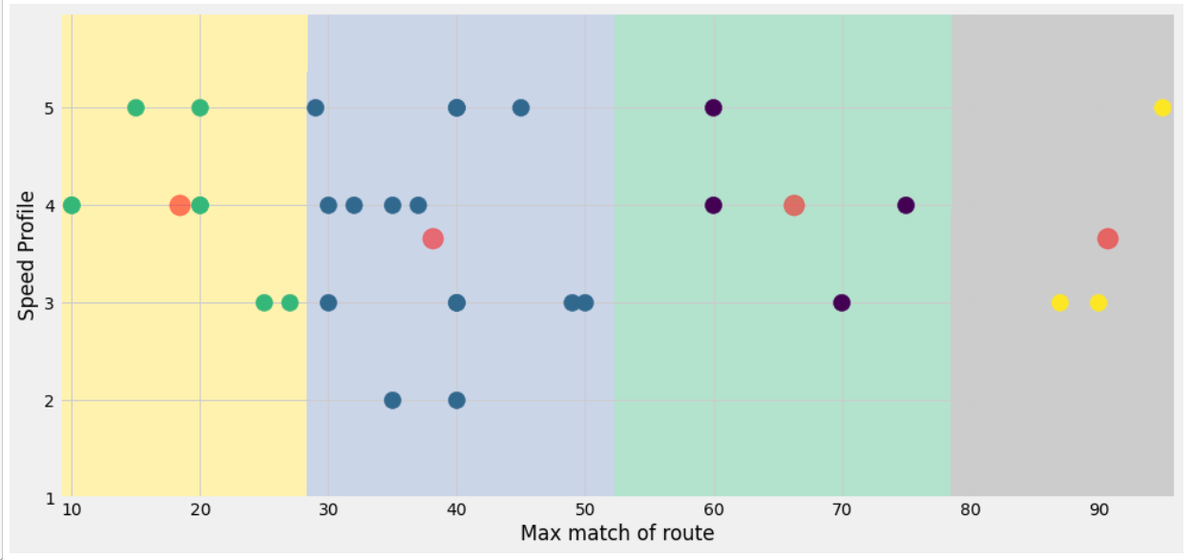
Cognitive Operator
Results in IsLeader column after applied algorithm.

Slide 32

State Modeling and Verification
UPPAAL

Slide 33
Implementation
Carla

Slide 34

Learning Outcomes
We were able to:
adopt CONSENS Method.
make a software model by MUML Techniques, architecture, communication and behavioral modeling.
model through UPPAAL.
implement Machine Learning algorithm.
simulate through Carla.
code in Python.

Slide 35
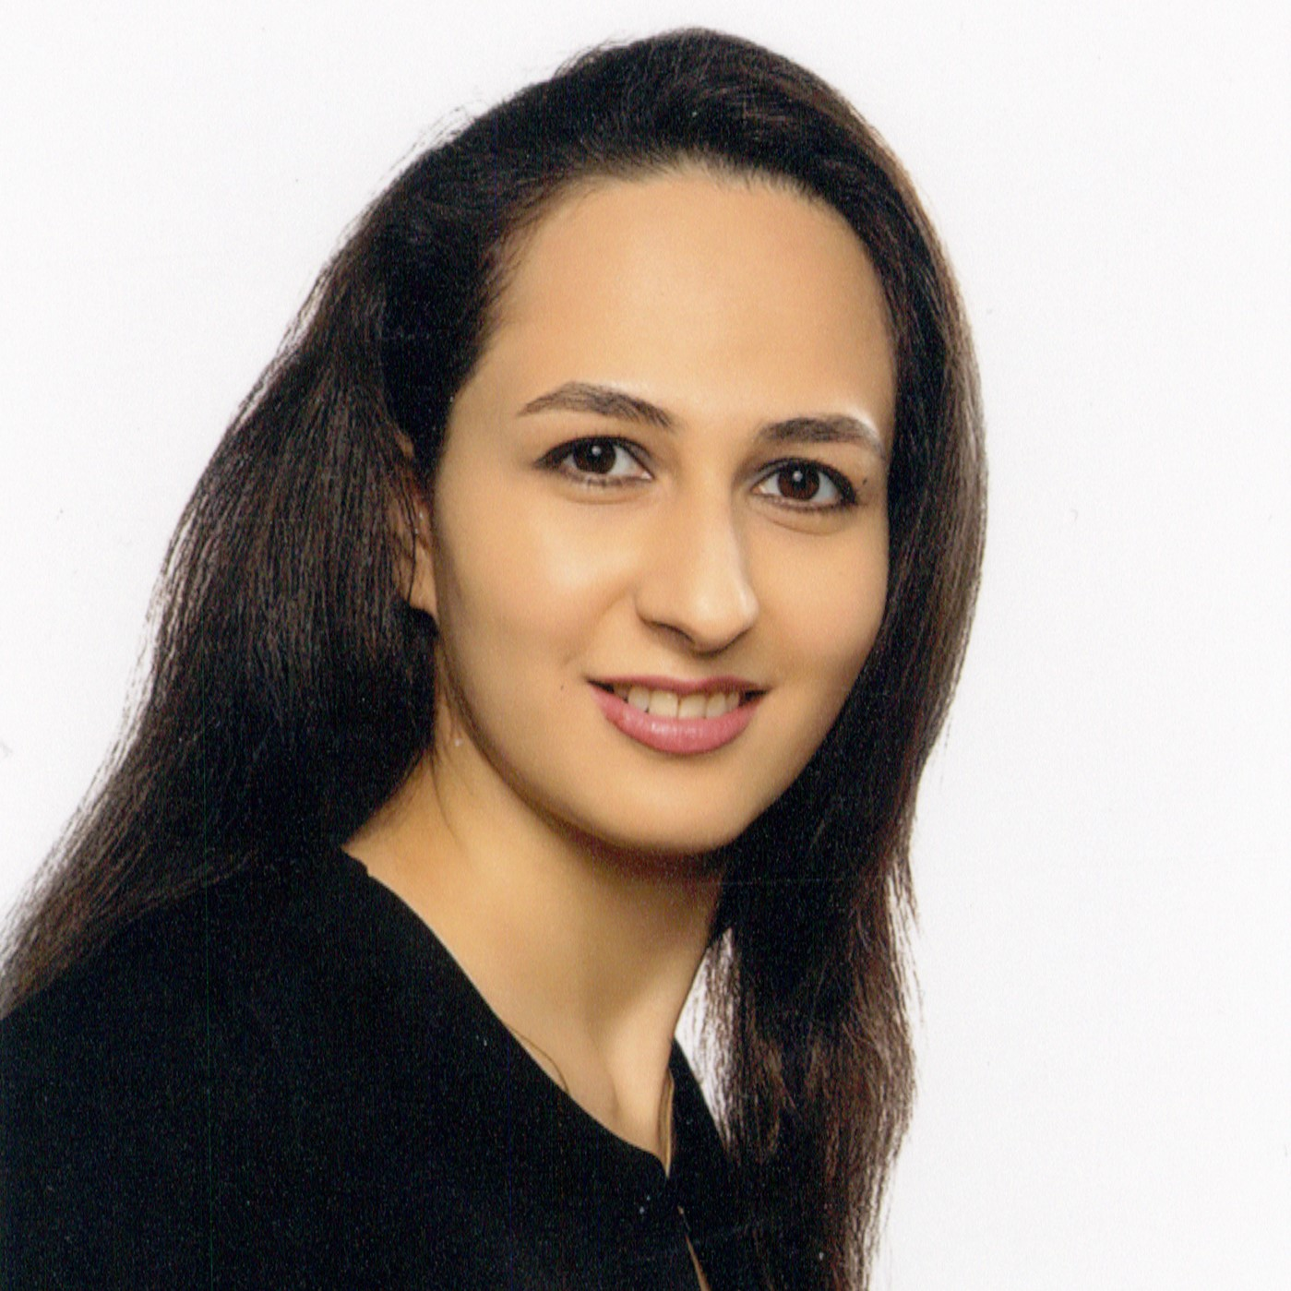
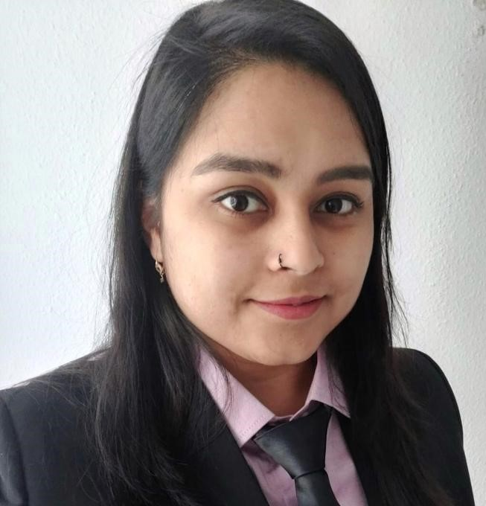

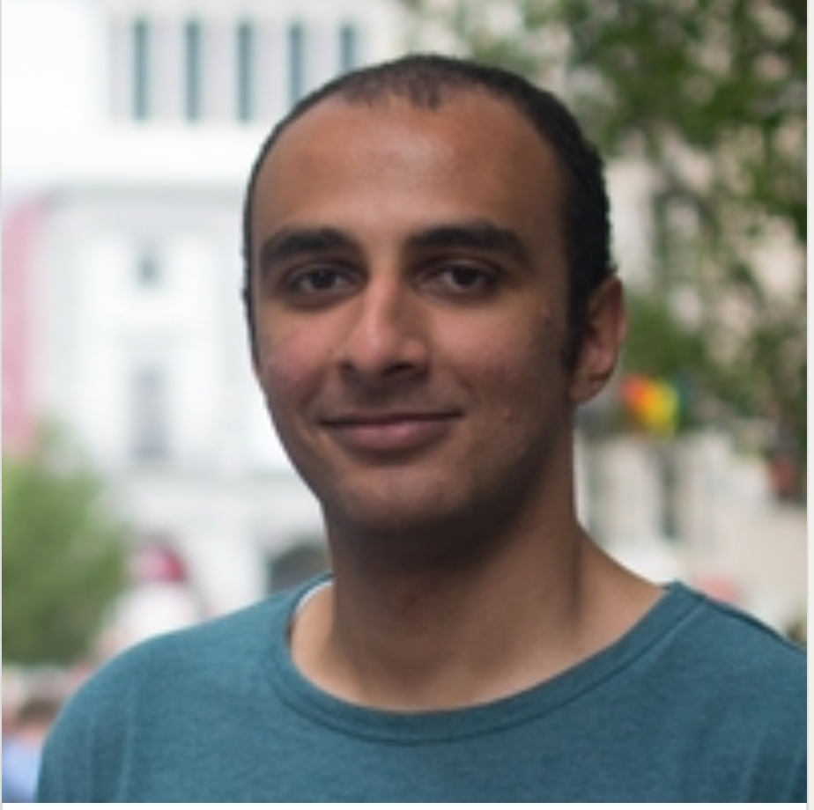

TEAM 1
Marjan Farazandeh
7209945
Diksha Rani
7209804
Ibrahim Ahmed
7209808
Mohamed Abdulmaksoud
7210382
MSE-Project

Slide 36
THANK
YOU

