Slide 1

Pharmacy Wait Times
Data 604 – Simulation
Final Project
Marjete Vucinaj
July 2023

Slide 2
Introduction
- Simulation can help predict, or better explain the impact of changes within a system, such as how adjusting staffing levels might influence outcomes. - Discrete event simulation (DES) is a sequence of events in time which influence the state of the system. - The goal of this project is to use DES to predict how staffing and medication readiness impact how quickly customers can pick up their medication at the pharmacy.

Slide 3
Problem & Significance
Problem: After visiting a health provider, many folks might be perscribed medication, then when they visit their local pharmacist to collect their medication, they are faced with unusually long wait times.
Significance: Customer satisfaction and their overall experience is poor especially when they may be unwell or in urgent need of their medication. This might even result in financial losses for the pharmacy if dissatisfied customers choose to switch to competing pharmacies and if their repuatation diminishes. More importantly, obtaining medication in a timely manner is a key indicater with how compliant a patient is to adhereing to their medication, so if the customer were to be impatient and leave the line without their medication this would result in harm to their health.

Slide 4
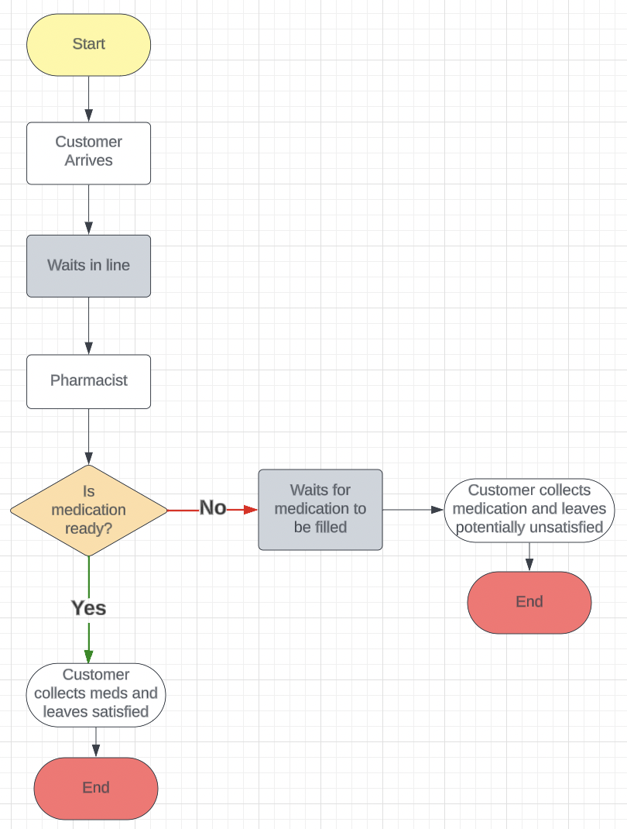
Flow-chart model
Some step by step in python
load library ->
Initialize Environment / Create Pharmacy environment ->
Define Pharmacy class ->
Define pick_up_medication() function ->
Define record_waiting_time() function ->
Define customer() function ->
Define generate_customers() function ->
Define run_simulation() function
Initialize results dictionary
Iterate over num_pharmacists_list
Plot average waiting times
Plot waiting times for medication ready or needs filling

Slide 5
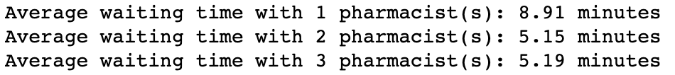
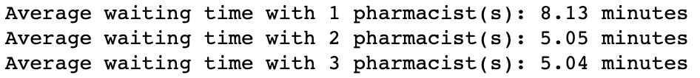
Simulate the process for the appropriate number of iterations (justify)
The results above are from the pharmacy model of 20 iterations and the code below shows the the result of the same code with 100 iterations. The average waiting time is about the same per pharmacist and shows diminishing changes with additional iterations therefore that 20 is a sufficient number of iterations.

Slide 6
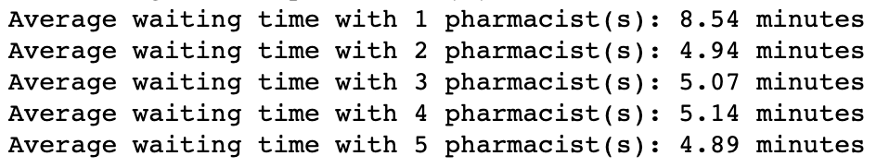
Justify the validity of the model and discuss how you verified it.
Validity: The assumptions my model makes are aligned with real life scenarios. Ideally, I would perform a statistical test to demonstrate this but I do not have raw data to compare it to. In concept, the model assumes that were there are more staff there is less wait time and where there are additional steps, such as waiting for the rx to be filled, then the wait time will be longer than if it was ready to go. The validity could probably be improved as it does not included issues with insurance or if there's is no record of the medication being sent, which happens in the real world but is not accounted for in my model.
Verification: One way to verify my model is to compare it to real data, and based on historical data such as research articles (source on last slide), my model produces reasonable results. In the code below, I also preformed a sensitivity analysis parameters with more pharmacists. Based on these observations, it seems that increasing the number of pharmacists can have a substantial impact on reducing the average waiting time. However, after reaching a certain threshold (in this case, around 2 pharmacists), the additional benefit of adding more pharmacists becomes minimal. By having three pharmacists in my simulation, it still shows similar data that after two pharmacists are staffed, additional workers do not result in a significant time decrease.

Slide 7
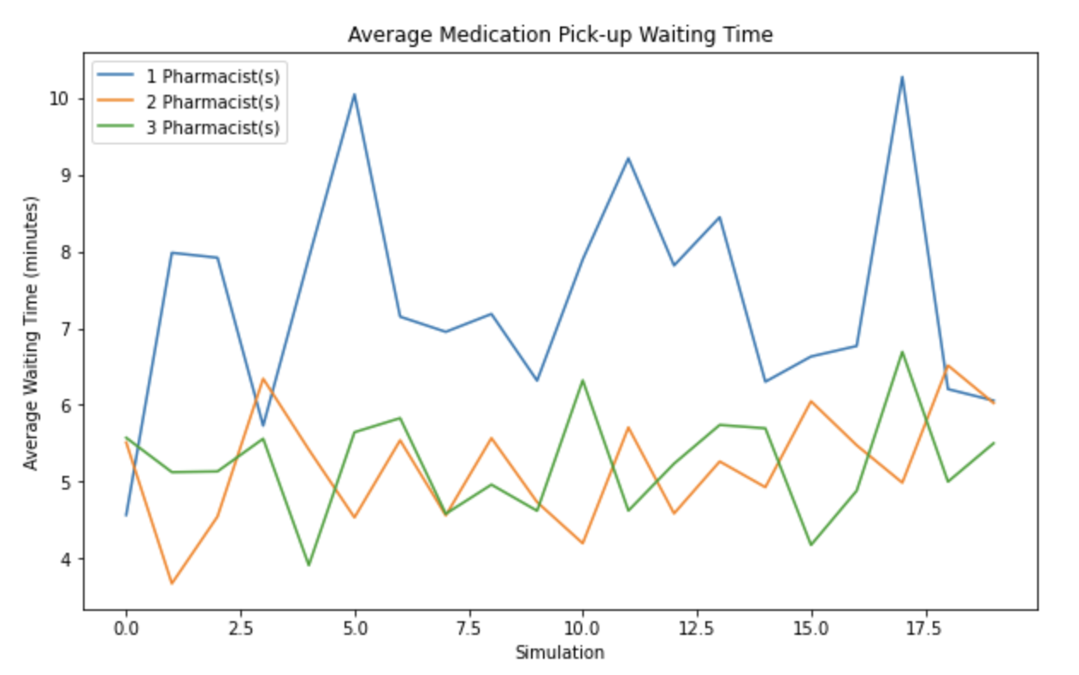
Visualizations

Slide 8
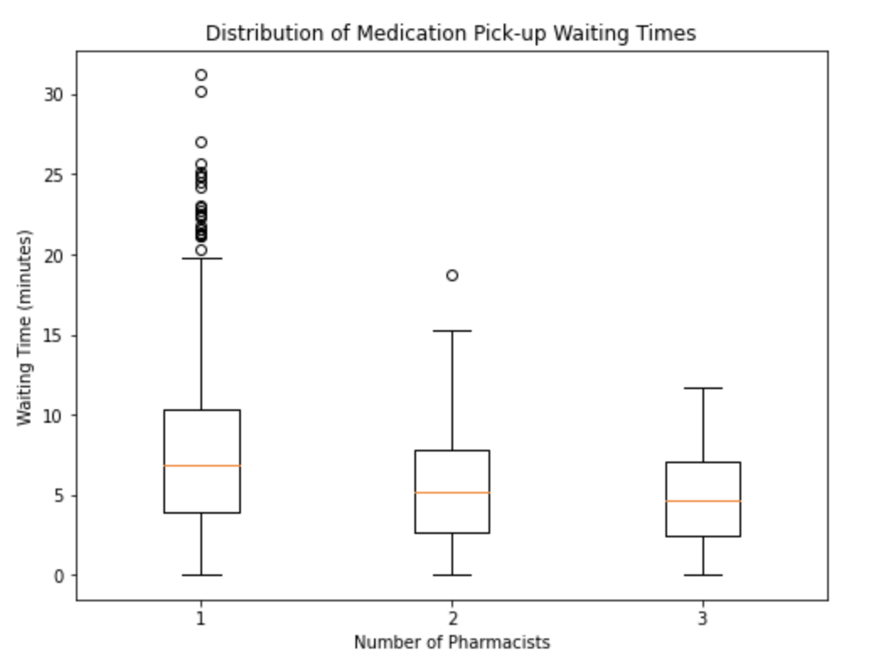
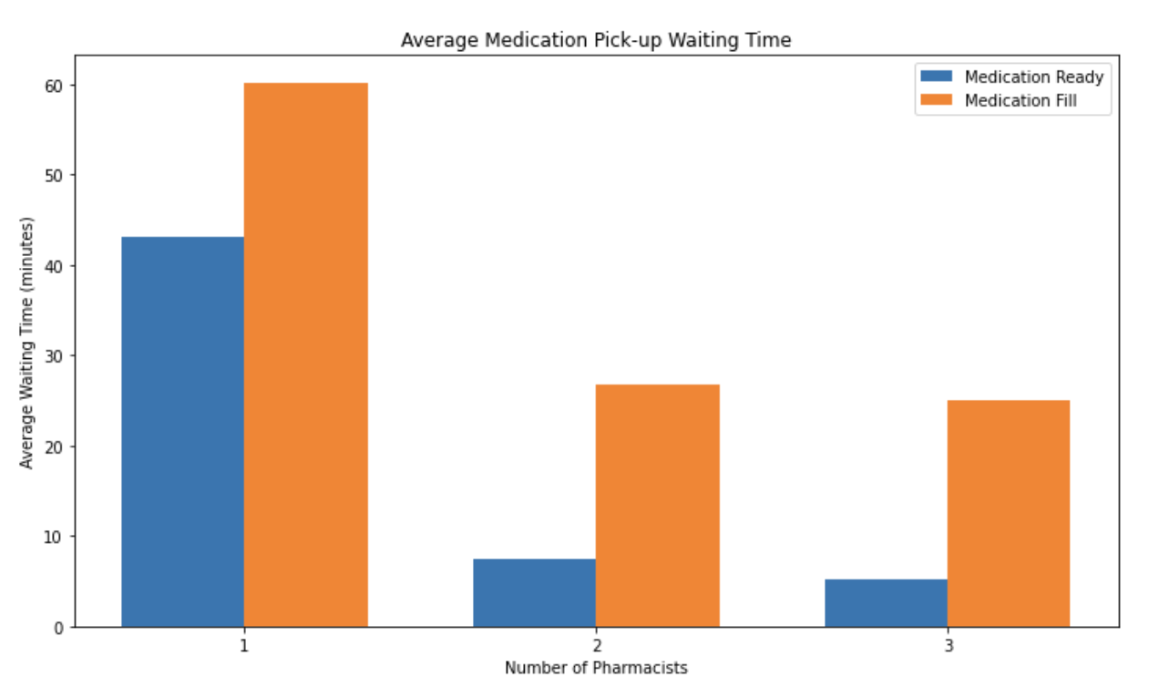
Visualizations

Slide 9
Conclusion
Reducing wait time for medication pick up at the pharmacy is important to ensure customer satisfaction and medication compliance and adherence.
The model simulated the wait time for 30 customers who arrive to the pharmacy to collect their medication. The model created adds in variables for one to three staff working and for customers' medication status: ready or needs to be filled, requiring more wait time.
The result of the model shows (1) wait time is longer when medication is not ready, and (2) there is a significant decrease in wait time from one staff working to two staff working; when there were 3 pharmacists are on shift the average wait time is about the same as two staff members. Additionally, if we look beyond the average wait time and break down the wait time for meds ready or needing to be filled, the same pattern is present.
Limitations: I did not want to over-complicate the model, but one limit was not going back to add in more variables such as the wrong medication being sent to the pharmacy, or insurance issues. In retrospect I wish I had the time to find a similar dataset with real data to do statistical comparisons and further validate the model.

Slide 10
Reference
Example of resource to show validity
https://onlinelibrary.wiley.com/doi/full/10.1111/j.1553-2712.2011.01249.x
Thank you!!

