Slide 1

Pharmacy Wait Times
Python Project
Marjete Vucinaj

Slide 2
Introduction
- Simulation can help predict, or better explain the impact of changes within a system, such as how adjusting staffing levels might influence outcomes. - Discrete event simulation (DES) is a sequence of events in time which influence the state of the system. - The goal of this project is to use DES to predict how staffing and medication readiness impact how quickly customers can pick up their medication at the pharmacy.

Slide 3
Problem & Significance
Problem: Patients experience prolonged wait times at local pharmacies when collecting prescribed medications.
Significance: Customer satisfaction and their overall experience is poor especially when they may be unwell or in urgent need of their medication. This might even result in financial losses for the pharmacy if dissatisfied customers choose to switch to competing pharmacies and if their reputation diminishes. More importantly, obtaining medication in a timely manner is a key indicator with how compliant a patient is to adhering to their medication, so if the customer were to be impatient and leave the line without their medication this would result in harm to their health.

Slide 4
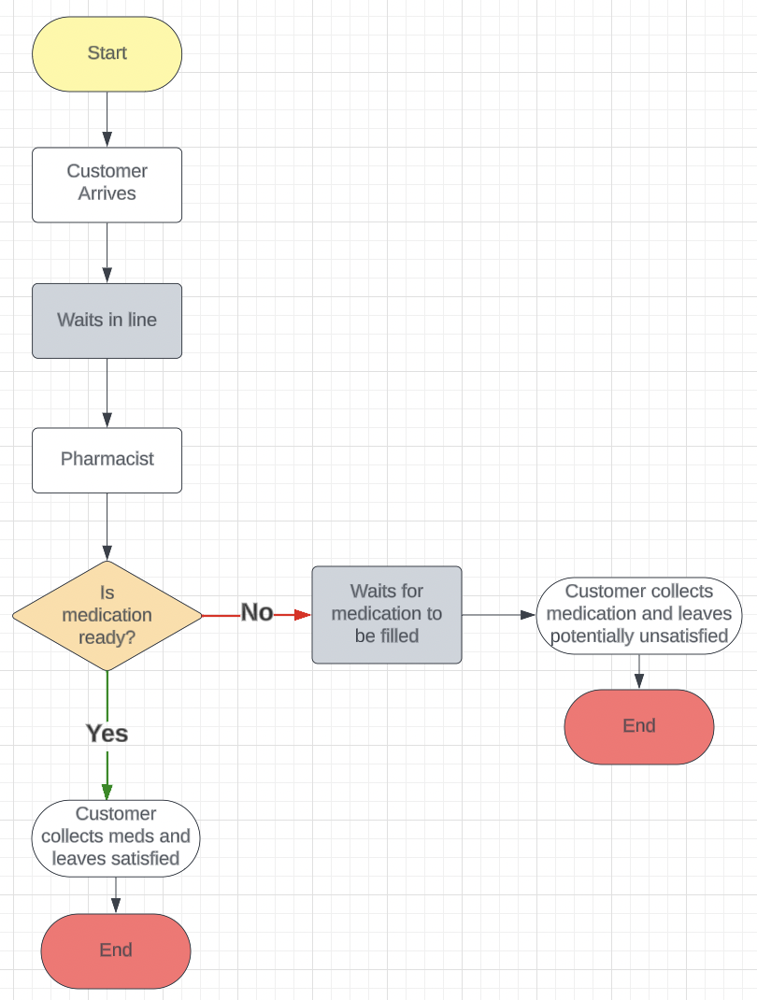
Flowchart Model
Some step by step in python
load library
Initialize Environment / Create Pharmacy environment
Define Pharmacy class
Define pick_up_medication() function
Define record_waiting_time() function
Define customer() function
Define generate_customers() function
Define run_simulation() function
Initialize results dictionary
Iterate over num_pharmacists_list
Plot average waiting times
Plot waiting times for medication ready or needs filling

Slide 5
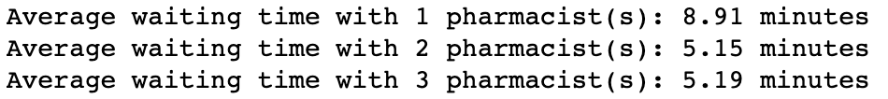
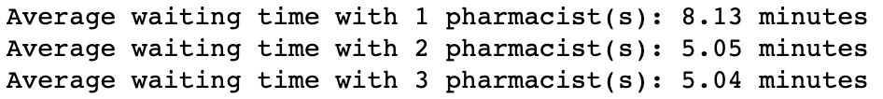
Simulate the process for the appropriate number of iterations (justify)
The results (to the right) are from the pharmacy model of 20 iterations and the code below shows the the result of the same code with 100 iterations. The average waiting time is about the same per pharmacist and shows diminishing changes with additional iterations therefore that 20 is a sufficient number of iterations.

Slide 6
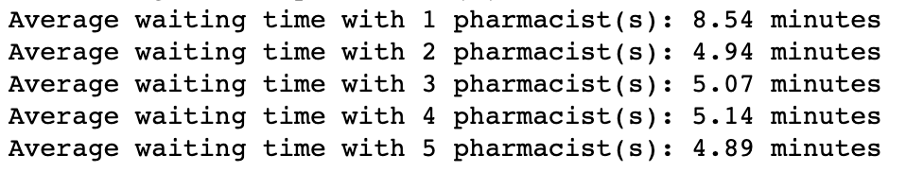
Justify the validity of the model and discuss how you verified it.
Validity:
The model aligns with real-life scenarios, assuming more staff reduces wait time and additional steps (e.g., prescription filling) increase it. However, it lacks considerations for insurance issues and missing prescription records, which occur in reality.
Verification:
Comparing to historical research suggests the model produces reasonable results. Sensitivity analysis shows adding pharmacists reduces wait times, but beyond two pharmacists, additional staff provide minimal improvement.

Slide 7
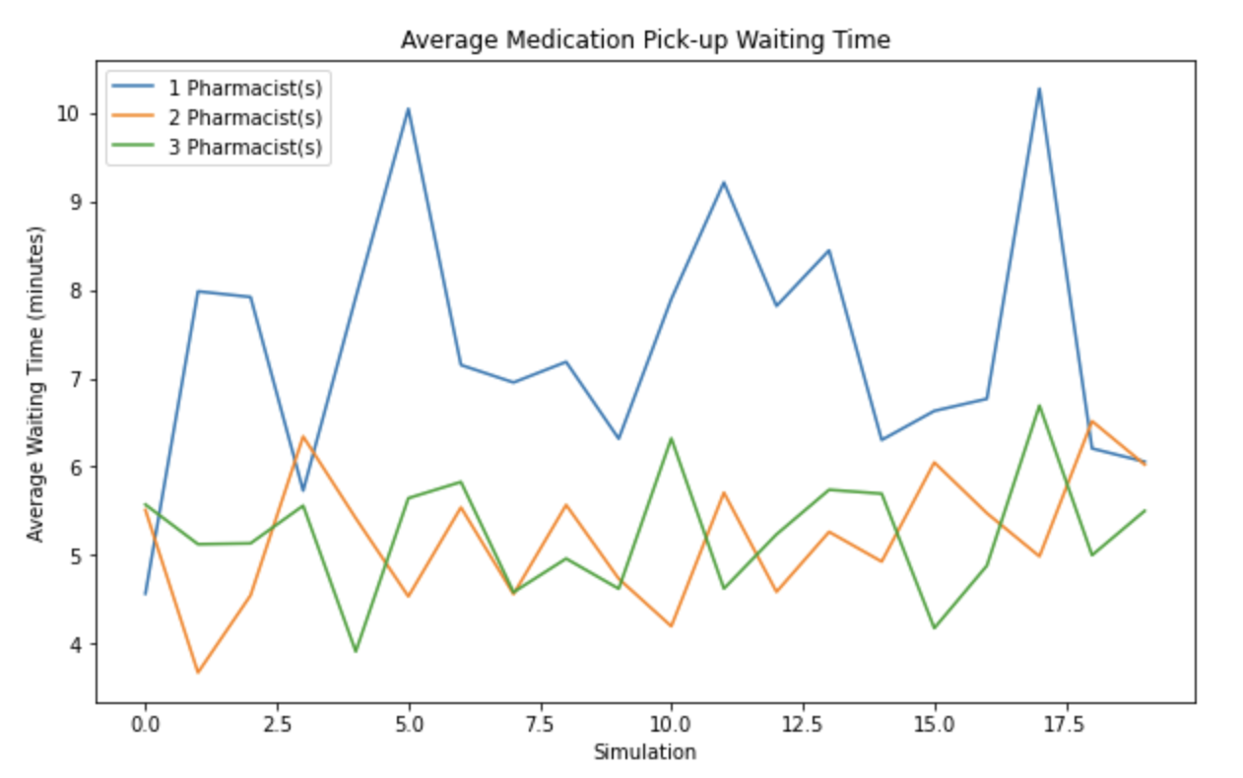
Visualizations

Slide 8
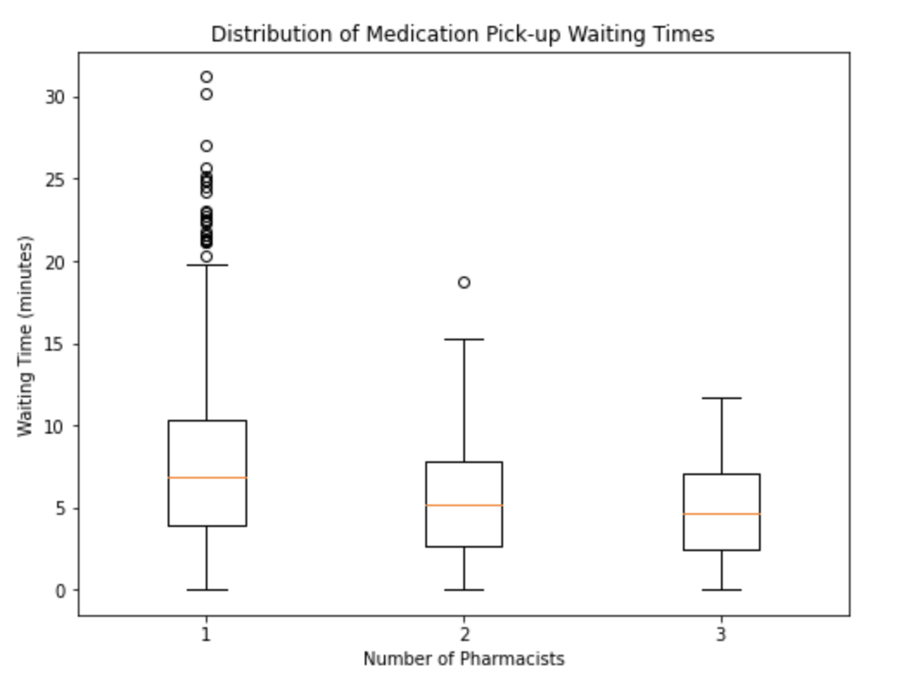
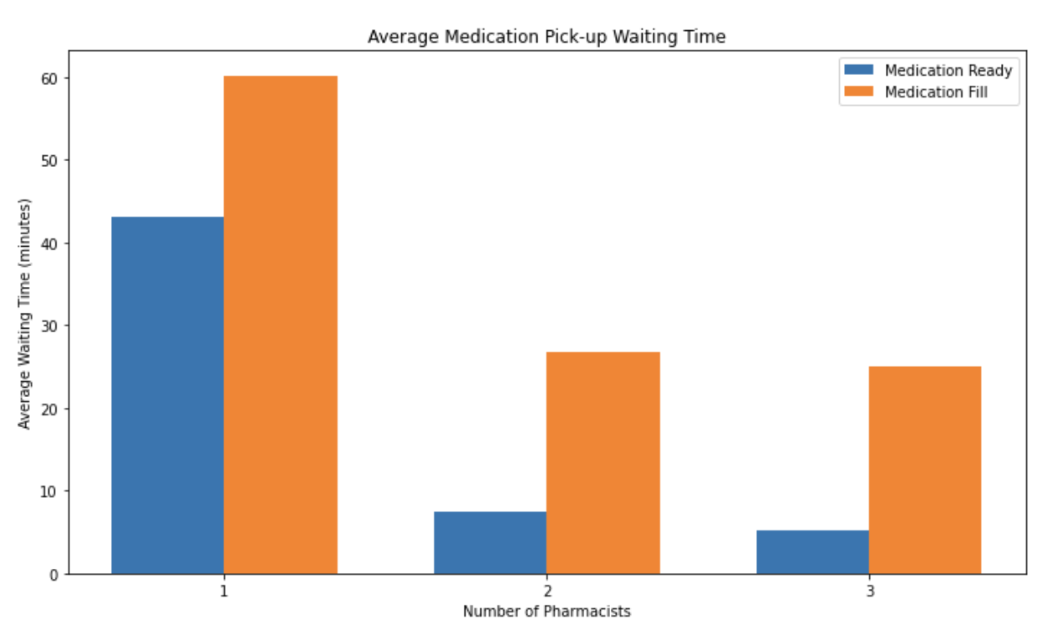
Visualizations

Slide 9
Conclusion
Reducing wait time for medication pick up at the pharmacy is important to ensure customer satisfaction and medication compliance and adherence.
The model simulated the wait time for 30 customers who arrive to the pharmacy to collect their medication. The model created adds in variables for one to three staff working and for customers' medication status: ready or needs to be filled, requiring more wait time.
The result of the model shows (1) wait time is longer when medication is not ready, and (2) there is a significant decrease in wait time from one staff working to two staff working; when there were 3 pharmacists are on shift the average wait time is about the same as two staff members. Additionally, if we look beyond the average wait time and break down the wait time for meds ready or needing to be filled, the same pattern is present.
**Limitations:** I did not want to over-complicate the model, but one limit was not going back to add in more variables such as the wrong medication being sent to the pharmacy, or insurance issues. In retrospect I wish I had the time to find a similar dataset with real data to do statistical comparisons and further validate the model.

Slide 10
Reference
Example of resource to show validity
https://onlinelibrary.wiley.com/doi/full/10.1111/j.1553-2712.2011.01249.x
Thank you!!

