Slide 1

This is my presentation
Sorsogon State University - Bulan Campus
Bulan, Sorsogon City
S.Y.: 2021-2022
Submitted to:
Mr. Jason Glina
Submitted by:
Marjorie F. Jetajobe
Bachelor of Science in Information Technology (2A)

Slide 2

Advantages and
Disadvantages of the ff:
1
2
3
4
5
6
7
Batch Operating System
Multitasking/Time Sharing OS
Multiprocessing Operating System
Real Time Operating System
Distributed Operating System
Network Operating System
Mobile Operating System

Slide 3
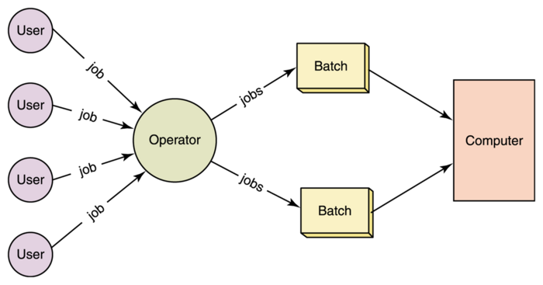

Did you
know?
image source: https://padakuu.com/article/27-batch-operating-systems
Batch Operating System
Groups jobs that perform similar type of function and these groups are called “Batch”.
The 1st operating system (2nd generation computer).
It executes job by batches.

Slide 4
Batch OS
Advantages
Disadvantages
It reduce lot of manual work.
Fast execution
It is easy to manage large work repeatedly in batch systems.
The user does not interact with the computer directly.
It is hard to debug.
Batch OS is sometimes costly.

Slide 5
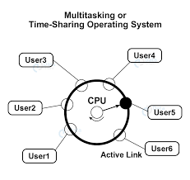
Did you
know?
image source: https://data-flair.training/blogs/wp-content/uploads/sites/2/2021/06/Time-Sharing-OS.jpg
Multitasking/Time Sharing Operating System
Multitasking is the execution of multiple task at a time.
Process is assigned some specific quantum of time. When the task is executed it is called as “Quantum”.
The allocation of computer resources in time slot to several program simultaneously.

Slide 6
Multitasking/Time Sharing OS
Advantages
Disadvantages
It improves response time.
Helps to reduce the CPU idle time.
It avoids duplication of software.
Improves response time.
It has reliability problem and data communication problem.
it needs special operating system because it consumes too much resources.

Slide 7
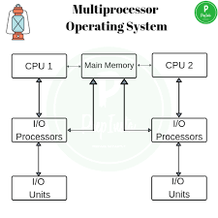
Did you
know?
image source: https://prepinsta.com/operating-systems/multiprocessor-operating-systems/
Multiprocessing Operating System
It is the use of two or more CPUs within a single computer system.
The ability of a system to support more than one processor within a single computer system.
Mainly two types of multiprocessors; symmetric and asymmetric multiprocessors.

Slide 8
Multiprocessing OS
Advantages
Disadvantages
System will not halt even one processor fails.
Number of processes getting executed per unit of time increase.
Cheaper because they share the data storage, peripheral devices, power supplies etc.
Multiple processors in a multiprocessor system that share peripherals, memory etc.
Larger pool of memory is required as compared to single processor systems.

Slide 9
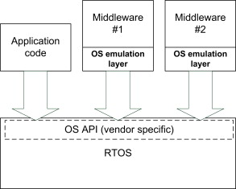
Did you
know?
image source: https://ars.els-cdn.com/content/image/3-s2.0-B9780128032770000205-f20-01-9780128032770.jpg
Real Time Operating System
It is used when there are time requirements that are very strict like missile systems, air traffic control systems, robots, etc,.
Software component that rapidly switches between tasks. There are two types the Hard Real-Time Systems and Soft Real-Time Systems.

Slide 10
Real Time OS
Advantages
Disadvantages
Takes less amount of time to shift from one task to another
Focusses on one application at a given time.
Completely free of errors, exhibits maximum results, and experiences very less downtime.
Designed to run only few of the tasks.
Program crashes can be frequently experience.
Constantly experiences signal interruptions.

Slide 11
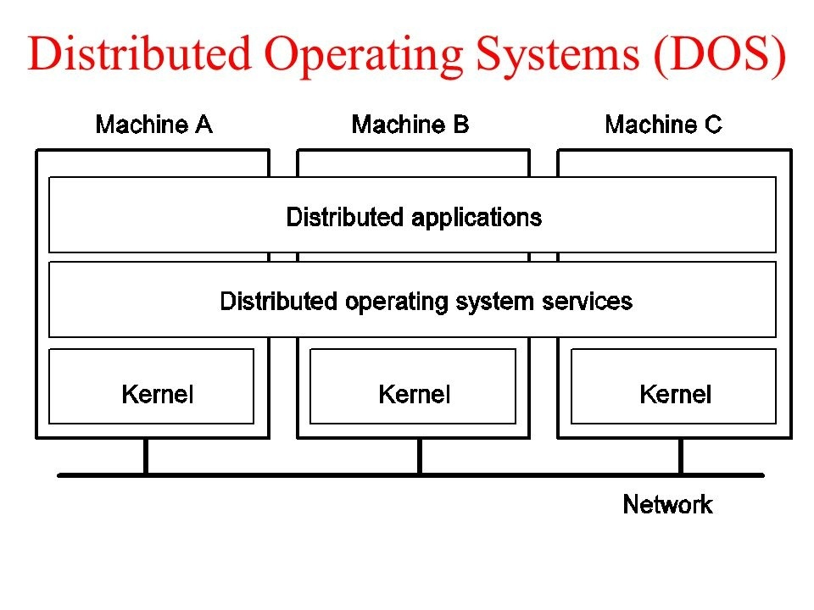
Did you
know?
image source: https://qph.fs.quoracdn.net/main-qimg-8535451db53faa2a4febd37df1c852a0-c
Distributed Operating System
Collection of independent, networked, communicating, and physically separate computational nodes.
Run and provide the capability to manage data, users, groups, security, applications, etc,.
It serve multiple real-time applications and multiple users.

Slide 12
Distributed OS
Advantages
Disadvantages
Give more performance than single system
More resources can be added easily
Resources like printers can be shared on multiple pc’s
Security problem due to sharing
Some messages can be lost in the network system
Bandwidth is another problem if there is large data then all network wires to be replaced which tends to become expensive

Slide 13
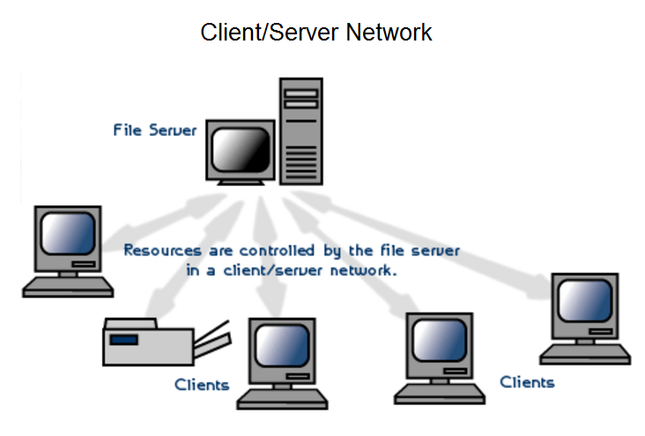
Did you
know?
image source: https://cdn.instrumentationtools.com/wp-content/uploads/2018/04/Client-server-network-system.png
Network Operating System
It provide the the capability to manage data, users, groups, security, applications, and other networking functions.

Slide 14
Network OS
Advantages
Disadvantages
Highly stable centralized servers
Security concerns are handled through servers
New technologies and hardware up-gradation are easily integrated into the system
Server access is possible remotely from different locations and types of systems
Servers are costly
User has to depend on a central location for most operations
Maintenance and updates are required regularly

Slide 15
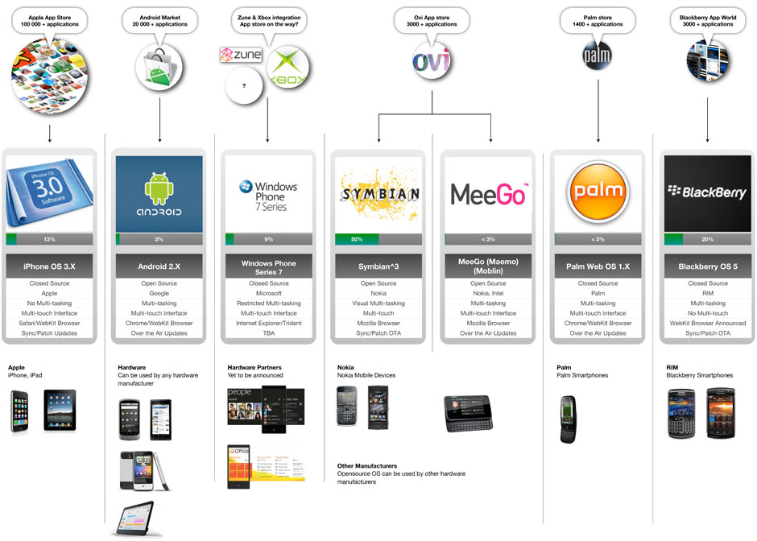
Did you
know?
image source: https://blog.oureducation.in/wp-content/uploads/2013/01/mobile-os-comparison.jpg
Mobile Operating System
It is built exclusively for a mobile device.
It manages all the hardware and optimizes the efficacy of the application software in the device.

Slide 16
Mobile OS
Advantages
Disadvantages
Enhances user experience
Full access to the device in software and hardware
Better charging options
Different programming languages and skills depending on operating system.
High costs
Lack of optimized web

Slide 17

thank you!

