Slide 1


Hardcore Workflow 4 DEV404
Peter Goodman & Stef Sewell
Lead Engineer, Software Architect
ADERANT

Slide 2
PLEASE READ (hidden slide)
This template is designed for use with Office PowerPoint 2007 and 2010.
This template uses Arial, a standard font that is included in Office 2007, Office 2010, Windows Vista and Windows 7.

Slide 3
Notes (hidden)
Some speakers at Microsoft like to use this slide for hidden “notes slides”.
Delete it if you don’t want to use it.
NEXT: <next slide title>

Slide 4
Deadlines & Resources
Thank you for taking part in TechEd New Zealand 2011. Below is a list of key dates and resources:
Important Content Deadlines – detailed instructions are found on the Speaker Portal at https://newzealand.msteched.com/signin:
July 18 - 29: CONTENT REVIEW (send to your Track Owner)
August 5 at 5pm: Upload FINAL PPT presentation on the Speaker Portal. This is the version that you will use at the event.
YOUR PROMPT FINAL PPT SUBMISSION IS APPRECIATED.
No design support will be offered onsite. Slide Design Resources – Located on the Speaker Portal (graphics, webinar, etc.)
If you include any third-party photography or art, licensing information and permission must be credited in the PPT or it will be deleted.
Points of Contact
Direct presentation questions to todd@avenues.co.nz
Direct content questions to your Track Owner
PRINTING: This template is intentionally set to print in colour, not black and white
Notes:
© 2010 Microsoft Corporation. All rights reserved. Microsoft, Windows, Windows Vista and other product names are or may be registered trademarks and/or trademarks in the U.S. and/or other countries.
The information herein is for informational purposes only and represents the current view of Microsoft Corporation as of the date of this presentation. Because Microsoft must respond to changing market conditions, it should not be interpreted to be a commitment on the part of Microsoft, and Microsoft cannot guarantee the accuracy of any information provided after the date of this presentation. MICROSOFT MAKES NO WARRANTIES, EXPRESS, IMPLIED OR STATUTORY, AS TO THE INFORMATION IN THIS PRESENTATION.

Slide 5
Scrub Checklist
Upload your final deck on the speaker portal on or before 05 August, 2011 at 5 pm.
PowerPoint presentations undergo a brief scrub process and are posted to CommNet for attendee access at least 48 hours prior to the session. No design support will be available onsite.
The Scrub Process will:
Verify that required slides are included
Remove any non-template logos and graphics from the walk-in slide
Remove all comments, hidden slides and speaker notes from slides
Set file properties box
Reset printability to grayscale
Notify Presentation Manager of any images identified as unlicensed for escalation
Rename files to match naming convention
Correct session title and session code to match printed Mini Guide and Schedule Builder
Speakers:
Use the provided event template and associated colors, fonts, layout and transition slides
Correct product names to follow applicable branding rules

Slide 6
PowerPoint Guidelines
Font, size, and color for text have been formatted for you in the Slide Master
This template uses Arial a standard font included in Office 2007, Office 2010, Windows Vista and Windows 7
Use the color palette shown below
Sample Fill
Sample Fill
Sample Fill
Sample Fill
Sample Fill
Sample Fill
Sample Fill
Sample Fill

Slide 7
Agenda
Workflow Runtime
Workflow Service Host Extensibility
Scaling out workflow services with Windows Server AppFabric

Slide 8
Key Workflow Concepts PDC09 – WF4 Inside Out
Programs are data
(opacity begone)
Scheduler-based program execution
(stackless & serializable)
Runtime-mediated code rendezvous
(thou shalt not block the thread)
Natural control flow
(run it the way you picture it)

Slide 9
Workflow Runtime Program Execution
Schedules execution of activity trees
Single threaded scheduler processing queue of work items
Use async activities for I/O
Bookmarking
Instance passivation to release resources
Instance resumption on continuation / callback

Slide 10

Runtime Scheduler
demo

Slide 11
Workflow Runtime Housekeeping
Persistence of state
Serialize instance to disk / database
Cornerstone of scale-out
Extensible
Emits tracking information
ETW based
Extensible

Slide 12
Executing a Workflow
WorkflowInvoker.Invoke(Activity workflow)
WorkflowApplication app = new WorkflowApplication(Activity workflowDefinition)
myWorkflowService.xamlx
WorkflowServiceHost
Scale out using Windows Server AppFabric

Slide 13
WorkflowServiceHostFactory Fine grained control over…
Tracking
Persistence
Control Endpoint
Creation Context
Exception Behaviour
WorkflowServiceHostFactory
Creation Endpoint
Idle Behaviour
Custom Extensions
Custom Behaviour
Stateful
Stateless
Security
Serialization

Slide 14
Workflow Service Host Factory
demo

Slide 15
Windows Server AppFabric Enterprise class service hosting on premise
Windows Server extension that provides the elastic scale-out
of workflow services across a load balanced cluster.
Workflow Management Service
Workflow Instance Lock
SQL Server 2008 Persistence Provider

Slide 16
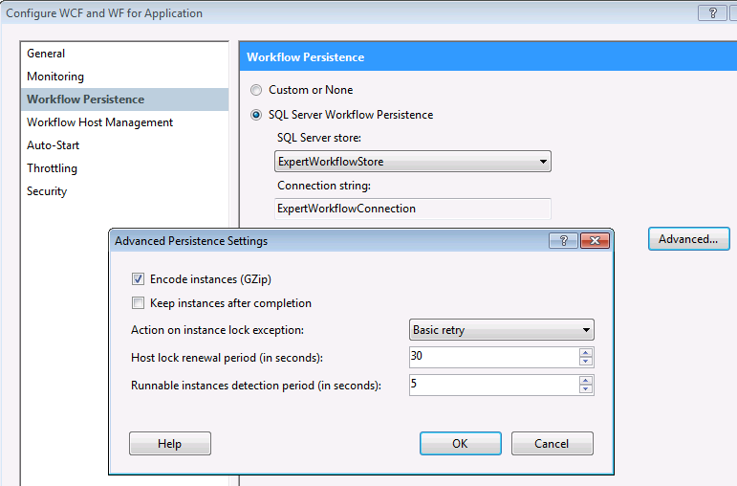
Workflow Persistence Settings
Notes:
Action on instance lock exception:
basic retry – exponential back off algorithm
aggressive retry – linear retry algorithm

Slide 17
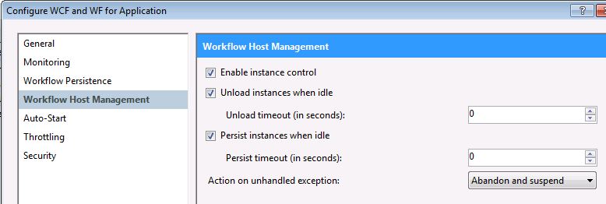
Workflow Persistence Settings Scale-out configuration

Slide 18
Scaling out WF & WCF Services Configure Programmatically via PowerShell
PS> import-module ApplicationServer
PS> get-command –module ApplicationServer
# PowerShell Only
PS> Set-ASMonitoringDatabaseArchiveConfiguration
Notes:
The AppFabric configuration can be set both using the IIS Admin and via the command line [PowerShell]. The PowerShell API provides a comprehensive set of commands to configure the system from a script.
The PowerShell API contains the odd command that is not available from the IIS Admin UI.

Slide 19



Scaling out WF & WCF Services Setting up Kerberos for Windows Authentication
IIS
AppPool
APP1 machine account
webapplication
service.svc
APP1
IIS
AppPool
APP2 machine account
Load Balancer
loadbalancer.domain.local
webapplication
service.svc
APP2
Notes:
Kerberos system involves the service decrypting the service ticket with its password – all instances of the service must therefore be running under the same account.
Calling http://app1.domain/webapplication/service.svc maps to the HTTP/app1.domain SPN which maps to the APP1 machine account in AD.

Slide 20
Scaling out WF & WCF Services Setting up Kerberos for Windows Authentication
IIS
AppPool
Domain\service account
webapplication
service.svc
APP1
IIS
AppPool
Domain\service account
Load Balancer
loadbalancer.domain.local
webapplication
service.svc
APP2

Slide 21
Scaling out WF & WCF Services Adding the SPN
setspn –a HTTP/loadbalancer.domain.local serviceAccount

Slide 22
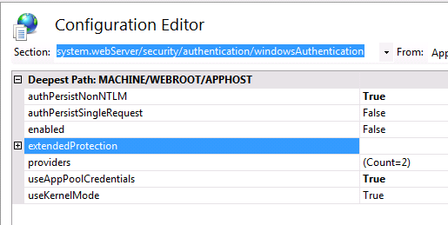
Scaling out WF & WCF Services IIS Configuration
appcmd set config /section:windowsAuthentication /useAppPoolCredentials:true
appcmd set config /section:windowsAuthentication /authPersistNonNTLM:true

Slide 23
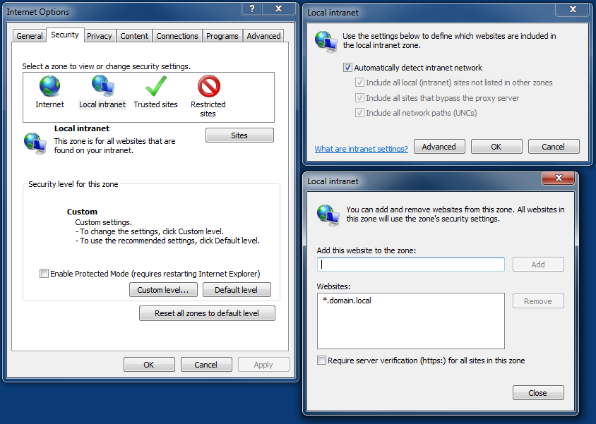
Scaling out WF & WCF Services Internet Zone Security
Notes:
The URL must be considered inside the local intranet zone for the Kerberos token to be passed. The token is not passed to internet zone sites.

Slide 24
Wrap up
Single-threaded scheduler – use Async I/O
WorkflowServiceHostFactory allows extensive customization of the WorkflowServiceHost
Windows Server AppFabric allows enterprise scale out of workflow services

Slide 25
PowerPoint Template Subtitle color
Example of a slide with a subhead
Set the slide title in “All Caps”
Set subheads in “Sentence case”
Generally set subhead to 36pt or smaller so it will fit on a single line
The subhead color is defined for this template but must be selected; In PowerPoint 2007/2010, it is the fifth font color from the left
Hyperlink color: www.microsoft.com

Slide 26
Chart Example

Slide 27

Slide for Showing Developer’s Software Code
Use this layout to show software code
The font is Consolas, a monospace font
The slide doesn’t use bullets but levels can be indented using the “Increase List Level” icon on the Home menu

Slide 28
Demo Title
Name
Title
Group
demo

Slide 29
Video Title
video

Slide 30
Partner Title
Name
Title
Company
partner

Slide 31
Customer Title
Name
Title
Company
customer

Slide 32
Announcement Title
announcement

Slide 33
questions

Slide 34
Related Content
Required Slide
Speakers, please list the Breakout Sessions, Interactive Discussions, Labs, Demo Stations and Certification Exam that relate to your session. Also indicate when they can find you staffing in the TLC.
Breakout Sessions (session codes and titles)
Breakout Sessions (session codes and titles)
Breakout Sessions (session codes and titles)
Breakout Sessions (session codes and titles)
Breakout Sessions (session codes and titles)
Find Me Later At…

Slide 35
Track Resources
Required Slide
Track PMs will supply the content for this slide, which will be inserted during the final scrub.
Resource 1
Resource 2
Resource 3
Resource 4

Slide 36




Resources
Learning
Connect. Share. Discuss.
Microsoft Certification & Training Resources
http://newzealand.msteched.com
www.microsoft.com/learning
Resources for IT Professionals
Resources for Developers
http://microsoft.com/technet
http://microsoft.com/msdn

Slide 37
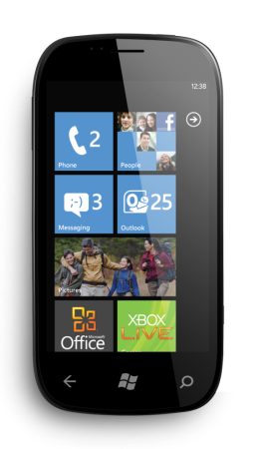

Evaluate your sessions
on CommNet and go in
the draw to win instant
prizes

Slide 38

© 2011 Microsoft Corporation. All rights reserved. Microsoft, Windows, Windows Vista and other product names are or may be registered trademarks and/or trademarks in the U.S. and/or other countries.
The information herein is for informational purposes only and represents the current view of Microsoft Corporation as of the date of this presentation. Because Microsoft must respond to changing market conditions, it should not be interpreted to be a commitment on the part of Microsoft, and Microsoft cannot guarantee the accuracy of any information provided after the date of this presentation. MICROSOFT MAKES NO WARRANTIES, EXPRESS, IMPLIED OR STATUTORY, AS TO THE INFORMATION IN THIS PRESENTATION.

