Slide 1
Visual Studio Extensibility, DSL Tools and T4 Code Generation
Peter Goodman
Notes:
Who am I?

Slide 2
Agenda
Visual Studio past and present
Extensibility Options
Extensibility Samples
DSL Tools
T4 Code Generation

Slide 3
Visual Studio Past and Present
Native Application
32-bit
Large and old code base
Visual Studio – 1995
Visual Studio .Net – 2002
Since 2005 supports VS Hives
Notes:
64-bit conversion considered too much code to migrate for too little immediate benefit.
Much better to wait for codebase to be gradually replaced with managed pieces

Slide 4
Why Extend?
Automate – it’s your job
Onboarding
Consistency

Slide 5
Extensibility Options
Snippets
Project Templates
Item Templates
Custom Commands
Toolbars
Menus
Tool Windows
Custom Tools
Custom Designers
Editor Extensions
Custom Languages
Notes:
Aderant Design Studio
Smart Form File Generator

Slide 6
Extensibility Options
Macros
Add-ins
VS Packages
VS Shell
Notes:
Macros are only in VBA
VS Packages have access to all APIs but addins can only use DTE / Automation
VS Shell allows complete custom Visual Studio app
Add-ins, macros, packages are not supported in Express editions

Slide 7
Extensibility Options
Visual Studio IDE
Package API
Interop Assemblies
Automation
Macros
Addins
VC#
Managed Package Framework
VSL
Custom Package A
Custom Package B
Native Package A
Notes:
Macros and Add-ins can only use Automation but MPF can use all APIs

Slide 8
Demo
Visual Studio Extensions

Slide 9
DSL Tools
Domain Specific Languages
Visual Designer
Custom XML File
Object Model and API
T4 Text Templating
Notes:
DSLs and their role in DDD
Visual Designer can be box and line, Win Forms or WPF
Can control the serialization of the XML file
Object Model is rich, transactional and includes validation and constraints
T4 was released along with DSL tools but as become a feature on its own

Slide 10
Demo
DSL Tools
Notes:
Create a new DSL Tools project
Implement a Class Designer
Create a template that implements the Classes as ViewModel classes with change notification
Implement the double-derived pattern

Slide 11
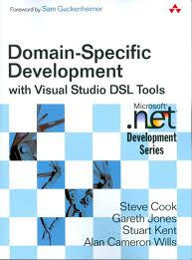

DSL Tools

Slide 12
T4 Text Templating
Generates Text Files / Strings
ASP style syntax <# …. #>
Built into Visual Studio from VS 2010
Used by Entity Framework, MVC scaffolding, WCF RIA and other MS technologies
Now supports pre-processed templates

Slide 13
Demo
T4 Text Templating
Notes:
Create a new DSL Tools project
Implement a Class Designer
Create a template that implements the Classes as ViewModel classes with change notification
Implement the double-derived pattern

Slide 14
Double Derived Pattern
public class MyGeneratedClass : IMyGeneratedClasses {
public string DoFoo() {
return "";
}
}

Slide 15
Double Derived Pattern
public class MyGeneratedClass : MyGeneratedClassBase {}
public class MyGeneratedClassBase : IMyGeneratedClasses {
public virtual string DoFoo() {
return "";
}
}

Slide 16
Double Derived Pattern
public partial class MyGeneratedClass : MyGeneratedClassBase {}
public class MyGeneratedClassBase : IMyGeneratedClasses {
public virtual string DoFoo() {
return "";
}
}

Slide 17
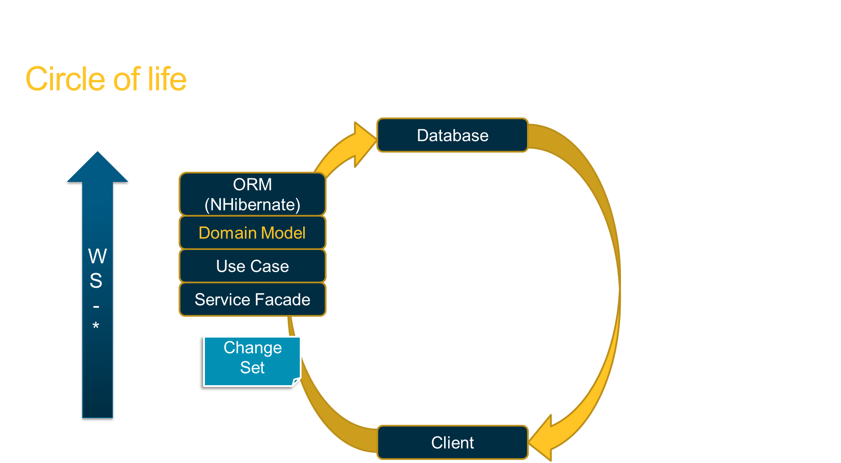

Slide 18
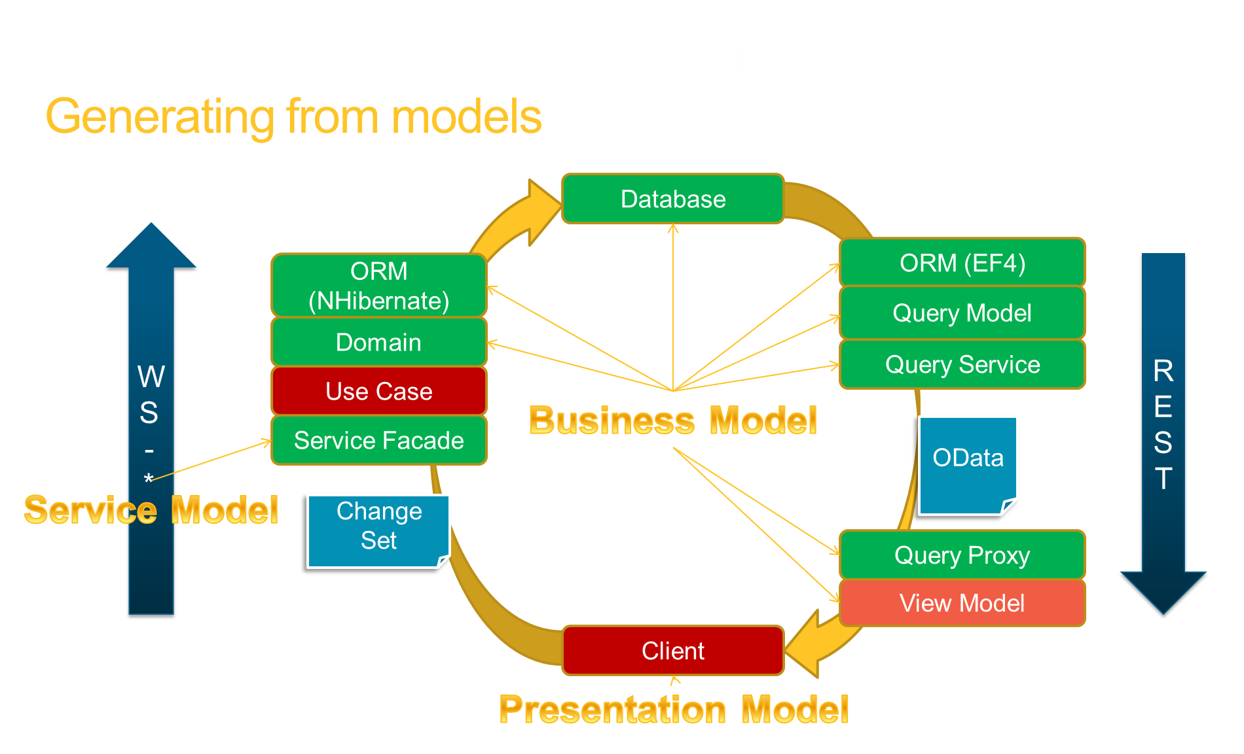

Slide 19
Questions?

Slide 20
Thanks
pete@petegoo.com
http://blog.petegoo.com

