Slide 1
Notes:
15 minutes – Intro and foundation
20 minutes – Workflow Basics demos
5 minutes – Workflow Services intro
15 minutes – Workflow Services demos
5 minutes – Q&A / wiggle room

Slide 2
Getting Started with Workflow in .NET 4
SESSION CODE: DEV208
Stef Sewell & Peter Goodman
Architect, Lead Engineer
ADERANT
Notes:
Let’s make a start… welcome to “Getting Started with Workflow in .NET 4”
Introductions
Stef – Tour Guide
Pete - Driver
ADERANT:
Leading ISV in the legal and professional services market.
TAP members for VS2010 and .NET 4 and Windows Server AppFabric – visibility of .NET 4 for the last 18 months.
Migrated WF3 embedded workflow solution to WF4 over 9 months.

Slide 3
Before we begin… Is this session for you?
“Runtime-Mediated Code Rendezvous”
Notes:
“Runtime mediated code rendezvous”
What does this mean to you, if anything?
If you are thinking “I have no idea what this means” – this is the session for you.
If you are thinking “this is role of the workflow scheduler” then this is not the session for you.
This is a 200 level session that introduces workflow and the Workflow 4 foundation in .NET 4. We are only going to scratch the surface but we will give you plenty of resources to follow up on.

Slide 4
Agenda Workflow Basics
What is a workflow?
Why would I use a workflow?
How do I create a workflow?
How do I execute a workflow?
How do I test and debug a workflow?
Anything else I need to know?
Notes:
Agenda
The session will cover two topics:
Workflow Basics
Workflow Services
Workflow Basics
We want to answer the following questions…

Slide 5
Agenda Workflow Services
What is a workflow service?
Why would I use a workflow service?
How do I create a workflow service?
How do I host a workflow service?
How do I monitor and manage a workflow service?
Anything else I need to know?
Notes:
Second topic is to address Workflow Services and in doing so answer the following questions.
Analogous to the workflow basics, the 101 of workflow services.

Slide 6
What is a workflow?
Notes:
If we go to wikipedia (source of all knowledge on the internet), it tells us that a ‘workflow consists of a sequence of connected steps.’ [Urban dictionary definition?]
Which is a start but the easiest way to describe a workflow is to show you one.

Slide 7
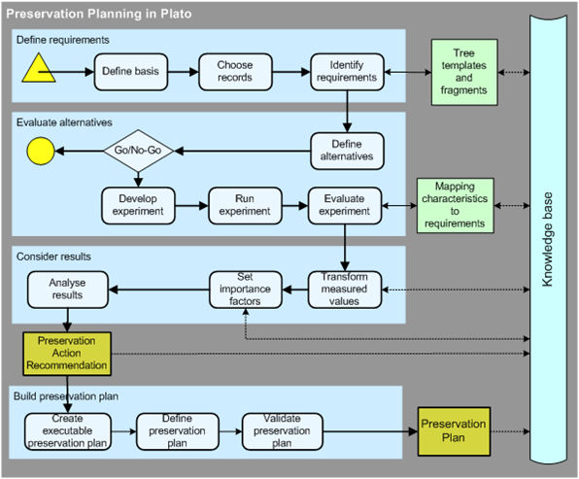
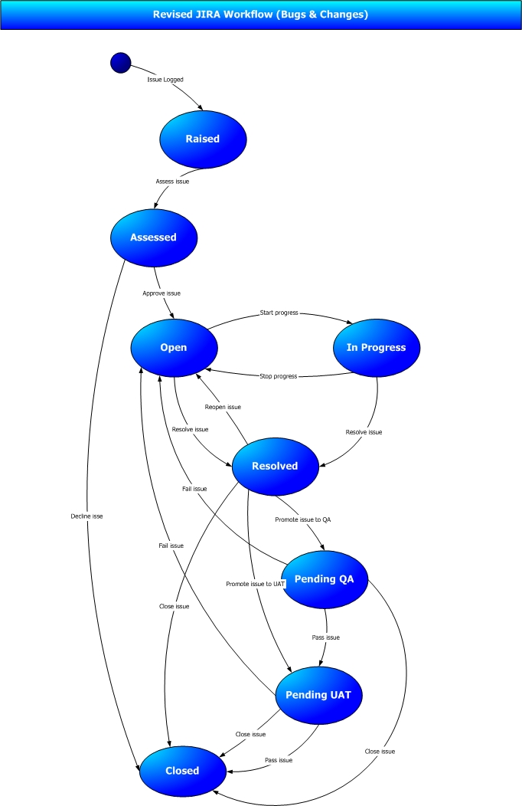
Notes:
Here are a couple of workflows I found using an image search in google.
There are different types of workflow: here we can see a flowchart style workflow and a state machine style of workflow.
In both cases the key aspects are:
It is a visual representation of a structured process.
There are a number of different steps, these step may either be actions that are performed or decision points that control the flow of the process.
The flow through the process is depicted by arrows, these are the permitted pathways from one step to the next.
So what we have is a way to visually capture a process in terms of the individual steps taken and the flow through those steps.
The process is constructed from steps that are meaningful in the context of the process. For example, if we wanted to map a document approval process, the some of the steps would be submit draft, review draft, review comments, edit document, approval document, publish document.
The language used to define the workflow is that of the problem space we are working.

Slide 8
A workflow is a program
Notes:
A workflow is a sequence of steps representing a process. In software engineering this is of course known as a program.
This is not earth shattering news, but it gives us a starting point from which we can refine what a workflow is.
Let’s add one word to this statement…

Slide 9
A workflow is a
declarative program
Notes:
A workflow is a declarative program, this one word reveals a lot of information about what a workflow is.
Pretty much everyone in this room is a .NET programmer and so creates code in C# or VB.NET. When programming in C# or VB.NET, for the most part we set out an explicit set of steps that need to be performed – we construct classes, we call methods on them, we set-up variables and perform operations. When writing a program supply an explicit set of instructions that define how to achieve our goal.
This is quite different to what we do in SQL (or LINQ). In SQL we define a query that states what we want but not how to get it. We pass the query to a query engine and it is responsible for taking our specification for data to find and translating this into the I/O, searching and sorting operations required to satisfy the request. In SQL it is possible to write the code in an imperative fashion using cursors but we don’t because SQL is easier and more aligned with the business problem finding data. SQL is a declarative language. SQL is also a DSL, a domain specific language (Structured Query Language) – its purpose is to define statements that return sets of data from a relational store.
Other examples are HTML and WPF which are both presentation technologies. In both cases what we want to display is described and this is passed to a rendering engine to translate this into actual pixels and behavior.

Slide 10
A workflow runtime is responsible for scheduling the execution of the steps
Notes:
So if workflow is a declarative program then we specify what we want, i.e. what we want our process to do. There needs to be an intermediary that knows how to execute the workflow and this is the workflow. A key component of the runtime is the scheduler which determines the appropriate order in which to execute the various steps within the workflow according to the connections between the steps.
The runtime also allows external events to affect the outcome of a workflow such as terminating it or cancelling before it reaches it’s natural conclusion.
The runtime is also extensible, there is a service model that allows additional capabilities to be added to the runtime via services. You can write your own services but Microsoft supplies a couple of fundamental extensions such as the ability to track workflow execution. As the steps executed, instrumentation is published by the runtime which can be captured, logged and reported against. For long running processes this is very useful as it allows us to determine where in the workflow we are.
A second very useful extension is the ability to persist a running workflow to a database so that a long running processes state can be saved at various points during its lifetime (allowing fault tolerance and resource optimization)– we’ll talk more about this feature later…
Workflow model is stackless and the state of execution of a workflow instance is serializable. This is the foundation of recovery and scalability of workflow programs.
Workflow programs are thread/process/machine agile. Any workflow host, with access to the definition and dependent assemblies can continue the execution of the instance.

Slide 11
A workflow is composed of an ordered sequence of activities
Notes:
An activity is the technical term for a step within a workflow. A workflow is composed, built up from, a number of activities which are arranged so that they executed in a particular order.
The development / design experience for workflow is visual, it is similar to using Visio to draw a process diagram. It is a natural metaphor for the business analyst. When ‘coding’ a workflow you drag activities from a toolbox and arrange them on a visual canvas. Set properties, connect with arrows and this can be executed. The runtime is responsible for executing the activities in turn.
In WF4 there is no workflow class! A workflow is an activity, this is most visible in the type system. In .NET 4, all of the workflow 4 types belong in side the System.Activities namespace. There is a System.Workflow namespace but that contains the workflow 3 types. If you are using workflow 4 you should never need to use a class with workflow in the namespace unless you are doing interop with workflow 3.
The activity is the atom of the workflow world, all things are built from activities. You can define your own activities as well using activities from Microsoft and other ISVs. When you build you own activities can either do so by constructing the new activity as a workflow in its own right (a composition of other activities), or you can do so in code if necessary. An activity is a unit of execution by the workflow engine – the execution of a workflow instance is single threaded and so there is only 1 workflow activity ever executing at any time on the scheduler thread.
It is possible for a workflow activity to spawn another thread to do work but the interaction between the activity and the workflow runtime is only ever on a single thread). This is the preferred model for workflow execution because you do not want to block the scheduler thread awaiting on I/O or some other long running process.

Slide 12
An activity is the atom in the workflow universe.
Notes:
What it is…
An activity is the primitive in the workflow model. The workflow runtime is responsible for scheduling the execution of activities. An activity may perform some computation or it might schedule child activities based on some logic. For example a parallel activity allows the scheduling of asynchronous activities which execute in parallel.
Development Experience composing applications…
The design experience for workflow is to compose the workflow from activities. Microsoft ships a number of activities out of the box but you can write your own. It is very likely that you will write your own activities so that you can capture units of work within your own domains that can then build built into a workflow. We’ll see examples of this very shortly.
Standard and custom written activity libraries…
Activities can be written to do anything, from simple operations such as variable assignment through to complex business logic such as cloning a order. The activities should be aligned to the business processes that the workflow is trying to model.

Slide 13
A workflow has data which is captured as variables
Notes:
A workflow is more than just behavior and flow, it also acts upon data. A workflow definition contains scoped variables with are .NET types. Data maybe complex object graphs such as a client with addresses and other contact information or it may be a basic type such as a boolean.
WF3 did not include state as part of the workflow definition. In WF4 it is part of the definition.

Slide 14
An activity has arguments to allow data to flow in and out
Notes:
The flow of data between activities is managed through arguments. As part of its definition, an activity declares in and out arguments to allow it to accept data to process and return results.

Slide 15
Why would I use a workflow?
Notes:
Two aspects to ‘development’:
Deployment of the workflow by designing a flowchart using a palate of activities. Drag-n-drop programming experience, connect up activities and set properties.
Creation of the activity libraries that allow 1. to take place.

Slide 16
You want to automate existing business processes
Notes:
A workflow is a set of steps, this could be nearly anything.
Companies already have a set of business processes, often paper based.
You want to capture these processes in a computer system and have it take care of the co-ordination. Typical use cases are:
Collaborative document creation: docs are created, reviewed, approved and published – SharePoint 2010 ! Need routing between the stages.
Automated Build System: Compile, Test, Copy Files, Sign with certificate, email success / failure – TFS 2010 !
Processes are subject to change, you want a simple authoring and publishing experience.
You want the ‘development’ of those processes to be intuitive – the natural UI for process design is a flowchart.
With an appropriate library of activities, workflows allow you to define processes using the language of the problem space and not have to translate from the problem to a technical solution. The activity library should reflect the domain and provide a logical set of constructs from which to compose programs.

Slide 17
You have long running logical processes that are episodic in nature.
Notes:
You have a process that takes minutes, hours, days, weeks, … to complete. How do you model that in software so that it tolerant of machine restarts and failures.
Some processes naturally have delays, e.g. account receivable:- every 15 days send a reminder which increasing amounts of red ink and legal threats. There are episodes of work followed by periods of inactivity until an event occurs such as a timeout.
Human based workflows are a great example of this: send out task and wait for it to be completed. When completed, send of approval or review task. Once review complete action item by updating business system etc.
Workflows are a good way to model state.
One of the services provided by the workflow runtime is persistence which allows a workflow instance to be saved to disk and not have to be in memory. The workflow service host takes care of the plumbing required to unload a workflow instance from memory and then re-load it when required.

Slide 18
You want to provide an intuitive customization model as part of your solution
Notes:
Business processes are often volatile and therefore subject to change. Using a workflow and a suitable activity library allows the creation / definition of the workflow to be performed by a role other than a software engineer.
Workflows are visual and offer a level of programming that most business analysts are comfortable with – it provides a natural UI for an analyst. If the activity library contains activities that map directly to the domain that the analyst is an expert in, then it is reasonable to expect that they could define their own workflow processes. These can then be executed offering a valuable customization feature set within your product. The workflow design experience is rehostable and workflow activity designers allow you to create an intuitive UX.
The workflow designer is easily rehostable and therefore can be embedded within your own applications.
Workflow definitions are serializable and therefore can be treated as data, saved to a database or file system as XAML.

Slide 19
How do I create a workflow?

Slide 20
DEMO: Business Process
Leave Request

Slide 21
DEMO: The Magic Eight Ball
Part 1 – Create & Execute

Slide 22
How do I debug test a workflow?

Slide 23
DEMO: The Magic Eight Ball
Part 2 – Test & Debug

Slide 24
Workflow Basics Anything else I need to know?
Lots that we don’t have time for so check out:
Total Noobs’ Guide to WF4 http://www.msteched.com/2010/NorthAmerica/DEV207
Building Activities for WF4 http://www.msteched.com/2010/NorthAmerica/ASI303
WF4 Inside Out [‘Runtime-Mediated Code Rendezvous’] http://www.microsoftpdc.com/2009/P09-22
The .NET Endpoint http://blogs.msdn.com/b/endpoint/
Notes:
If you want to find out about the ‘runtime mediated code rendezvous’ watch WF4 Inside Out

Slide 25
Workflow Basics Anything else I need to know?
A First Look at WCF and WF in .NET 4 http://www.msteched.com/2009/NewZealand/SOA206
Stef’s Blog: http://web.me.com/stefsewell/TechEd2010
Pete’s Blog: http://blog.petegoo.com/

Slide 26
Agenda Workflow Basics
What is a workflow?
Why would I use a workflow?
How do I create a workflow?
How do I execute a workflow?
How do I test and debug a workflow?
Anything else I need to know?

Slide 27
Agenda Workflow Services
What is a workflow service?
Why would I use a workflow service?
How do I create a workflow service?
How do I host a workflow service?
How do I monitor and manage a workflow service?
Anything else I need to know?
Notes:
Second topic is to address Workflow Services and in doing so answer the following questions.

Slide 28
What is a workflow service?

Slide 29
A WCF service whose implementation is a workflow
Notes:
WCF services are usually implemented as code in C# and VB. Workflow provides us with an alternate authoring experience.
We want to model communication as a workflow.
Using activities such as Send and Receive, we can model services as workflows. The receive activity allows us to make a service call to a workflow and pass data into it. The workflow can then process this data an executes a number of activities before returning a result to us.
Workflow service host takes care of exposing the workflow as a service: exposing a service contract, hosting the endpoints.

Slide 30
Why would I use a
workflow service?

Slide 31
Service logic easily modeled as a workflow
Notes:
Given the messaging activities, we can easily implement the service logic as flow of activities – the design experience is visual. It is easier to read a workflow rather than code.
Our service is a composition of other services, the Visual Studio IDE makes it very easy to compose services calls as a workflow. We can add a service reference and VS will build an activity for us to allow this service to be consumed inside a workflow – demo shortly.
Service wants to perform asynchronous work and co-ordinate. Workflow gives us a serial programming model but the workflow runtime takes care of handling the asynchronous calls. This is true of all workflows and not just services.
For example:
Service co-ordinates a number of other services, e.g. car hire ‘best buy’ site. Parallel + async activities provides a simple to use but powerful co-ordination model.

Slide 32
Service encapsulates a long running process
Notes:
The workflow service host provides the infrastructure that means we as developers don’t have to worry about a number of issues that complication long running service operations:
Workflow Service host gives us the ability to persist a workflow to a database.
Activities allow us to define messaging patterns.
The workflow host takes care of managing the state of the workflow. Persistence also allows
Reliability
Availability – ability to recover from failures
Scalability – a workflow instance can we handled by any machine in the application farm.
Different algorithms for the wait on the release of the instance lock: simple retry, back-off exponentially.
Workflow Management Service:
InstanceLock control (releasing locks on failed instances)
Durable Timers
Control commands routed to instance control endpoint {Suspend, resume, terminate, cancel}.

Slide 33
How do I create a workflow service?

Slide 34
DEMO: The Magic Eight Ball Service
Part 1 – Create & Host
Notes:
Highlight ‘CanCreateInstance’

Slide 35
How do I monitor and manage a workflow service?

Slide 36
DEMO: The Magic Eight Ball Service
Part 2 – Monitor & Manage

Slide 37
Workflow Services Anything else I need to know?
Lots that we don’t have time for so check out:
DEV306: Taming SOA Deployments using Window Server AppFabric (Wed, 10:40 – 11:40)
Declarative N-Tier Applications using WPF, WCF and WF http://www.msteched.com/2009/NewZealand/SOA306
Developer’s Introduction to Windows Workflow Foundation (WF) in .NET 4 http://msdn.microsoft.com/en-us/library/ee342461.aspx
Windows Server AppFabric http://msdn.microsoft.com/en-us/windowsserver/ee695849.aspx
Workflow Service and Windows Server AppFabric

Slide 38
Agenda Workflow Services
What is a workflow service?
Why would I use a workflow service?
How do I create a workflow service?
How do I host a workflow service?
How do I monitor and manage a workflow service?
Anything else I need to know?

Slide 39




Related Content
DEV306: Taming SOA Deployments using Window Server AppFabric (Wed, 10:40 – 11:40)

Slide 40
Please submit Feedback

Slide 41
Questions ?

Slide 42

© 2008 Microsoft Corporation. All rights reserved. Microsoft, Windows, Windows Vista and other product names are or may be registered trademarks and/or trademarks in the U.S. and/or other countries.
The information herein is for informational purposes only and represents the current view of Microsoft Corporation as of the date of this presentation. Because Microsoft must respond to changing market conditions, it should not be interpreted to be a commitment on the part of Microsoft, and Microsoft cannot guarantee the accuracy of any information provided after the date of this presentation. MICROSOFT MAKES NO WARRANTIES, EXPRESS, IMPLIED OR STATUTORY, AS TO THE INFORMATION IN THIS PRESENTATION.

