Slide 1
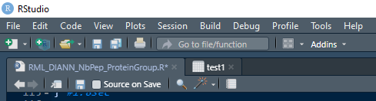
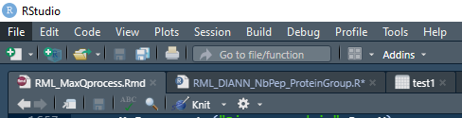
0 –Maxquant analysis : Copier mqpar.xml and #runningTime.txt (found in « combined/proc ») is the txt folder.
(txt folder must contain proteinGroups.txt, peptides.txt and evidence.txt)
For DIA-NN analysis : folder must contain report.pg_matrix.tsv, report.tsv, report.pr_matrix.tsv and report.log.txt
1 – Open R.
2 – Clic on
3 – Select file DIANN_MaxQ_process.Rmd
4 – Clic on
5 – A window opens but be aware, it can open behind rstudio window. Please check taskbar. 6 – For DIA-NN analysis : Select report.pg_matrix.tsv
– For Maxquant analysis : Select ProteinGroup.txt

Slide 2
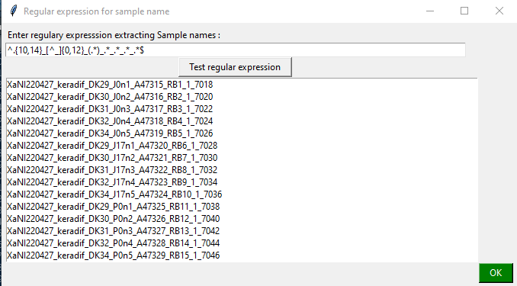
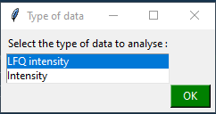
7 – For DIA-NN analysis : a window allowing extraction of sample names using regular expression appears.
Clic on « Test regular expression » to check if regular expression is adapted. If not, change it.
Clic OK
7 – For Maxquant analysis : Choose if analysis will be done on LFQ intensities or on intensities.
Clic OK

Slide 3
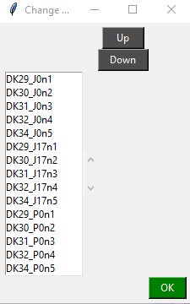
8 – A window allowing reordering of samples appear :
To change order : select one sample and clic on up or down. Doit for each sample to reorder then clic OK To keep order as it is : clic OK

Slide 4
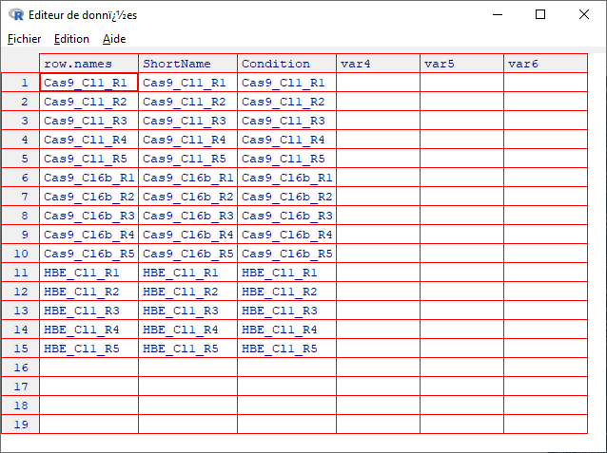
9 – A table showinf sample names appear. In Condition column enter condition corresponding to each samples.
Close the table once it’s done.
To note :
This step is only asked the first time you use the sript on this data. After, a file named ExperimentalDesign.txt is generated in the folder and is used next time you will use the script on this data.
In this ExperimentalDesign.txt file you can also change color of conditions that will be used on report’s plots.

Slide 5
10 – Programmation of Student tests :
Pour make Student tests:
Select conditions to compare, type of T-test, significativity and fold change threashold.
Clic OK
Pour ne pas faire les tests de Student :
Clic NoStat on the right bottom
11 – Let time for script to run.
12 – When it is finished a Word file appears. Save it to keep it.
DIANN_MaxQ_process.rmd generates 4 files :
- a Word file containing report with many plots including PCA, heatmaps, volcanoplot ...
- a Excel file containing protein quantifications, student tests results and number of peptides per proteins.
- a txt file containing the same data as the Excel file
- a .rds file that can be use with shiny_PROTEOMIC.R script to custom plots.

