Slide 2
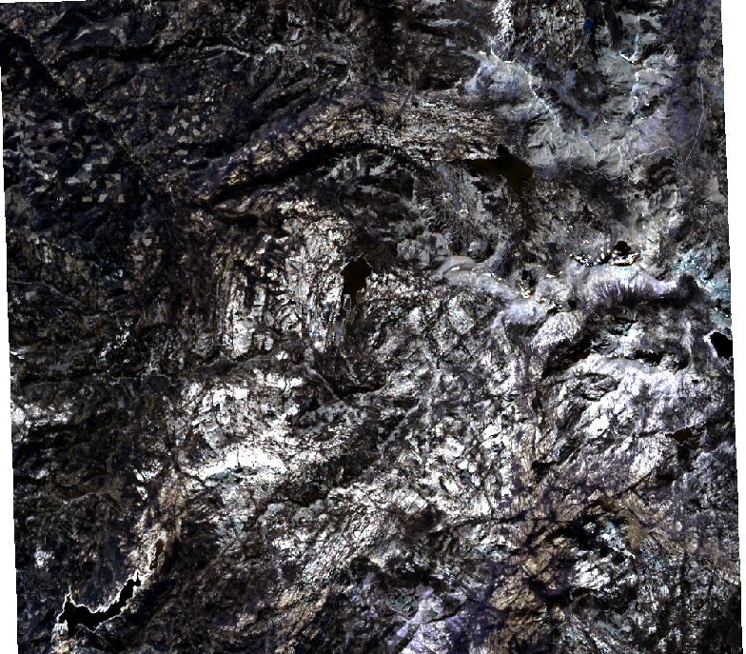
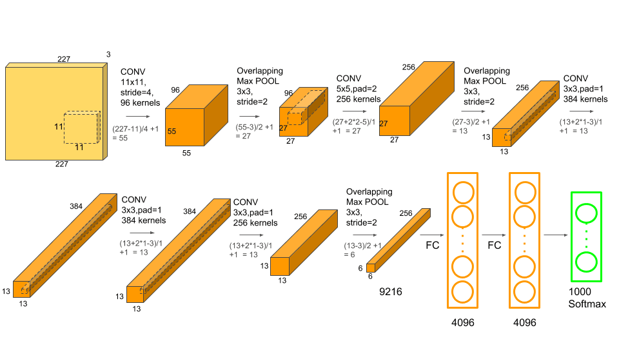

ImageNet feature augmentation
Time
Band
Extract single labeled pixel
Create time/band image
6-month sample of 4 years
Classifier model (TBD)
Regression
RF
NNet
Time series Landsat data
Labeled with tree damage survey date (USFS)

Slide 3
