Slide 1


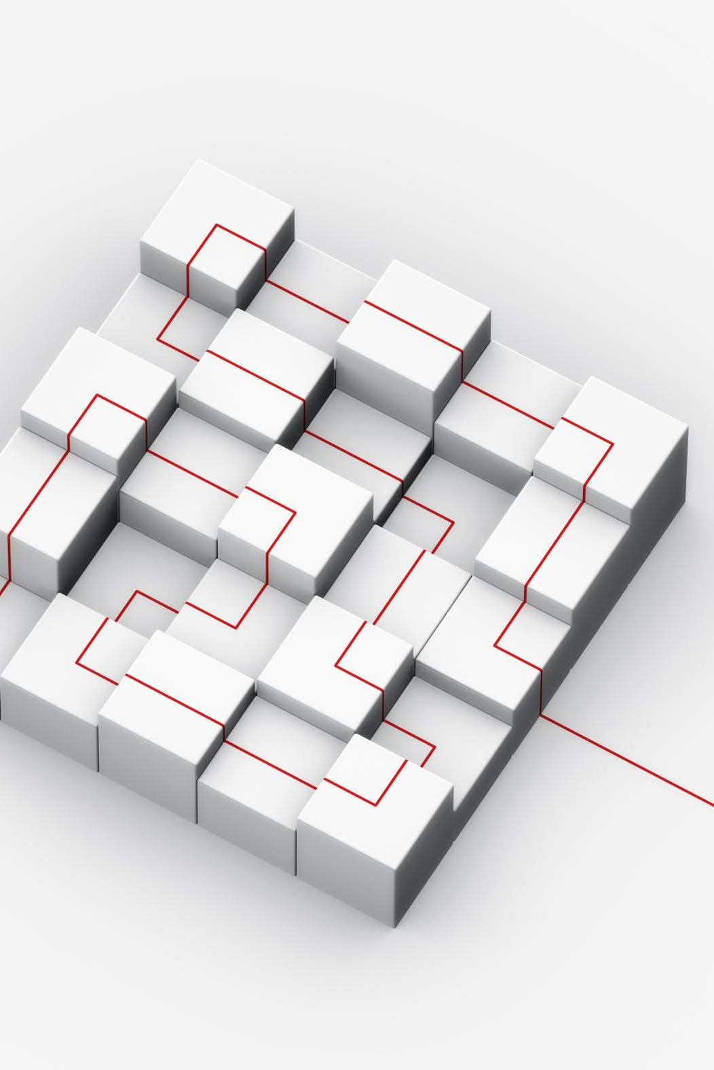
Design, Configure, and Deploy Switches Utilizing VLANs, Trunking, and Port Aggregation

Slide 2
Introduction to Switching
- A switch connects devices in a LAN using MAC addresses.
- Unlike hubs, switches are intelligent and reduce collisions.
- Enhanced with VLANs, trunking, and port aggregation for performance.

Slide 3
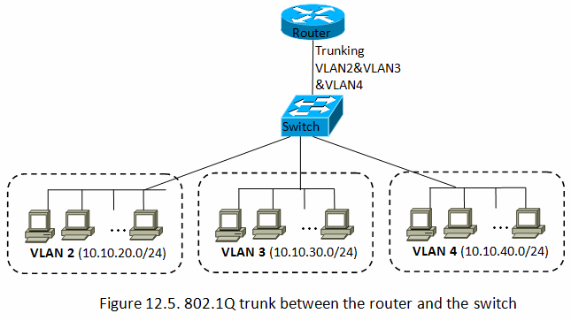
What is a VLAN?
- VLAN = Virtual LAN, logical separation inside a switch.
- Example:
VLAN 10 – Sales
VLAN 20 – HR
VLAN 30 – IT
- Benefits: Security, reduced broadcast traffic, easier management.

Slide 4
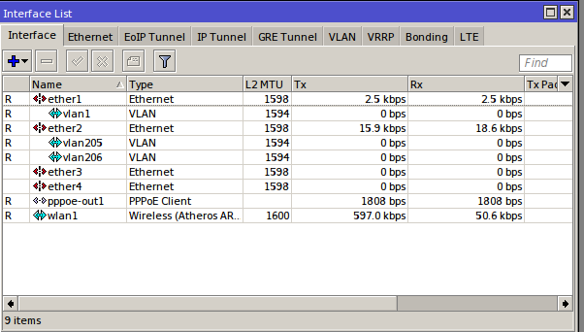
VLAN Configuration
Steps:
1. Create VLAN IDs
2. Assign ports to VLANs
3. Verify VLAN membership
Example (MikroTik):
/interface vlan add name=VLAN10 vlan-id=10 interface=ether1
/interface bridge port add bridge=br1 interface=ether2 pvid=10

Slide 5
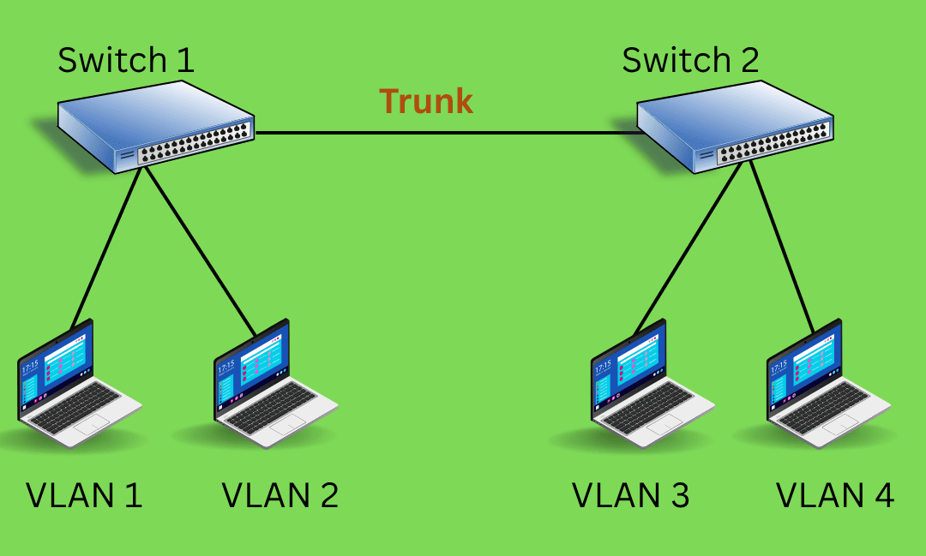
What is Trunking?
- Trunk link carries multiple VLANs between switches.
- Uses 802.1Q tagging.
- Required when VLANs span multiple switches.

Slide 6
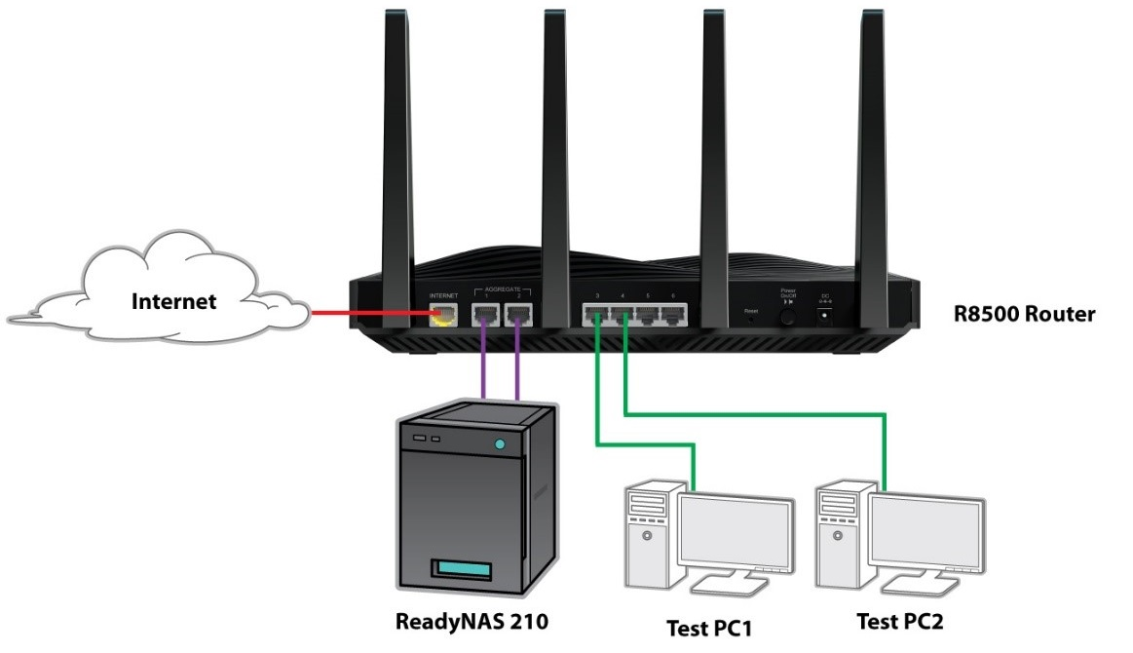
What is Port Aggregation?
- Combines multiple ports into one logical link (LACP).
- Benefits:
* Higher bandwidth
* Redundancy if one link fails
- Example: Server with 2x1Gbps links = 2Gbps total.

Slide 7
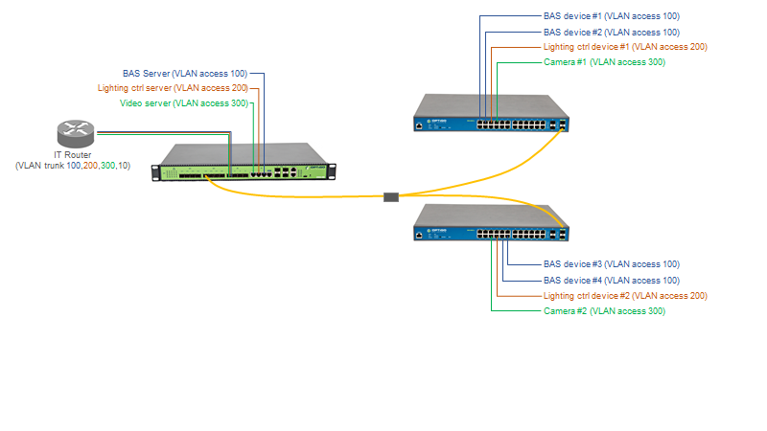
Network Design Example
Notes:
Explanation of the VLAN Network Design
IT Router (Left side)
The router is configured with a trunk port.
This trunk carries multiple VLANs: 100, 200, 300, and 10.
That means it can handle traffic from different VLANs and forward them correctly.
Main Switch (Next to router)
Connected to the router via a trunk link.
Hosts different servers, each assigned to a specific VLAN:
BAS Server → VLAN 100 (Building Automation System)
Lighting Control Server → VLAN 200
Video Server → VLAN 300
Two Distribution/Access Switches (Right side)
These switches are connected together and also connected to the main switch using trunk links (yellow cables).
Each switch provides access to different devices, and each device is assigned to its VLAN.
Devices Connected to Switches
BAS Devices (1–4) → VLAN 100
Lighting Control Devices (1–2) → VLAN 200
Cameras (1–2) → VLAN 300
How It Works
VLANs separate the network logically, so even if devices share the same physical switches, their traffic is isolated.
The trunk links allow VLAN traffic to travel between switches and the router, ensuring that devices in the same VLAN can still communicate across the network.
For example:
A camera in VLAN 300 can reach the video server (also VLAN 300), even though they are on different switches.
BAS devices in VLAN 100 can communicate with the BAS server.
VLAN 200 devices can control lighting but stay isolated from VLAN 100 and VLAN 300 devices.
👉 In short: This design uses VLANs for network segmentation, trunk links to carry multiple VLANs, and ensures that servers and devices are only reachable within their designated VLANs.

Slide 8
Benefits Recap
- VLANs: Segmentation, security, performance.
- Trunking: VLAN propagation across switches.
- Port Aggregation: High bandwidth + redundancy.
[Insert icons: shield, speedometer, arrows]

Slide 9
Conclusion
- VLANs, trunking, and port aggregation = efficient, secure networks.
- Essential for modern enterprise switching.
- Proper planning and testing ensures success.

Slide 10
quIz

