Slide 1

NLP
Introduction to machine learning

Slide 2

Natural language understanding
Classification of text
Natural language generation
Prediction of text
Autocorrect
Translations

Slide 3
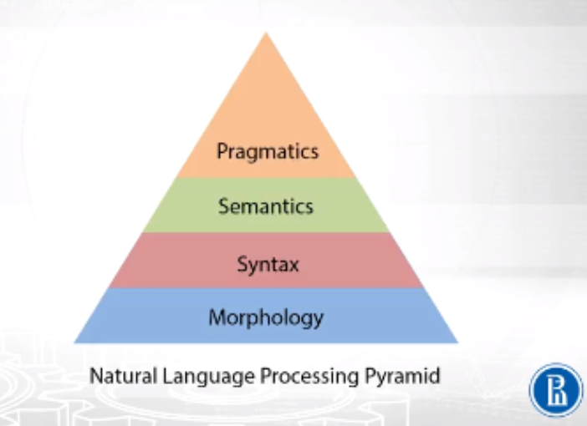
Meaning of words in context
Meaning of words
How words structure together
The construction of words

Slide 4
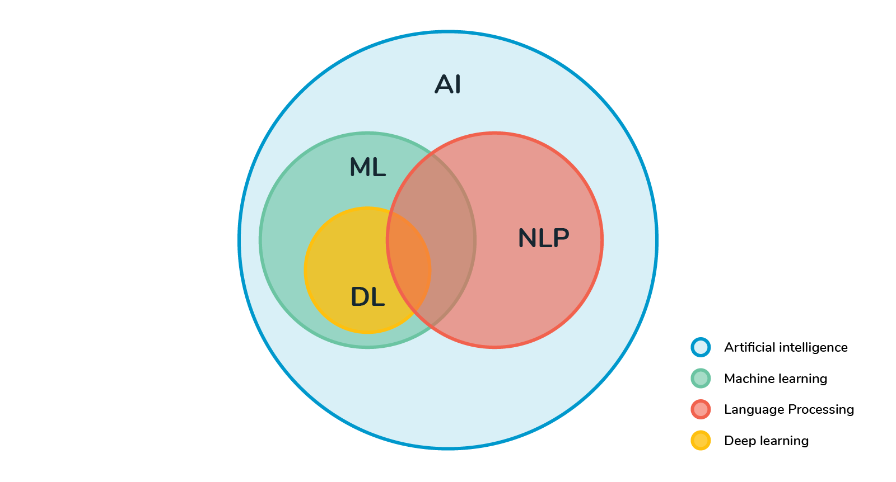

Slide 5
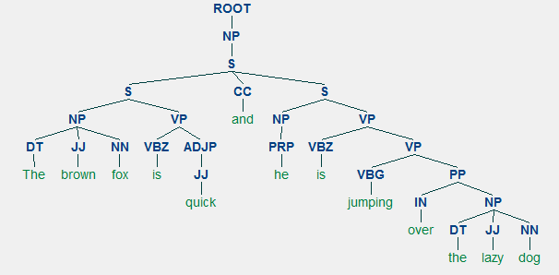
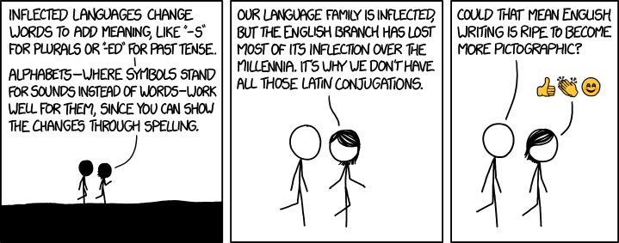
Preprocessing Stemming/Lemmatization
Removing stop words Part of speech tagging Parsing
Explicit methods
Bag of words
Word to vec
Machine learning methods
Recurrent neural net (LSTM)

