Slide 1
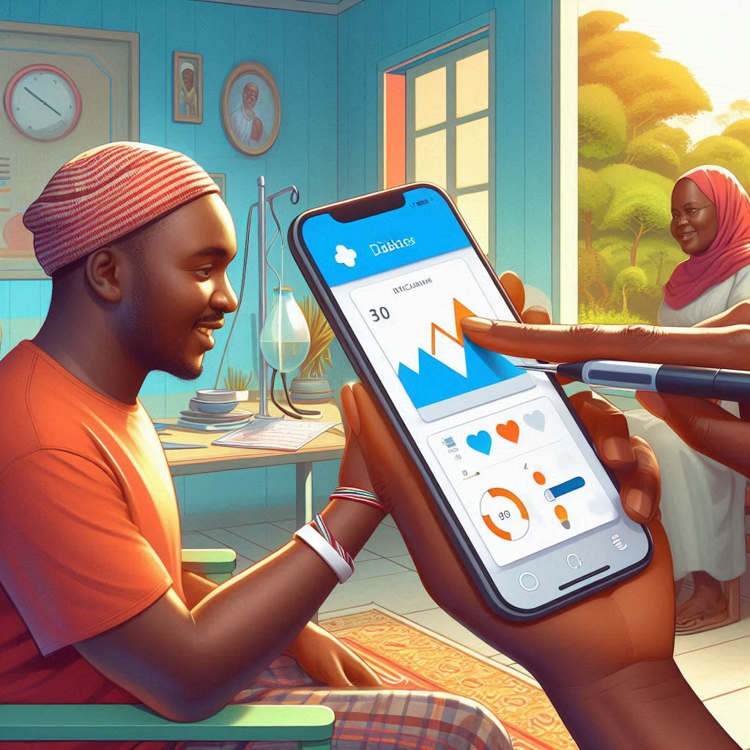

HOSPITAL AT HOME FOR DIABETES AND HYPERTENSION MANAGEMENT
leveraging technology for remote patient care
LUMIN AI

Slide 2






Introduction
Major Health Issues
Remote Management Needs
There is an increasing Demand for remote management of non-communicable diseases (NCDs), especially for patients with chronic conditons.
Diabetes and hypertension are significant health challenges globally, with a particular impact in kenya

Slide 3

Problem Statement
High prevalence
1
Diabetes and hypertension often coexist, multiple risk factors.
Limited Access to Care
2
In Kenya, 78% of people with hypertension are not on treatment, and diabetes management is often hospital centered.
3
Healthcare Burden
hospital visits are costly, time-consuming, and expose patients to risk like hospital-acquired infections.
4
Need for remote care
Patient recover better in familiar home settings, but there's limited infrastructure for home-based management of chronic conditions.

Slide 4


Timely Care
provision
Enhanve quality of life for patients ease the burden of health care systems.
Develop an integrated system that enables remote monitoring, treatment scheduling , and management of diabetes and hypertension patient in their homes
Integrated
System
Development
Objective
Quality of life
enhancments
Provide timely care, ensure better patient outcomes, and reduce hospital dependence.

Slide 5




why the home hospital concept?
Health Care Model
Lower Risk of Infections
Cost-Effectiveness
Emotional Support
A health care model that provides personalized care to patients in their homes reducing the need of prolonged hospital stays.
Lower risk of hospital-acquired infections
Cost-effective and resource-efficient healthcare.
Increased comfort and emotional support for patients from family.

Slide 6
System Components
Website
Wearable Devices
Provides a dashboard forproviding patient vitals.Utilizes AI-based predictive analytics to detect health risks early.
Allows continuous monitoring of blood pressure, glucose levels, and heart rate.
Ensures real-time data integration into the website for continuous patient management.

Slide 7


Goal Performance Management
Personalized care
Tailored recommendations on diet, sleep and exercise.
Personalized care
Convenience
Recieve feedback and monitoring at home.
Convinience
Improved Outcomes
Better patient adherence to treatment, reducing complications and hospital admissions.
Improved adherence
Data-Driven Decisions
Uses AI insights to optimize treatment plans.
data driven desciscions
Early Intervention
Timely detection and management of critical conditions.
Early Intervention

Slide 8

Implemntation Plan
Phase 4: Results Delivery
Phase 1: System Development
Generate detailed reports for users showing trends, health risks, and recommendations.
Provide regular feedback on health improvements, risk levels, and goals.
4
1
Develop a web portal which takes in user data manually. Optionally, a wearable device can be used for real time collection or use ehisting Continous Glucose Monitors (CGM)s.
Phase 3: API Development
Phase 2: AI Integration
:
Create an API that provides personalized health recommendations (diet, exercise, sleep) based on the user's metrics and AI analysis.
3
2
Implementing machine learning algorithms for to determine a patients chance of having diabetes or hypertension.

Slide 9





challanges of homebased care approach
Data Privacy and Security
Device Compatibilty
Addressing the challanges associated with data privacy and security for sensitive health information
Managing compatibility and integration with multiple wearable devices.
Data Encryption
Legal and Regulatory Compliance
Implementing encryption methods for secure data storage and transmission.
Must comply with laws. Emerging regulations could complicate the app's operation
Accuracy of Predictions
Doesn't Replace Doctors: The app is not a substitute for professional medical evaluation.
The AI may provide inaccurate results with regards to the data quality.Users might skip consulting medical professionals.

Slide 10


Conclusion
Transformative Potential:
The 'Hospital at Home' system for diabetes and hypertension management has the potential to transform patient care in Kenya.
Enhanced Patient Outcomes:
By enabling remote monitoring, predictive AI analytics, and personalized treatment plans, the system can improve patient outcomes, reduce hospital dependence, and make healthcare more accessible and efficient.

Slide 11
Our Team
Mark kimurai
Benson Ngugi
Ray Kimutai
Macrey Bwalei
Kelvin Kiprop

Slide 12
Thank You

