Slide 1
Rhythms
Analyzing Rhythms (Part 3)
Instructor: Mark Kramer

Slide 2
Today
Rhythms from spike trains

Slide 3
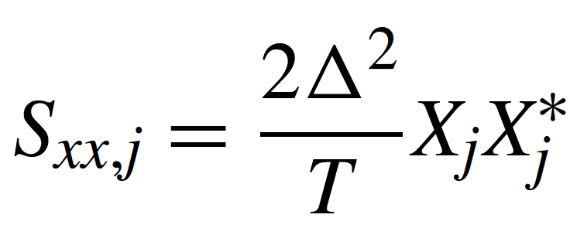
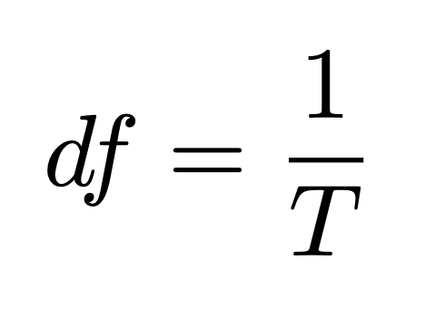
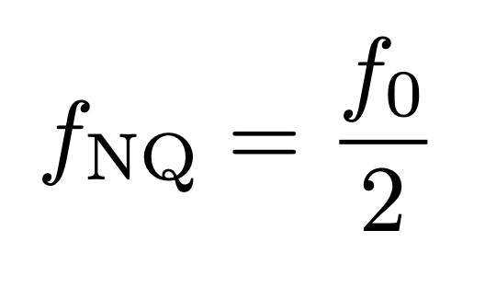
Review
spectrum →
which rhythms dominate a signal
~
Frequency resolution
Duration of recording
Nyquist
frequency
Sampling frequency

Slide 4
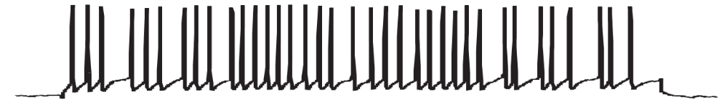
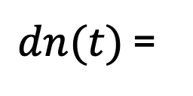
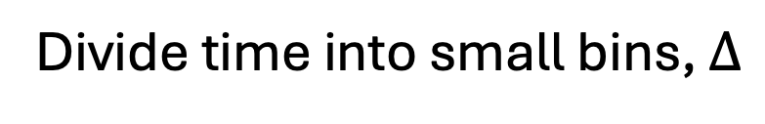
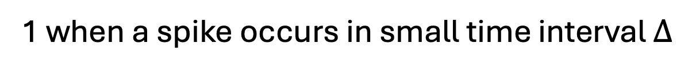
Today
spikes
...
Divide time into small bins, $∆$
indicate spikes
00001110001110110000
Define:
{
1 when a spike occurs in small time interval $Δ$
$dn(t)$ =
0 otherwise

Slide 5
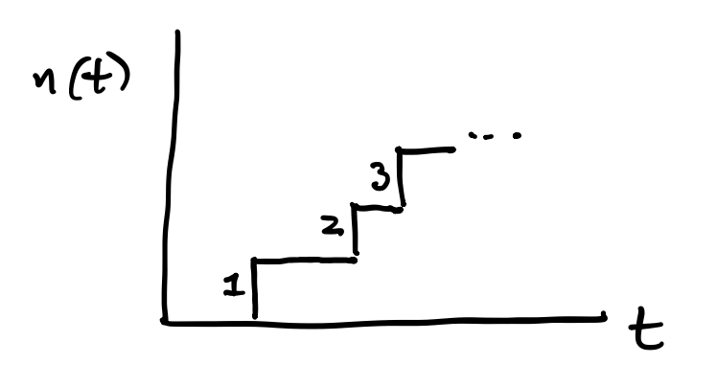
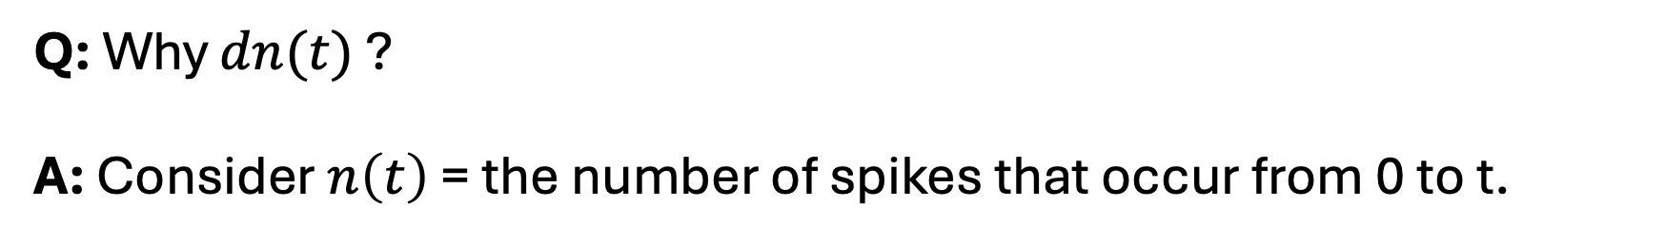
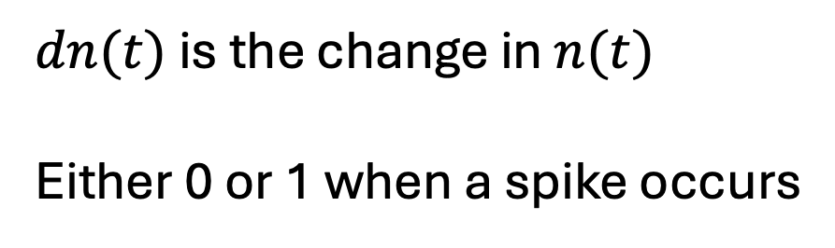
Why?
Q: Why $dn(t)$ ?
A: Consider $n\left(t\right)$ = the number of spikes that occur from 0 to t.
$dn(t)$ is the change in $n(t)$
Either 0 or 1 when a spike occurs
3
2
1

Slide 6
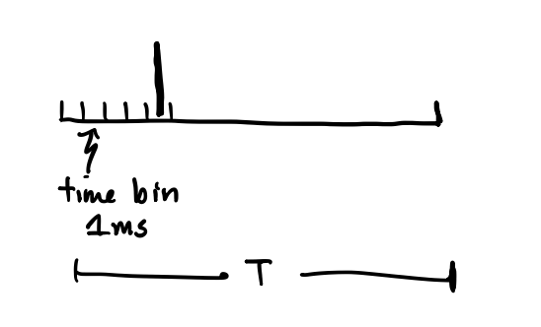

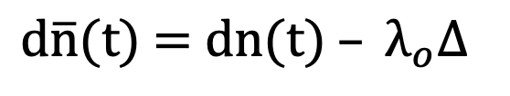
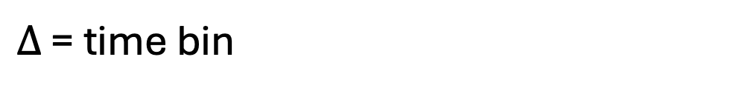
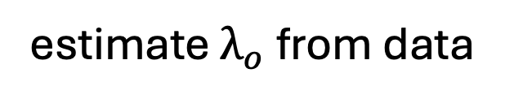
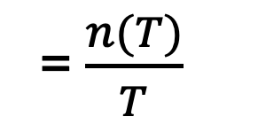
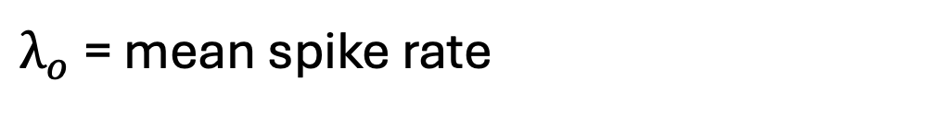
Subtract the mean
$\text{d}\overline{\text{n}}\text{(}\text{t}\text{) = }\text{dn}\text{(}\text{t}\text{) }– λ_{o}∆$
Define:
where
$λ_{o}$ = mean spike rate
= $\frac{n(T)}{T}$
number of spikes after total time T
estimate $λ_{o}$ from data
total time
spike
(e.g., 1 ms)
$∆$ = time bin
at most 1 spike in a bin
$$λ_{o}∆$$
= expected number of spikes in a single time bin

Slide 7
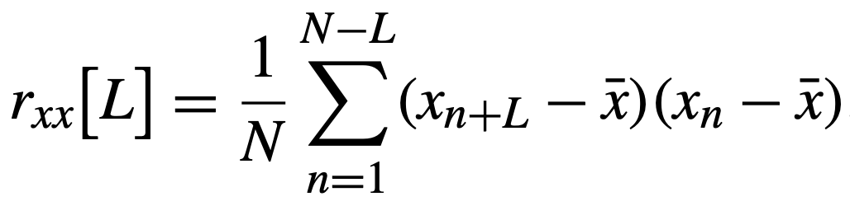
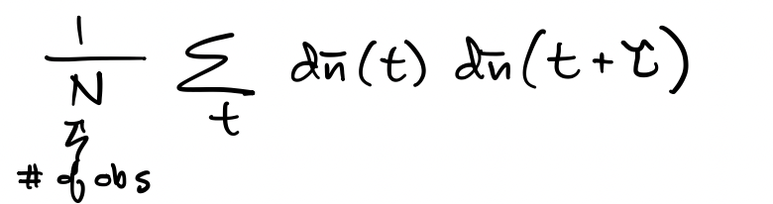
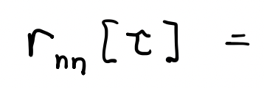
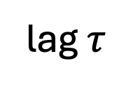
Autocovariance (spike train)
Given a spike occurred at time t, how likely is another spike at t+$τ$ ?
Idea: Compare spike train to a shifted version of itself ... match?
previously
Notation change
lag $τ$
spike train (mean subtracted)

Slide 8
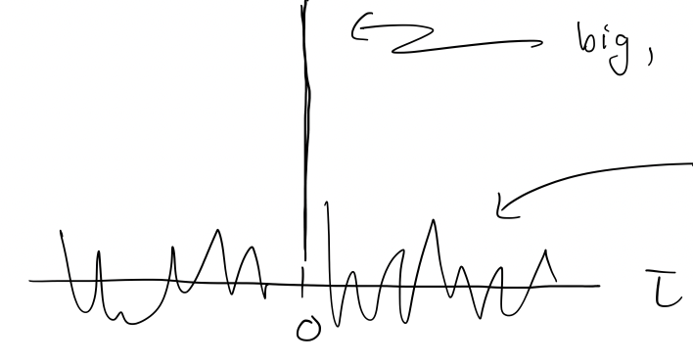
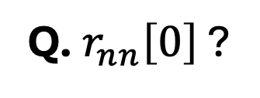
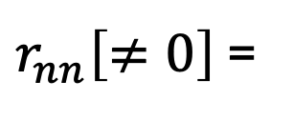
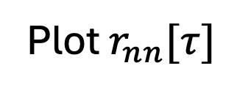
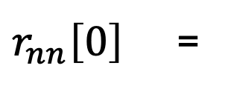
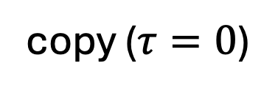
Autocovariance (spike train)
Ex.
copy ($τ=0$)
Q. $r_{nn}\left[0\right]$ ?
$r_{nn}\left[0\right]$ =
big (spikes align)
Big, usually ignore it
$r_{nn}\left[≠0\right]$ =
?
Interesting (how spike now
relates to future spikes)
Plot $r_{nn}[τ]$

Slide 9
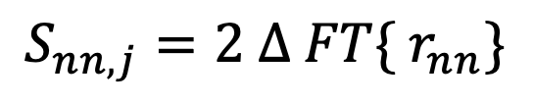
Autocovariance (spike train)
Remember: spectrum is the Fourier transform of the autocovariance
$$S_{nn,j}=2 ∆ FT\{ r_{nn}\}$$
function of frequency
function of time
So, the peak in $r_{nn}$ at lag 0 impacts the spectrum
Q. How?

Slide 10
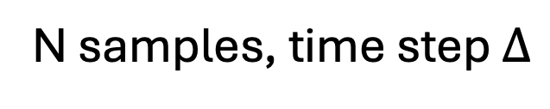
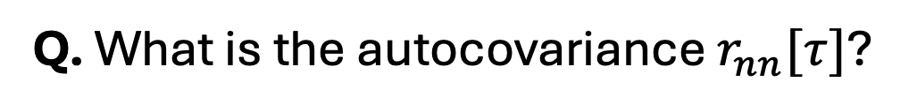
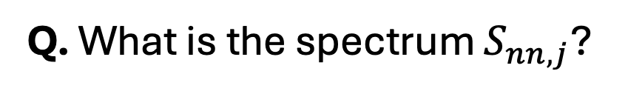
Autocovariance (spike train)
Ex. Random spiking at a fixed rate
N samples, time step $∆$
each moment in time: a (biased) coin flip
No dependence on past or future
Q. What is the autocovariance $r_{nn}[τ]$?
Q. What is the spectrum $S_{nn,j}$?

Slide 11
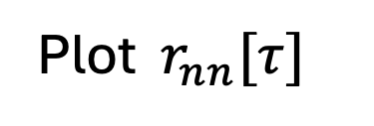
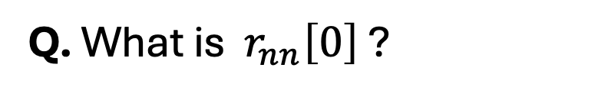
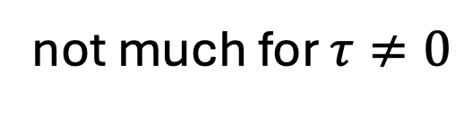
Autocovariance (spike train)
Ex. Random spiking at a fixed rate
big peak at 0 lag
Plot $r_{nn}[τ]$
not much for $τ≠0$
Q. What is $r_{nn}\left[0\right]$ ?

Slide 12
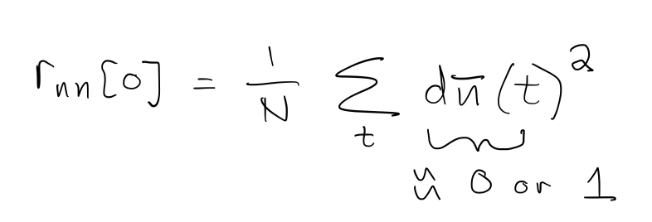
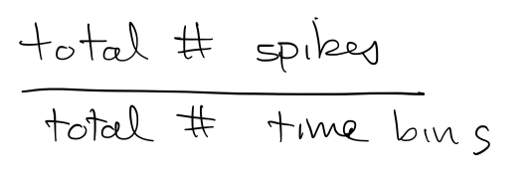
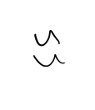
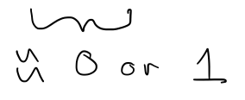
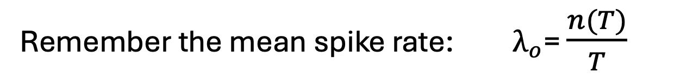
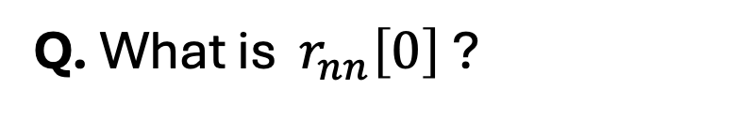
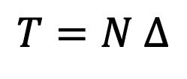
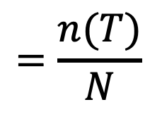
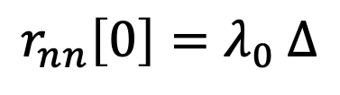
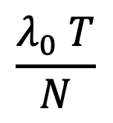
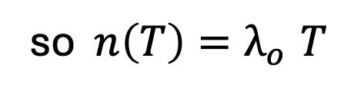
Autocovariance (spike train)
Ex. Random spiking at a fixed rate
Q. What is $r_{nn}\left[0\right]$ ?
$$=\frac{n(T)}{N}$$
Remember the mean spike rate: $λ_{o}$= $\frac{n(T)}{T}$
so $n\left(T\right){=λ}_{o}T$
$$\frac{λ_{0} T}{N}$$
$$T=N ∆$$
$${r_{nn}\left[0\right]=λ}_{0} ∆$$
expected number of spikes in a time bin

Slide 13
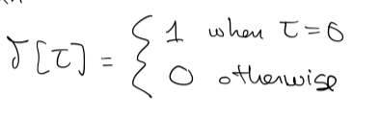
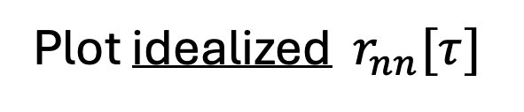
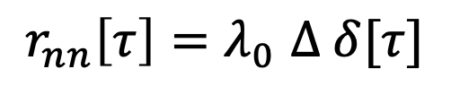
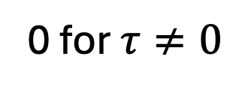
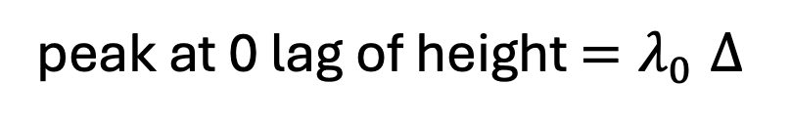
Autocovariance (spike train)
Ex. Random spiking at a fixed rate
Plot idealized $r_{nn}[τ]$
peak at 0 lag of height ${=λ}_{0}∆$
0 for $τ≠0$
lags
0
$$r_{nn}\left[τ\right]{=λ}_{0}∆ δ[τ]$$
where
Q. What is the spectrum?

Slide 14
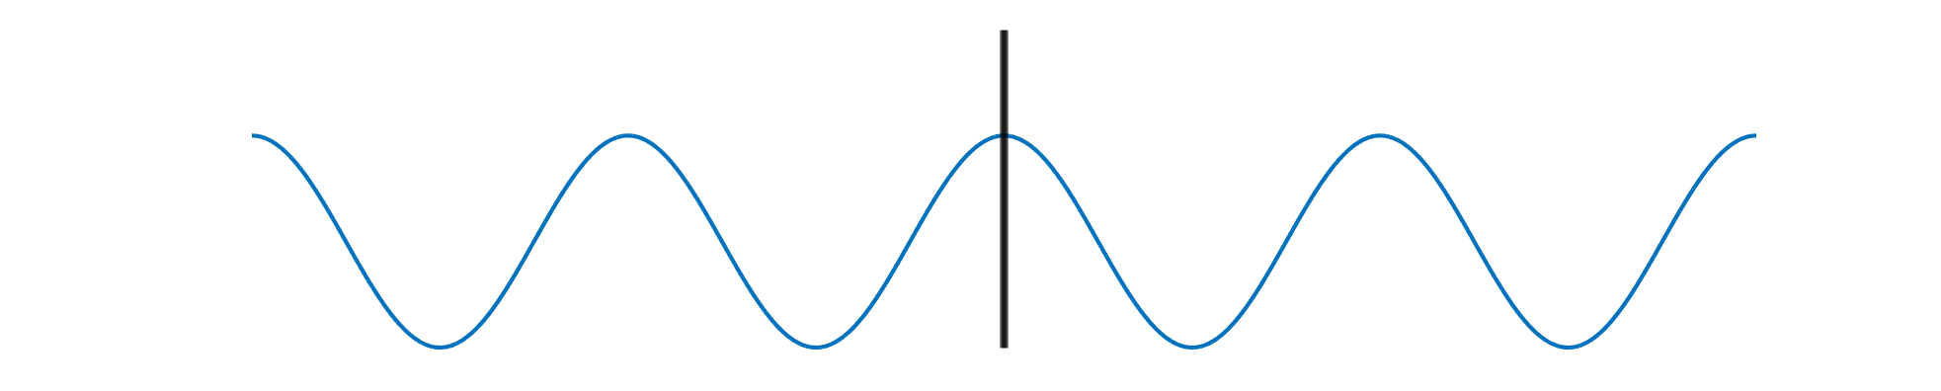








Autocovariance (spike train)
in our example
$$r_{nn}\left[τ\right]{=λ}_{0}∆ δ[τ]$$
Ex. Random spiking at a fixed rate
Q. What is the spectrum?
Use
$$S_{nn,j}=2 ∆ FT\left\{ r_{nn}\right\}$$
$$=2 ∆ FT\{λ_{0}∆ δ[τ]\}$$
$$=2 ∆^{2}λ_{0} FT\{δ[τ]\}$$
In our case, we need $FT\{δ[τ]\}$
Q. What frequency sinusoids do we need?
A. All the frequencies
$FT\{δ[τ]\}$
=1
Need contribution from each frequency to capture this sharp event

Slide 15






Autocovariance (spike train)
Ex. Random spiking at a fixed rate
Q. What is the spectrum?
$$S_{nn,j}=2 ∆ FT\{ r_{nn}\}$$
$$S_{nn,j}=2 ∆ FT\{λ_{0}∆ δ[τ]\}$$
$$r_{nn}\left[τ\right]{=λ}_{0}∆ δ[τ]$$
$$S_{nn,j}=2 ∆{ (λ}_{0}∆) FT\{δ[τ]\}$$
$$S_{nn,j}=2 { ∆}^{2}{ λ}_{0} 1$$
$$S_{nn,j}=2 { ∆}^{2}{ λ}_{0}$$
This is the spectrum of random spiking at fixed rate

Slide 16




Autocovariance (spike train)
Ex. Random spiking at a fixed rate
Q. What is the spectrum?
$$S_{nn,j}=2 { ∆}^{2}{ λ}_{0}$$
$$S_{nn,j}$$
Plot it
$$2 { ∆}^{2}{ λ}_{0}$$
$$f$$
Note: Power at all frequencies

Slide 17



Spectrum (spike train)
Use autocovariance to gain intuition
Alternative: compute spectrum directly.
Fourier transform of spike train
Like our approach for “fields”
- new notation
complex exponentials at frequency $f_{j}$
spike train with mean subtracted

Slide 18





Spectrum (spike train)
Q. What is the spectrum?
A. Use autocovariance to gain intuition
Random spiking
$$S_{nn,j}=2 ∆ FT\{ r_{nn}\}$$
Autocovariance
Spectrum
$λ_{0}∆$
$$S_{nn,j}$$
$$2 { ∆}^{2}{ λ}_{0}$$
0 for $τ≠0$
lags
$$f$$
0

Slide 19

Autocovariance (spike train)
Ex. Random spiking at a fixed rate
Q. What is the autocovariance?
Q. What is the spectrum?

Slide 20



Autocovariance (spike train)
Ex. Random spiking with refractory period.
refractory period
N samples, time step $∆$
each moment in time: a (biased) coin flip
Q. What is the autocovariance $r_{nn}[τ]$?
Q. What is spectrum $S_{nn,j}$ ?

Slide 21

Autocovariance (spike train)
Ex. Random spiking with refractory period.
Q. What is the autocovariance $r_{nn}[τ]$?
[sketch]
lags
0

Slide 22

Autocovariance (spike train)
Ex. Random spiking with refractory period.
Q. What is spectrum $S_{nn,j}$ ?
[sketch]
$$S_{nn,j}$$
$$f$$

Slide 23

Autocovariance (spike train)
Ex. Random spiking with refractory period.
Q. What is the autocovariance $r_{nn}[τ]$?
Q. What is spectrum $S_{nn,j}$ ?

