Slide 1
Spike-field coherence
(and cross-covariance)
Computing the coherence (Part 2)
Instructor: Mark Kramer

Slide 2
Coherence: words
A constant phase relationship between two signals, at the same frequency, across trials.
Note
  “same frequency”
  “across trials”

Slide 3
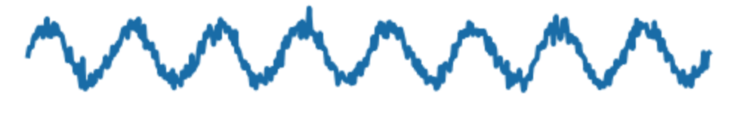
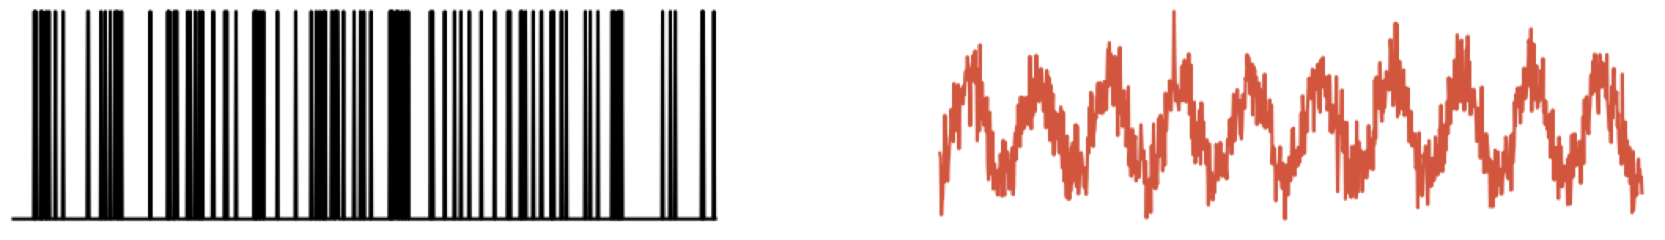
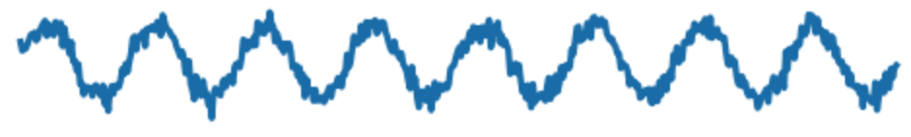
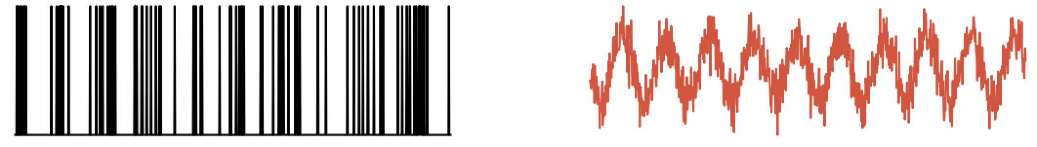
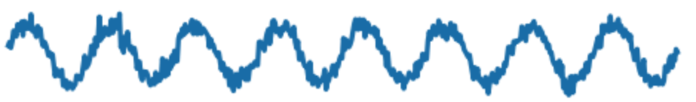
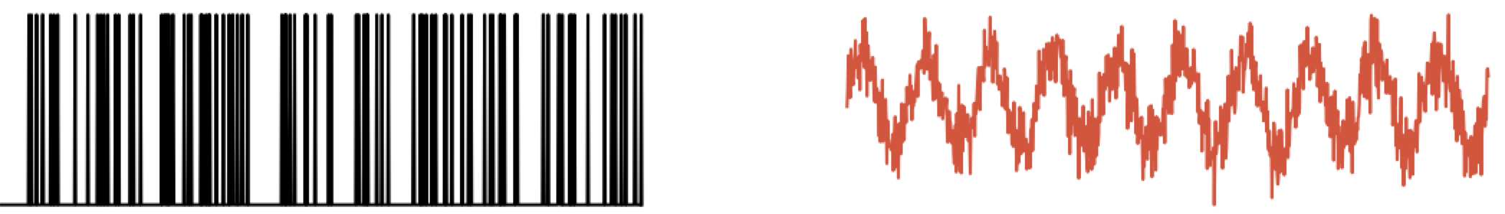
Coherence: idea
Ex: Record data simultaneously from two sensors, across multiple trials
x (field: EEG, LFP, ...)
y (field: EEG, LFP, ...)
Trial 1
Trial 2
Trial 3
Is there a constant phase relationship between x & y, at the same f, across trials?

Slide 4
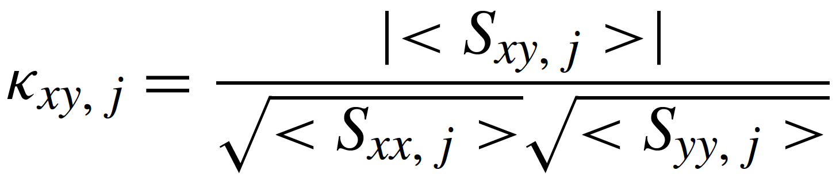
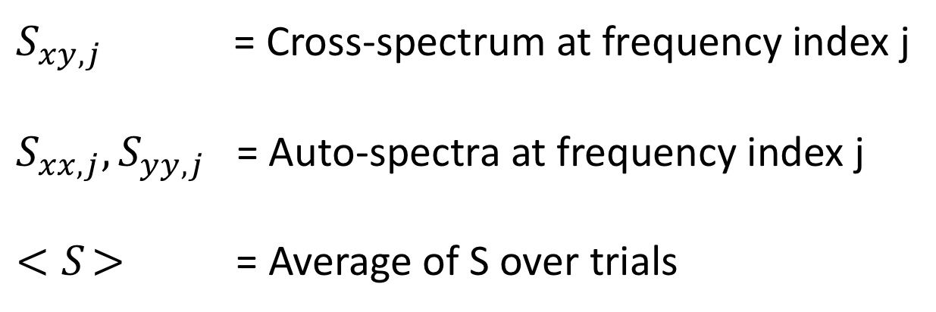
Coherence: equations
Remember:
$S_{xy,j}$ = Cross-spectrum at frequency index j
$S_{xx,j},S_{yy,j}$ = Auto-spectra at frequency index j
${<S}_{ }>$ = Average of S over trials

Slide 5
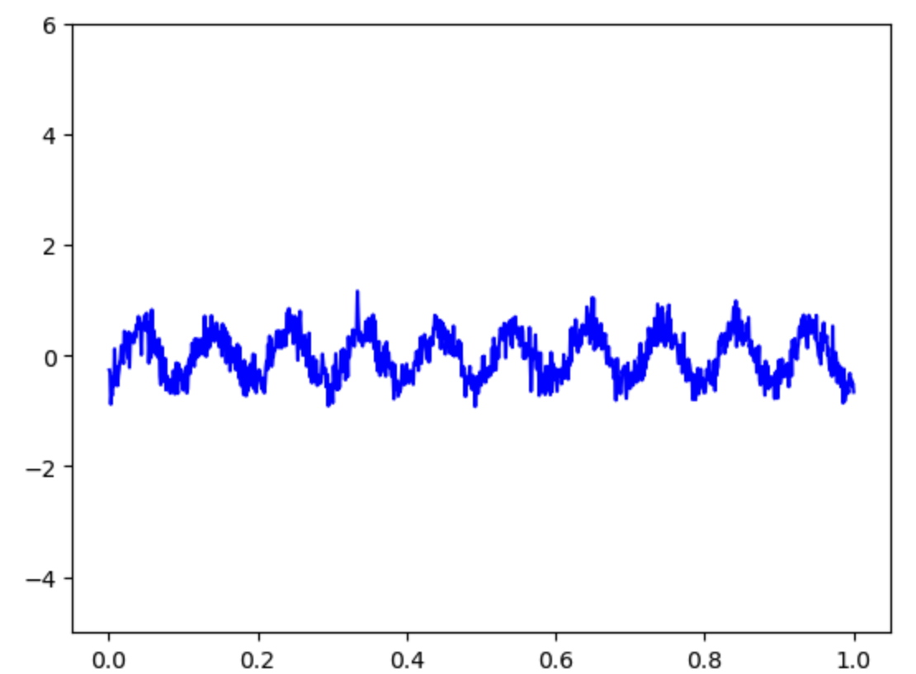
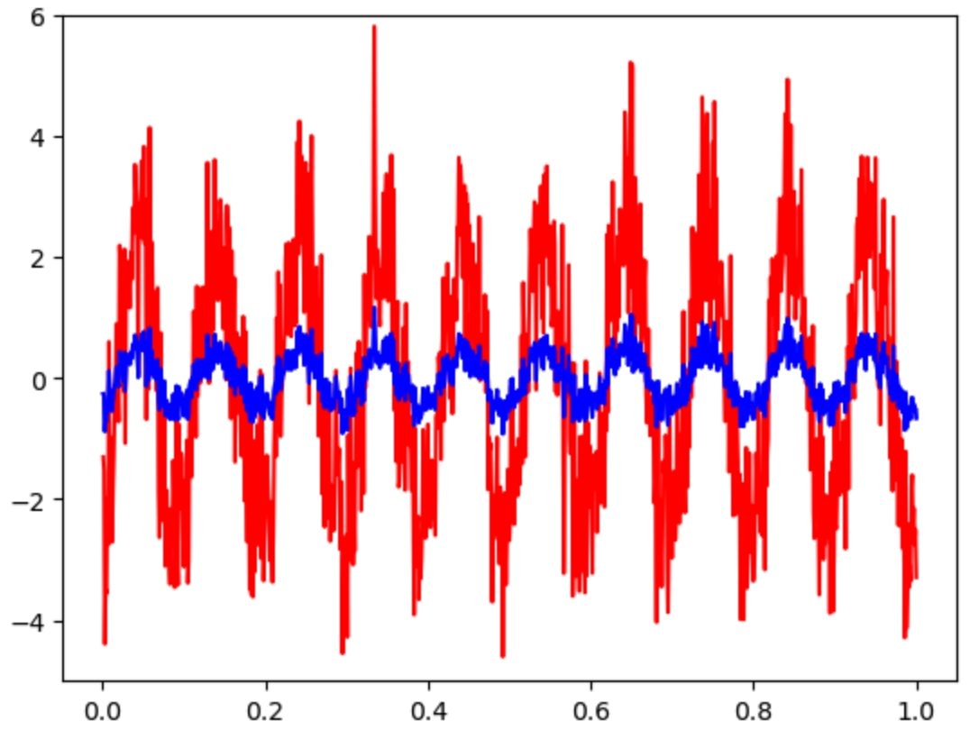
Coherence: impact of scaling
Q. How does scaling x or y impact the coherence?
multiply
by
5
Q. Impact on coherence between x and y?

Slide 6
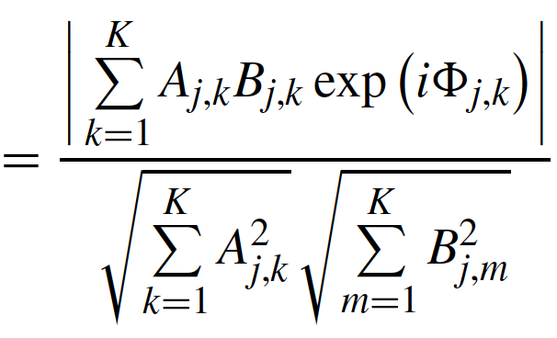
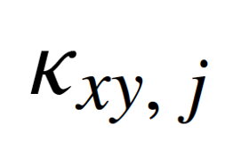
Coherence: impact of scaling
Scale: A_{j,k}→ 5A_{j,k}
5A_{j,k}
(5A_{j,k})²
The 5’s cancel
➔ no impact on coherence
Q. How does scaling x or y impact the coherence?
A. It doesn’t.

Slide 7
Spike-field coherence: idea
Example: Record data simultaneously from two sensors, across multiple trials
x (spikes)
y (LFP)
Trial 1
Trial 2
Trial 3
Is there a constant phase relationship between x & y, at the same freq, across trials?

Slide 8

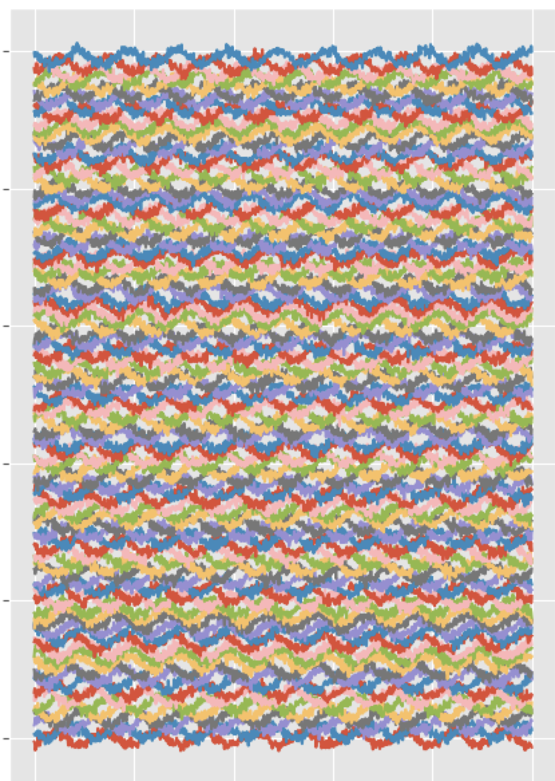
Spike-field coherence
x (spikes)
y (LFP)
Consider the data:
trials
trials
time
time
We want a measure of consistent neural spiking at a specific phase of the field ...

Slide 9
Spike-field coherence : idea
Example: Record data simultaneously from two sensors, across multiple trials
Organize the data ...
x (spikes)
y (field)
trials
trials
time
time
Each row is a trial,
each column is a time point,
organize data in matrices.

Slide 10
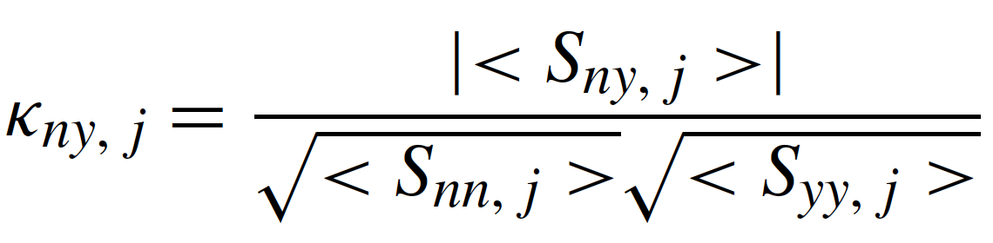
Spike-field coherence: equation
trial averaged cross spectrum
trial averaged spike spectrum
trial averaged field spectrum
y = field signal (e.g., EEG, MEG, LFP, ...)
n = spike train (e.g., [0 0 0 0 0 0 1 0 0 0 0 0 0 0 0 ... ])
Same equations ... but new problems ...

Slide 11
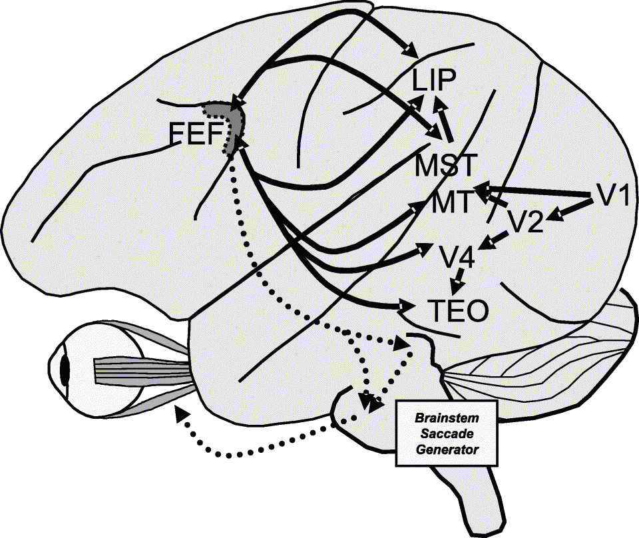
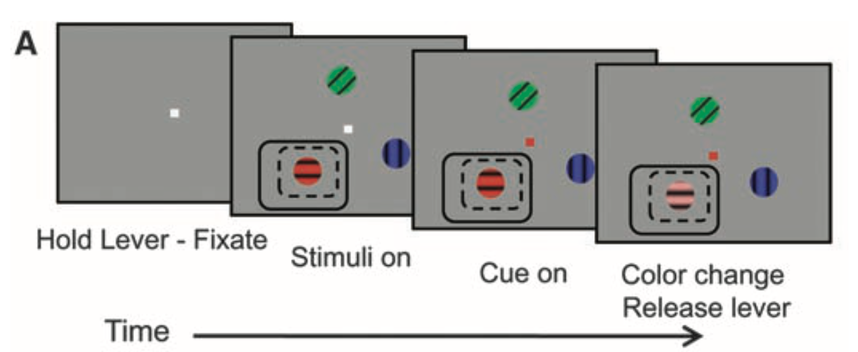
Spike-field coherence: example
Record LFP and spikes
[Gregoriou et al., Science, 2009]
[Thompson & Bichot, Prog. Brain Res, 2005]
in the receptive field (RF) of FEF & V4

Slide 12
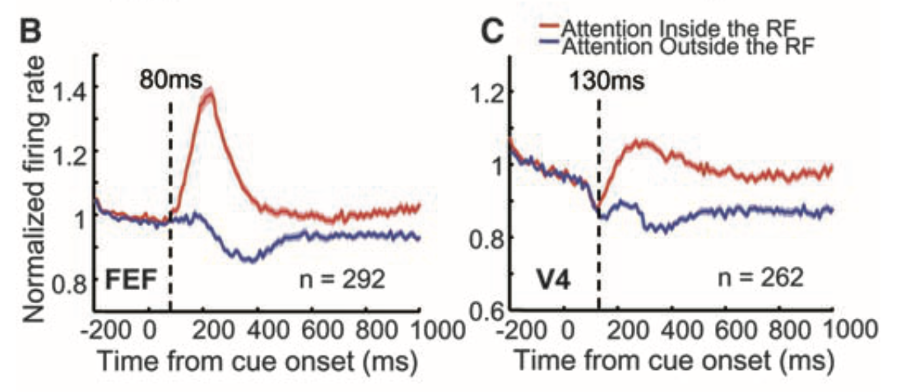
Spike-field coherence: example
[Gregoriou et al., Science, 2009]
Firing rate increases when attending to stimulus in receptive field

Slide 13
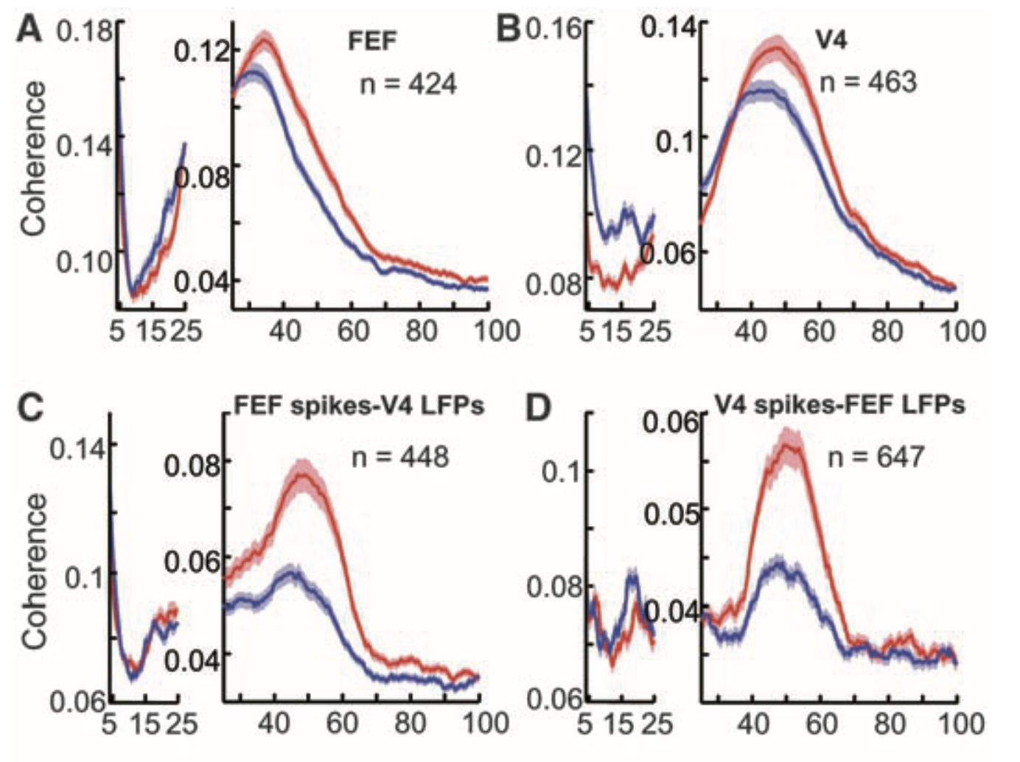

Spike-field coherence: example
[Gregoriou et al., Science, 2009]
Spike field coherence increases when attending to stimulus in receptive field

Slide 14
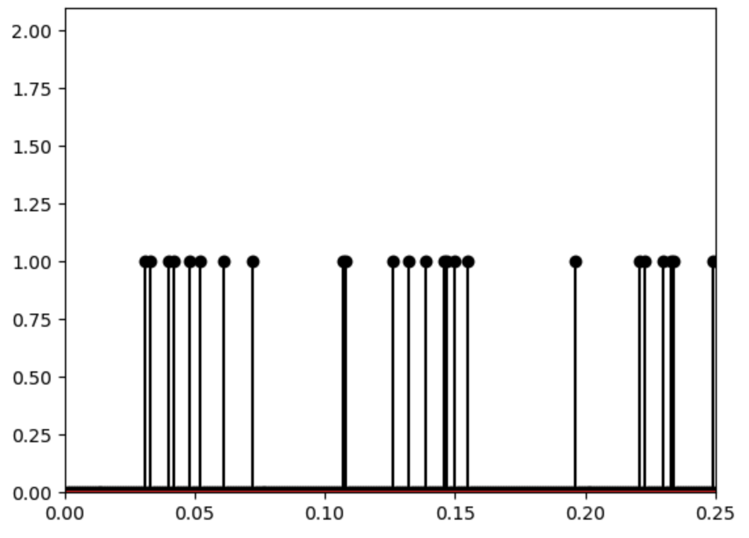
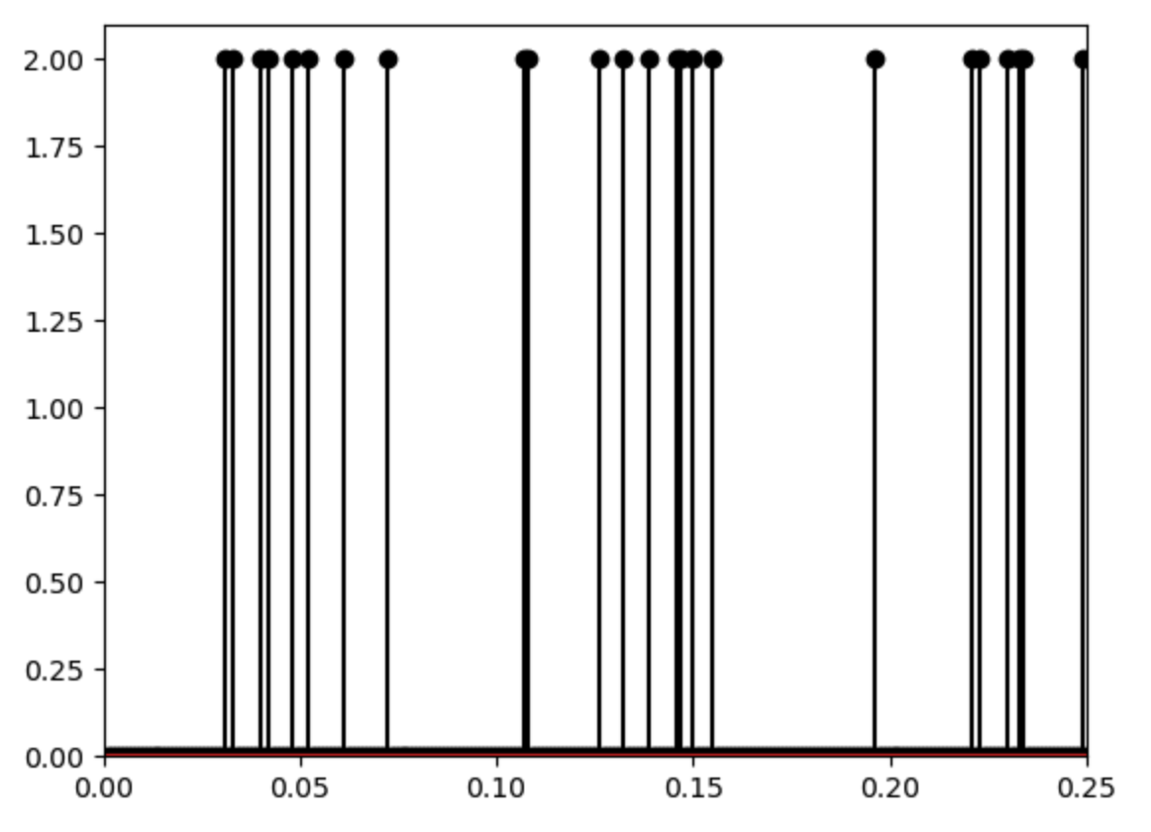
Spike-field coherence: dependence on rate
So, firing rate & spike-field coherence increase.
Q. Confounds?
Q. How does scaling the spikes (x) impact the spike-field coherence?
Q: How do you scale a spike train?
multiply
by
2
No!

Slide 15
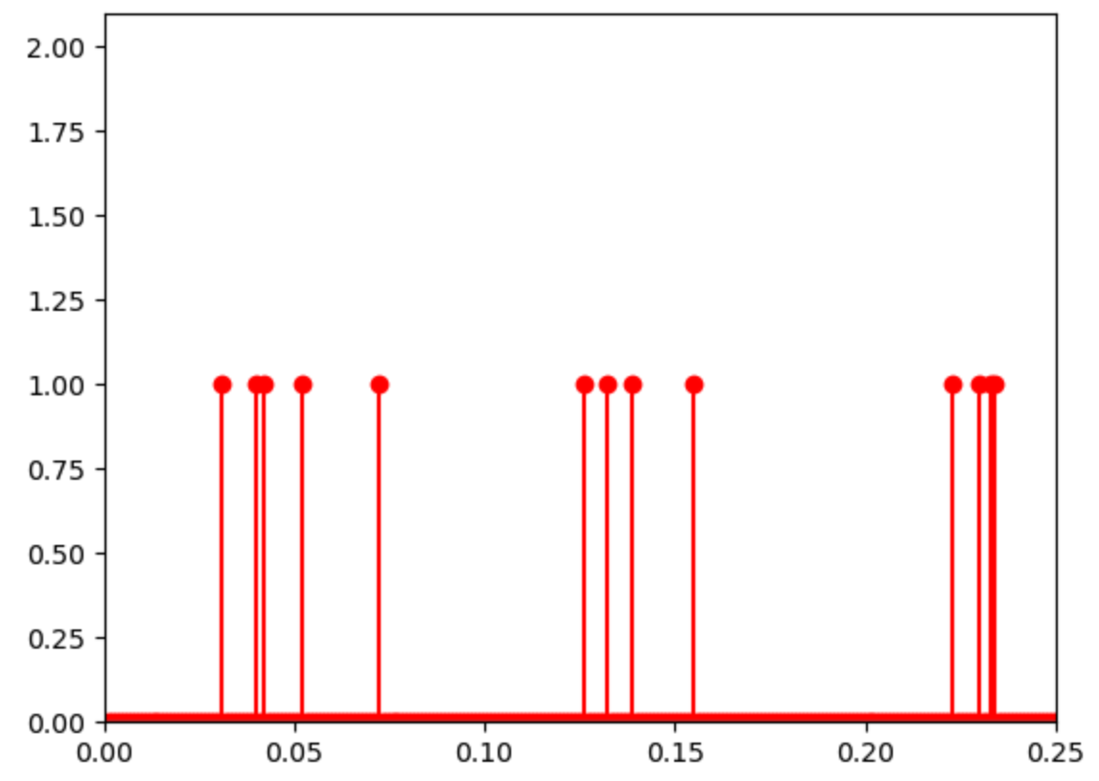
Spike-field coherence: dependence on rate
Q. How does scaling x or y impact the coherence?
Q: How do you scale a spike train?
thin
by
1/2
change the firing rate

Slide 16
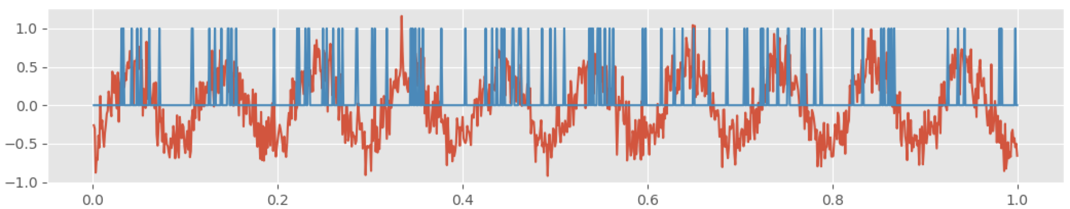
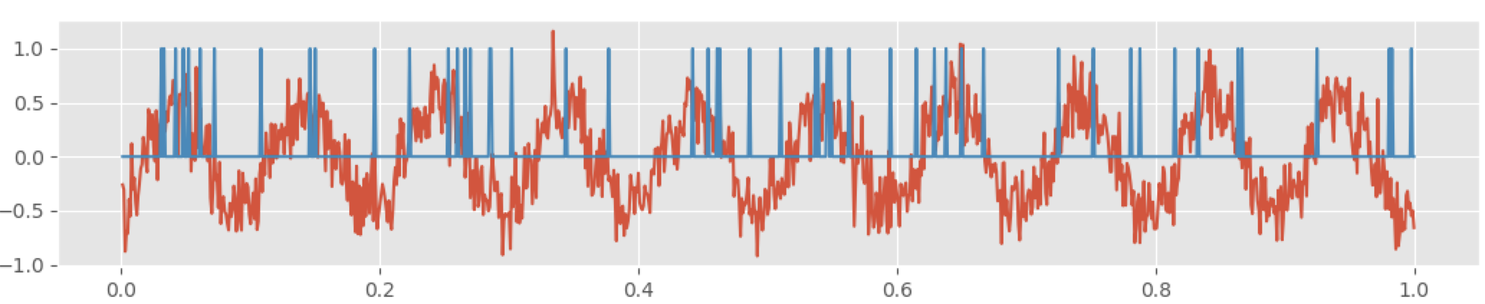
Spike-field coherence: dependence on rate
Q: Does the spike-field coherence depend on the firing rate of the neuron?
Original spike & field
Scale the spiking (remove 50% of spikes, chosen at random, “thinning”)

Slide 17

Spike-field coherence: dependence on rate
Q: Does the spike-field coherence depend on the firing rate of the neuron?
Here, rate: expected number of spikes in a given duration
Try it ...

Slide 18
Spike-field coherence: dependence on rate
Q: Does the spike-field coherence depend on the firing rate of the neuron?
Observations:
greater thinning →
fewer spikes →
lower coherence
as the rate tends to 0,
so does the spike-field coherence
The spike-field coherence reflects
(1) the relationship between spiking activity and the phase of field, and
(2) the mean firing rate.

Slide 19
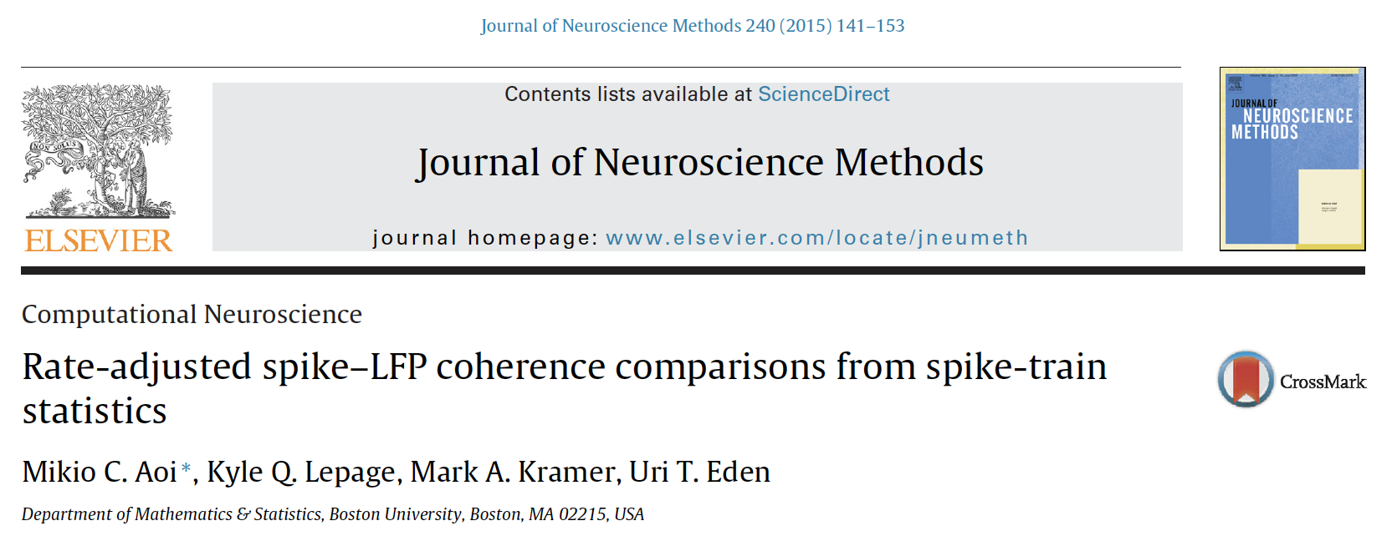
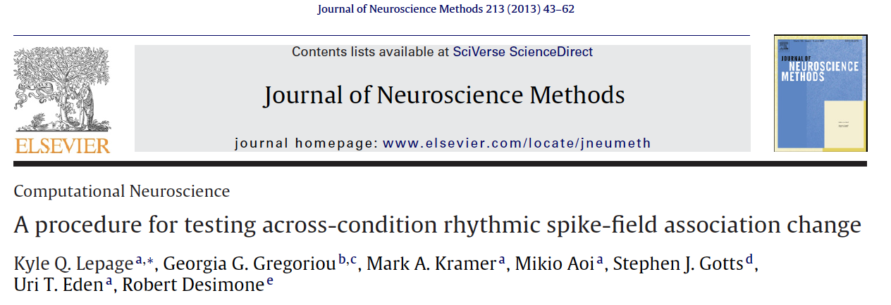
Spike-field coherence: dependence on rate
Q: What next?
Q: If, in your experiment, the overall spike rate differs between two neurons, then
how do you compare the spike-field coherence?
include a rate adjustment factor in the coherence measure to account for rate dependence.
build a generalized linear model to separate overall neural activity from spike train-LFP oscillatory coupling.

