Slide 1
Coherence
(and cross-covariance)
Computing the coherence (Part 1)
Instructor: Mark Kramer
Notes:
9:00-10:30 Mark

Slide 2
Today
Review/reminder
Coherence

Slide 3
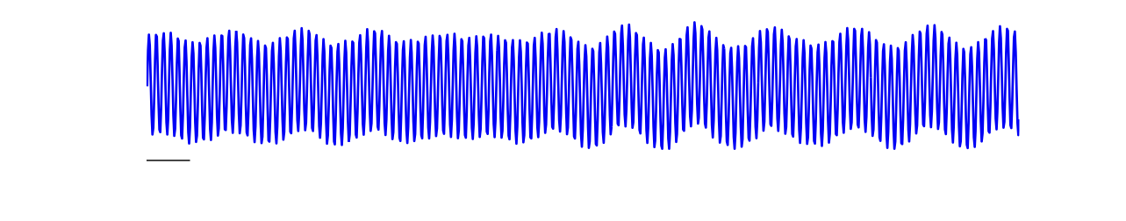
Rhythms
Consider these (experimental data)
100 ms
Visual inspection
Rhythmic (dominant fast rhythm)
It’s complicated
Beyond visual inspection . . . quantitative characterization?

Slide 4
Spectrum
Beyond visual inspection . . .
Consistent with visual inspection
Axes: Power [dB] vs Frequency [Hz]
A simpler representation in frequency domain. Two peaks at ~5-8 Hz, 60 Hz
An improved understanding of rhythmic activity.
How?

Slide 5
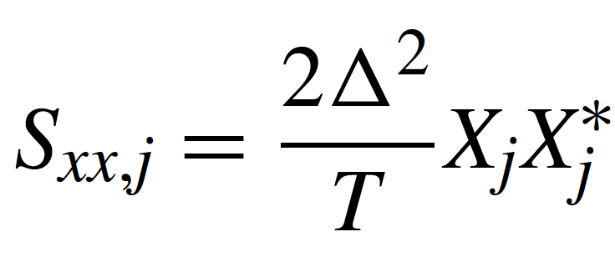
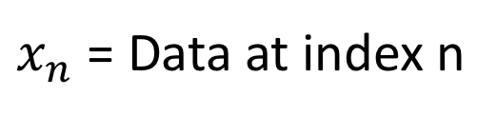
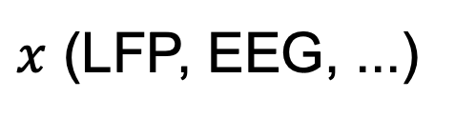
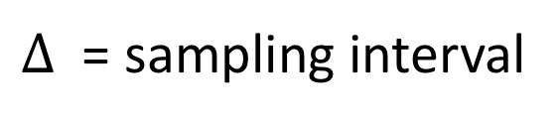
Spectrum
Here, $x$ is activity recorded from a single trial:
$x$ (LFP, EEG, ...)
Note: Time is discrete
$x_{n}$ = Data at index n
(Auto-)spectrum of signal x
complex conjugate
$Δ$ = sampling interval
T = total time of observation
$X_{j}$ = Fourier transform of the data (x) at frequency j

Slide 6
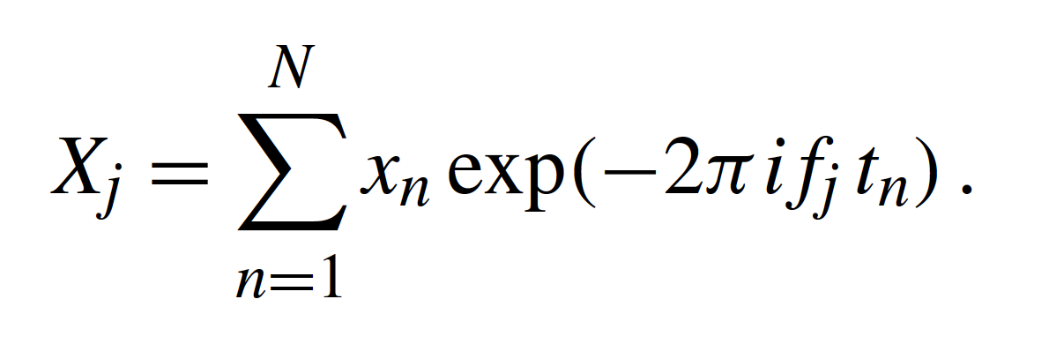
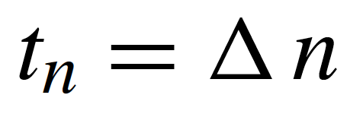
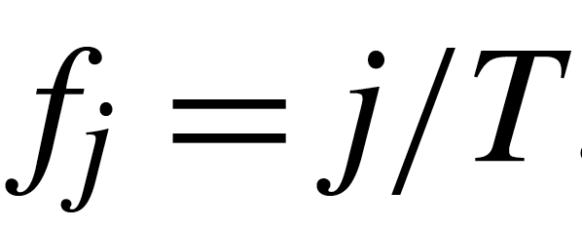
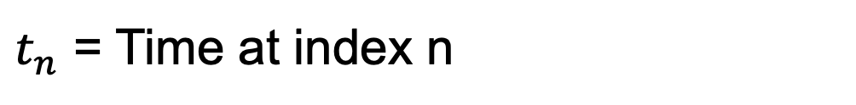
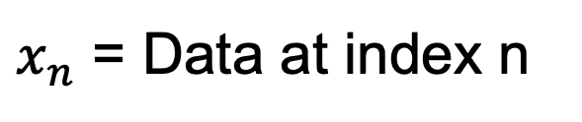
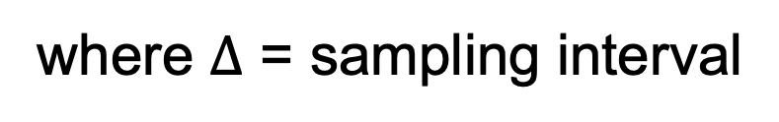

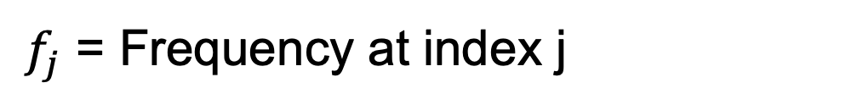
Spectrum
$i=\sqrt{−1}$
Fourier transform of the data x.
x (LFP, EEG, ...)
$x_{n}$ = Data at index n
$t_{n}$ = Time at index n
where $Δ$ = sampling interval
$f_{j}$ = Frequency at index j
where T = total time of observation

Slide 7
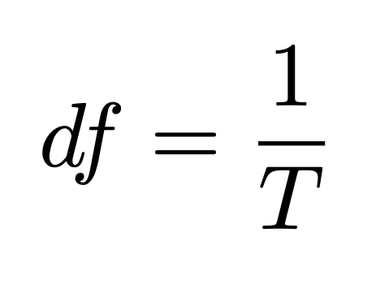
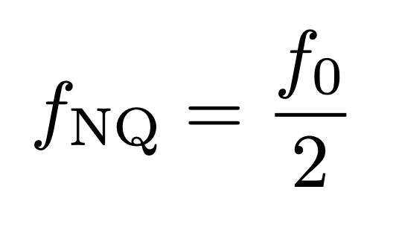
Spectrum
Two important quantities
Frequency resolution
Nyquist
frequency
Q. We record data at 250 Hz. What is the highest frequency we can observe? What is the frequency resolution?

Slide 8
Coherence: words
A constant phase relationship between two signals, at the same frequency, across trials.
Note
  “same frequency”
  “across trials”

Slide 9
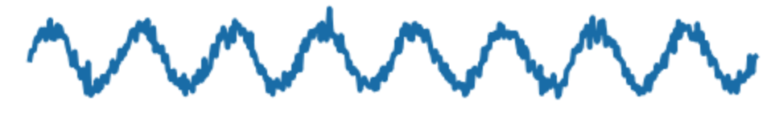
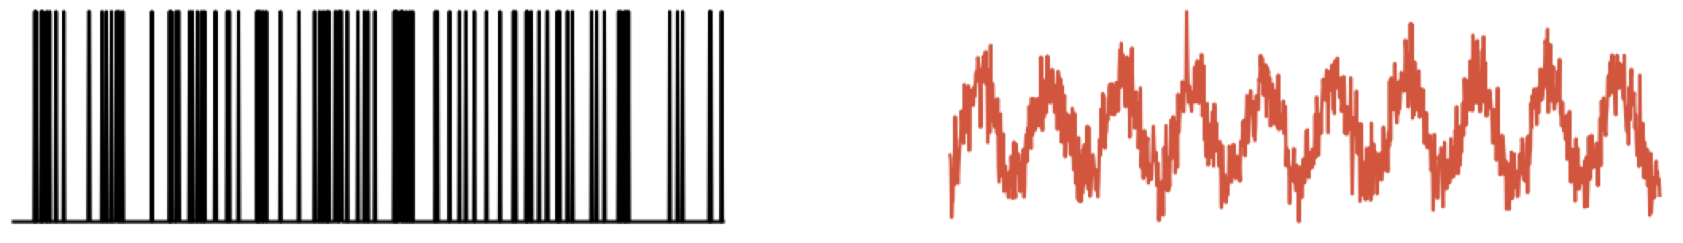
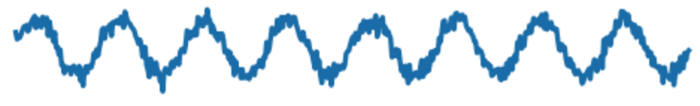
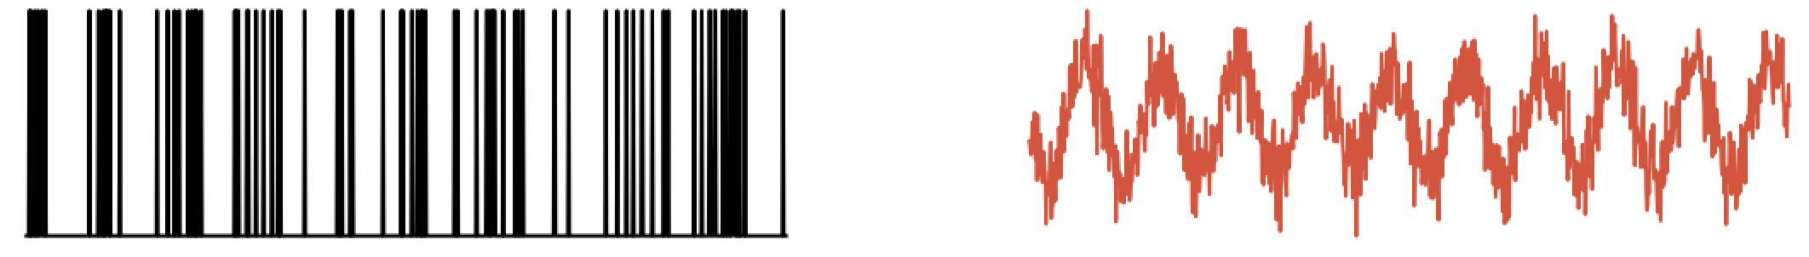
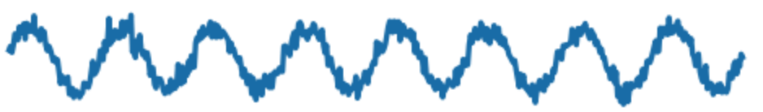
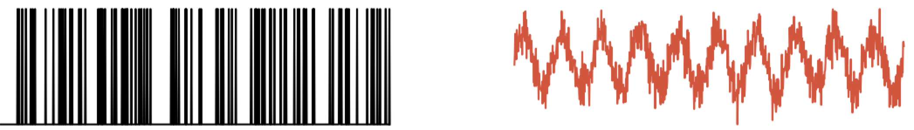
Coherence: idea
Ex: Record data simultaneously from two sensors, across multiple trials
x (field: EEG, LFP, ...)
y (field: EEG, LFP, ...)
Trial 1
Trial 2
Trial 3
Is there a constant phase relationship between x & y, at the same f, across trials?

Slide 10
Coherence: idea
Ex: Record data simultaneously from two sensors, across multiple trials
Organize the data ...
x (field: EEG, LFP, ...)
y (field: EEG, LFP, ...)
trials
trials
time
time
Each row is a trial,
each column is a time point,
organize data in matrices.

Slide 11
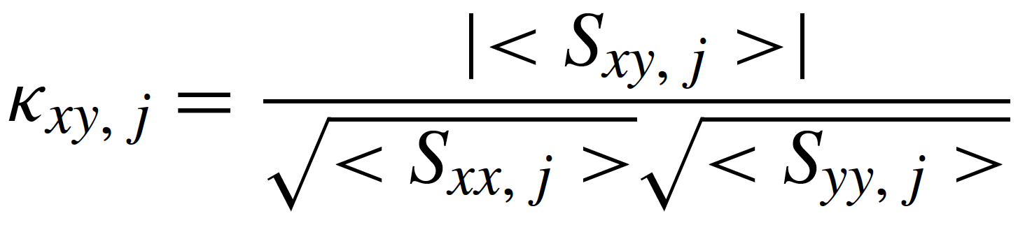
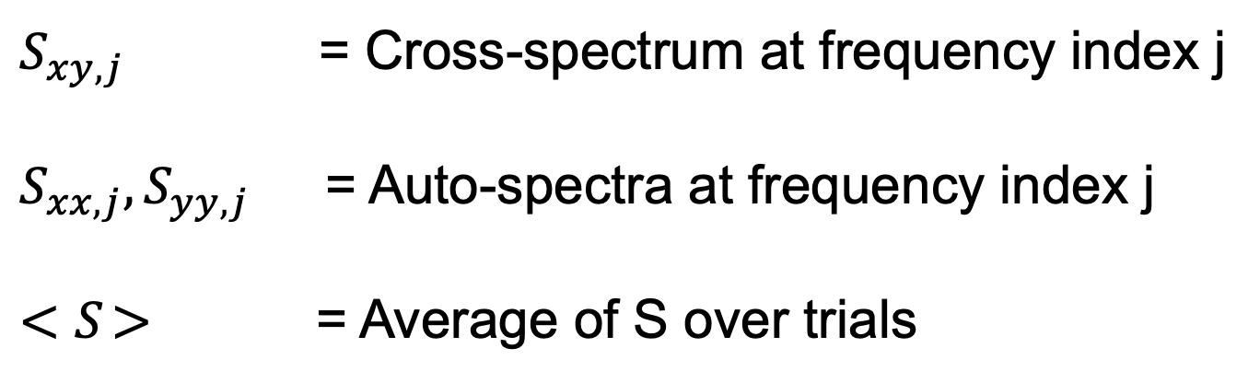
Coherence: equations
This is what we’ll compute:
$S_{xy,j}$ = Cross-spectrum at frequency index j
$S_{xx,j},S_{yy,j}$ = Auto-spectra at frequency index j
${<S}_{ }>$ = Average of S over trials
Define each piece ...

Slide 12
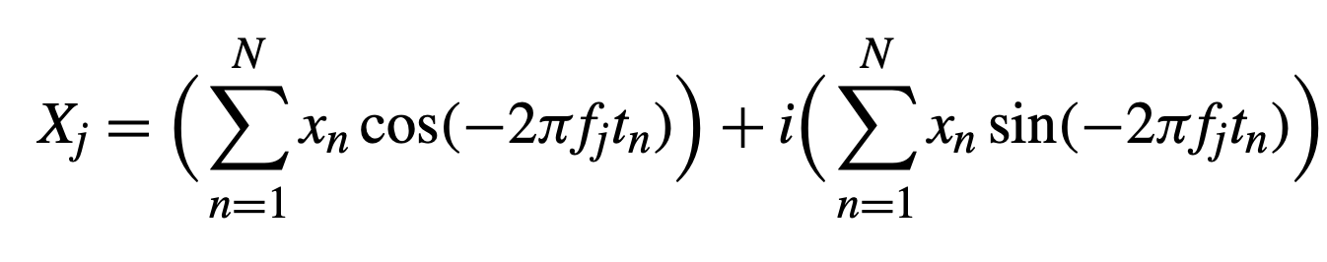
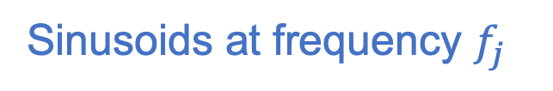
Spectrum: intuition
More spectrum intuition ...
Fourier transform of the data x.
Data as a function of time index n
Replace with
Euler’s formula
Sinusoids at frequency $f_{j}$
Real
Imaginary

Slide 13
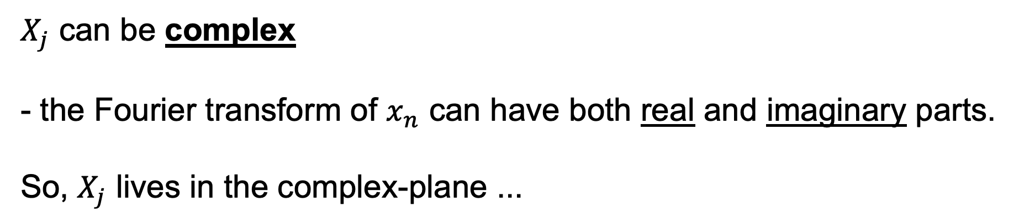
Spectrum: intuition
More spectrum intuition ...
Fourier transform of the data x.
$X_{j}$ can be complex
- the Fourier transform of $x_{n}$ can have both real and imaginary parts.
So, $X_{j}$ lives in the complex-plane ...

Slide 14
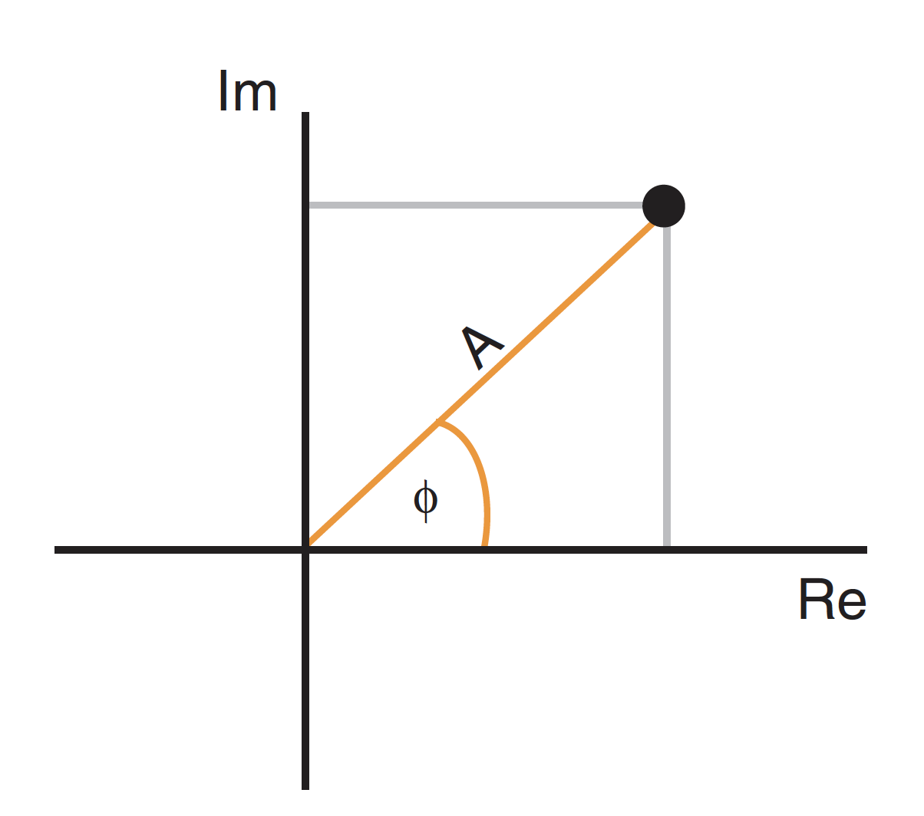
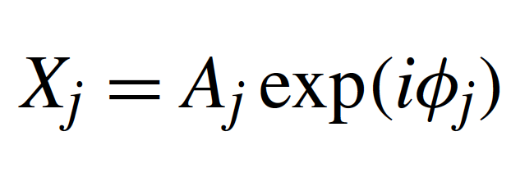
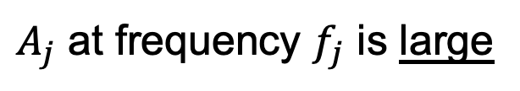
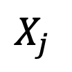
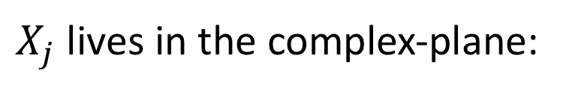
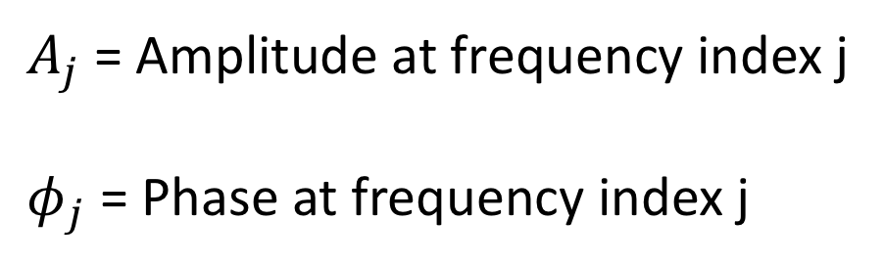
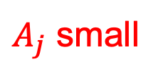
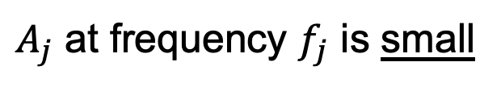
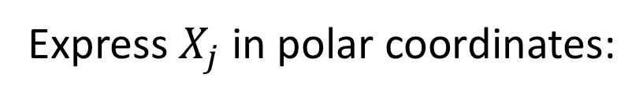
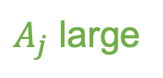
Spectrum: intuition
$A_{j}$ large
$X_{j}$
$X_{j}$ lives in the complex-plane:
Express $X_{j}$ in polar coordinates:
$A_{j}$ small
$A_{j}$ = Amplitude at frequency index j
$φ_{j}$ = Phase at frequency index j
Match:
$A_{j}$ at frequency $f_{j}$ is large
Mismatch:
$A_{j}$ at frequency $f_{j}$ is small

Slide 15
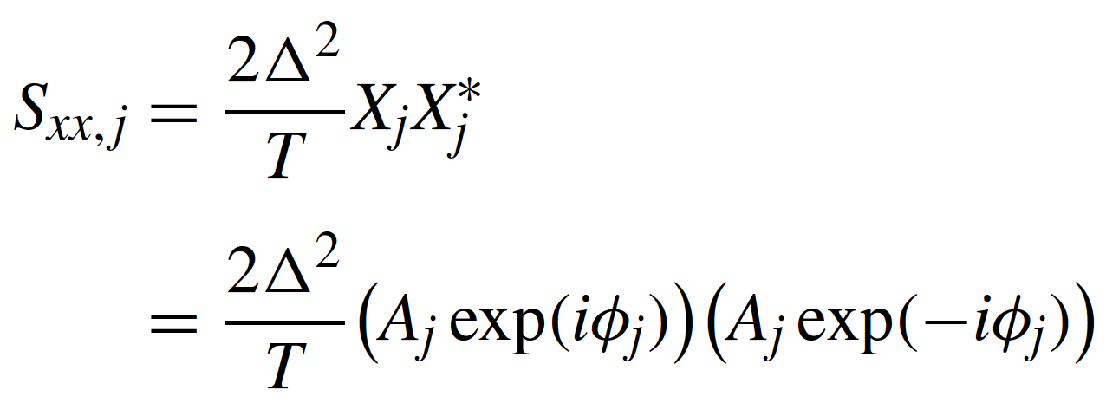
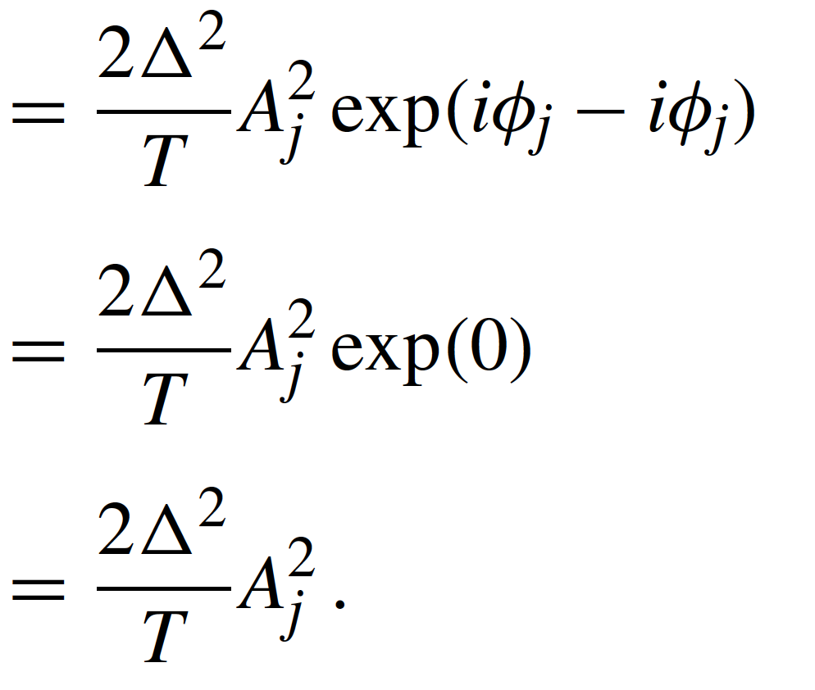
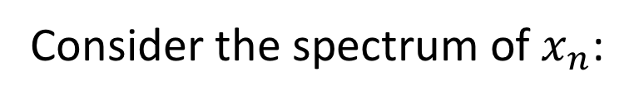
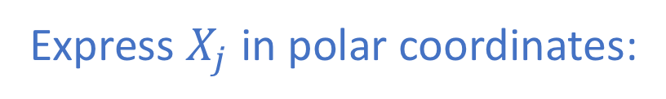

Spectrum: intuition
Consider the spectrum of $x_{n}$:
Express $X_{j}$ in polar coordinates:
More direct interpretation of the spectrum at frequency $f_{j}$:
better match → larger amplitude of $X_{j}$ in the complex plane → more power

Slide 16
Spectrum from multiple trials
Ex: Record data across multiple trials
Trial 1
Trial 2
Trial 3
K total trials
Q. Spectrum?

Slide 17
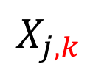
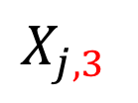
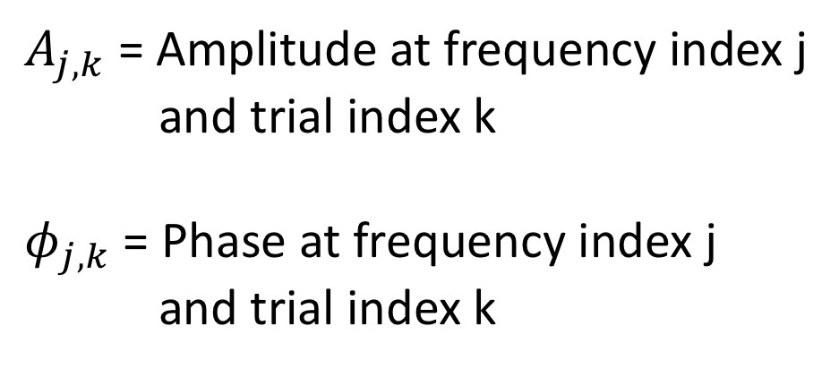
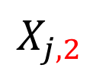
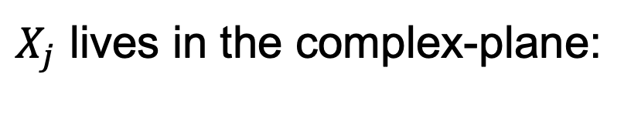
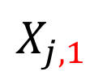
Spectrum from multiple trials
$X_{j}$ lives in the complex-plane:
Fourier transform for each trial lives in the complex-plane:
In polar coordinates:
$X_{j,1}$
$X_{j,2}$
$A_{j,k}$ = Amplitude at frequency index j
and trial index k
$φ_{j,k}$ = Phase at frequency index j
and trial index k
$X_{j,k}$
$X_{j,3}$

Slide 18
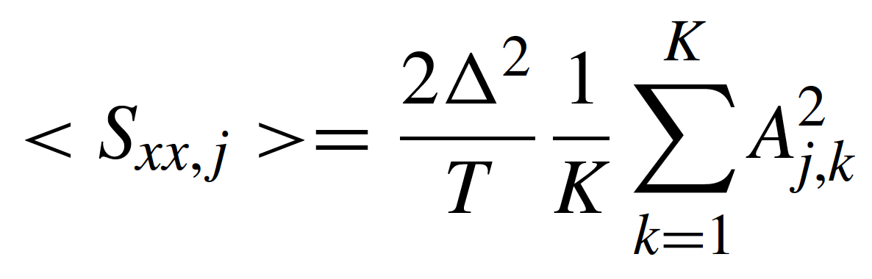
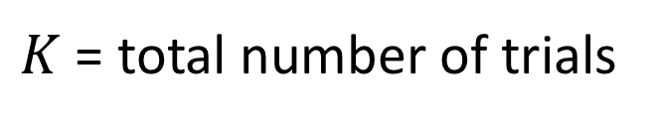
Spectrum from multiple trials
To compute coherence, we need the trial-averaged spectrum:
Average squared amplitude
over trials
Single trial spectrum
$A_{j,k}$ = the amplitude of the signal x, at frequency index j, and trial index k .
$K$ = total number of trials

Slide 19
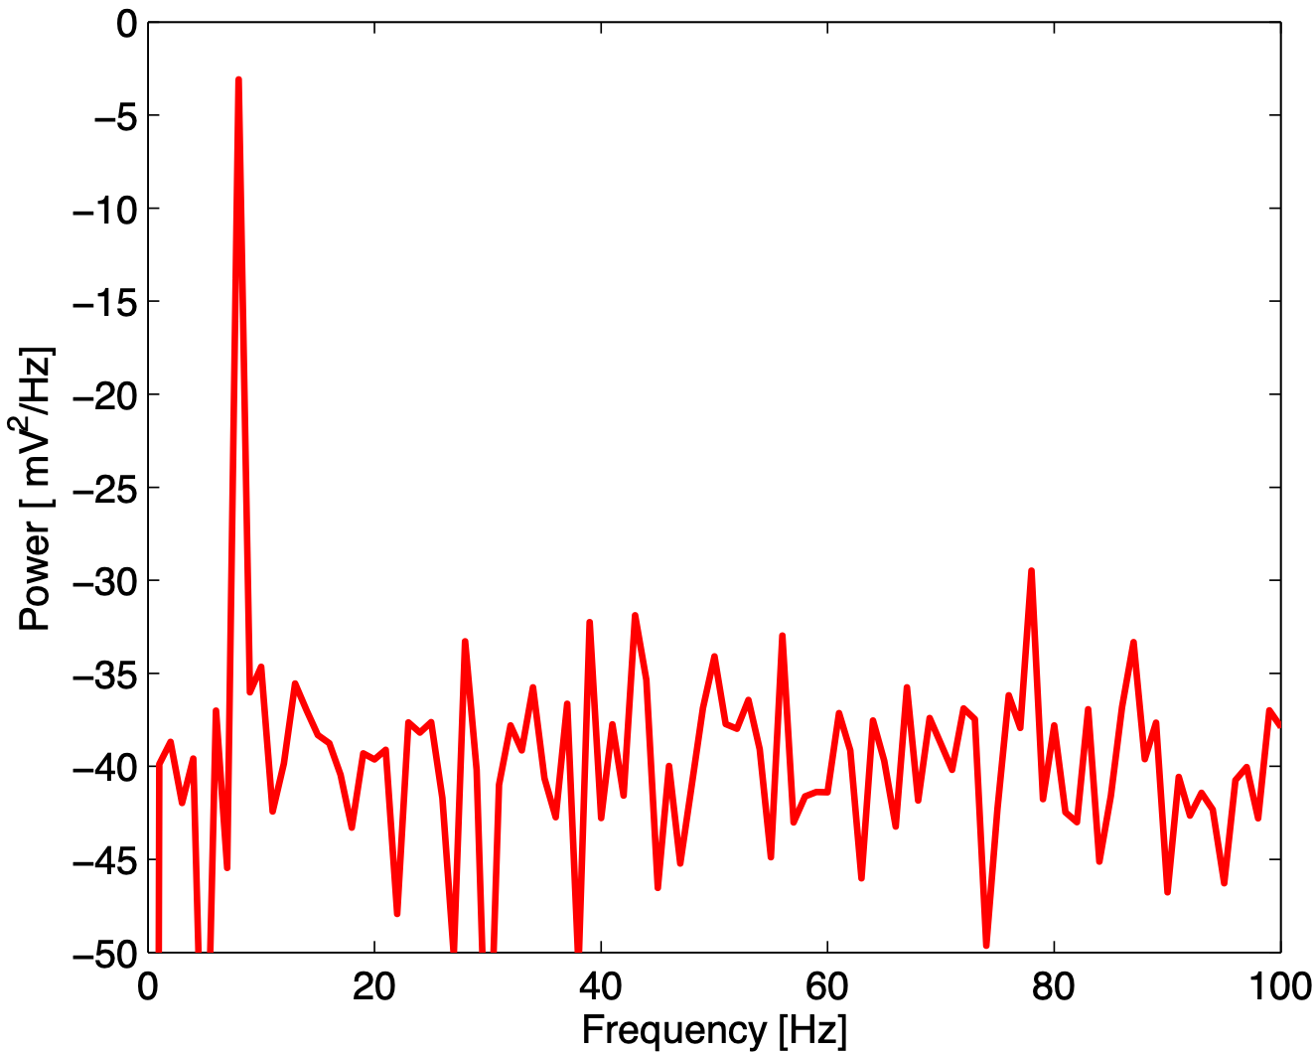
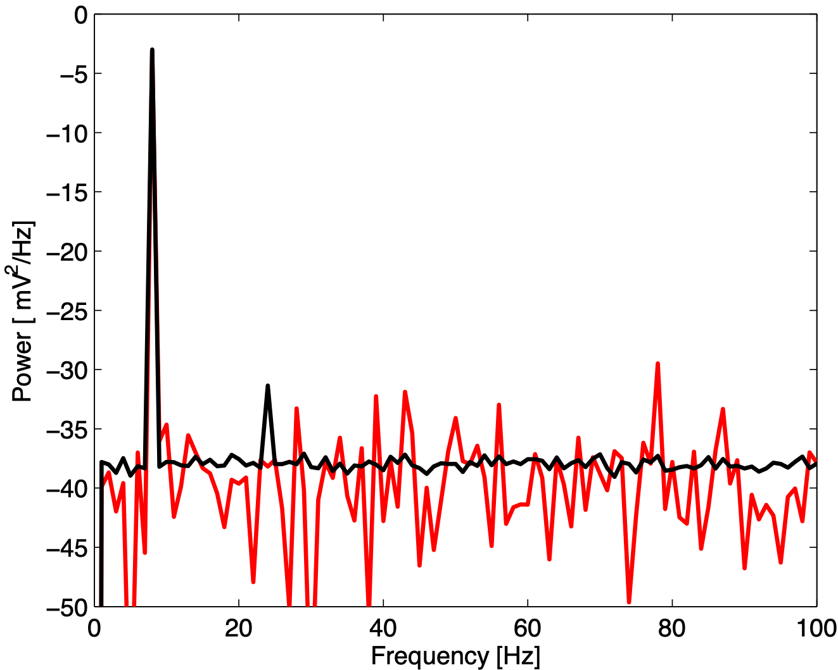
Spectrum from multiple trials
Single trial:
10 Hz
10 Hz
Trial averaged
dB]
dB]
variability
24 Hz
Trial averaged spectrum:
reduced variability.
reveals another peak . . .

Slide 20
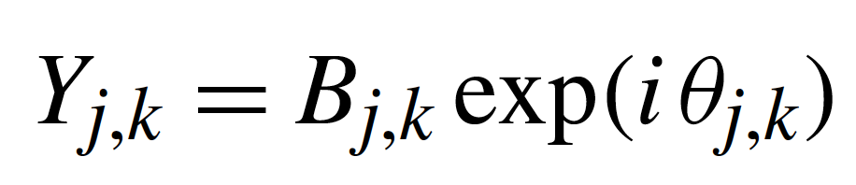




Coherence: equations
Similarly, for signal $y_{n}$.
Fourier transform of y at frequency j, and trial k:
$B_{j,k}$ = the amplitude of the signal y at frequency index j and trial index k .
$θ_{j,k}$ = the phase of the signal y at frequency index j and trial index k .
The trial-averaged spectrum of y at frequency index j
$$B$$
$$yy$$

Slide 21

Coherence: equations
✓
✓
Consider the trial averaged cross-spectrum ...

Slide 22



Coherence: equations
The trial averaged cross-spectrum at frequency index j:
Like the auto-spectrum, but use X and Y.
In polar coordinates:
Phase of x
Phase of y
where
is the phase difference between the two signals, at frequency index j and trial k.

Slide 23

Coherence: equations
Put it all together ...
In polar coordinates ...
cross-spectrum of x & y,
depends on trial averaged
amplitudes, phase differences.
x trial averaged spectrum,
at frequency index j
y trial averaged spectrum,
at frequency index j

Slide 24



Coherence: intuition
To build intuition, assume: the amplitude is identical for both signals and all trials.
Note: no trial dependence
then
only involves the phase difference between the two signals averaged
across trials.

Slide 25








Coherence: intuition
Case 1: Phases align across trials.
=
0
Plot
in the complex plane.
sum these vectors end to end across trials
divide by K
$$≈1$$
strong coherence - constant phase relation between
the two signals across trials at frequency index j.

Slide 26





Coherence: intuition
Case 2: Random phase differences across trials.
Plot
in the complex plane.
1
sum these vectors end to end across trials
divide by K
$$≈0$$
weak coherence - random phase relation between
the two signals across trials at frequency index j.
The weak coherence in this case
results from the random phase relation over trials between the two signals.

Slide 27

Coherence: summary
0: no coherence between signals x and y at frequency index j
1: strong coherence between signals x and y at frequency index j .
The coherence is a measure of the phase consistency between two signals at frequency index j across trials.

Slide 28


Cross-covariance
Remember autocovariance
Now cross-covariance
Q. What’s different?

Slide 29

Cross-covariance
Idea: compare two time series (x and y)
Do they match?

Slide 30



Cross-covariance
Compute cross-covariance at different lags L

Slide 31

Cross-covariance
mean of signal y,
trial k
Trial-averaged cross-covariance
average over trials
signal x,
time n+L,
trial k.
signal y,
time n,
trial k.
mean of signal x,
trial k

Slide 32

Cross-covariance vs coherence
Remember:
auto-spectrum
auto-covariance
In the same way:
xy
xy
cross-spectrum
cross-covariance
The cross-spectrum is the Fourier transform of the cross-covariance.
(frequency domain)
(time domain)

Slide 33

Coherence: examples

