Slide 1
Rhythms
Analyzing Rhythms (Part 2)
Instructor: Mark Kramer

Slide 2
Today
Autocovariance

Slide 3
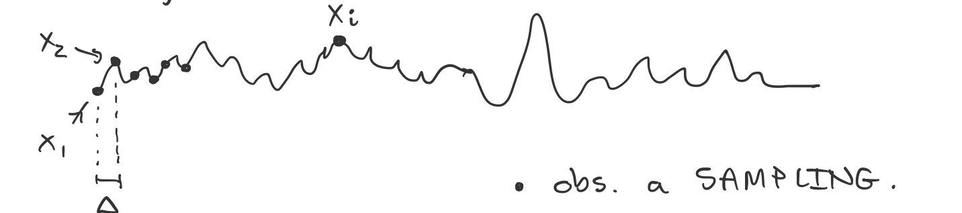

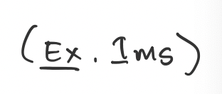
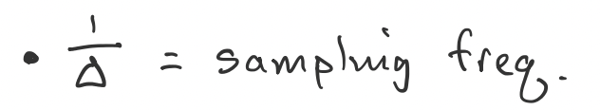

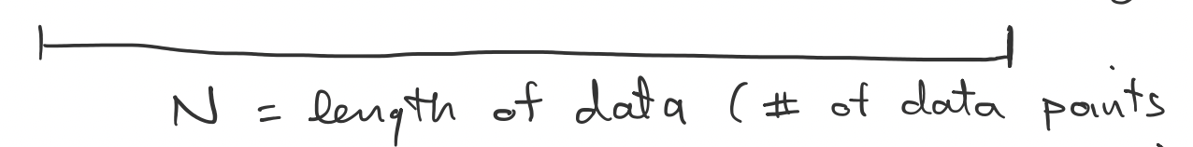
Notation

Slide 4
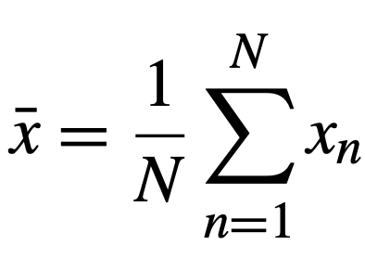
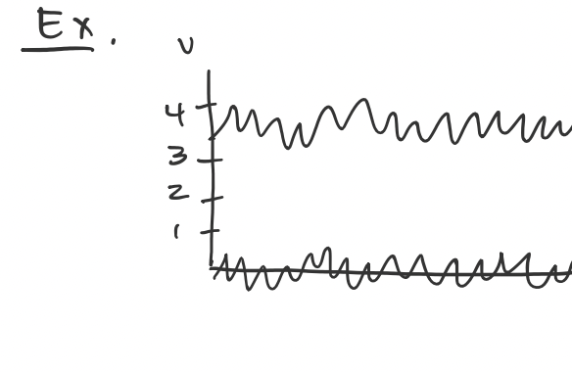
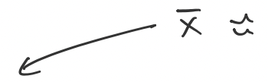
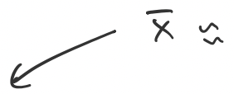
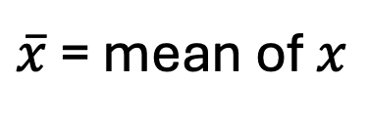
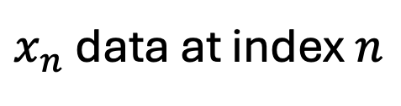
Mean & variance
$x_{n}$ data at index $n$
Define
Define
$\overline{x}$ = mean of$x$
x
t

Slide 5
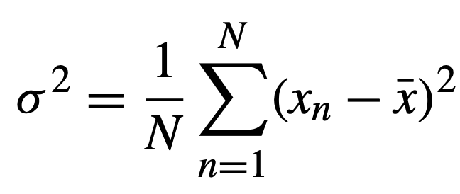
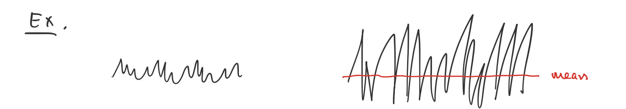


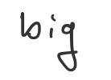
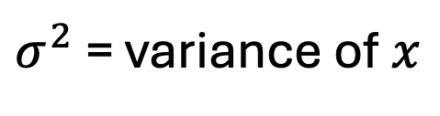
Mean & variance
$x_{n}$ data at index $n$
Define
$σ^{2}$ = variance of$x$
Define

Slide 6
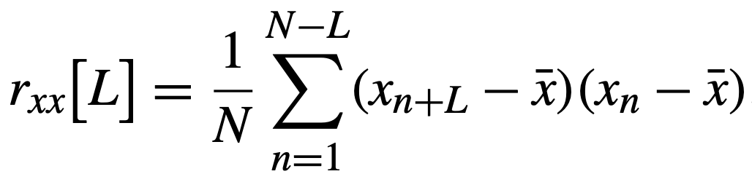
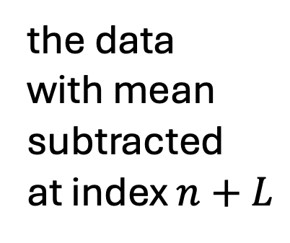
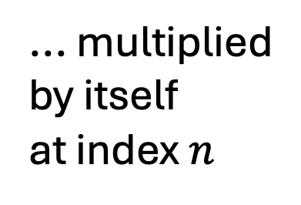
Autocovariance (equation)
Define:
The autocovariance of x at lag L
the data
with mean
subtracted
at index $n+L$
... multiplied
by itself
at index $n$
sum over
data x

Slide 7
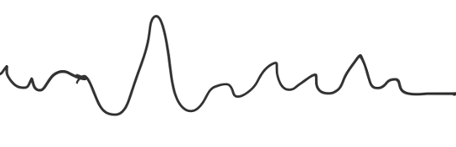


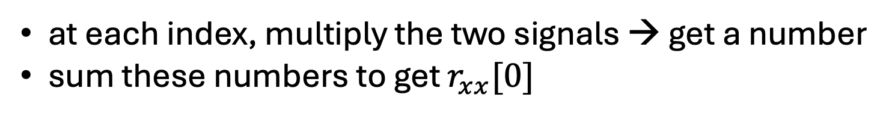

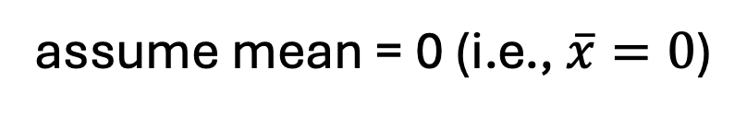


Autocovariance (intuition)
Fix L=0
$$x_{n}$$
$$x$$
multiply
...
assume mean = 0 (i.e., $\overline{x}=0$)
$$x_{n+0}$$
at each index, multiply the two signals → get a number
sum these numbers to get $r_{xx}[0]$
Note: compare to variance
Q. Will this number be big or small?
$$r_{xx}\left[0\right]= σ^{2}$$

Slide 8
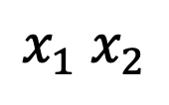

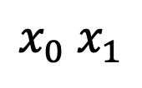
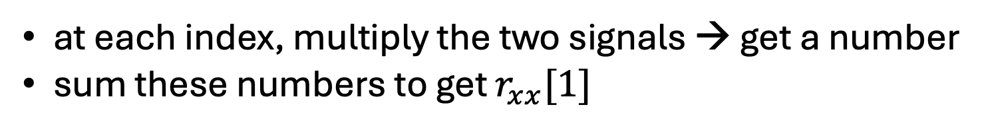
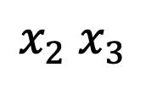
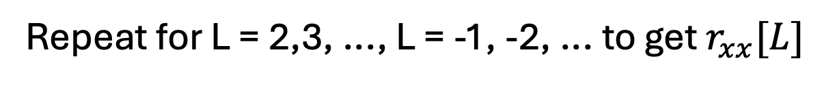

Autocovariance (intuition)
Fix L=1
$$x_{n}$$
$$x$$
multiply
...
assume mean = 0 (i.e., $\overline{x}=0$)
$$x_{n+1}$$
at each index, multiply the two signals → get a number
sum these numbers to get $r_{xx}[1]$
$$x_{0} x_{1}$$
$$x_{1} x_{2}$$
$$x_{2} x_{3}$$
Q. Will this number be big or small?
...
Repeat for L = 2,3, ..., L = -1, -2, ... to get $r_{xx}[L]$

Slide 9
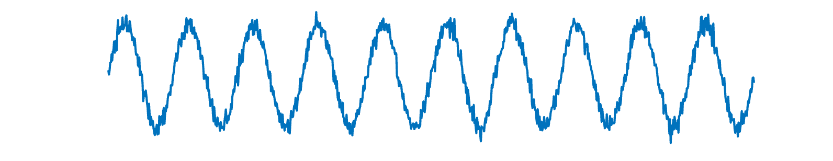


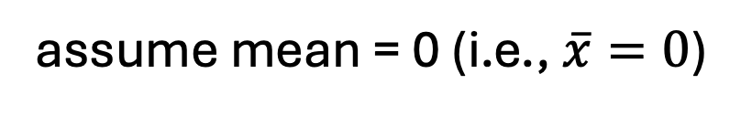
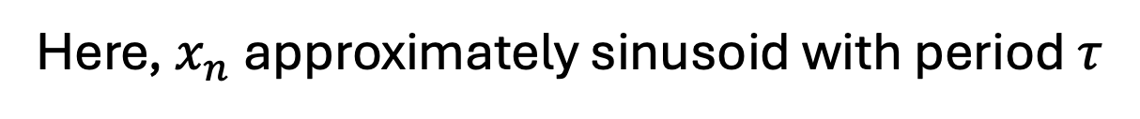
Autocovariance (example)
Ex. Consider these nearly sinusoidal data
$$x_{n}$$
$$τ$$
Here, $x_{n}$ approximately sinusoid with period $τ$
assume mean = 0 (i.e., $\overline{x}=0$)

Slide 10
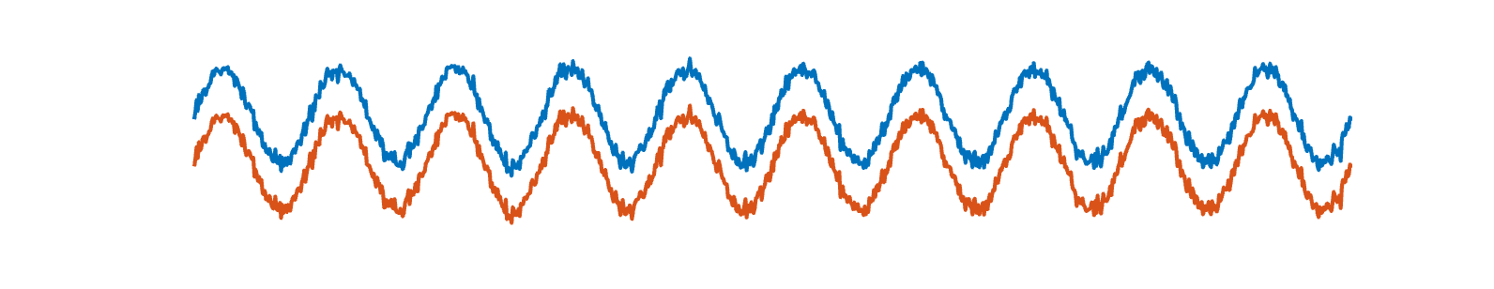

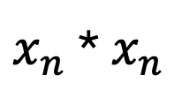


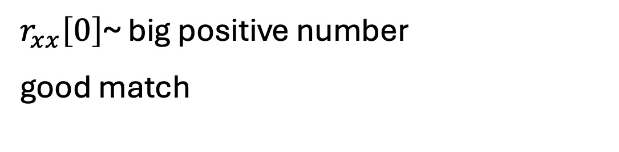

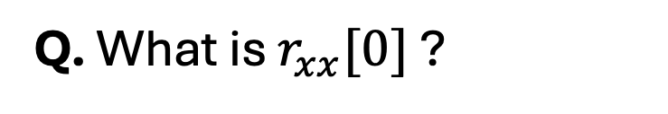
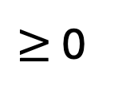
Autocovariance (example)
Q. What is $r_{xx}[0]$ ?
$$x_{n}$$
$$x_{n+0}$$
$$x_{n}$$
multiply
...
$x_{n}$ * $x_{n}$
$≥$ 0
$$x_{n+0}$$
$r_{xx}\left[0\right]$~ big positive number
good match

Slide 11
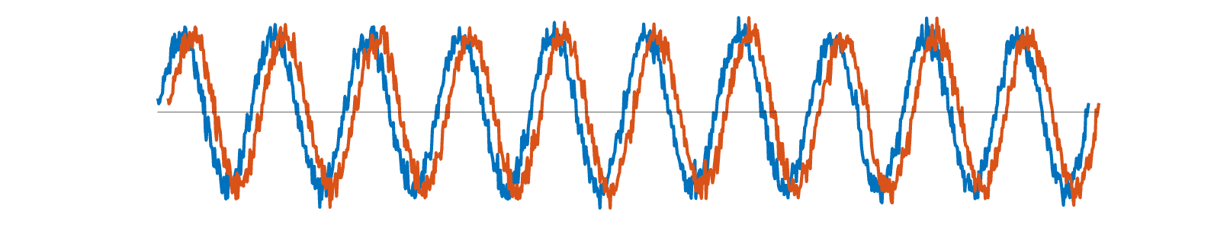
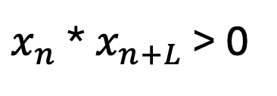



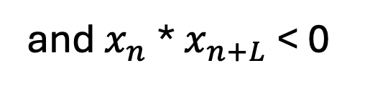
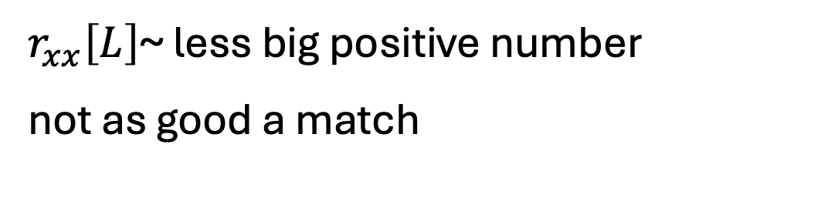

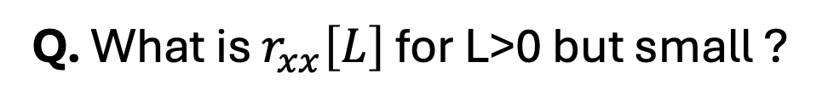
Autocovariance (example)
Q. What is $r_{xx}\left[L\right]$ for L>0 but small ?
$$x_{n}$$
$$x_{n+L}$$
$x_{n}$ * $x_{n+L}$ > 0
and $x_{n}$ * $x_{n+L}$ < 0
$$x_{n}$$
multiply
...
$r_{xx}\left[L\right]$~ less big positive number
not as good a match
$$x_{n+L}$$

Slide 12
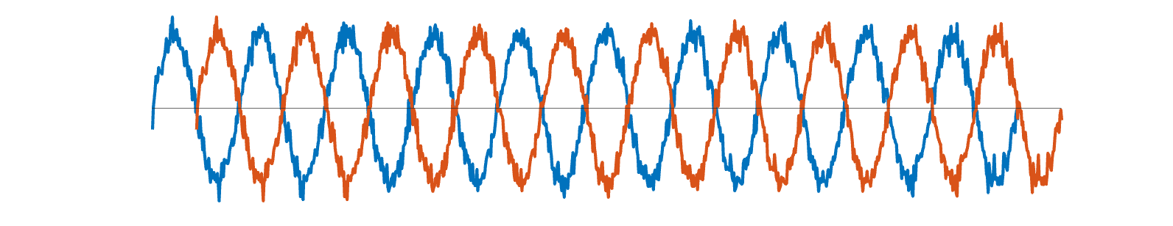
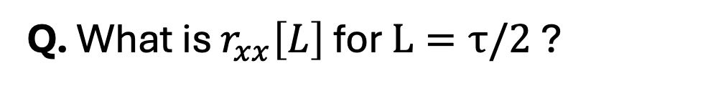
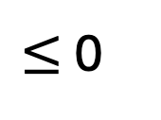
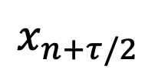
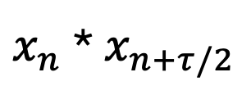
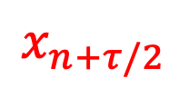


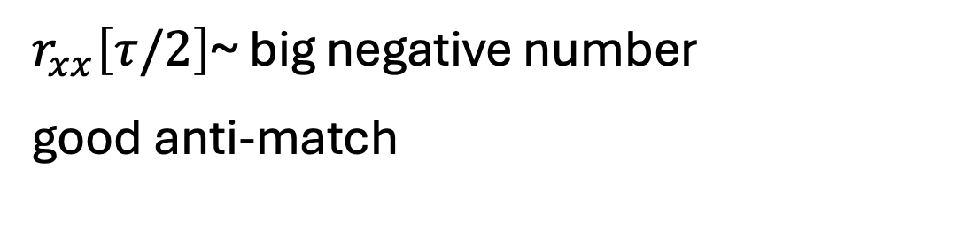
Autocovariance (example)
Q. What is $r_{xx}\left[L\right]$ for $L=τ/2$ ?
$$x_{n}$$
$$x_{n+τ/2}$$
$$x_{n}$$
$x_{n}$ * $x_{n+τ/2}$
$≤$ 0
multiply
...
$$x_{n+τ/2}$$
$r_{xx}\left[τ/2\right]$~ big negative number
good anti-match

Slide 13
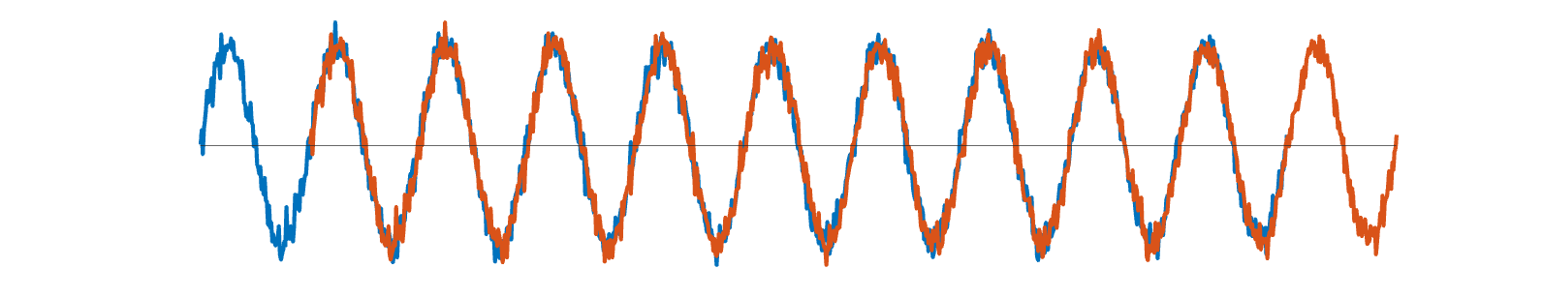
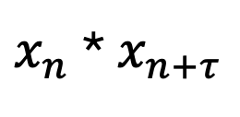
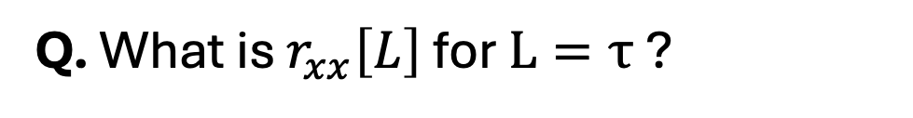

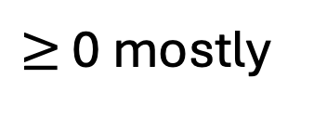


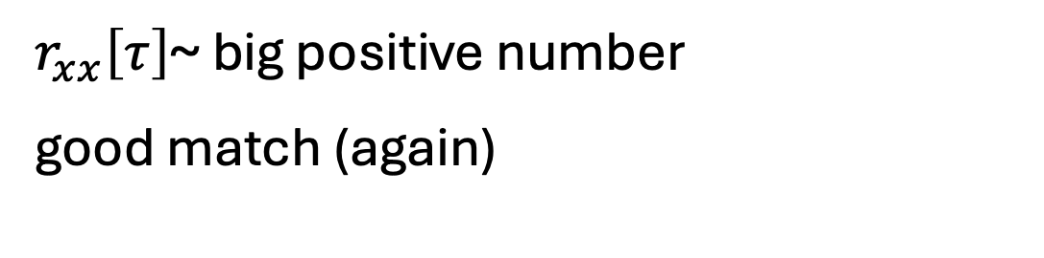
Autocovariance (example)
Q. What is $r_{xx}\left[L\right]$ for $L=τ$ ?
$$x_{n}$$
$$x_{n+τ}$$
$$x_{n}$$
$x_{n}$ * $x_{n+τ}$
$≥$ 0 mostly
multiply
...
$$x_{n+τ}$$
$r_{xx}\left[τ\right]$~ big positive number
good match (again)

Slide 14









Autocovariance (example)
Q. Plot $r_{xx}\left[L\right]$ versus $L?$
$r_{xx}\left[L\right]$
L= $− τ$
L= $τ$
L=0
L<0
L>0
Lag L
L = $−τ/2$
L= $τ/2$
Periodic x →
periodic $r_{xx}\left[L\right]$

Slide 15







Autocovariance (example 2)
Consider these noisy data
$$x_{n}$$
Here, $x_{n}$ (Gaussian) random noise
assume mean = 0 (i.e., $\overline{x}=0$)
Q. What is $r_{xx}[0]$ ?
Q. What is $r_{xx}\left[L\right]$ versus $L?$

Slide 16






Autocovariance vs spectrum
$r_{xx}$
Ex.
Data
$$S_{xx}$$
Q. Are $r_{xx}$ and $S_{xx}$ related?

Slide 17



Autocovariance vs spectrum
Remember the spectrum:
Fourier transform of x
where
substitute in ...

Slide 18





Autocovariance vs spectrum
$$X_{j}$$
$$X_{j}^{∗}$$
New dummy time index
Note: replace $i$ with $−i$
Note: replace $x_{m}$ with $x_{m}^{∗}$
But $x_{m}^{∗}$ is real, so $x_{m}^{∗}=x_{m}$

Slide 19










Autocovariance vs spectrum
Replace
$$X_{j}$$
$$X_{j}^{∗}$$
$$df= \frac{1}{T}$$
$$\frac{j}{T}$$
$$=\frac{j}{N∆}$$
$$f_{j}=j ∗ df$$
$$f_{j}=$$
$$t_{n}=n ∆$$
$$t_{m}=m ∆$$

Slide 20






Autocovariance vs spectrum
$$l$$
$$T=N∆$$
$$n=m+l$$
sum over all $n$ → sum over all $l$
Define a new variable

Slide 21


Autocovariance vs spectrum
Q. What is this?
$r_{xx}\left[l\right]$
spectrum
autocovariance

Slide 22







Autocovariance vs spectrum
a few more steps ...
$$T=N∆$$
$$\frac{j}{T}$$
$$f_{j}=$$
$$t_{l}=l ∆$$

Slide 23







Autocovariance vs spectrum
complex exponentials at frequency $f_{j}$
sum over time
Remember the Fourier transform of $x_{n}$
or
$$X_{j}= FT\{x_{n}\}$$
complex exponentials at frequency $f_{j}$
sum over time
So
$$S_{xx,j}=$$
$$2 ∆ FT\{ r_{xx}\}$$
The spectrum is the Fourier transform of the autocovariance.

Slide 24


Autocovariance vs spectrum
The spectrum is the Fourier transform
of the autocovariance.
$r_{xx}$
Autocovaraince: time-domain, lag $L$
Spectrum: freq-domain measure, $f_{j}$
Different perspective on the
dependent structure in the data.
$$S_{xx}$$
In practice, consider both (sometimes)

Slide 25

Autocovariance vs spectrum

