Slide 1
Rhythms
Analyzing Rhythms (Part 1)
Instructor: Mark Kramer

Slide 2
Today
Practical notions
Sampling frequency, Nyquist frequency, tapering

Slide 3
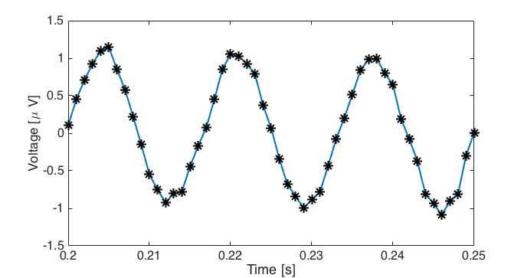
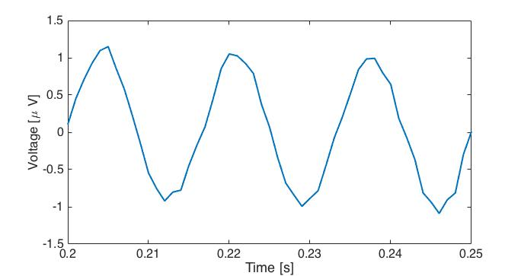


Data is not continuous
Consider a small snippet of data
$$∆$$
time between samples
Notation: $x_{n}$ = Data at index n

Slide 4
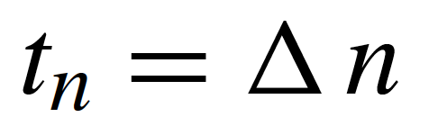
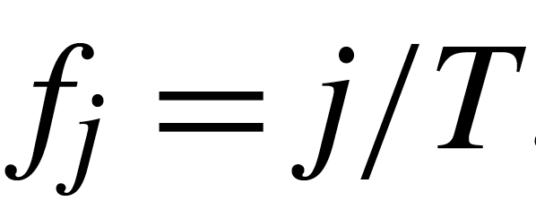
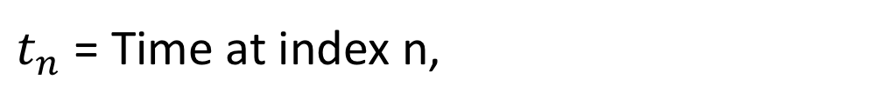
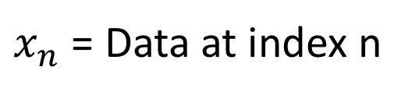
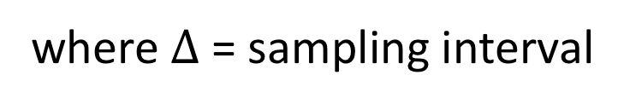
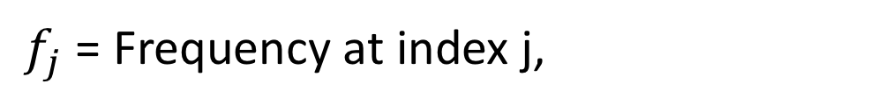
Data is not continuous
Notation
x (EEG, LFP, MEG, ...)
$x_{n}$ = Data at index n
$t_{n}$ = Time at index n,
where $Δ$ = sampling interval
$f_{j}$ = Frequency at index j,
where T = total time of observation

Slide 5
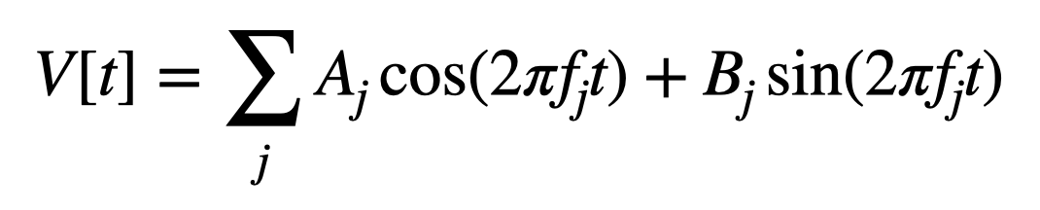
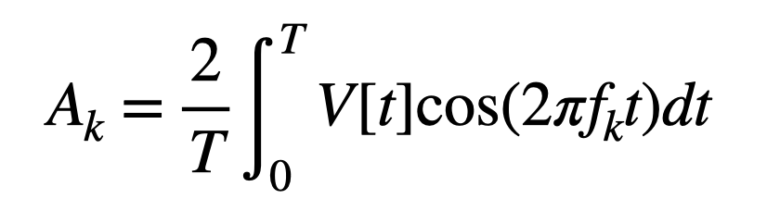
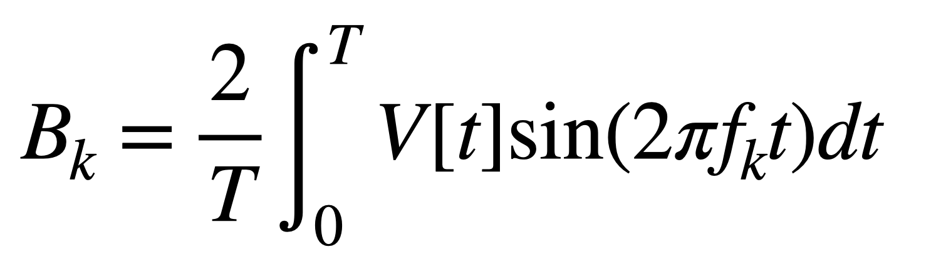
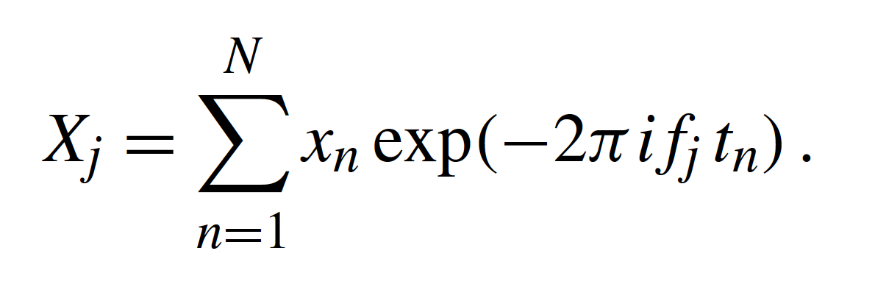
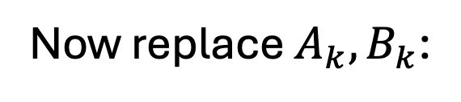
Discrete time Fourier transform
Previously
and
Compare data V[t] to cosine at frequency $f_{k}$ , does it match?
Now replace $A_{k}, B_{k}$:
????
Fourier transform of the data x.

Slide 6

Discrete time Fourier transform
$$i^{2}=−1$$
Define the parts
????
FT of x
index j
time
index n
data x
index n
frequency
index j
sum over
all time n

Slide 7
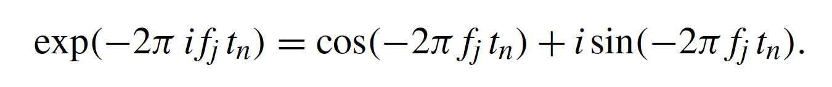
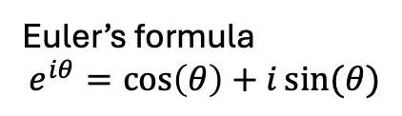

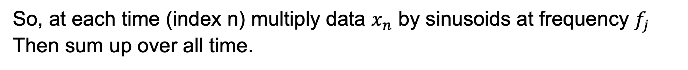
Discrete time Fourier transform
Euler’s formula
$$e^{iθ}=\cos\left(θ\right)+i\sin{(θ})$$
Fourier transform intuition:
Feynman: “the most remarkable formula in mathematics”
Data as a function of time index n
Data as a function of
frequency index j
Sinusoids at frequency $f_{j}$
Euler’s formula:
So, at each time (index n) multiply data $x_{n}$ by sinusoids at frequency $f_{j}$
Then sum up over all time.

Slide 8

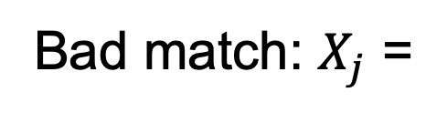
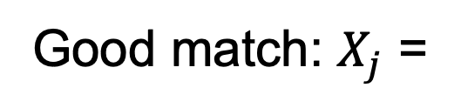
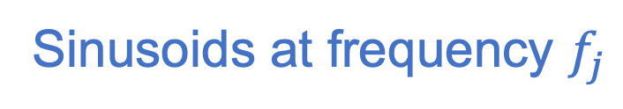
Discrete time Fourier transform
Fourier transform intuition:
Data as a function of time index n
Data as a function of
frequency index j
Sinusoids at frequency $f_{j}$
Idea: compare our data $x_{n}$ to sinusoids at frequency $f_{j}$ and see how well they “match”.
Good match: $X_{j}$ =
big
Bad match: $X_{j}$ =
small
$X_{j}$ reveals the frequencies $f_{j}$ that match our data.

Slide 9
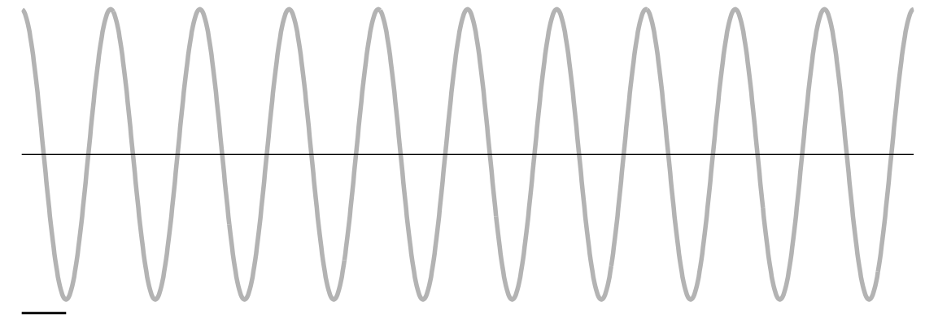
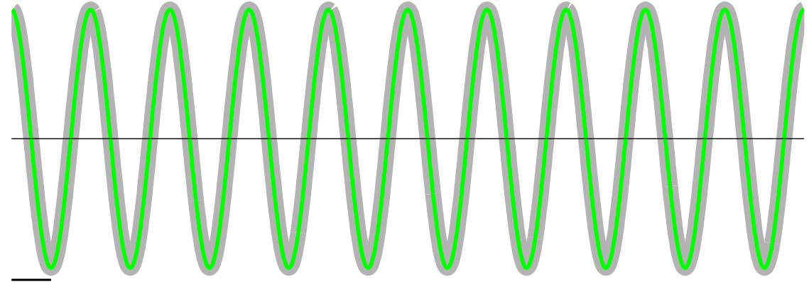
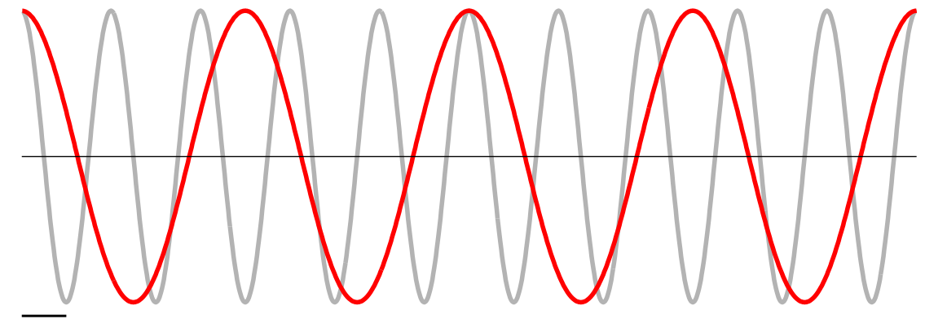
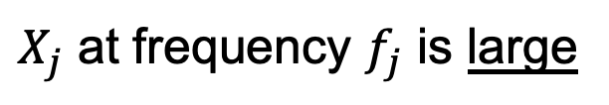
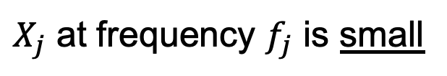
Spectrum: idea
Fourier transform intuition:
“Compare” data to sinusoids at different frequencies
Match:
$X_{j}$ at frequency $f_{j}$ is large
Mismatch:
$X_{j}$ at frequency $f_{j}$ is small
Example:
“Data”
10 Hz cosine
4 Hz
10 Hz
Multiply (+,-,+,-,...) & add
Multiple (+,+,+,+,...) & add
... small value
... large value
4 Hz does not match data
10 Hz matches data

Slide 10
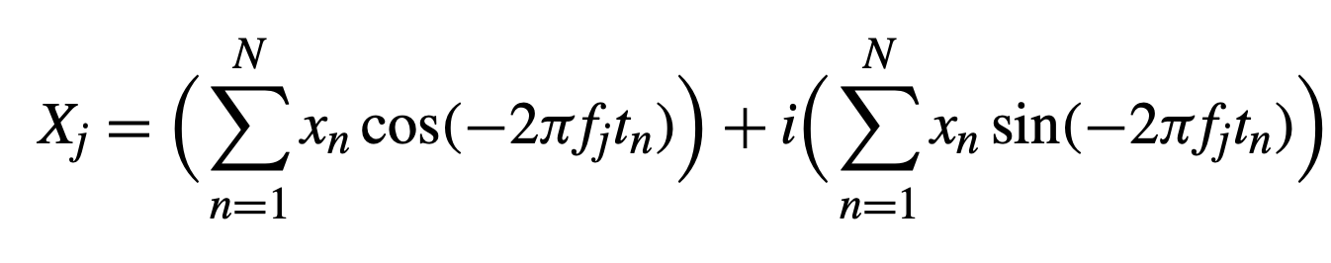
Discrete time Fourier transform
Sound familiar?
Fourier transform of the data x.
replace with Euler’s formula
Looks like
Same idea: compare data to sinusoids and see how well they match

Slide 11
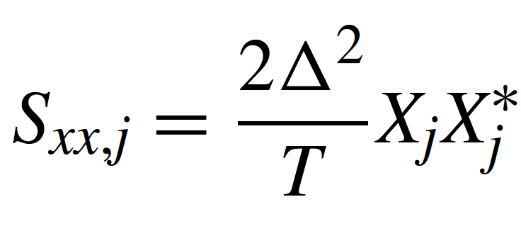
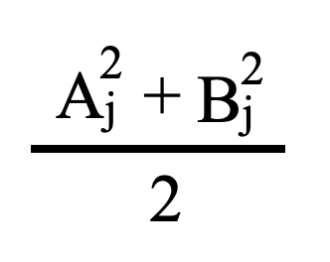

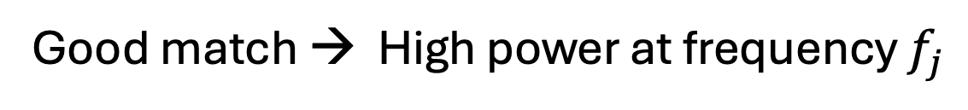
Spectrum: definition
(change sign of $i$ everywhere)
The power of data x
at frequency index j
Previously
Constant that depends on
sampling interval,
duration of recording
FT of
data
Complex
conjugate
of FT of data
Same idea!
Power at frequency $f_{j}$ indicates how well sinusoids at $f_{j}$ “match” our data.
Good match → High power at frequency $f_{j}$

Slide 12
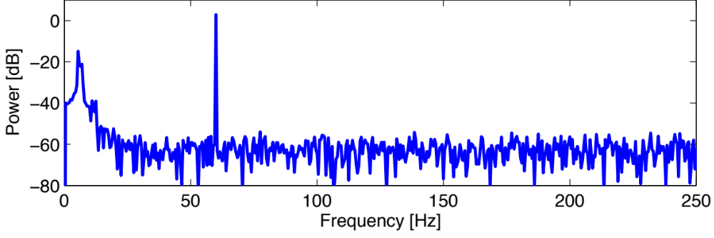
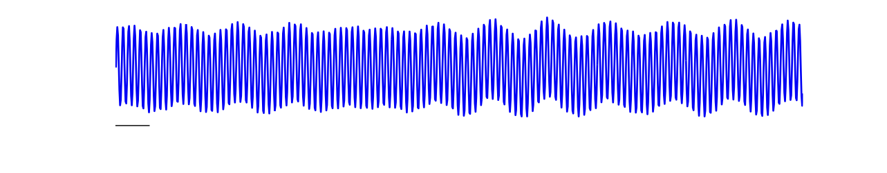
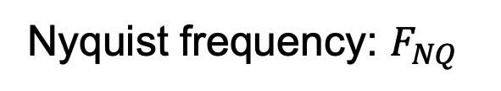
Spectrum
... reveals the dominant frequencies that “match” the data.
5-8 Hz & 60 Hz sinusoids
“match” the sensor data
100 ms
Important quantities
Frequency resolution: df
Nyquist frequency: $F_{NQ}$
Define these two quantities.

Slide 13
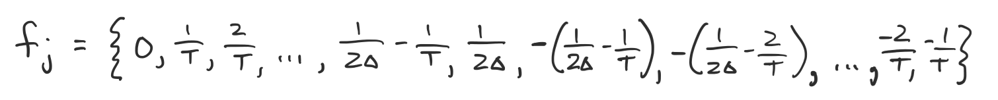
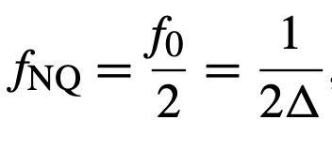
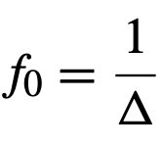
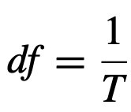
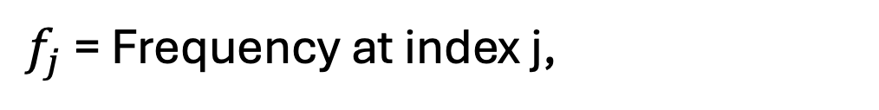
Frequencies
$f_{j}$ = Frequency at index j,
where T = total time of observation
Two important quantities
Largest frequency: Nyquist frequency
half the sampling frequency
sampling frequency
Frequency resolution
reciprocal of total recording duration

Slide 14
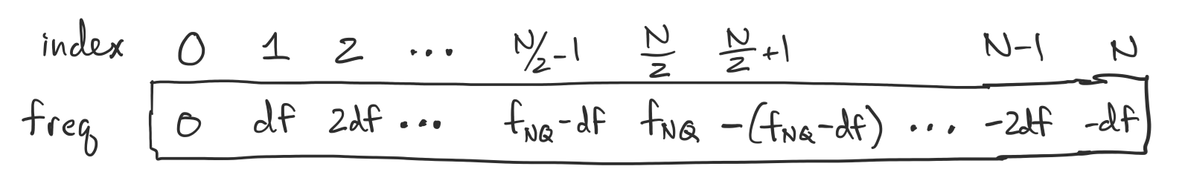
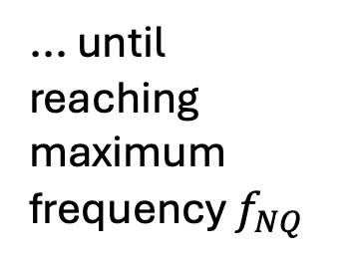

Frequencies
Visualize $f_{j}$ as a vector
N-2
N-1
Step forward in intervals of frequency resolution df
... until reaching maximum frequency $f_{NQ}$
then, frequencies are negative, starting with the largest magnitude.
decrease in magnitude until -df

Slide 15

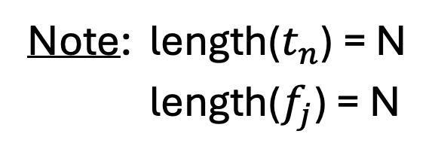
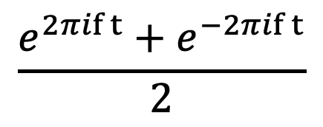
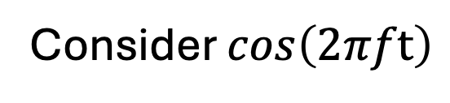
Frequencies
Note: length($t_{n}$) = N
length($f_{j}$) = N
time and frequency vectors have the same length N
If we record N data points, then we have N frequencies to examine.
Note: Frequencies $f_{j}$ include negative values.
Euler’s formula
$$\frac{e^{2πif t}+e^{−2πif t}}{2}$$
Consider $cos\left(2πft\right)$
a real signal
f > 0
f < 0
We need positive & negative frequencies to represent a real signal.

Slide 16
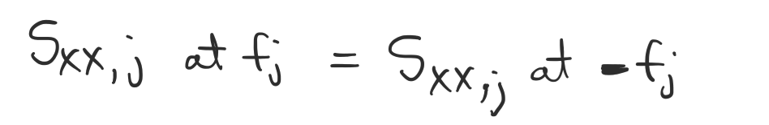
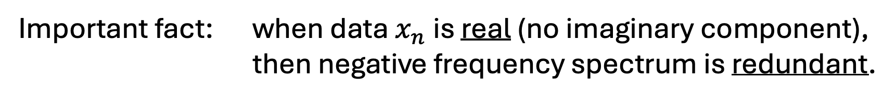

Frequencies
Note: Frequencies $f_{j}$ include negative values.
Important fact: when data $x_{n}$ is real (no imaginary component),
then negative frequency spectrum is redundant.

Slide 17
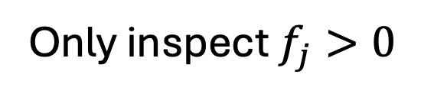

Frequencies
Q: Is $x_{n}$ real?
A: Yes (in neuroscience)
Only inspect $f_{j}>0$
Ignore negative frequencies (redundant)

Slide 18
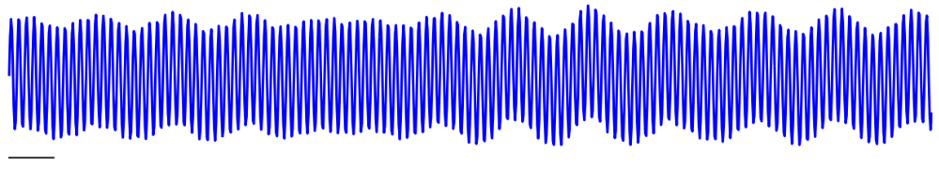

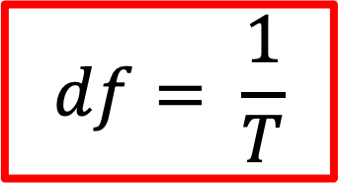
Spectrum: $df$
frequency resolution
where T = Total duration of recordings.
$$df= \frac{1}{T}$$
What is df?
Ex.
T = 2 s
so df =
0.5 Hz
Q: How do we improve frequency resolution?
A: Increase T or record for longer time.

Slide 19
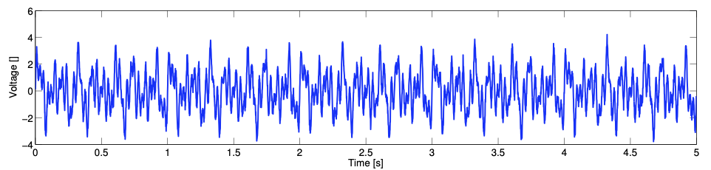

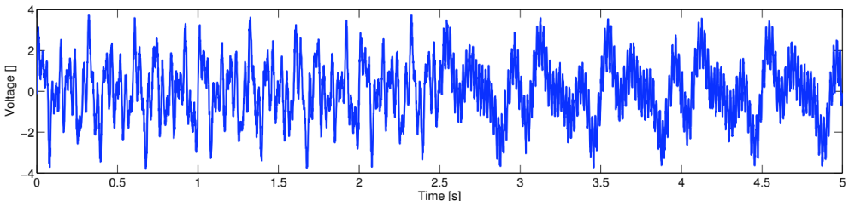

Spectrum: $df$
df = 0.2 Hz = 1/T , so T =
5 s
Demand 0.2 Hz frequency resolution
But, data may change during longer recordings . . .
Balance resolution requirements with consistency in data.

Slide 20
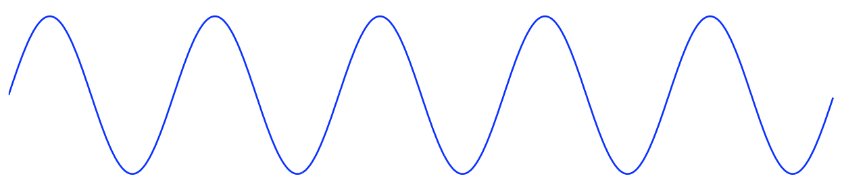
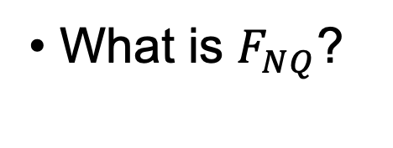


Spectrum: $F_{NQ}$
START HERE
Nyquist frequency
where f0 = sampling frequency.
What is $F_{NQ}$?
$$F_{NQ}=f_{0}/2$$
The highest frequency we can observe.
True signal: fs
Sample:
f0 >> 2 fs
Accurate reconstruction
f0 = 2 fs
2 samples/cycle
Max freq we can observe at this sample rate!
Enough to reconstruct signal, but just barely.
f0 < 2 fs
High frequency (in data) mapped to low frequency (aliased).
All hope lost! Indistinguishable from true low frequency signals.

Slide 21



Spectrum: ${df, F}_{NQ}$
Summary
Frequency resolution
Duration of recording
Nyquist
frequency
Sampling frequency
For finer frequency resolution:
record more data.
To observe higher frequencies:
increase sampling rate.

Slide 22

Example
[Schneider et al, Neuron, 2021]
Q. What rhythms dominate?

Slide 23
Quiz
Require a 2 Hz frequency resolution, and to observe rhythms up to 500 Hz. What is the experiment / recording setup?

Slide 24
Spectrum: four (important) asides
Units
Scale
Tapers
Spectrogram

Slide 25




Spectrum: units
Q. What are the units of the spectrum?
$$\frac{{\left[s\right]}^{2}}{[s]}$$
$$\left[V\right][V]$$
$$\left[s\right]{ \left[V\right]}^{2}$$
$$\frac{{\left[V\right]}^{2}}{[Hz]}$$
“volts squared per Hertz”

Slide 26


Spectrum: scale
Emphasize lower amplitude signals
A note on scale . . .
60 Hz
5-8 Hz
10 log10(Sxx,f)
Without the decibel scale . . .
60 Hz
Sxx,f
$$m$$
?

Slide 27


Spectrum: tapers
Doing nothing, we make an implicit taper choice . . .
. . . Data goes on forever . . .
But we observe it in a small window
1
0
We get:
0
0
Signal
Rectangle taper
What we’re observing:
x

Slide 28




Spectrum: tapers
The rectangle taper impacts the power spectrum.
Pure
sinusoid
at 20 Hz
Rect
sidelobes
sidelobes
Spectrum we want
Sharp peak is “smeared out” . . .

Slide 29




Spectrum: tapers
Idea: smooth the sharp edges of rectangle taper.
Taper
Hann Taper
Data
Compute spectrum of tapered data.
Rect
Hann
Rect
Taper reduces the sidelobes.

Slide 30




Spectrum: tapers
Lost
Lost
Ex:
Rect
Rect
Hann
~12 Hz
Good: Reduced sidelobes reveals a new peak.
  Bad: Broader peaks & lose data at edges.
“More lives have been lost looking at the [rectangular tapered spectrum] than by any other action involving time series.” [Tukey 1980]

Slide 31

Spectrum: spectrogram
Idea: Divide data into smaller intervals, then compute the spectrum in each interval

Slide 32

Spectrum: spectrogram
spectrogram
Display as
Usually, color
indicates power

Slide 33

Spectrum: spectrogram
[Shi et al, Epilepsy & Behav Reports, 2022]

Slide 34





Spectrum: spectrogram

Slide 35

Spectrum: summary
Data as a function of time index n
Sinusoids at frequency $f_{j}$
Frequency resolution
Nyquist
frequency
Units, decibel scale, tapers, spectrograms, ...

Slide 36

Spectrum practicals

