Slide 1
Model summary
x. Basic HH model in a N by N gird.
x. All cells are excitatory.
x. Connectivity is either neighbor-to-neighbor (all 8 neighbors), or small world, which is mostly neighbor-to-neighbor with a few random connections.
x. The boundary is “no flux”, so we always drop the outer perimeter before displaying the results.
x. Start with an active neuron at the upper left corner.
x. Estimate the LFP as the summed synaptic input to each neuron. Sum these LFPs over small sub-squares to approximate population activity.
Active source here
ignore boundary.
Approximate the population activity by summing the LFP over smaller “sub-squares” (in yellow).

Slide 2
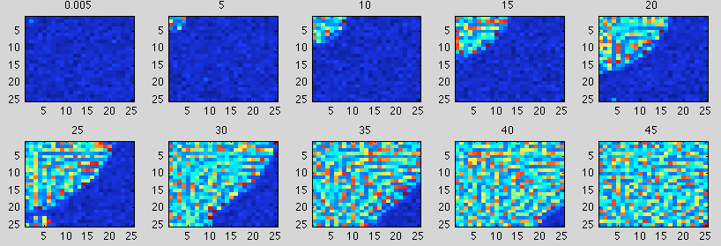
Neighbor-to-neighbor connectivity
Plot of voltage(color) of each HH cell over 2-dim space. Red is an action potential spike. Each subplot is a frame in time – here time is in milliseconds, but I don’t think time/space can be meaningfully compared directly to ECoG results. Note activity starts in upper left corner then spreads.

Slide 3
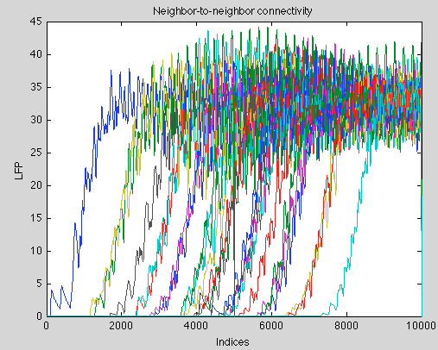
Neighbor-to-neighbor connectivity
Plot of “LFP” averaged over sub-squares. The sub-squares are [5-by-5]. There are 25 total sub-squares. Notice the orderly “recruitment”

Slide 4
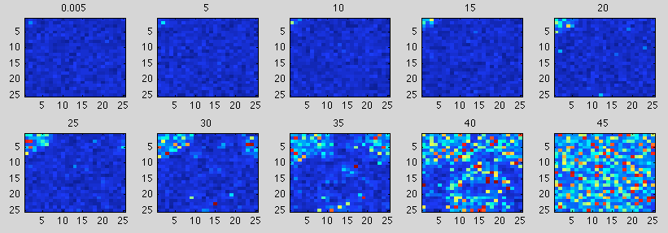
Small-world connectivity
Plot of voltage(color) of each HH cell over 2-dim space. Red is an action potential spike. Each subplot is a frame in time – here time is in milliseconds. Note activity starts in upper left corner then spreads. Note at “time=30”, there’s the emergence of activity at other points in space. The spatial pattern is “disorderly”.

Slide 5
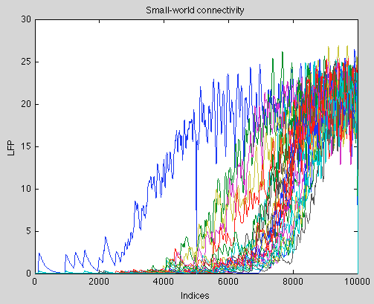
Small-world connectivity
Plot of “LFP” averaged over sub-squares. The sub-squares are [5-by-5]. Notice, examining these spatial data in time, the “recruitment” still looks orderly. Also, notice that with small world connectivity, the recruitment looks a little faster …

Slide 6
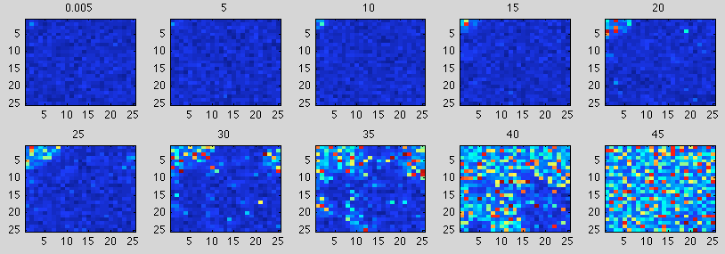
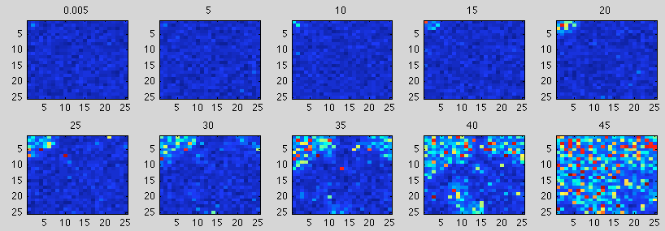
Small-world connectivity
Here are two runs of the same small-world connectivity. So, the “anatomy” is the same, but the recruitment can differ from run to run.

