Slide 1

Applied Data Science Capstone Project
The Third Place

Slide 2
Table of Contents
Introduction and Background
Problem Statement and Project Objective
Value Proposition
Data
Methodology
Results
Conclusions
Appendix

Slide 3
Introduction and Background
Ray Oldenburg, urban sociologist, first coined the term “Third Place” in 1991, to reference social environments that are distinct from an individual’s home (“First Place”) and work environment (“Second Place”). Third places are where people congregate and interact other than work or home.
It has been noted that England has pubs, France has cafés, and Austria has coffee houses. In the past in the U.S., common third places included country stores, post offices, barber shops, hair salons, soda shops, and taverns.
Examples of Third Places in the U.S. today are:
Cafes, restaurants, pubs, coffee houses - Churches
Parks and other outdoor recreational areas - Schools, Libraries
Indoor recreational areas such as arcades - Social and community centers

Slide 4
Introduction and Background
But not all public venues are automatically considered a true Third Place. Characteristics of a Third Place are:
  Neutral space – no economic or social status prerequisites for participation
  Accessibility – are inclusive, and readily assessable
  Accommodating – provide for the needs of participants
  Regulars – regular occupants or participants who set the mood and characteristics of the venue
  Low Profile – not extravagant or pretentious, but accepting and inclusive
  Conversation – is the primary activity, although not necessarily the only activity
  Atmosphere – typically exhibit home-like warmth, acceptance and belonging

Slide 5
Introduction and Background
Sociologists propose that Third Places are critical for active civic engagement and effective democratic governance, and function as anchors of community life by facilitating positive social interactions and a “sense of belonging”. A shared sense of pride, commitment, and well-being are critical for strong and vibrant communities.
The Third Place concept has been widely embraced and developed since it’s introduction by business, academia, local governance, urban planners, architects and designers, and social policy advocates.

Slide 6
Problem Statement and Objective
Problem Statement
Attempts to quantify Life Satisfaction or Quality of Life often consider only Income or Economic related metrics, and fail to consider broader and more subjective metrics such as community involvement, sense of belonging and well-being – all attributes engendered by Third Places.
Objective
This analysis proposes to use Foursquare data on public and social venues (potential Third Places) for New York City communities to determine correlation to more conventional measures of Life Quality or Satisfaction.
Insights developed by this type of analysis could provide additional depth to assessments of “well-being”, and identify opportunities for businesses, communities, and policy makers in efforts to enhance community quality of life.

Slide 7
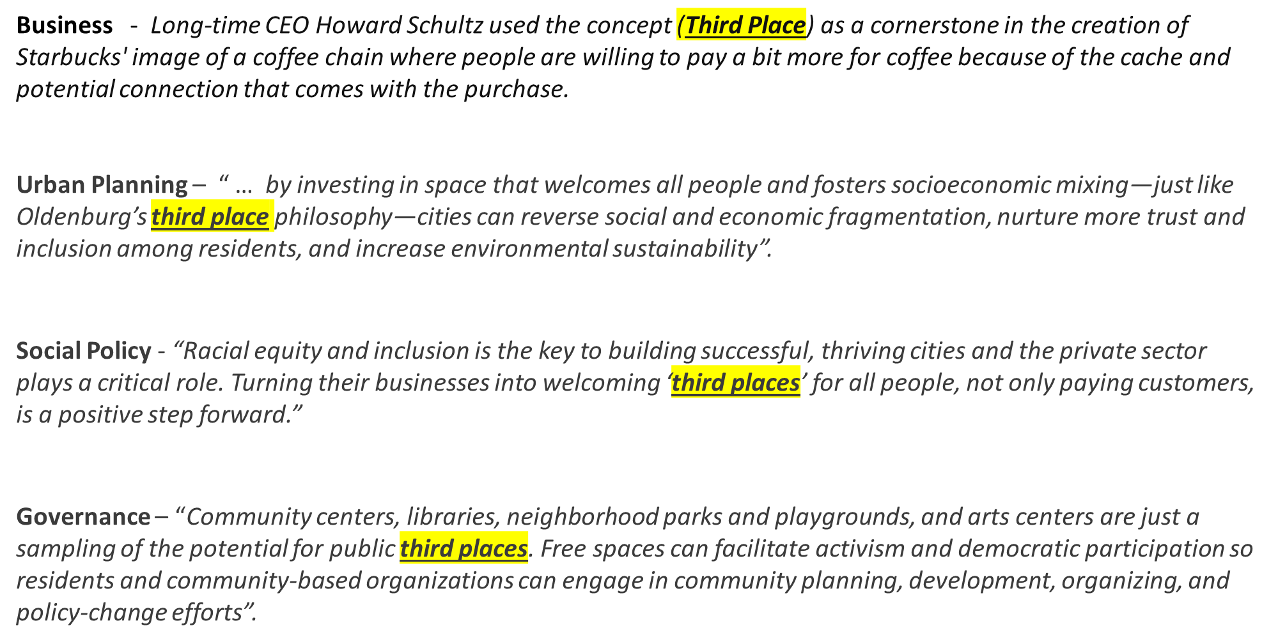
Value Proposition
The value of increased understanding of The Third Place dynamic extends to individuals, communities, business, governance, and social policy makers, as noted in the following quotes -

Slide 8
Data
The primary data sets used:
  Foursquare
    Trending public venue data by category and grouped by New York City (NYC) neighborhood
  U.S. Census - Community Survey Data for Public Use Microdata Areas (PUMA)
  Selected Life Satisfaction indicator metrics for each New York City PUMA
  New York City Community Planning Boards
  Additional Life Satisfaction indicator data for NYC Community Districts
Data Sourcing –
API’s will be constructed or utilized as offered by sources to extract each data set

Slide 9
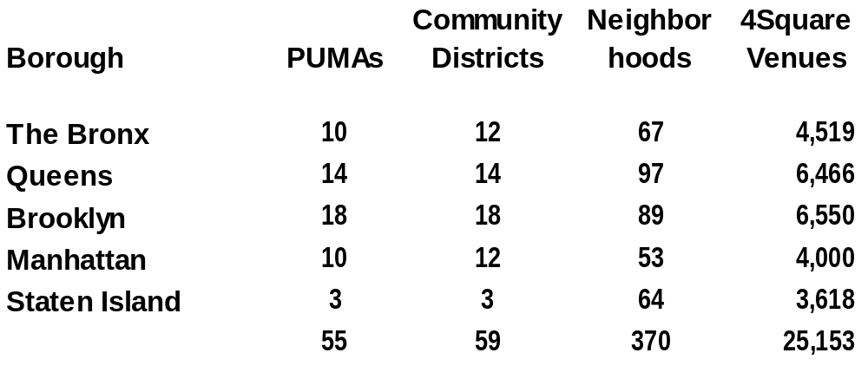
Data
Data Architecture
U.S. Census Bureau Public Use Micro-data Areas (PUMA) database contains a wide variety of Community economic data. For NYC, the PUMA geographical areas correspond directly to NYC Community Board Districts, allowing Four Square Neighborhood Venue data to be accurately combined with the Census Bureau data
NYC Data Set Description

Slide 10
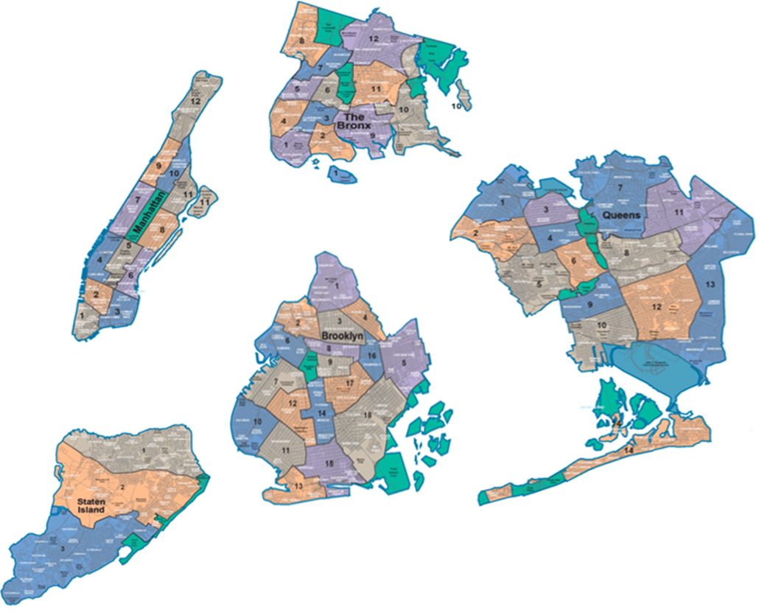
Data
New York City Boroughs and Community Districts

Slide 11
Methodology
For insights into how Third Place venues correlate to Communities with different Life Satisfaction indicators the following process was followed;
    Using Cluster Analysis, a Life Satisfaction rank was constructed for each NYC Community based on U.S. Census Community Survey data
    Machine Learning algorithms were used to predict each Community District’s assigned Life Satisfaction average Rank using their respective sets of Public Venues.
Life Satisfaction Indicator Ranks developed using K-means Cluster Analysis-
1 – High Satisfaction
2 – Moderate to High Satisfaction
3 – Moderate Satisfaction
4 – Moderate to Low Satisfaction
5 – Low Satisfaction

Slide 12
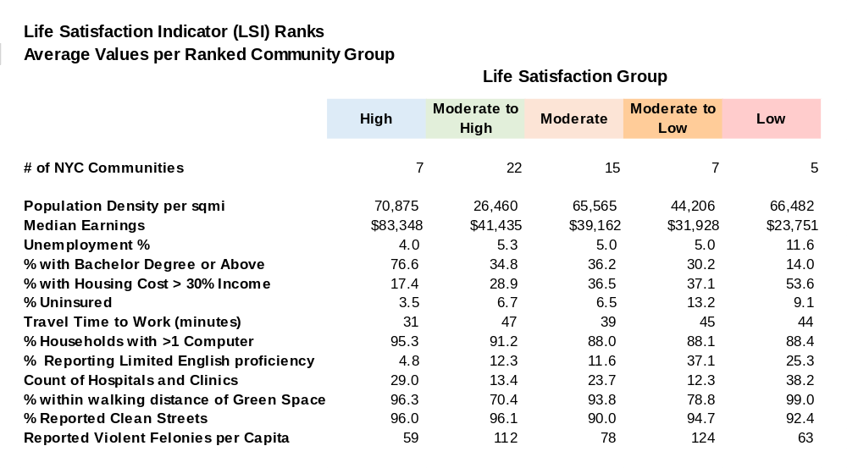
Methodology
The Average Value of Life Satisfaction Indicators for component Communities of each Ranked Group are shown below.

Slide 13
Methodology
Classification Analysis using Machine Learning
Machine Learning models were used to attempt prediction of LSI Rank for each NYC Community based on their Public Venue data.
The Machine Learning algorithms utilized were:
K Nearest Neighbor
Log Regression
Decision Tree
Naïve Bayes
Support Vector Machine
Random Forest
All data was normalized. Additionally, all venues with average frequency of occurrence less than 2% were excluded. The ML algorithm parameters were optimized using GridSearchCV. Model results were evaluated on the basis of Jaccard and F1 Scores. Confusion Matrix’s were used to evaluate misclassification error types.

Slide 14
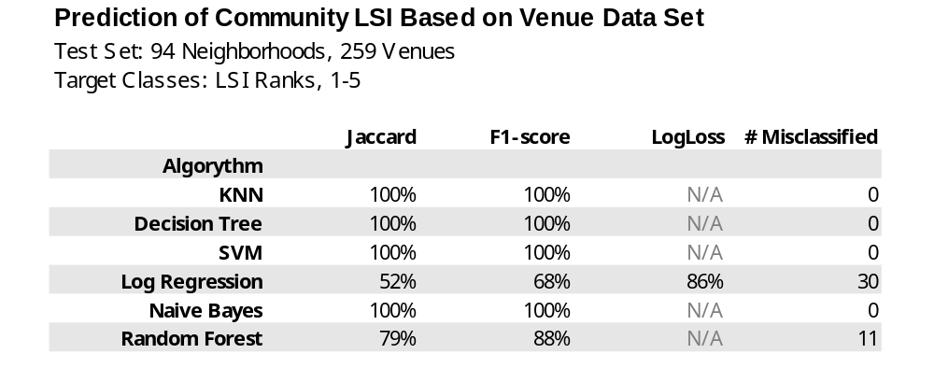
Results
Results –
Machine Learning Classification Models were able to successfully predict Life Satisfaction Ranks for NYC Communities using their respective sets of Public Venues from Four Square.
Results by algorithm type are shown below, including Accuracy and Precision scores, and the number of prediction errors (misclassifications of neighborhood LSI ranks).

Slide 15
Conclusion
Conclusion
The high accuracy rates of the Machine Learning model predictions indicates that the composition of Public Venues are differentiated between Communities with varying ranges of Life Satisfaction indicators.
This initial finding can provide valuable insights as Public Venues and Third Places continue to play a role in developing successful business strategies, urban planning, community development, social policies, and local governance.
Further Analysis to be Performed -
Given the premise that Public Venues can promote active civic engagement and positive social interaction, the differences in Venue composition must be better understood:
Do these differences represent a more advantaged set of venues for some Communities verses a more disadvantaged set for other Communities, or
Do they indicate that different venue sets for Communities with varying Life Satisfaction indicators more effectively facilitate positive social interactions, stronger civic engagement and “sense of belonging”?

Slide 16
APPENDIX

Slide 17
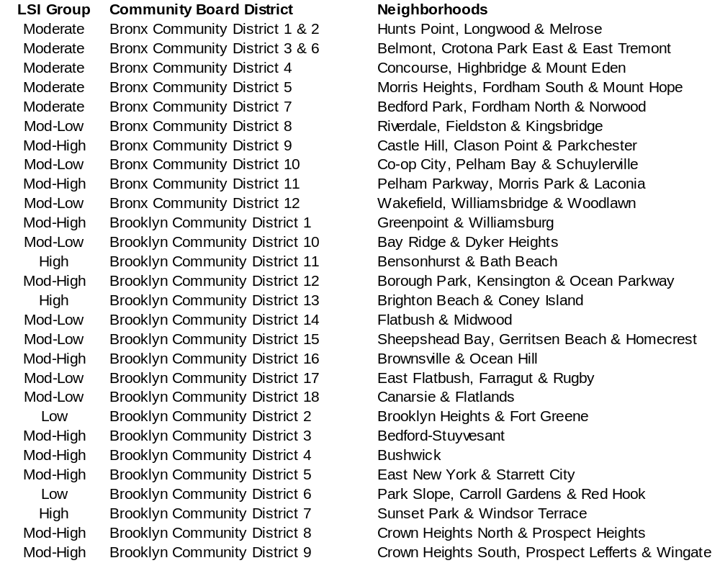
Ranked NYC Community Districts and Neighborhoods

Slide 18
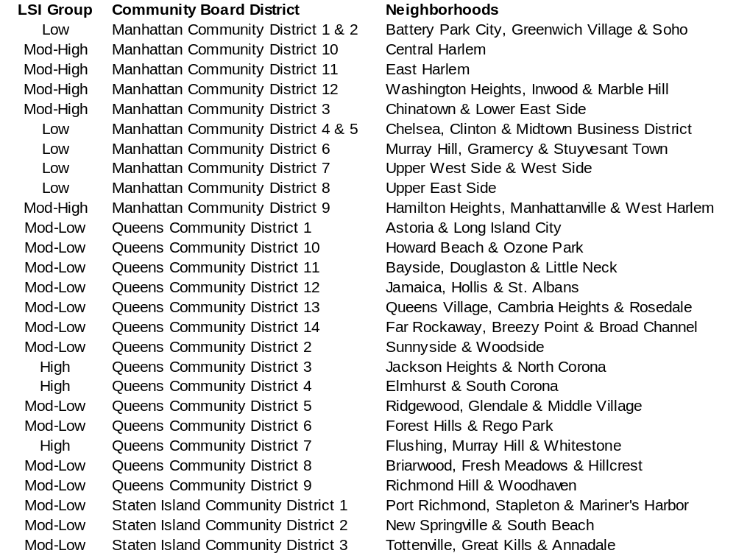
Ranked Community Districts and Neighborhoods

Slide 19
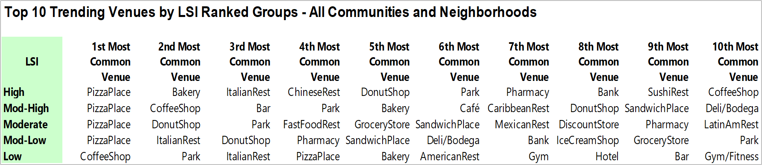
Top Ten Venues by LSI Group

