Slide 1
Team Triple Threat
Presents......
SnowBird

Slide 2
SnowBird
SnowBird is the most powerful learning tool that help Grade 6 students with their academic by playing interactive multimedia games.
SnowBird is an educational learning tool for Grade 6 students. It keeps track of individual users and user statistics. Study buddies can be added into and exported out of the system to allow sharing of study buddies.

Slide 3
Features
Import & Export
Adaptive Learning
Multimedia
Data recovery feature

Slide 4
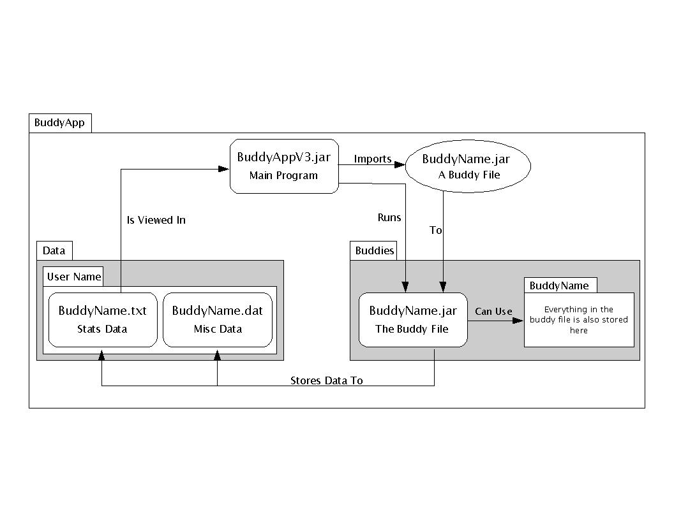
Architectural Diagram

Slide 5
Testing
We tried to subject our code to all extreme cases.
In the case of graphical tests, we conducted thorough inspections.
  BuddyApp - 800 lines of test code (133/class)
  Mathbuddy - 650 lines of test code (650/class)
  Breakbuddy - 650 lines of test code (216/class)
  CircuitBuddy - 100 lines of test code (100/class)
  SoundSearch - 500 lines of test code (63/class)

Slide 6
Known Bug
For BreakBuddy, once the user enters the game, there is a gray text area in the middle. However, when the user starts to play the game, the gray text area will be gone.
Other buddies and SnowBird are bug-free

Slide 7
Feedback
All buddies were approved by an elementary school principal and a grade 6 student before they were implemented.
One principal has expressed interest in our buddy system.
The sound search buddy was described by a grade 6 student as "Kind of Cool"

Slide 8
Post-Mortem Analysis
What project management techniques worked well, and what worked not so well?
  Face to face meetings work very well
  Activity logs provides clear and better overview of what has been done and revised
  Google calendar is used effectively
  Online msn meetings do not work well

Slide 9
Post-Mortem Analysis
What were the major technical problems you encountered?
  SVN is not stable all the time
  We were not familiar with some advanced JAVA GUI coding, and we needed to spend researching on that
  Computers break down

Slide 10
Post-Mortem Analysis
What were the major "human" problems you encountered while working as a team?
  Partners sometimes disagree over the same issue
  Partner(s) could not finish the assigned work on time due to other projects, assignments, and midterms, etc. for other courses

Slide 11
Post-Mortem Analysis
If you were to do the project over again, what would you do differently?
  Start each assignment early and use time more wisely
  Spend more time looking into the base technologies at the beginning
  Design the webpage so that it can expand easily
  Skip some of the minor technical planning until we actually get to it

Slide 12
Post-Mortem Analysis
What would you have done the same?
  Using JavaDocs and Google code website
  Planning out the system before making it
  Regular discussions and meetings with partners to find the best solutions to problems

Slide 13
Post-Mortem Analysis
What advice would you give to next year's students?
  Use JavaDocs
  Do not leave things till last minute
  Planning out the system before making it
  Compartmentalize website, and choose a topic focusing on users available to you
  Make sure to interview your employer ASAP so you are certain you are on the same page

Slide 14
End

