Slide 1


FOOF RBG Wiring

Slide 2
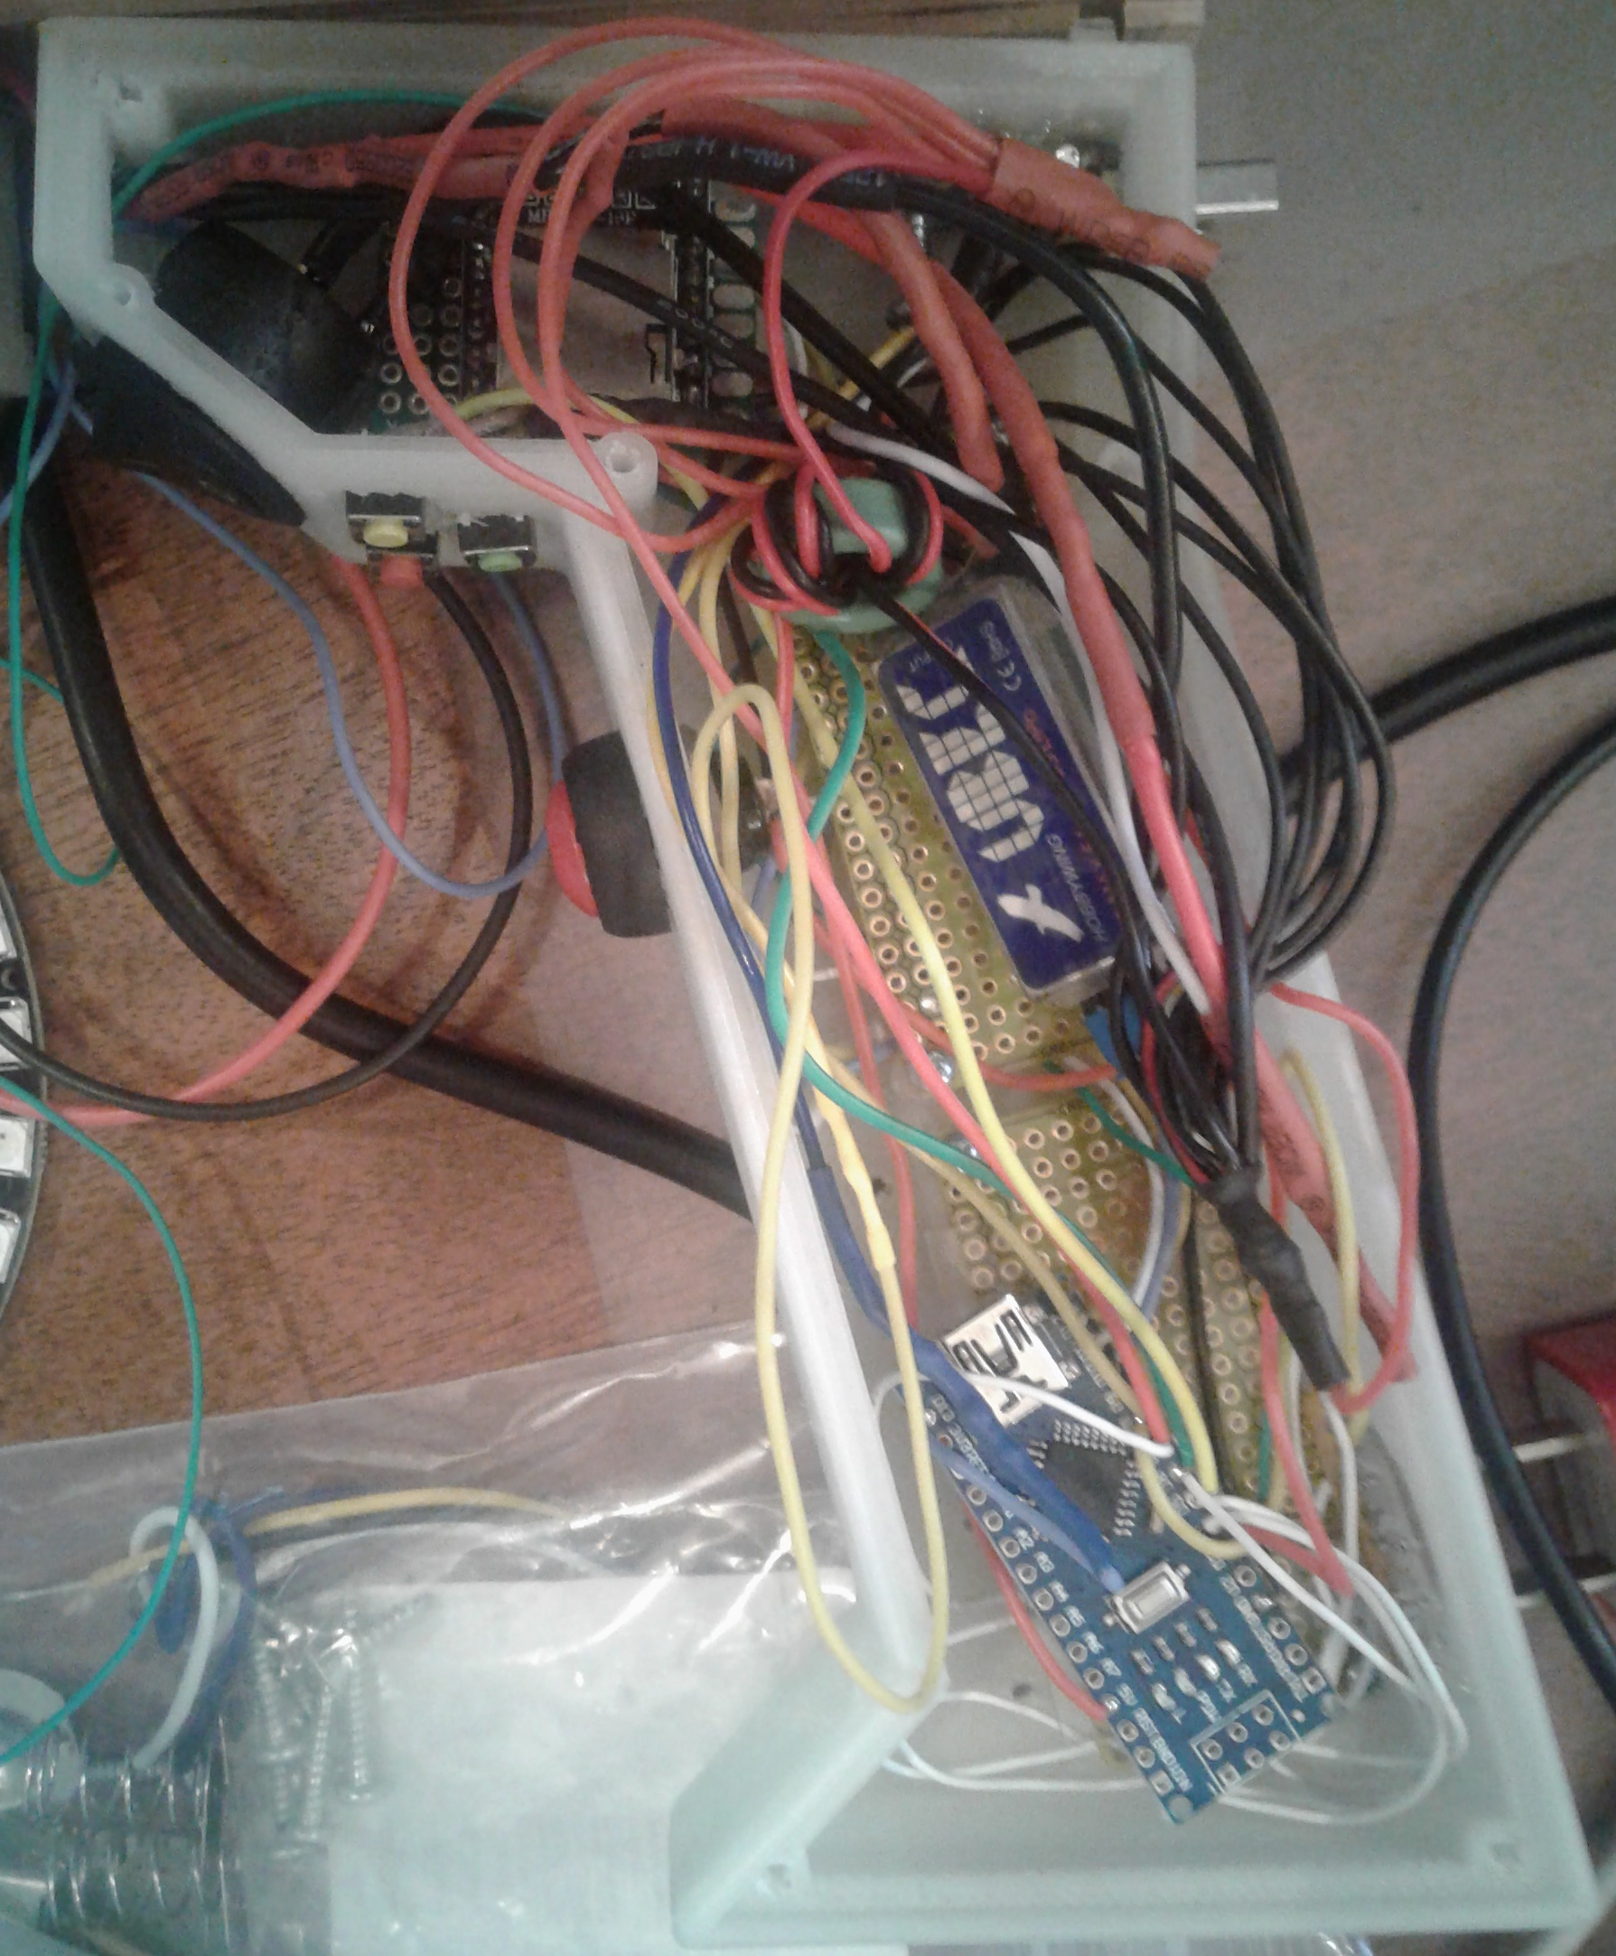
FOOF RBG Electronics Compartment

Slide 3
FOOF RBG Power

Slide 4
FOOF RBG Ground

Slide 5
FOOF RBG Pullups

Slide 6
FOOF RBG USB Connector

