Slide 1


Build FOOF Rubber Band Gun SW https://github.com/Mark-MDO47/RubberBandGun
… the AWESOME
24 June 2022

Slide 2
FOOF Rubber Band Gun Operation
Trig
+ Green
Trig
+ Green
Done
Sound
Or
LED
When
What
Choose
Wait
Shoot
Trig
+ R/Y
Pwr
On
This is the
FOOF RBG…
Trig
Only
Trig
+ Green
Trig
+ Green
Cfg
Reset
Copy
Trig
+ R/Y
Fctry Rst
Copy
Do
It
Trig
+ R/Y
Trig
+ R/Y
Config
Trig
+ R/Y
Advanced
Demo
Time
Credits
Trig
+ Green
Trig
+ R/Y
Trig
+ R/Y
Trig
+ Green
Trig
+ Green

Slide 3
FOOF Rubber Band Gun State Machine and Factory Settings
Tab ‘StateTable’
In Spreadsheet
makeStateTable.py
State Table Code
editor
RBG_SciFi_StatesAndInputs.h
Tab ‘Rules’ in Spreadsheet
Annotated
Tab ‘StateTable’
In Spreadsheet
Excel ™
Tab ‘Sounds’
In Spreadsheet
Tab ‘FactorySettings’
In Spreadsheet
RBG_SciFi_StatesAndInputs.h
Excel ™
editor
Tab ‘LEDpatterns’
In Spreadsheet

Slide 4
FOOF Rubber Band Gun eSpeak and Sound Files
Reformat
SD Card
Tab ‘Sounds’
In Spreadsheet
eSpeak script
RobotSounds.py
bash.exe and eSpeak
*.wav Files
raw_*.wav Files
copyem.py
Audacity
docopyem script
Insert SD Card
in YX5200
bash.exe

Slide 5
FOOF Rubber Band Gun Debug Tools
RBG_SciFi_StatesAndInputs.h
RBG_SciFi.ino
Visual Studio 2019
Console App
VS_debuggable.py
*.cpp code
Debug State Transitions
Copy “COM” output
To debug2.txt
Run RBG with Debug Options
Tab ‘debugging’
In Spreadsheet
Sort,
Remove dups,
Debug
bash.exe
Tab ‘debugging’
In Spreadsheet
“grep” statements

Slide 6
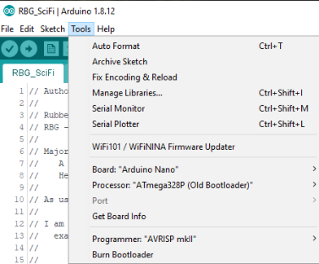
FOOF Rubber Band Gun RBG_SciFi.ino Arduino Setup
https://support.arduino.cc/hc/en-us/articles/360016785580-Error-avrdude-stk500-getsync-attempt-X-of-10-not-in-sync-resp-
Error: avrdude: stk500_getsync() attempt X of 10: not in sync: resp=
Board “Arduino Nano”
Processor “ATmega328P (Old Bootloader)”
Programmer “AVRISP mkll”
If your Arduino NANO was purchased earlier than 2018 you have the older official version of Nano. In this case Select Tools > Processor > ATmega328P and select: (Old Bootloader) and try to compile your sketch again. It is also recommended to update Arduino AVR Core 1.16.21 or later through Boards Manager.
If you have the newer version of the Nano board (manufactured in 2018 or later), make sure you have Arduino AVR Boards 1.6.21 or newer installed. Check this in Arduino IDE: Tools > Board > Boards Manager and select Tools > Processor > ATmega328P.

Slide 7

FOOF Rubber Band Gun RBG_SciFi.ino programming
RBG_SciFi.ino
Take the clear acrylic cover off, pull back the barrel/solenoid/motor assembly as if loading, turn the RBG power on, plug in the USB Male Mini 5 Pin to the Arduino NANO and the other side to your computer, and program. Reverse steps to disconnect.
NOTE: when the RBG power is on while the USB connector is connected and periodically resetting the Arduino, it continuously resets and pulses the solenoid/motor circuit at an interval of about 1.5 seconds. This might eventually damage the solenoid/motor or its circuitry, so it is important to pull back the barrel/solenoid/motor assembly before powering on.
NOTE: The reason I suggest powering on the RBG while programming is so that the entire RBG is not being powered through our inexpensive clone Arduino Nano.
YX
5200
UBEC
125
IN
USB
Ardu
KCX

Slide 8
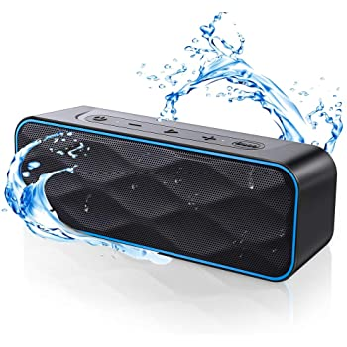
FOOF Rubber Band Gun Programming Arduino for Bluetooth
YX
5200
Connections to program the KCX-BT-EMITTER
See RubberBandGun_wiring.pdf
See ProgrammingArduino_SerialMonitor_SampleOutput.pdf
See ProgrammingArduino.ino
USB
UBEC
125
IN
Ardu
Prog Ardu
3 wires
KCX

