Slide 1


FOOF RBG Wiring https://github.com/Mark-MDO47/RubberBandGun
… the AWESOME
2020-09-10

Slide 2
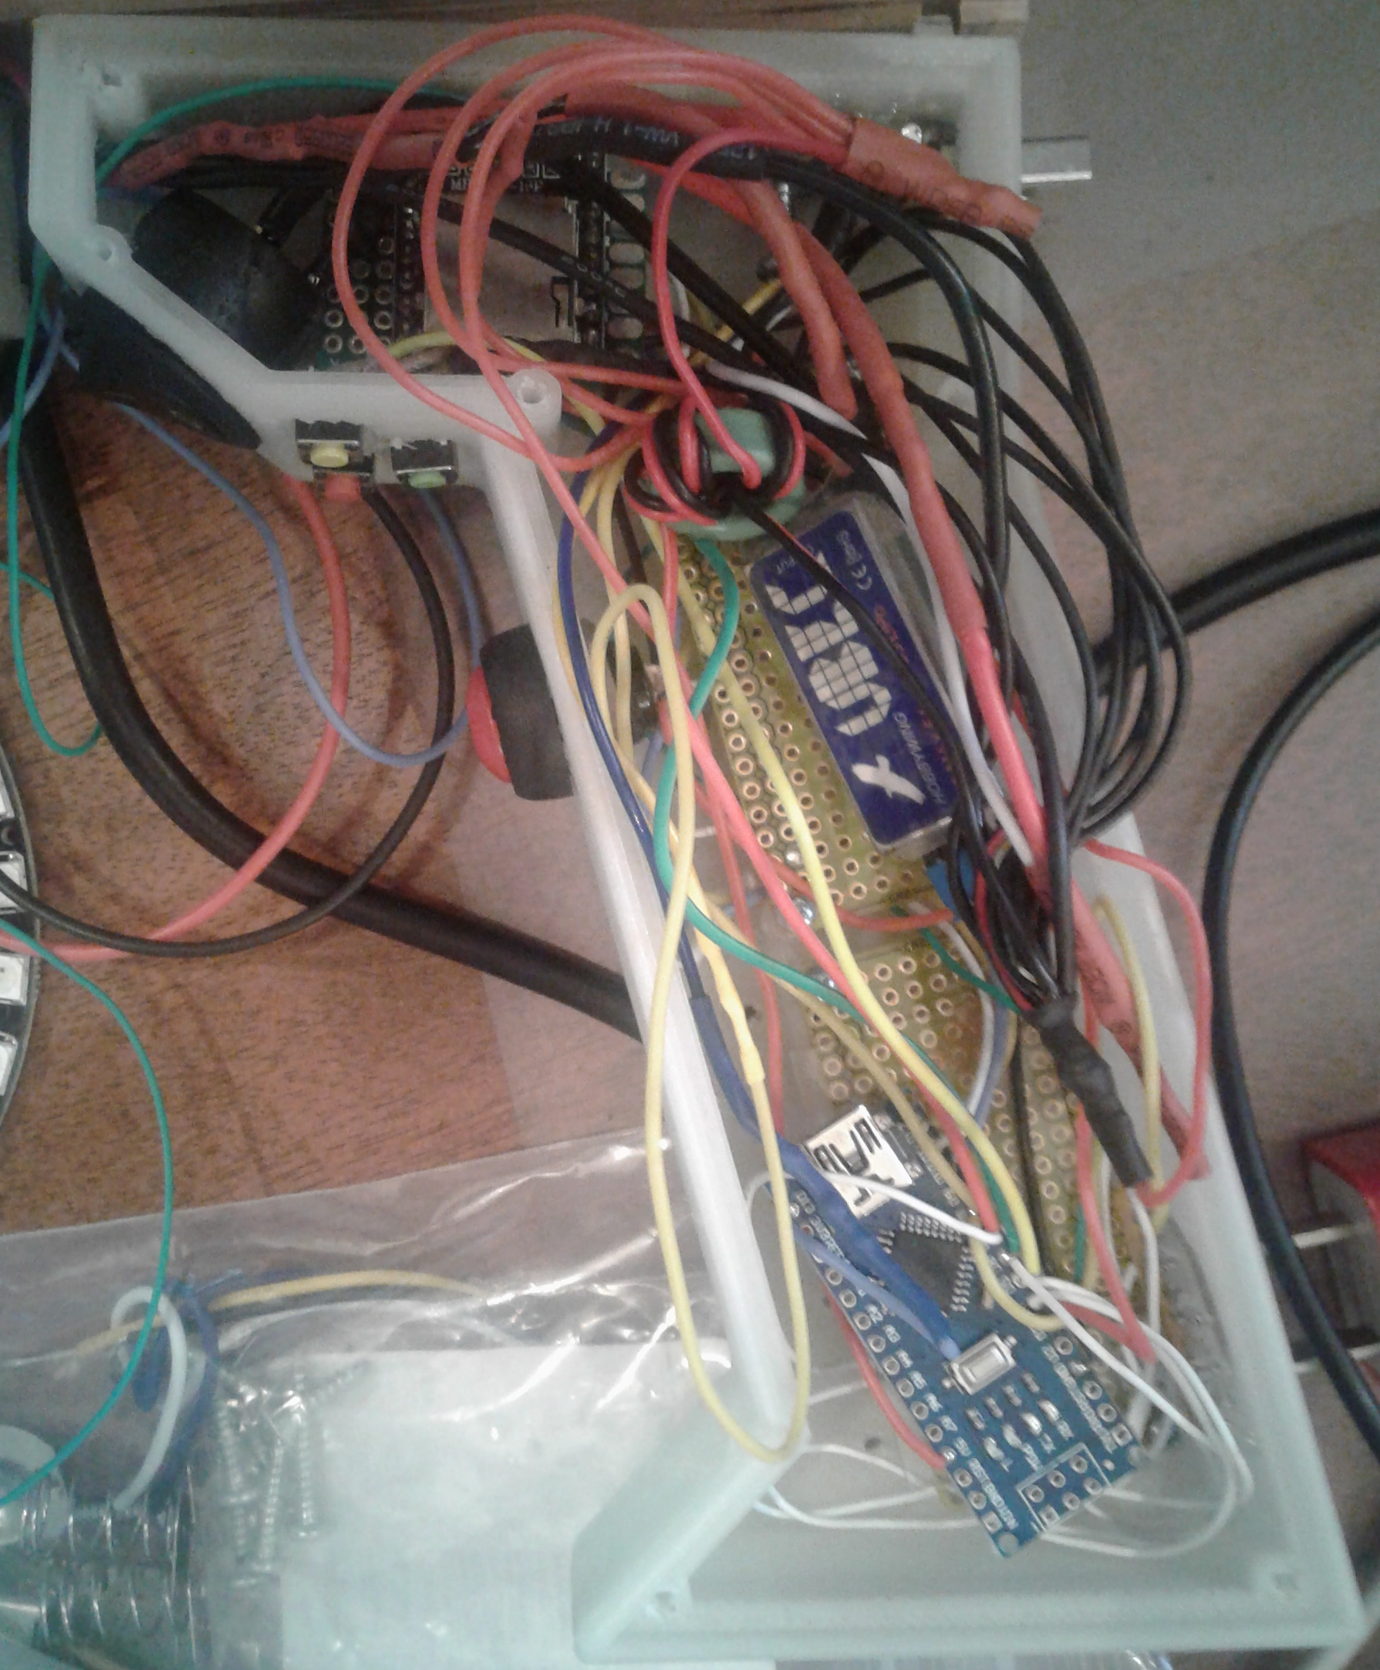
FOOF RBG Electronics Compartment
YX
5200
UBEC
IN
125
Ardu
KCX

Slide 3
FOOF RBG Power
Battery 8.3V: 1 connection:
- on/off switch
USB 8.3V: 3 connections:
- on/off switch
- USB White Wire
- UBEC +V Input
LEDs 5V 20 AWG: 6 connections:
- YX5200 pin “01”
- Arduino pin “5V”
- UBEC 5V output
- SN74HCT125N pin “14”
- 10K Ohm SIP pin “??”
- KCX_BT_EMITTER pin “+5V”
LEDs 5V 20 AWG
USB 8.3V
White Wire
Battery 8.3V
YX
5200
UBEC
IN
125
Ardu
KCX

Slide 4
FOOF RBG Ground
Note: UBEC grounds CONNECTED
LED GND 20 AWG : 8 connections:
- YX5200 pin “10”
- Arduino pin “GND”
- UBEC GND input
- UBEC GND output
- SN74HCT125N pin “07”
- USB Black Wire
- KCX_BT_EMITTER pin “GND”
LED GND 20 AWG
YX
5200
UBEC
IN
125
Ardu
KCX

Slide 5
FOOF RBG USB Connector Other
YX
5200
UBEC
IN
125
Ardu
KCX

