Slide 1
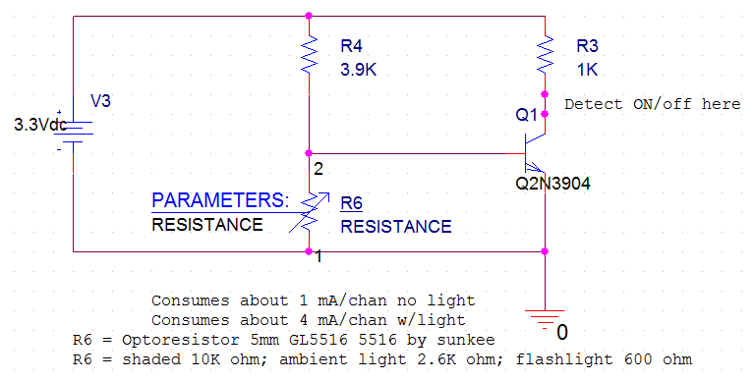

Slide 2
shaded 10K ohm
Ambient light 2.6K ohm
flashlight 600 ohm Direct laser 300 ohm

Slide 4
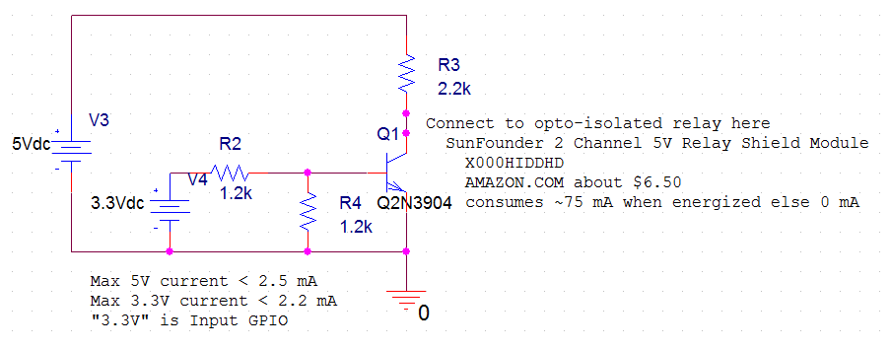

Slide 6
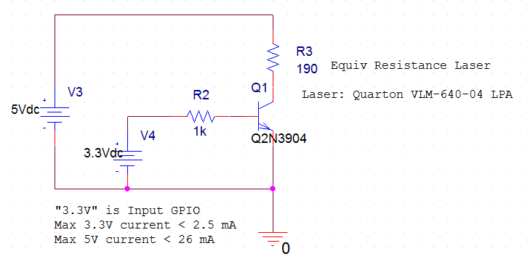

Slide 8
