Slide 1
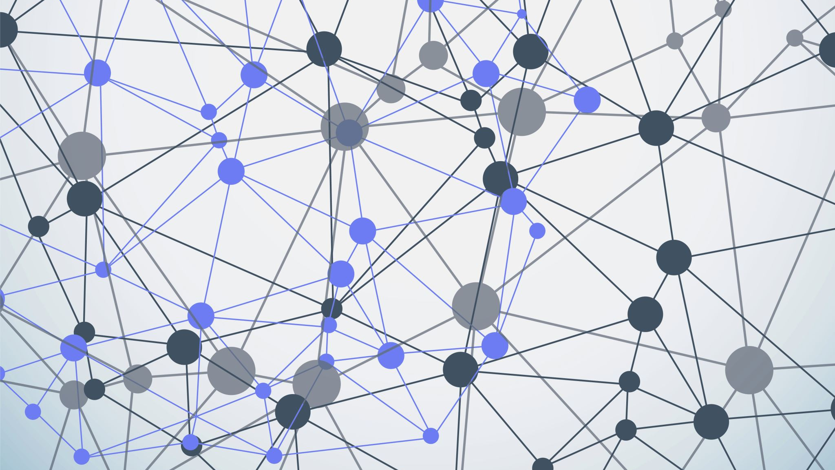
ATTENTION-AUGMENTED CNN ARCHITECTURES FOR MULTIPLE SCLEROSIS MRI CLASSIFICATION: A COMPARATIVE STUDY OF ATTENTION MECHANISMS, METRIC LEARNING, AND VISION TRANSFORMERS
By Mark McNaught
Supervisor: Dr Chris McCaig

Slide 2
Project Aims
Aim: Systematically evaluate how attention mechanisms, metric learning, and transformer-inspired components extend a pretrained CNN baseline for binary MS classification (under limited-data and compute)
SRQ1 — Attention mechanisms: Do SE-Net channel, CBAM dual, and spatial-isolated attention each improve classification and calibration? And can channel and spatial contributions be separated?
SRQ2 — Metric learning: how does replacing the standard classification head used in SRQ1 with a post-hoc NCA + kNN pipeline impact performance?
SRQ3 — Tokenised Self-Attention: Does a single MHSA layer over ViT-style CNN spatial tokens improve on the baseline classification head?
SRQ4 — Transformer comparison: how does the best CNN variant compare against a parameter-matched Vision Transformer trained under the same protocol?

Slide 3
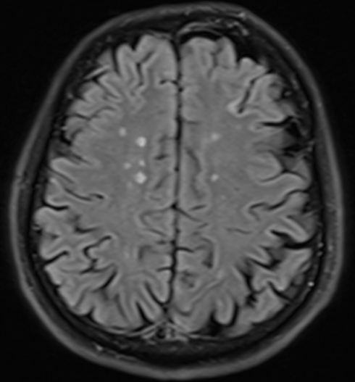
Multiple Sclerosis (MS)
Chronic, inflammatory demyelinating disease of the central nervous system
A leading causes of long-term neurological disability in young adults
Affects 2.9 million people globally, 150,000 in the UK
Mean age of onset: ~30 years
Profound impact on quality of life
Image 1: MRI axial scan of MS positive patient (Kaggle 2022)

Slide 4
Diagnostic Challenges
No single definitive diagnostic test (McDonald Criteria), depends on
expert interpretation of magnetic resonance imaging (MRI),
DiS
DiT
integrated with clinical history (clinical attacks)
Misdiagnosed in 15% of cases, underdiagnosed in 36%
Average diagnostic delay: 17+ months
Radiologist interpretation is expert-dependant and variable
Inter-rater differences of up to 68% in lesion volume estimations
Traditional methods fail to provide consistent results and generalisation across scans
Solution: Deep learning - learn representations directly from data
Data scarcity issue for small medical datasets
Transfer learning

Slide 5
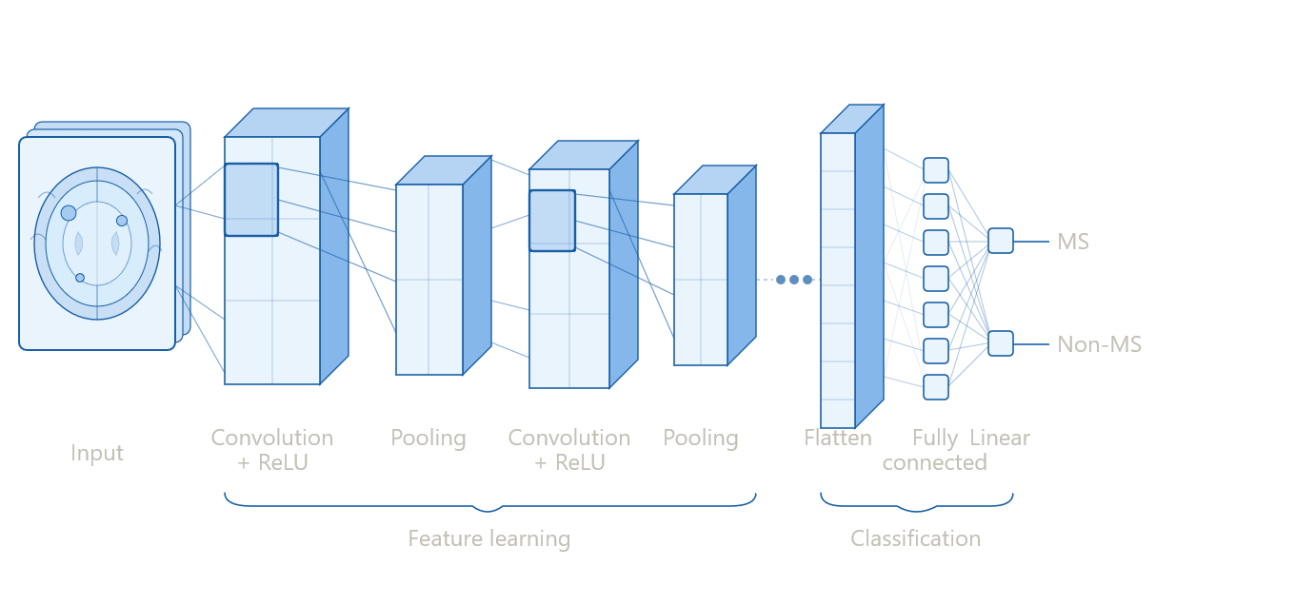
Convolutional Neural Networks (CNNs)
Dominant paradigm: 76% of deep learning MS MRI approaches use CNNs
Spatially structured lesion patterns are a natural fit
Learnable filters detect local patterns: edges, textures, structures
Hierarchical representations: low-level features → semantically meaningful features
Weight sharing: detect a feature once, apply everywhere
Figure 1: diagram of basic block of a CNN
Notes:
A convolutional neural network processes an image through a series of layers that progressively build up a description of its contents.
The core operation is convolution — a small filter slides across the image, computing a weighted sum at each position to detect a particular pattern, like an edge or a texture.
The same filter is applied everywhere, so once the network learns to detect something it can find it anywhere in the image.
After each convolution, a ReLU activation is applied, which simply sets any negative values to zero — this introduces non-linearity, allowing the network to learn complex patterns that a purely linear operation could not capture.
Pooling then reduces the size of the resulting map by summarising small regions, typically by taking the maximum value, making the representation more compact and robust to small shifts in position.
Stacking many of these layers produces a hierarchy — early layers detect simple things like edges and contrast, while deeper layers combine these into increasingly complex and meaningful structures, eventually representing high-level features like the spatial patterns characteristic of MS lesions on a FLAIR scan.

Slide 6
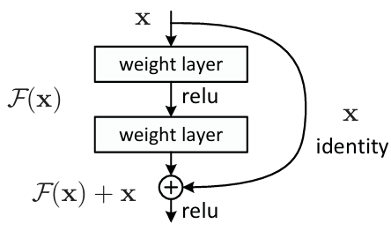
Residual Networks (ResNets)
Adding more layers should improve performance — in practice it makes it worse, even on the data the model was trained on
ResNets fix this by letting the input skip over each block and rejoin the output — so layers only learn small adjustments rather than everything from scratch
This keeps gradients flowing back through the network and unlocks training at much greater depths
Figure 2: diagram of ResNet basic block (He et al. 2015)
Notes:
As researchers stacked more and more convolutional layers hoping for better performance, something unexpected happened — accuracy got worse, not better, even on the training data itself.
This ruled out overfitting as the cause; the network was simply failing to learn. The problem was that very deep networks struggled to optimise through so many stacked transformations, and gradients became increasingly weak as they travelled back through the layers during training, leaving early layers barely updating at all.
ResNets solved this with shortcut connection passes the original input directly to the output of the block, where it is added back in.
This means the block only needs to learn what needs to change — a much easier task — and crucially, gradients can flow back directly through the shortcut without having to pass through every layer, keeping training stable at depths that were previously intractable.

Slide 7
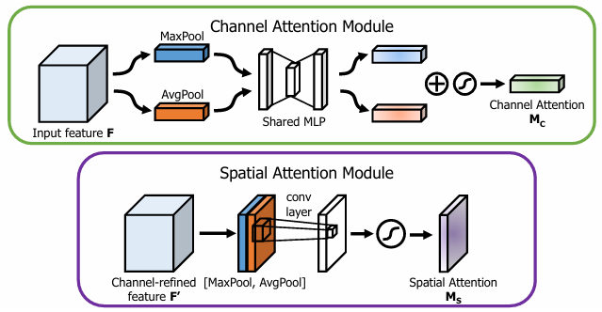
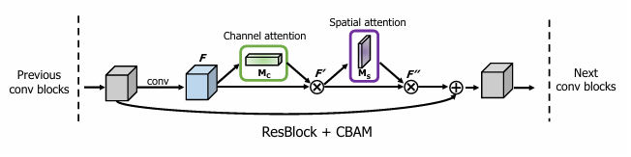
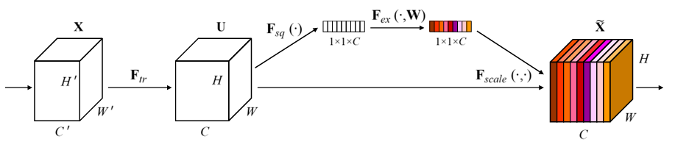
Attention mechanisms
Channel: what is important (weights channels)
Spatial: where is important (weights regions)
End placement: inserted before the final average pooling layer, operates on the complete feature map once
Block-level pre-shortcut: inserted inside every residual block, after the convolutions but before the skip connection rejoins — gates only what the convolutions learned
Block-level post-shortcut: same position but after the skip connection has been added back, gates the fully merged signal
Figure 3: diagram of channel and spatial attention modules (Woo et al. 2018)
Figure 4: diagram CBAM module (Woo et al. 2018)
Figure 5: diagram Squee-Excitation block (Hu et al. 2019)
Notes:
SE-Net applies channel attention — it looks at all 512 feature channels produced by the final convolutional stage, learns which channels are most informative for the current image, and scales each one up or down accordingly, answering the question of what to focus on. CBAM extends this by adding a spatial attention step after the channel step — once it has decided which channels matter, it then produces a 2D map over the height and width of the feature map, highlighting where in the image the most discriminative regions are, answering where to focus.
SE-Net's channel branch uses only average pooling to summarise each channel, while CBAM's channel branch uses both average and max pooling simultaneously — retaining both the typical response and the peak response of each channel — before combining them to produce the scaling weights; CBAMIsolated pairs SE-Net's simpler average-only channel branch with CBAM's spatial branch, meaning the only variable between it and plain SE-Net is the presence of spatial attention, making it the only fully controlled single-variable comparison in the study.

Slide 8
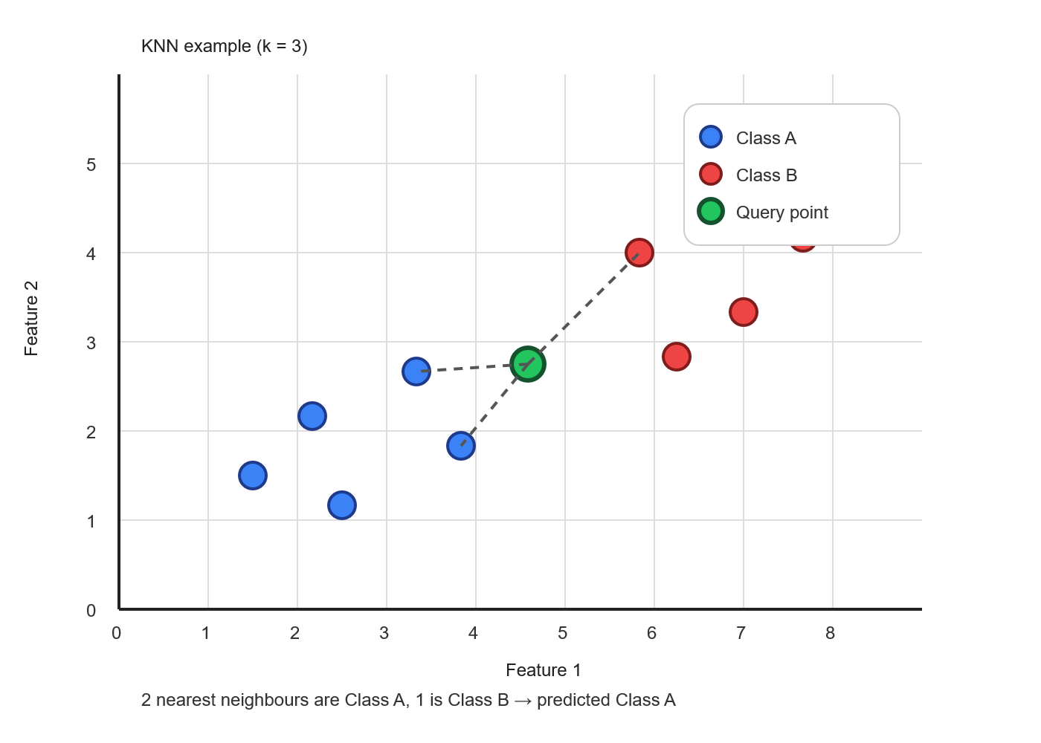
Metric Learning
Standard classifiers learn to separate classes — but don't explicitly structure the embedding space by similarity
Metric learning restructures that space so similar samples cluster together and dissimilar ones are pushed apart
NCA learns a linear projection of the embedding space that maximises kNN classification accuracy
Applied post-hoc to frozen backbone embeddings — no retraining required
Figure 6: diagram of kNN classification with k=3

Slide 9
Vision Transformers
Transformers process sequences — ViTs adapt this to images by splitting them into fixed patches, embedding each as a token, and processing the sequence with self-attention
Self-attention computes relationships between all tokens simultaneously — captures long-range dependencies that CNNs cannot
Cost: ViTs are data-hungry — without the inductive biases of convolutions, they need far more examples to learn effective representations
Notes:
The CNNMHSAHybrid is designed as a deliberate midpoint between CNNs and ViTs: a frozen ResNet18 backbone extracts spatial features, which are then flattened into 49 tokens and passed through a single Multi-Head Self-Attention layer — borrowing ViT's patch tokenisation and global attention mechanism without adopting its full architecture.
The critical difference from CNN attention variants like CBAM and SE is that those operate locally and sequentially (per-channel or per-spatial-position in isolation), whereas MHSA computes joint, content-dependent relationships across all spatial positions simultaneously.
The critical difference from a full ViT is restraint: rather than stacking 12 transformer blocks on raw image patches, the hybrid adds only a single MHSA layer (~400K parameters) on top of already-rich CNN features, retaining the backbone's inductive biases — local receptive fields, translation equivariance, hierarchical feature building — while adding the one capability CNNs lack: global spatial reasoning.

Slide 10
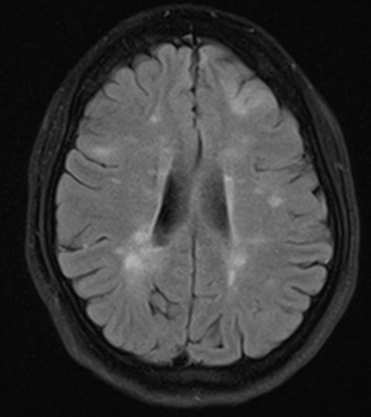
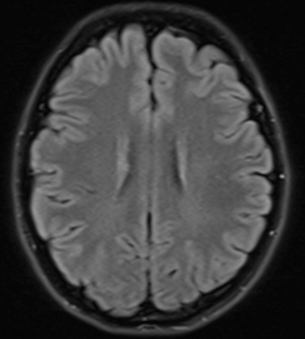
Dataset & Setup
1,652 axial FLAIR MRI slices from 131 patients — MS: 650, Control: 1,002
Stratified 80/20 split → 1,321 train+val, 331 held-out test set aside at the outset
5-fold cross-validation for model selection; all experiments CPU-only (Dell XPS 13, 16GB RAM)
Conservative augmentation: horizontal flip + ±10° rotation only — preserves lesion spatial structure
Image 2: MRI axial scans of MS positive and control patients, respectively (Kaggle 2022)

Slide 11
Performance Metrics
F1 score — primary metric; balances precision and recall, robust to class imbalance
AUC-ROC — measures separability across all classification thresholds
ECE (Expected Calibration Error) — measures how well predicted probabilities reflect true likelihood; lower is better
Model fold selection: best mean validation F1 across folds
Final evaluation: single run on held-out test set, used once after all model selection decisions made
Notes:
F1 Score — the harmonic mean of precision and recall, meaning it penalises both false positives and false negatives equally; used as the primary metric here because the dataset is class-imbalanced, making raw accuracy misleading
AUC-ROC — measures the model's ability to separate MS from non-MS cases across all possible classification thresholds, rather than at a fixed cutoff; a score of 1.0 indicates perfect discrimination, 0.5 indicates chance-level performance
ECE (Expected Calibration Error) — measures whether the model's predicted probabilities are reliable; a well-calibrated model that outputs 90% confidence should be correct approximately 90% of the time — lower ECE indicates better alignment between confidence and actual accuracy

Slide 12
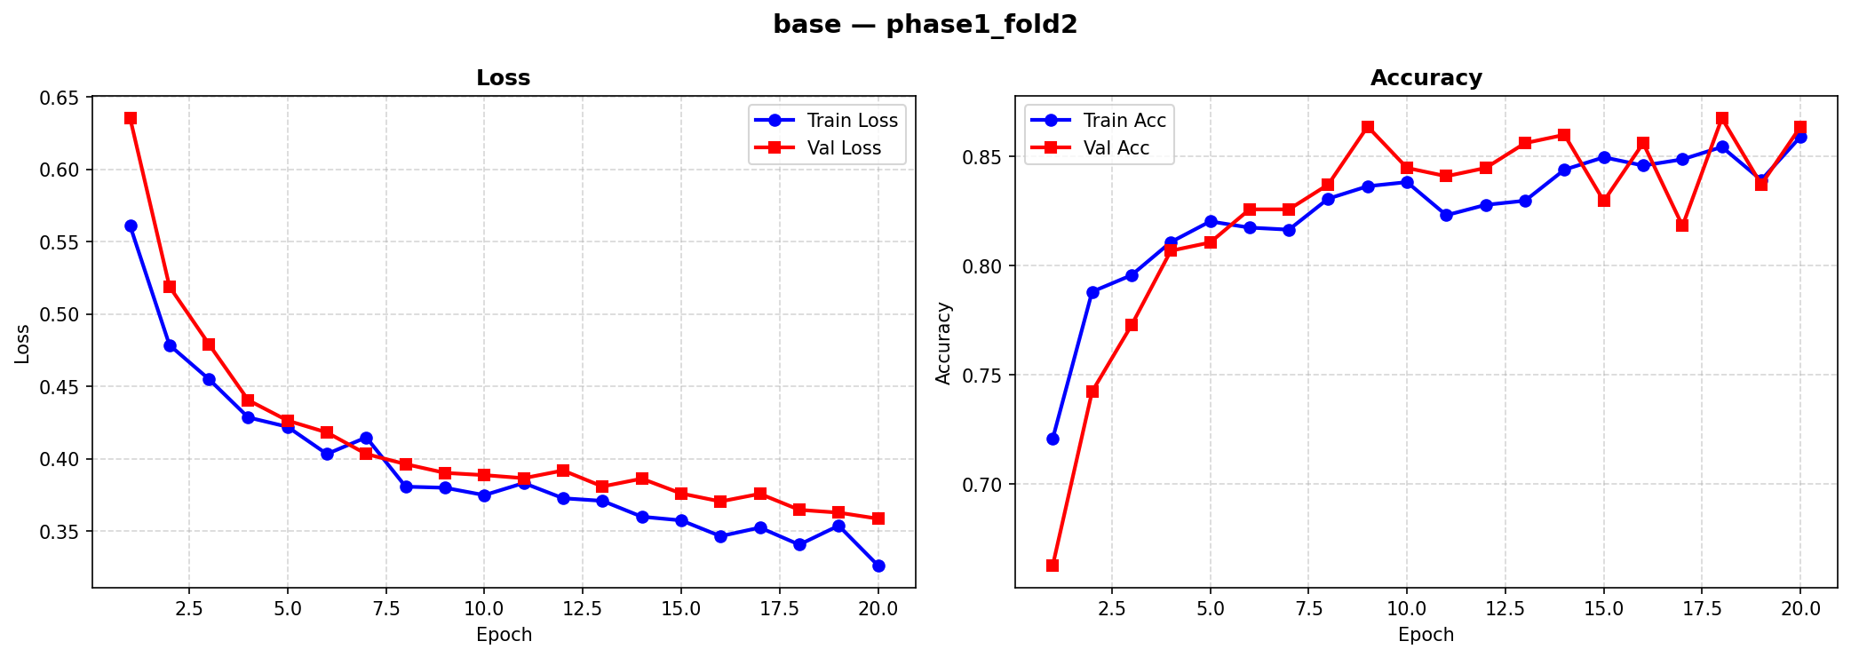
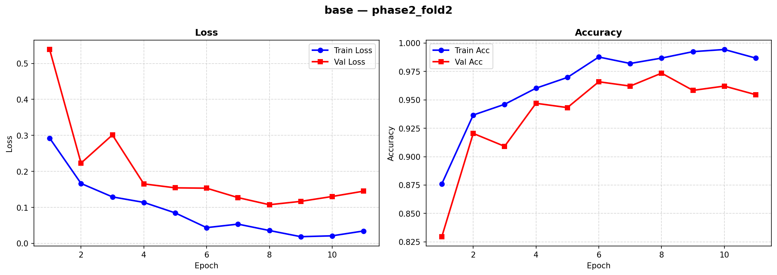
Two-Phase Transfer Learning
Figure 7: ResNet18 base training curves for fold 2/5
Phase 1: backbone frozen — only classifier head and attention modules trained Phase 2: all parameters unfrozen — full fine-tuning at reduced LR with weight decay for regularisation
Prevents randomly initialised attention modules from corrupting pretrained features before they've learned anything useful

Slide 13
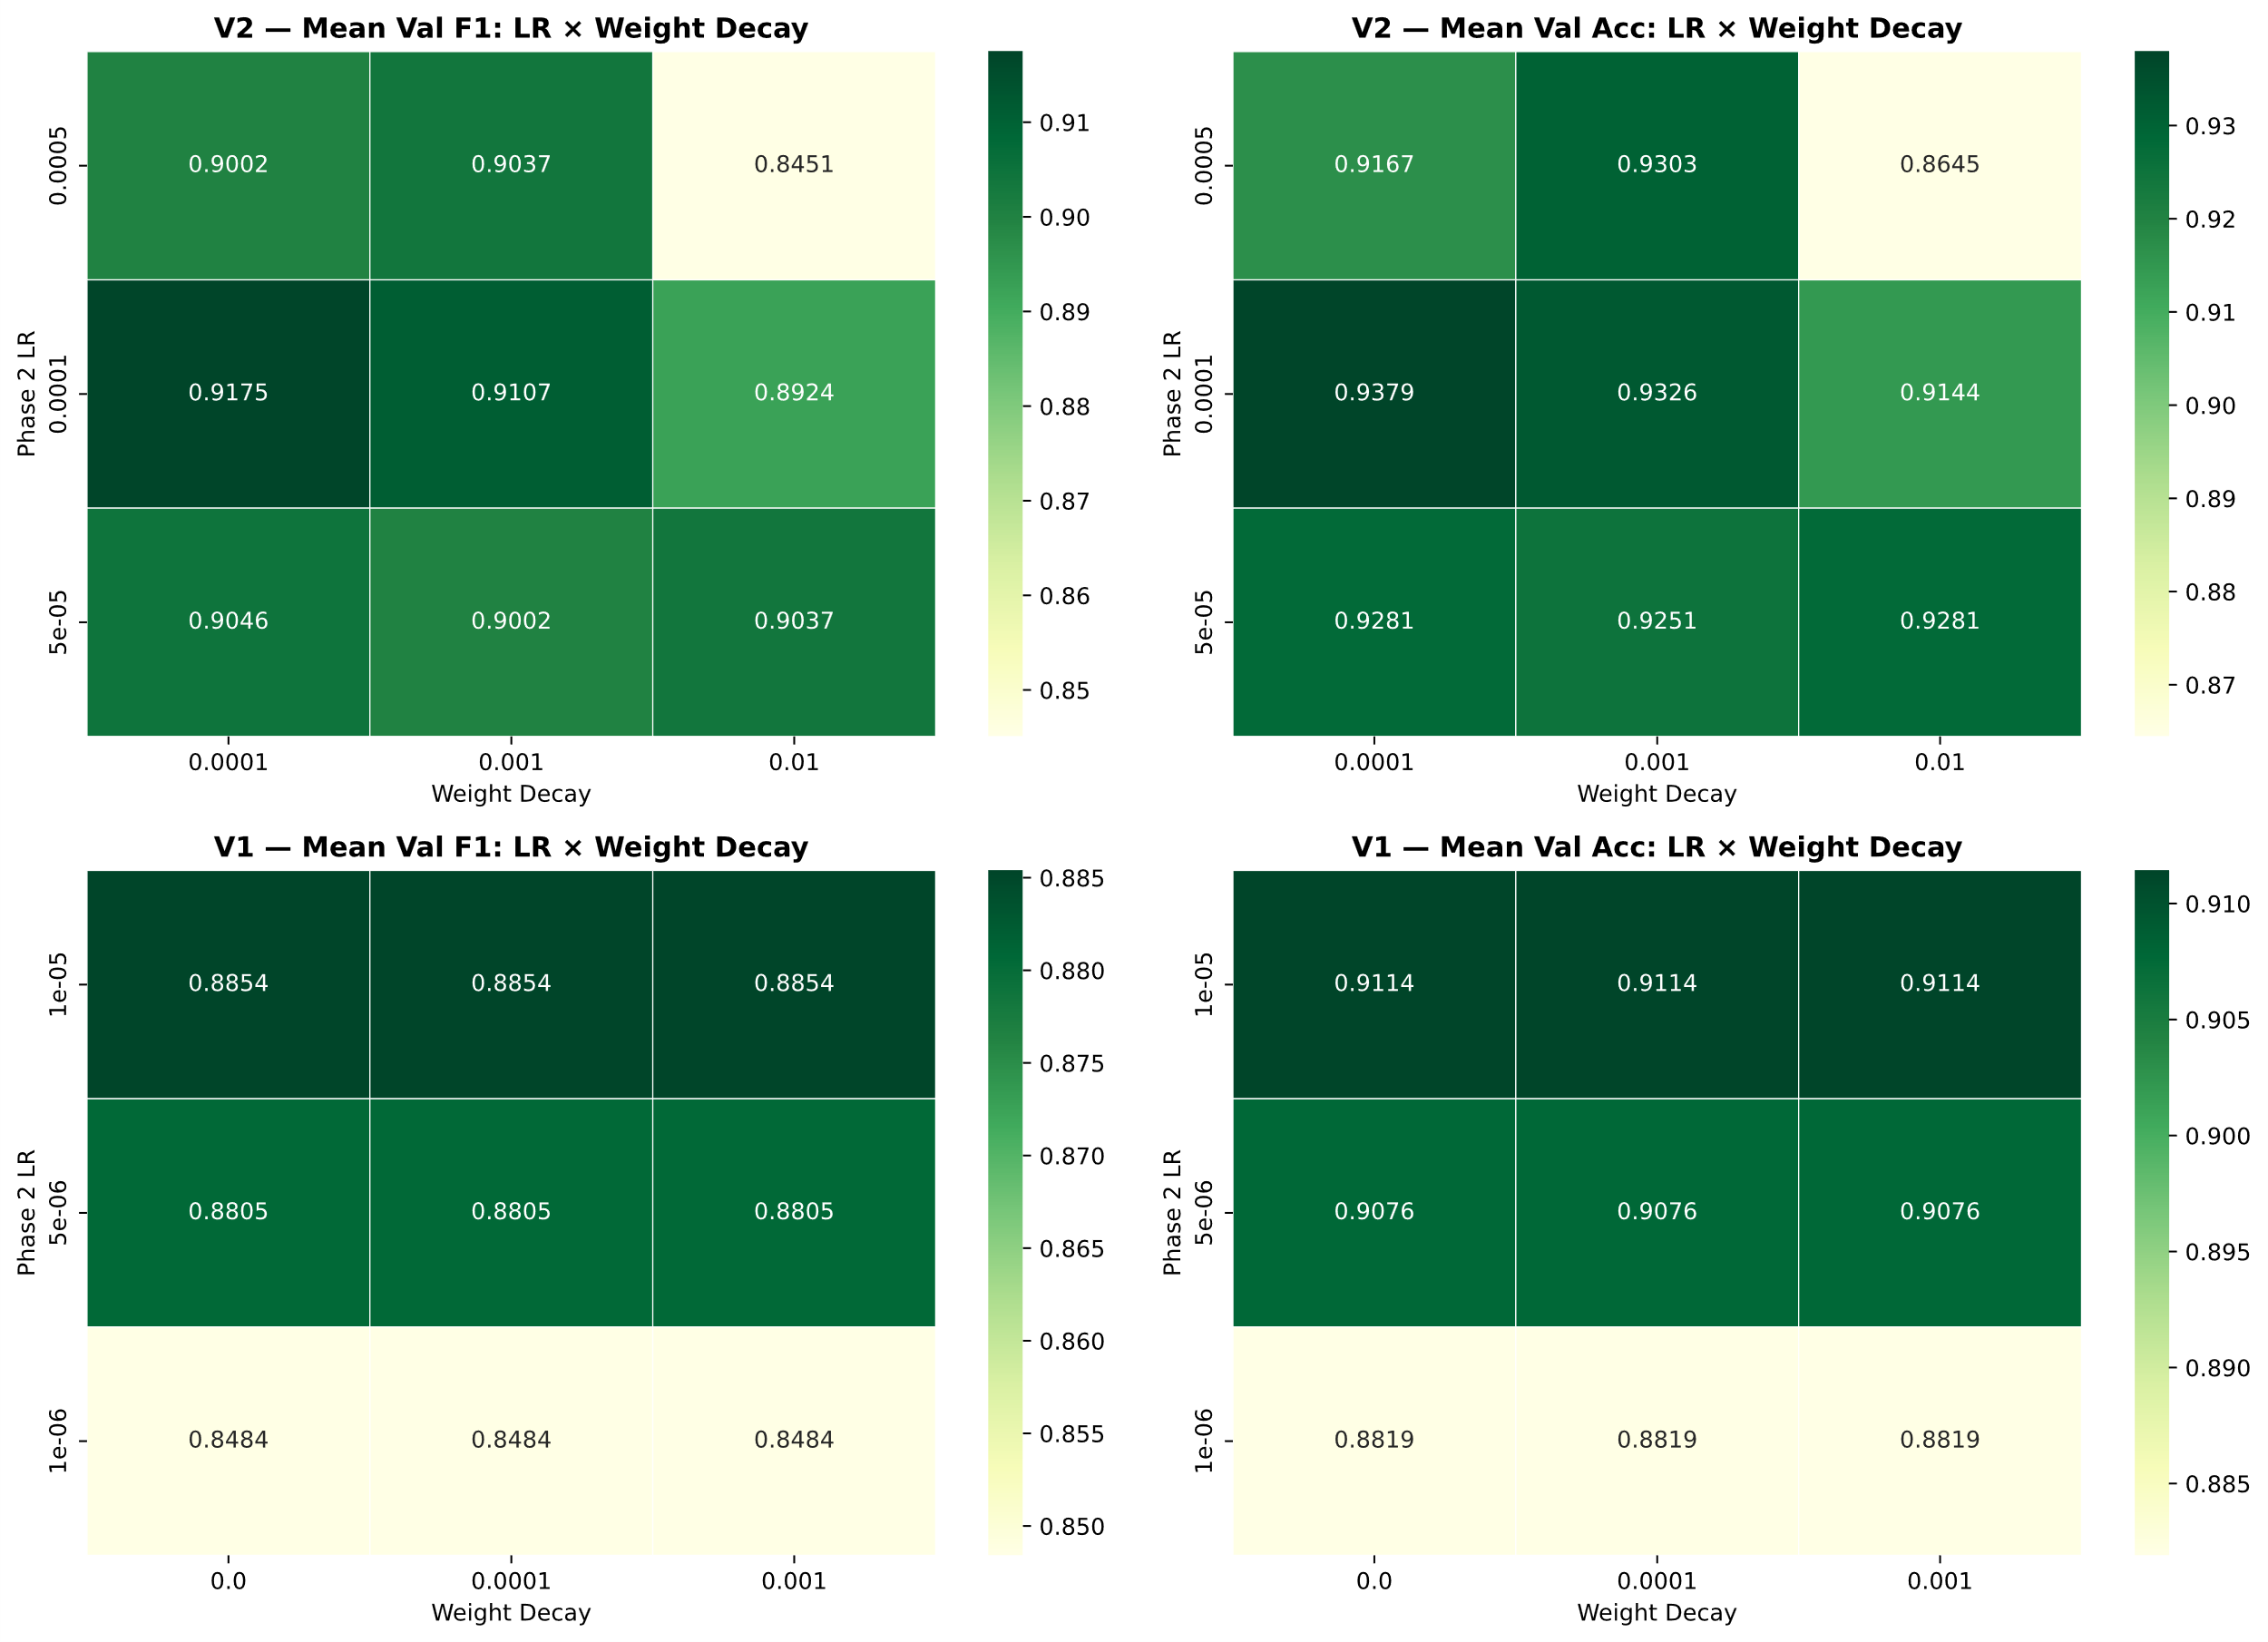
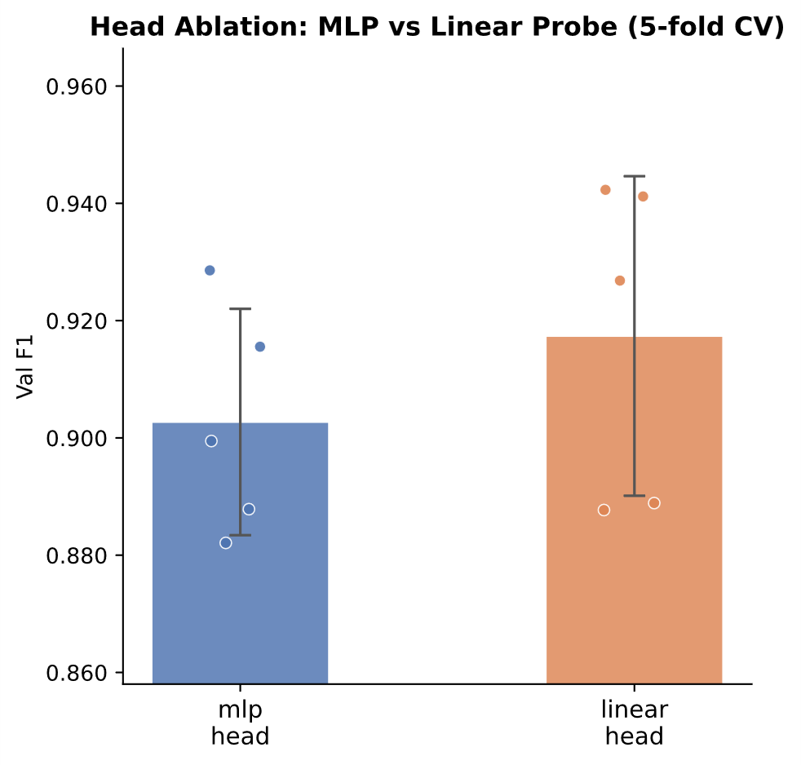
Experimental Design Decisions
Head ablation: linear probe vs MLP head tested before any attention variants trained
Linear probe wins
Adopted for all future experiments, eliminating head capacity as a confound
Figure 8: heatmap of ResNet18 phase 2 grid searches
Hyperparameters selected via 3-fold grid search on the plain ResNet18 baseline
Only searched Phase 2 Learning rate and weight decay
Phase 1 parameters performed well in pilot testing and as such were kept
Grid search on baseline only — prevents architecture-specific tuning from confounding comparisons
Figure 9: head ablation chart

Slide 14
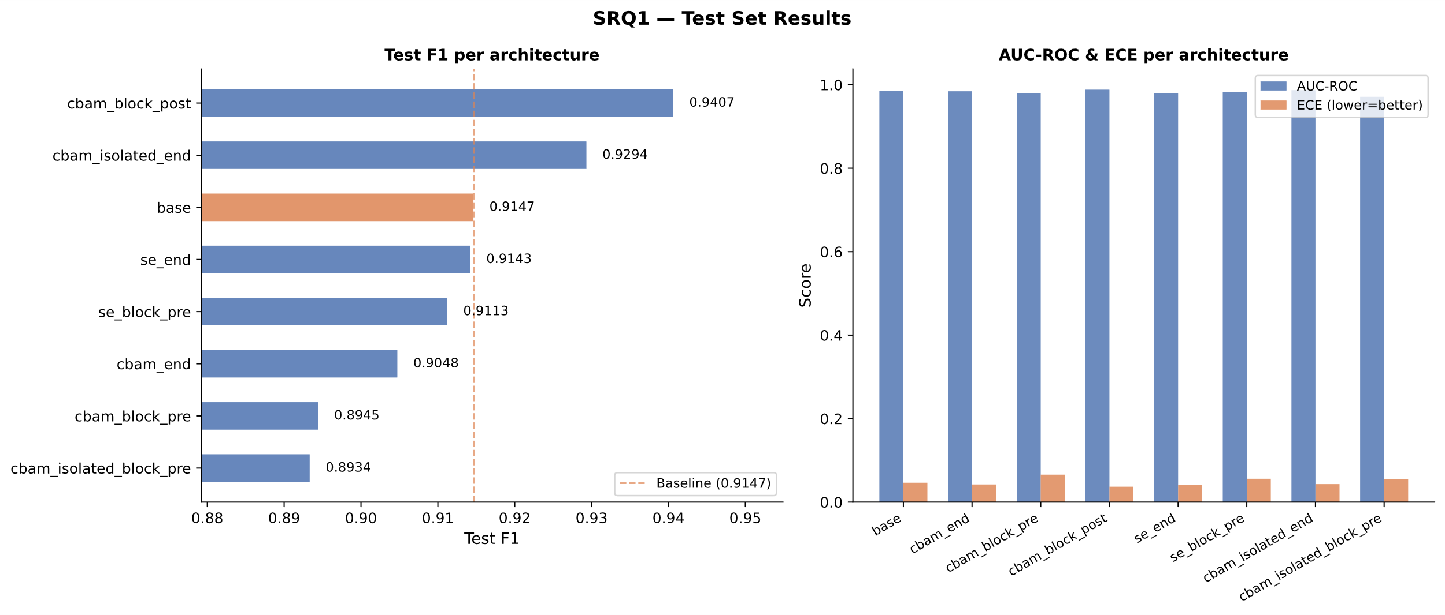
SRQ1 Attention Mechanisms
Notes:
Pair A: base vs se_end
does channel attention help?
No, Δ = −0.0004
Pair B: se_end vs cbam_isolated_end
does spatial attention help?
Yes, Δ = +0.0151
Pair C: cbam_isolated_end vs cbam_end
does dual-pool channel beat single-pool?
No, Δ = −0.0246
Pair D: se_end vs cbam_end
SE-Net vs full CBAM?
SE wins, Δ = +0.0095

Slide 15
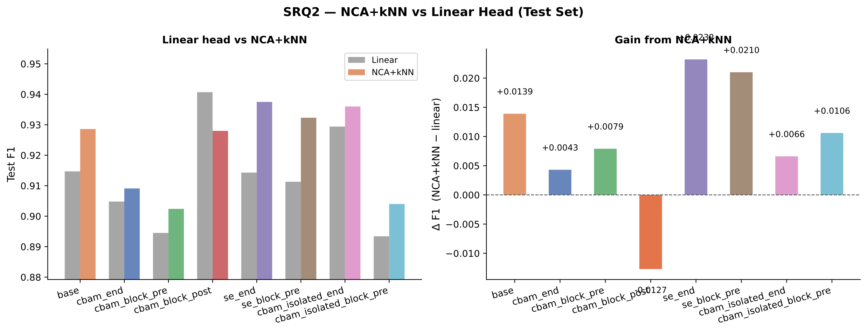
SRQ2 Metric Learning
Notes:
NCA+kNN improves 7/8 backbones on held-out test data
Largest gains on weakest linear heads — cbam_block_pre Δ = +0.0079, se_end Δ = +0.0232
Only exception: cbam_block_post Δ = −0.0127 — already had the strongest linear head, no room to gain
Best model in the study: se_end + NCA+kNN, F1 = 0.9375

Slide 16
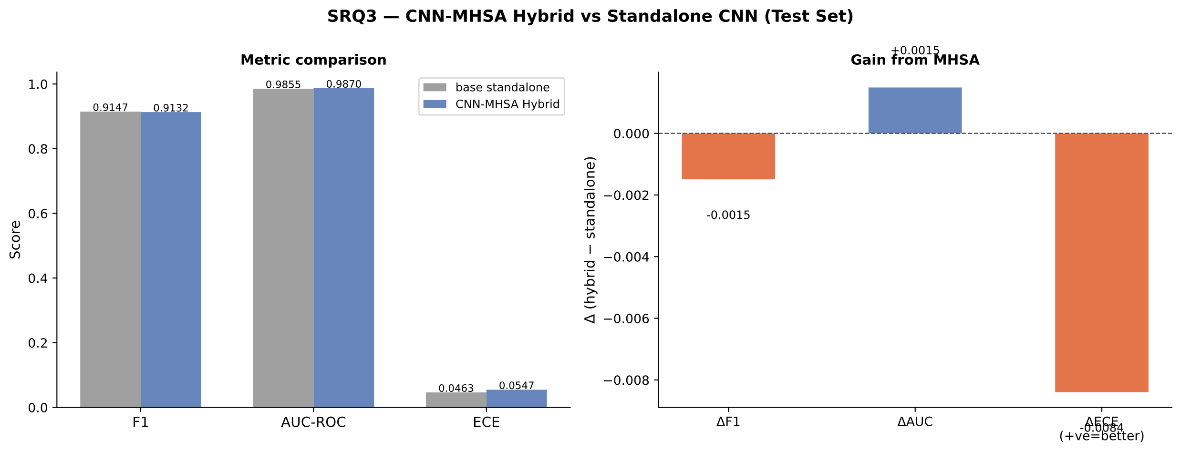
SRQ3 Tokenised Self-Attention
Notes:
Adding a single MHSA layer on top of the CNN backbone produced virtually no change in F1
The hybrid is marginally worse on calibration (ECE 0.0547 vs 0.0463), suggesting the attention layer introduces slight overconfidence without a corresponding accuracy benefit
The key interpretation is not failure — it's that global self-attention over CNN features provides no meaningful advantage at this dataset scale; the CNN backbone had already captured sufficient spatial information
This is consistent with the hypothesis that ~1,000 training samples is simply too few for an MHSA layer to learn useful global relationships that the CNN missed, rather than a flaw in the architecture itself

Slide 17
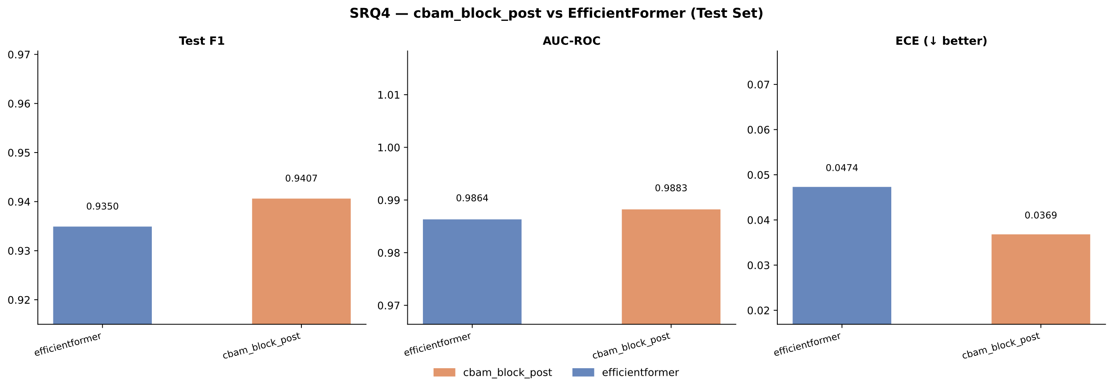
SRQ4 ViT Comparison
Notes:
EfficientFormer used the exact same training protocol as the CNNs — same hyperparameters, same folds, no ViT-specific tuning — making this a fair architectural comparison
Despite that, it delivered competitive results: F1 0.9350 vs 0.9407, AUC-ROC 0.9864 vs 0.9883 — a gap of under 1% across the board
The only more notable difference is calibration (ECE 0.0474 vs 0.0369), meaning cbam_block_post is slightly more confident and correct at the same time
cbam_block_post still edges it out, which is expected — CNNs have inductive biases suited to images (locality, translation equivariance) that tend to help in small datasets
But the key takeaway is that a fundamentally different architecture — global token attention vs local convolutions — essentially matched the CNN with no extra tuning effort
This suggests strong pretrained representations in EfficientFormer are doing a lot of the heavy lifting, compensating for the lack of image-specific inductive biases

Slide 18
Sources
Kaggle (2022), ‘Multiple sclerosis mri dataset’, https://www.kaggle.com/datasets/ buraktaci/multiple-sclerosis. Accessed: 16 March 2026.
He, K., Zhang, X., Ren, S. and Sun, J. (2015), ‘Deep residual learning for image recognition’. URL: https://arxiv.org/abs/1512.03385
Hu, J., Shen, L., Albanie, S., Sun, G. and Wu, E. (2019), ‘Squeeze-and-excitation networks’. URL: https://arxiv.org/abs/1709.01507
Woo, S., Park, J., Lee, J.-Y. and Kweon, I. S. (2018), ‘Cbam: Convolutional block attention module’. URL: https://arxiv.org/abs/1807.06521

