Slide 1
Your Career & Computer Literacy
Stacie Seaman

Slide 2
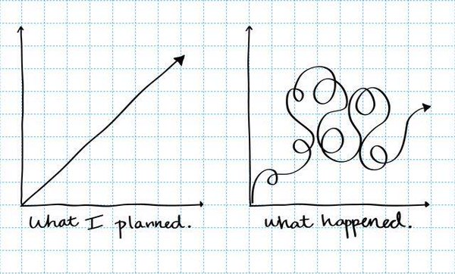
My Story

Slide 3
My Story
Bachelor’s in Psychology (1981); Bachelor’s in Nursing (2001); Registered Nurse; IT Director; COO of Software Engineering firm; Editor; Life Coach
Banner Health (2001-2014)
In 2014 had 38,000 employees, 22 hospitals in 7 states (AZ, CA, NV, CO, NE, WY, AK)
Banner Health IT – 1,000 employees
Standardized Electronic Medical Record (customized Cerner install)
Clinical Applications Department = all clinical software that wasn’t Cerner
Examples of specialized settings: Outpatient Rehab (Physical Therapy, Occupational Therapy, Speech therapy), Radiation Oncology, Obstetrics, Transplant)
Built blended teams of clinical-background analysts (RN, PT, PharmD) and IT-background (CIS, BIS) analysts and engineers.
I had Direct Reports in Greeley and Phoenix. Eventually moved to 100% remote work.

Slide 4
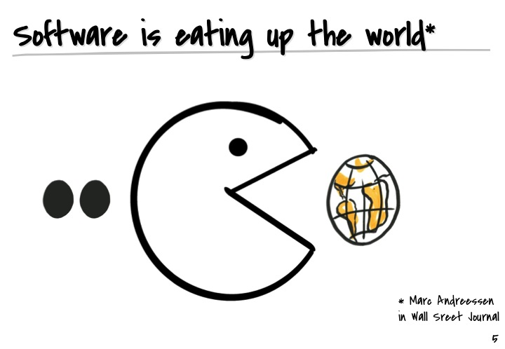
Business = Software
Industries Transformed by Software
Music – iTunes
Investing – Stock Exchange
Media – Netflix, YouTube, DIY content
Marketing – Social Media
Banking – electronic, mobile, e-deposit
Travel – online booking
Newspapers – print closing down
Retail – online surpassed block and mortar

Slide 5
Your Career – CIS and Finance
Computer Information Systems
Dev Ops
REPORTS!! (SQL Queries, Crystal Reports, Dashboards) Managers have an insatiable hunger for useful reports on their data. The ability to create these reports = job security. Dashboards are created by linking a front-end web page to a database.
Finance
Top 7 Digital Transformations in Financial Services
1. Mobile Banking
2. Mobile Pay – very common in UK
3. Mobile Apps - loans, budgeting, financial management
4. Blockchain – cryptocurrency stalled out. Growth in RegTech
5. Automated Wealth Managers – AI and wealth bots
https://www.forbes.com/sites/danielnewman/2019/01/16/top-7-digital-transformation-trends-in-financial-services-for-2019/#b708ed65310b

Slide 6
Your Career – Accounting and Management
Accounting
5 Key Accounting Trends to Know for 2020
Big Data and Analytics
Automation and Artificial Intelligence
Cloud Accounting for Small to Midsize Businesses
Outsourcing of Accounting Duties
Social Media as a Source of Talent and Clients
https://www.purdueglobal.edu/blog/business/5-accounting-trends/
https://financesonline.com/accounting-trends/
Management
More top-performing CEOs now have engineering degrees than MBAs - Washington Post
“34 of the top 100 CEOs in 2018, according to the Harvard Business Review report, had an engineering degree, compared with 32 who had an MBA. Eight of the top CEOs had both degrees.”
https://www.washingtonpost.com/business/2018/10/22/more-top-performing-ceos-now-have-engineering-degrees-than-mbas/?utm_term=.84589d3f1d7e

Slide 7
Your Career – Marketing
Marketing
Technology now completely dominates marketing
SERP Position Zero & Featured Snippets, Voice Search, AI/automation, Live Video, Personalization, Customer Experience
Technology driven changes in customer behavior (data privacy)
https://marketinginsidergroup.com/marketing-strategy/2020-marketing-trends-you-need-to-know/
https://www.smartinsights.com/digital-marketing-strategy/technology-changing-consumer-behaviour-is-biggest-marketing-trend/

Slide 8
Your Career – Entrepreneurs
Entrepreneurs
7 Tech trends for Future Entrepreneurs
Digital Workplace
Automation
No-code development
Blockchain
AI-driven development
Edge computing
Ethics around digital privacy
https://customerthink.com/7-tech-trends-for-future-entrepreneurs/
Other Degree Majors?

Slide 9
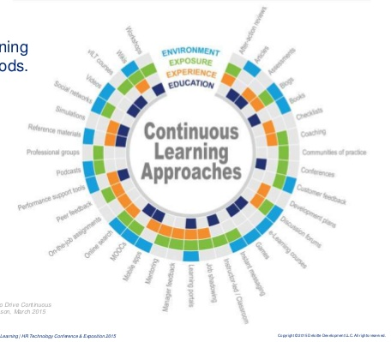
Your Career
Essential Skill for Success = Continuous Learner
The ability to continually develop and improve one's skills and knowledge in order to perform effectively and adapt to changes in the workplace.
Earning a degree is a single, intense learning episode in your life. Never quit learning and you will be successful.

Slide 10

LinkedIn
LinkedIn is used by 87% of Recruiters
Keep your profile up to date.
Your headline should use key search words for the job you want.
Your current skills and objectives should be comprehensive.
Highlight your recent experience.
https://www.topresume.com/career-advice/14-ways-to-leverage-your-linkedin-profile-during-your-job-search

Slide 11
Résumé Tips from a Hiring Manager
20 Seconds
Average amount of time a hiring manager will look at your résumé
1 Page!
Keep narrative to a minimum
Focus on skills
Recruiters use key word scanning extensively
Know the most sought after key words for your job and use them in your résumé

Slide 12
Questions?
Stacie Seaman

