Slide 1
Your Career & Computer Literacy
Stacie Seaman

Slide 2
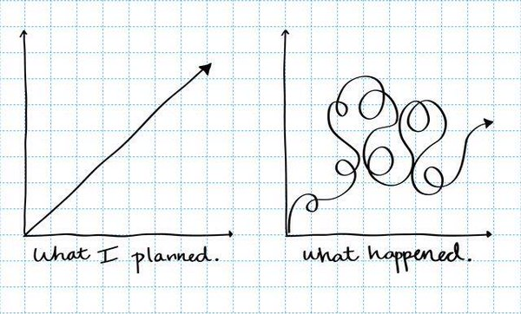
My Story

Slide 3
My Story
Bachelor’s in Psychology; Bachelor’s in Nursing; Registered Nurse; IT Director; COO of Software Eng. firm; Editor; Certified Life Coach
Banner Health (2001-2014)
In 2014 had 38,000 employees, 22 hospitals in 7 states (AZ, CA, NV, CO, NE, WY, AK)
Banner Health IT – 1,000 employees
Standardized Electronic Medical Record (customized Cerner install)
Clinical Applications Department = all clinical software that wasn’t Cerner
Examples of specialized settings: Outpatient Rehab (Physical Therapy, Occupational Therapy, Speech therapy), Radiation Oncology, Obstetrics, Transplant)
Built blended teams of clinical-background analysts (RN, PT, PharmD) and IT-background (CIS, BIS) analysts and engineers.
I had Direct Reports in Greeley and Phoenix. Eventually moved to 100% remote work.

Slide 4
Your Career – CIS and Finance
Computer Information Systems
Dev Ops
REPORTS!! (SQL Queries, Crystal Reports, Dashboards) Managers have an insatiable hunger for useful reports on their data. The ability to create these reports = job security.
Finance
Blockchain is a digitized, decentralized, public ledger of all cryptocurrency transactions. Originally developed as the accounting method for the virtual currency Bitcoin, blockchains – which use what's known as distributed ledger technology (DLT) – are appearing in a variety of commercial applications today. Currently, the technology is primarily used to verify transactions, within digital currencies though it is possible to digitize, code and insert practically any document into the blockchain. Doing so creates an indelible record that cannot be changed; furthermore, the record’s authenticity can be verified by the entire community using the blockchain instead of a single centralized authority.
https://www.investopedia.com/terms/b/blockchain.asp#ixzz5VKGYzp4F

Slide 5
Your Career – Accounting and Management
Accounting
How Technology Is Disrupting Accounting -- And Why The Industry Must Adapt - Forbes
“The next 20 years will see even more dramatic change for the profession. Artificial Intelligence (AI), cognitive computing/machine learning, natural language processing and blockchain are the hot topics today – of course, converging with big data.”
https://www.forbes.com/sites/thomsonreuters/2017/09/20/how-technology-is-disrupting-accounting-and-why-the-industry-must-adapt/#3bf188461fc3
Management
More top-performing CEOs now have engineering degrees than MBAs - Washington Post
“34 of the top 100 CEOs in 2018, according to the Harvard Business Review report, had an engineering degree, compared with 32 who had an MBA. Eight of the top CEOs had both degrees.”
https://www.washingtonpost.com/business/2018/10/22/more-top-performing-ceos-now-have-engineering-degrees-than-mbas/?utm_term=.84589d3f1d7e

Slide 6
Your Career – Marketing and Entrepreneurs
Marketing
Web sites, SEO, social media
How Technology Will Change Marketing - Business Today
Mobile, AI, Blockchain, Chatbots, Machine learning.
https://www.businesstoday.in/opinion/columns/how-technology-will-change-marketing-in-2018/story/279593.html
Entrepreneurs
How many hats do you have to wear in order to succeed in a startup?
Will you understand the software needs/requirements of your business?
Other Degree Majors?

Slide 7
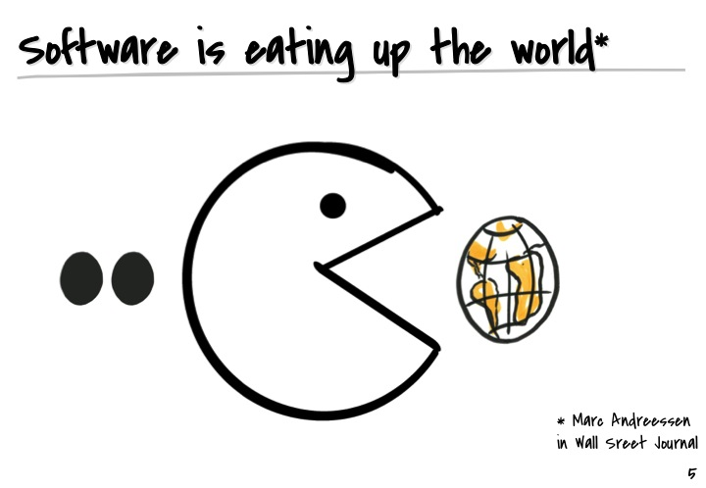
Business = Software
Industries Transformed by Software
Music – iTunes
Investing – Stock Exchange
Media – Netflix, YouTube, DIY content
Marketing – Social Media
Banking – electronic, mobile, e-deposit
Travel – online booking
Newspapers – print closing down
Retail – online surpassed block and mortar

Slide 8
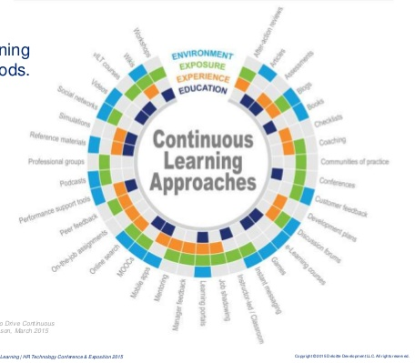
Your Career
Essential Skill for Success = Continuous Learner
The ability to continually develop and improve one's skills and knowledge in order to perform effectively and adapt to changes in the workplace.
Earning a degree is a single, intense learning episode in your life. Never quit learning and you will be successful.

Slide 9

LinkedIn
LinkedIn is used by 87% of Recruiters
Keep your profile up to date.
Your headline should use key search words for the job you want.
Your current skills and objectives should be comprehensive.
Highlight your recent experience.
https://www.topresume.com/career-advice/14-ways-to-leverage-your-linkedin-profile-during-your-job-search
Example…

Slide 10
Résumé Tips from a Hiring Manager
20 Seconds
Average amount of time a hiring manager will look at your résumé
1 Page!
Keep narrative to a minimum
Focus on skills
Recruiters use key word scanning extensively
Know the most sought after key words for your job and use them in your résumé

Slide 11
Questions?
Stacie Seaman

