Slide 1

GIT
A version control system
Mark turner

Slide 2
What is version control?
We’ve all been there…
Added a new feature to a program which ended up breaking a previous version
A simple example of version control:
Main.py, main-2.py, main-3.py, main-4.py, main-5.py

Slide 3
Main.py, main-2.py, main-3.py, main-4.py, main-5.py
However, this can become confusing, and is inefficient when each iteration may only have minor changes
More files could clog up your computer
If only there was a better way…

Slide 4
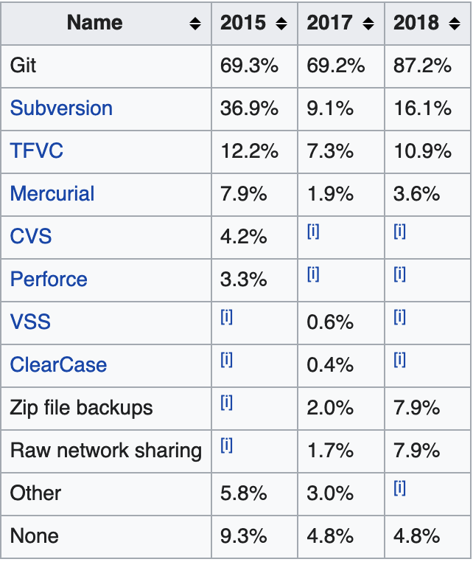
Examples of Version control systems
Git
Subversion
Zip file backups
Raw network sharing
Source: Stack Overflow Annual Developer Survey 2015, 2017, 2018

Slide 5

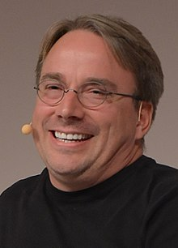
History of git
Invented by Linus Torvalds in 2005
Solving an issue where it was hard to keep track of changes on the Linux Kernel (millions of lines of code)

Slide 6


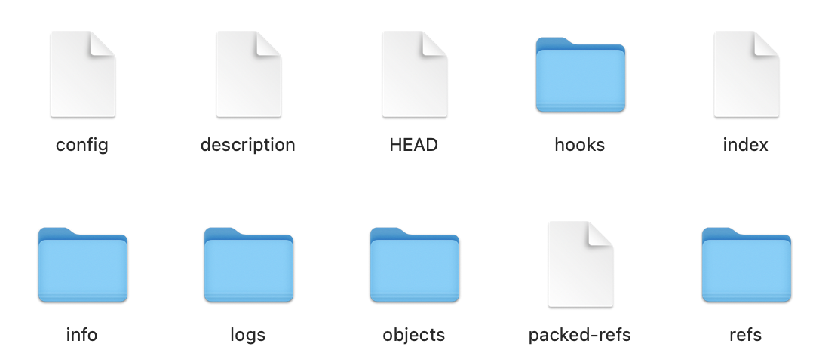
So, how does it work?
When you initialise Git, it creates a .git folder
This .git folder contains other folders and files which track the changes that are made to all the different files (objects) automatically

Slide 7
The advantages
You can go back in time!
But with the advantage of optimised storage space
You can even make branches for when you are testing features, with a main branch when you know something works, and then a testing branch for new features

Slide 8
Git commit
Git won’t automatically track every single time you edit a file.
First you have to “stage” the file, meaning that its current state is ready to be committed
A git commit is when you finally want git to save your changes

Slide 9


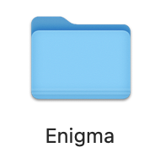


Commit
Created helpers.py
Deleted temp.txt
Staging Area
Modified main.py
Files on your computer

Slide 10
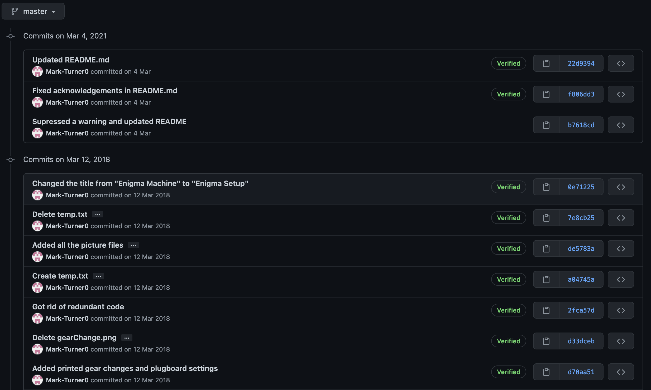

Slide 11
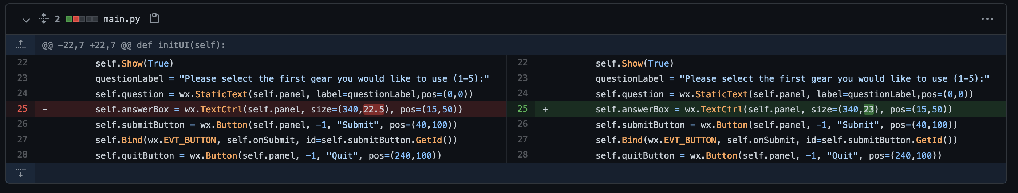
Showing the difference between commits:

Slide 12

Git remote servers
GIT != GITHUB
!=

Slide 13


GitHub
GitLab
BitBucket

Slide 14

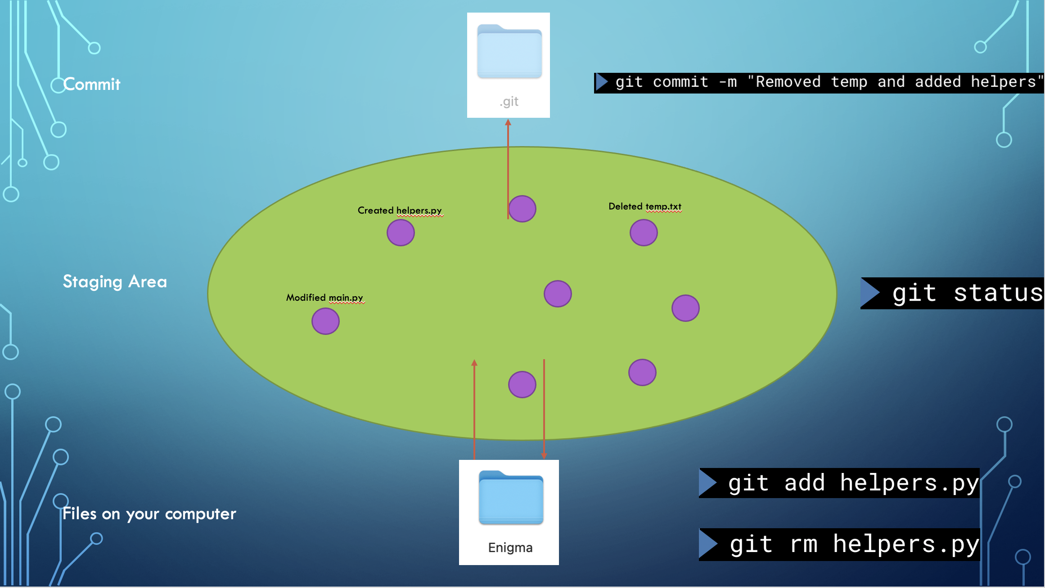

Slide 16
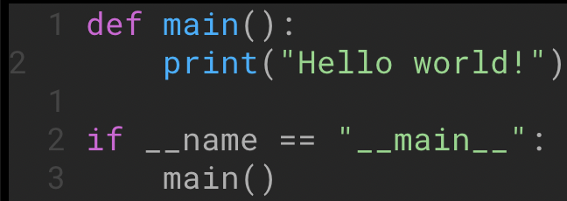
Merging
Of course, when multiple people work on the same file, you can have conflicts:

