Slide 1
Memory Game
Perevezentsev Mark

Slide 2
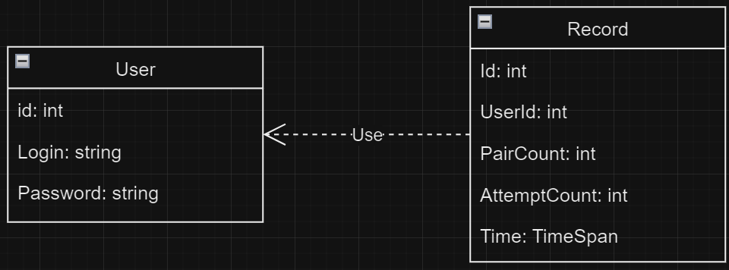
Diagram of classes

Slide 3
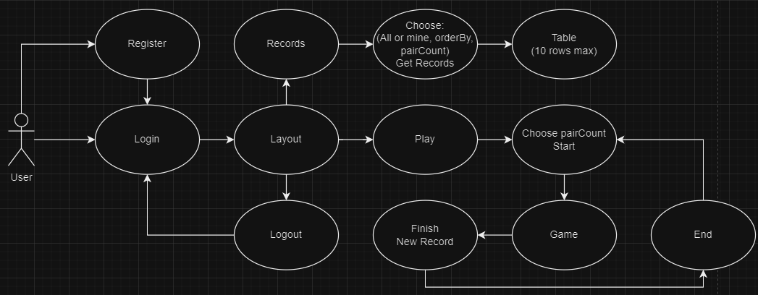
Use-Case Diagram

Slide 4
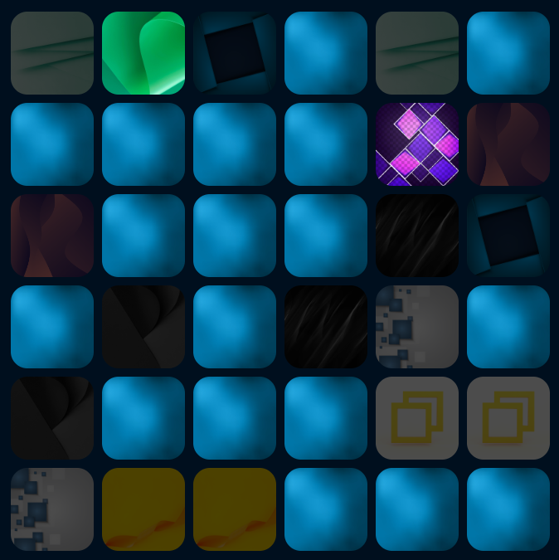
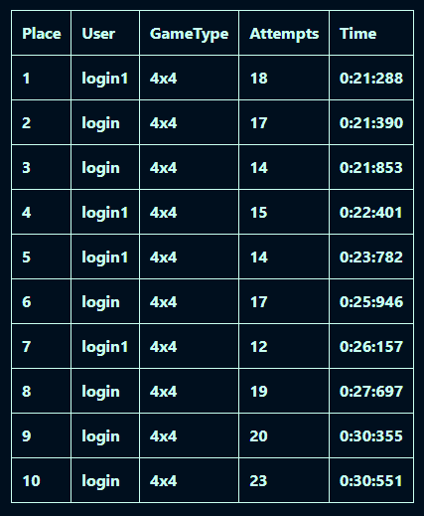
Game

