Slide 1
Camera-based PPE detection with Jetson Nano

Slide 2
Overview
Problem:
Personal Protection Equipment (PPE) is important, but due to various reasons employee/workers sometime tends to forget/incorrectly wear them at work without noticing it.
PPE usage is heavily relied on muscle memory or complicated manual checklists to ensure proper usage.
Even with smart device solutions, they tends to be rare, require proprietary hardware or software and are expensive/demanding, thus making them not very practical in many cases.
Optical surveillance system is commonplace, cheap to setup and easy to maintain now, and older analog Surveillance system can be digitized without much difficulties thanks to the widespread use of computers and specialty designed micro computers.
Solution:
An addon hardware or software based service can be made to use that existing surveillance system feed to detect, record and send notifications for improper PPE usage automatically. Thus increasing workplace safety at low cost and low complexity.

Slide 3
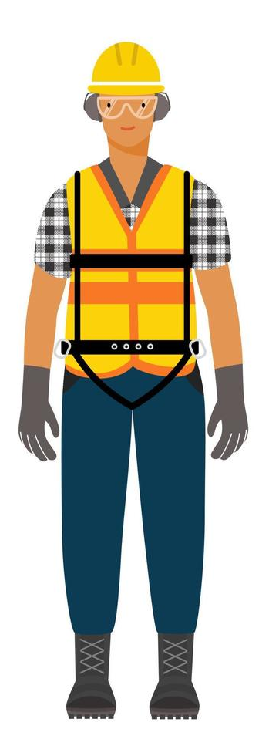

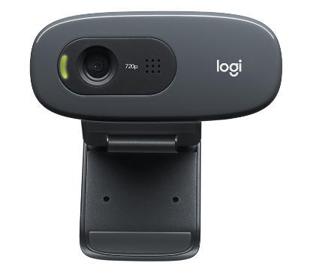
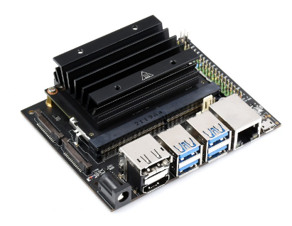

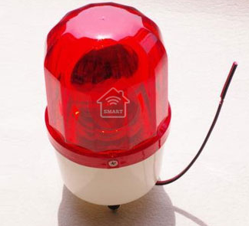
Diagram
Work safety officer workstations
Dedicated surveillance servers
Employees/Workers
Personal device
Camera(s)
Jetson Nano
Notification lights

Slide 4
AI Model
SSD-Mobilenet is used for this project.
Training process are done by following this guideline:
https://github.com/dusty-nv/jetson-inference
Dataset:
2 classes (safe, unsafe) totaled over 400 images.
Images are collected from Roboflow community collection.
Label, Annotate and export to VOC format by using Roboflow tool

Slide 5
Solution Demo
PreRequisites:
Setup Jetson Nano and attached camera module(Follow the guideline https://github.com/dusty-nv/jetson-inference).
For this demo, GPIO PIN11 on Jetson Nano is configured to lit up whenever we detect improper / lack of PPE on any person for simplified monitoring process.
The model is retrained and exported to Onnx as per Mobile-SSD documentation / guide.

Slide 6
Solution Demo
Demo step:
- Configure your Jetson Nano with the provided library of TensorRT as per Nvidia provided guide to setup all necessary development environment for Jetson AI. (CSI Camera was used for this demo)
https://github.com/dusty-nv/jetson-inference/blob/master/docs/building-repo.md
- Unpack provided dataset used to train this demo session in your Jetson Nano at this location.
/jetson-inference/python/training/dectection/ssd/data
- Train your SSD-MobileNet AI model with the provided dataset by following this guide.
https://github.com/dusty-nv/jetson-inference/blob/master/docs/pytorch-ssd.md
- Place provided safetyEquipmentDetection.py file in Jetson Nano detection/ssd folder and run the script with the following command to see Jetson Nano powered PPE detection program in action.
python3 safetyEquipmentDetection.py /dev/video0

Slide 7
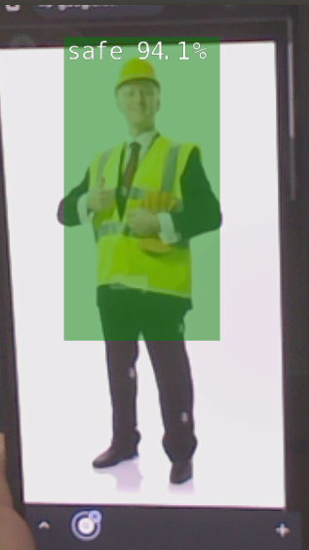
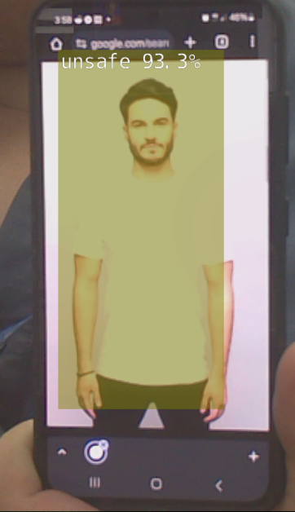
Solution Demo
Nicely dressed, but no PPE in sight
Dressed sharp and dressed safe!

