Slide 1
GPS Measurement Experiments
Andrew Tu
EECE 5698 Robotics Sensing and Navigation
Northeastern University

Slide 2
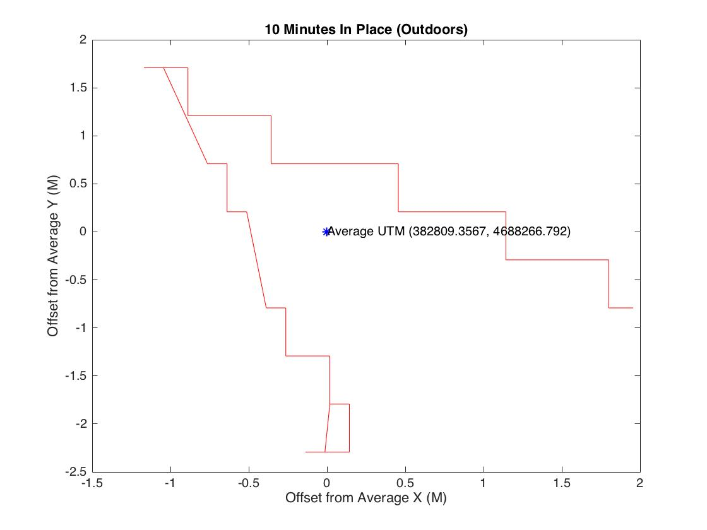
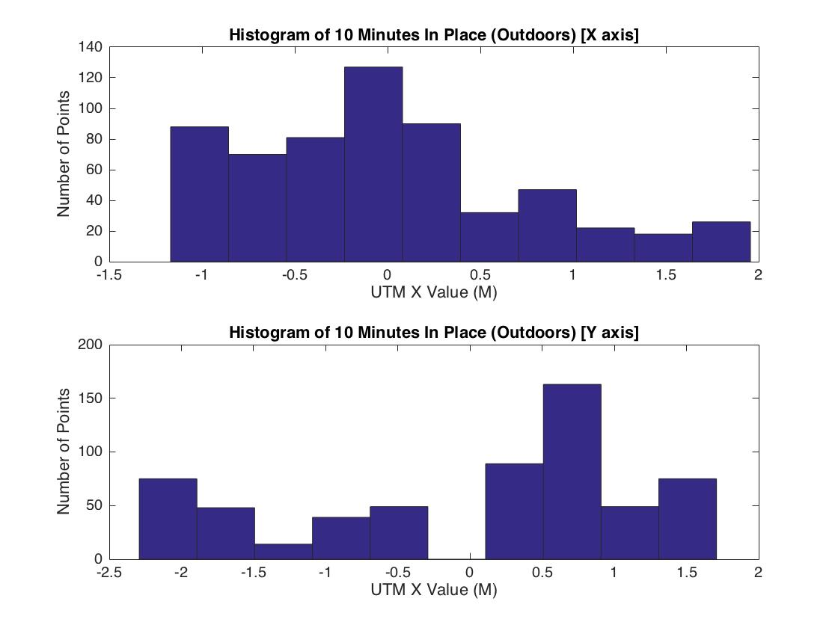
10 Min In Place outdoors
+/- 3 meters of accuracy when outside
Errors fall where there were buildings, i.e. standing between Eagan and Dana, buildings are North West and South East. GPS errors are in same directions!

Slide 3
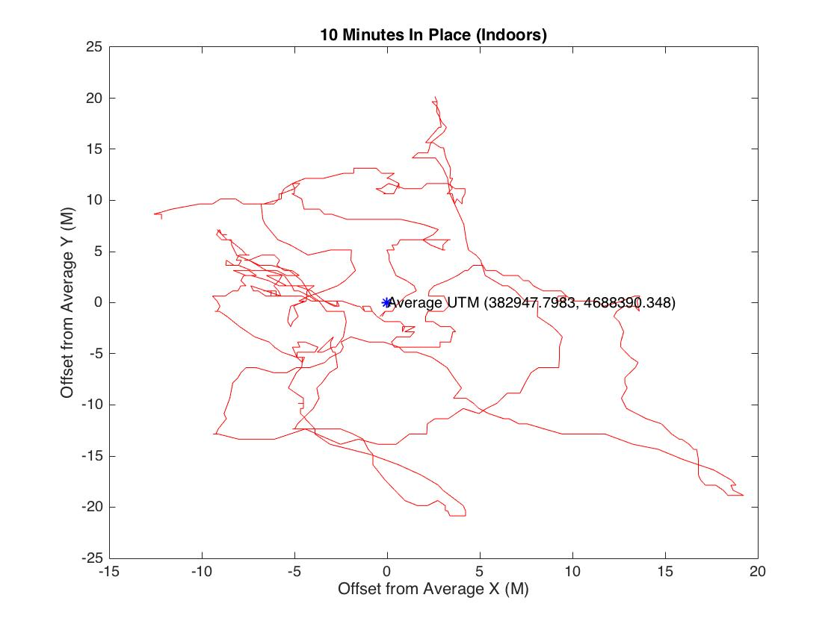
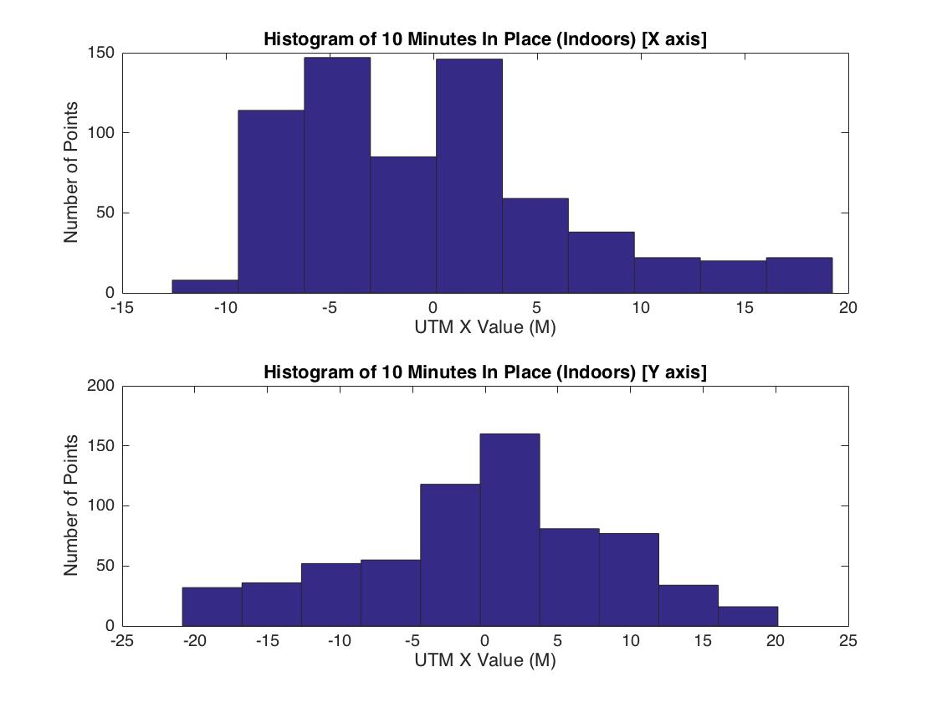
10 Min in Place Indoors
Variation N/S direction is normally distributed
Variation E/W is skewed toward the West
+/- 20 m of error when inside in any direction

Slide 4
Significantly Greater Variation Indoors
Error is significantly greater outside than inside.
Data is more skewed outdoors while more circular indoors

Slide 5
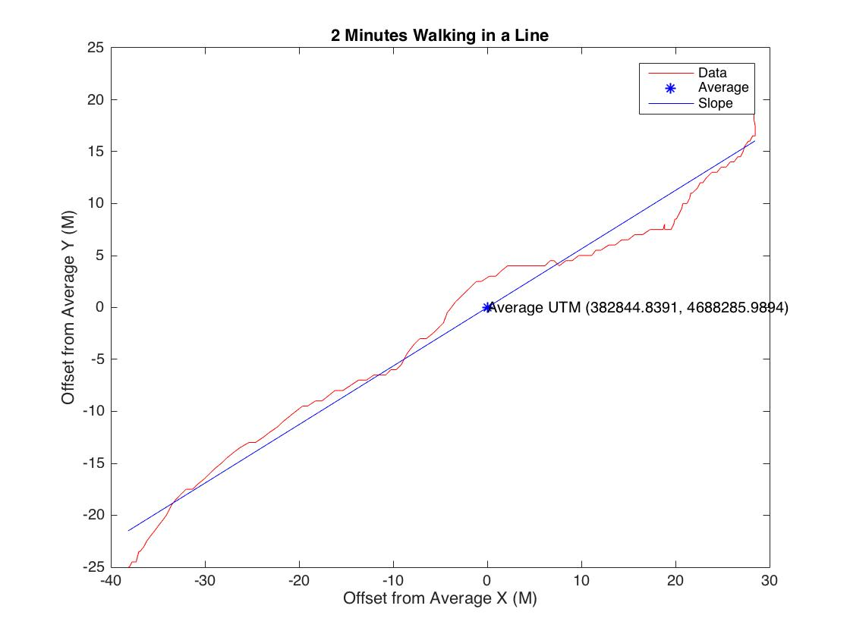
2 Min Walking in a Line
- Best fit line using least squares regression
- R^2 Value of . 976
- P Value of 3.07e-114

