Slide 1
RTK GPS Measurement Experiments
Andrew Tu
EECE 5698 Robotics Sensing and Navigation
Northeastern University

Slide 2
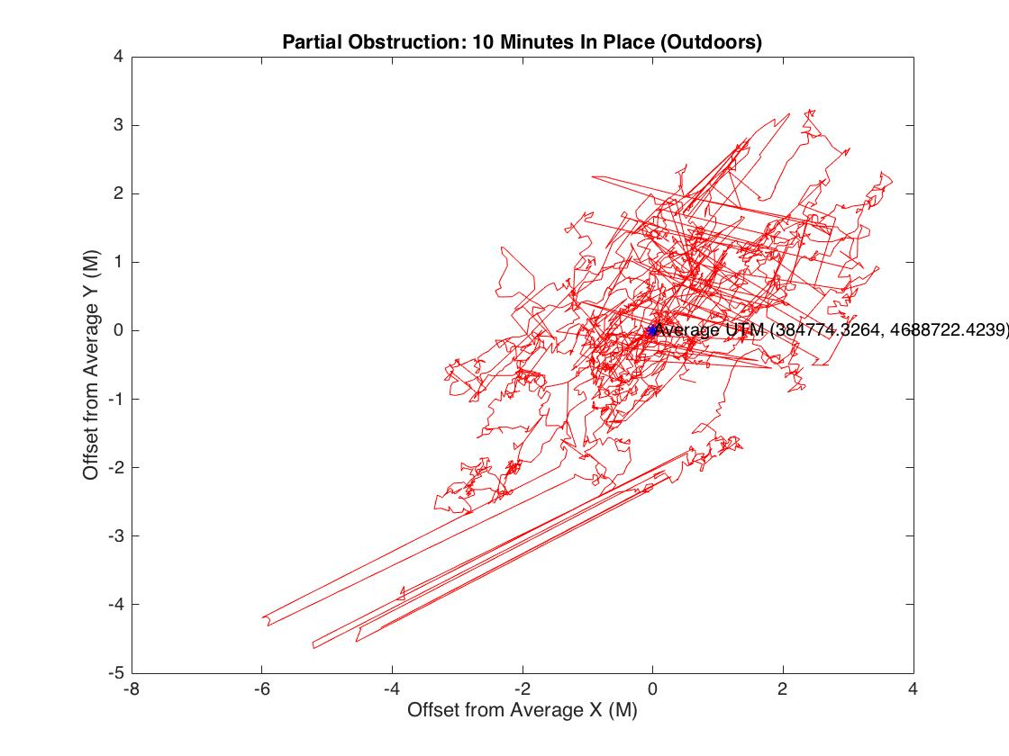
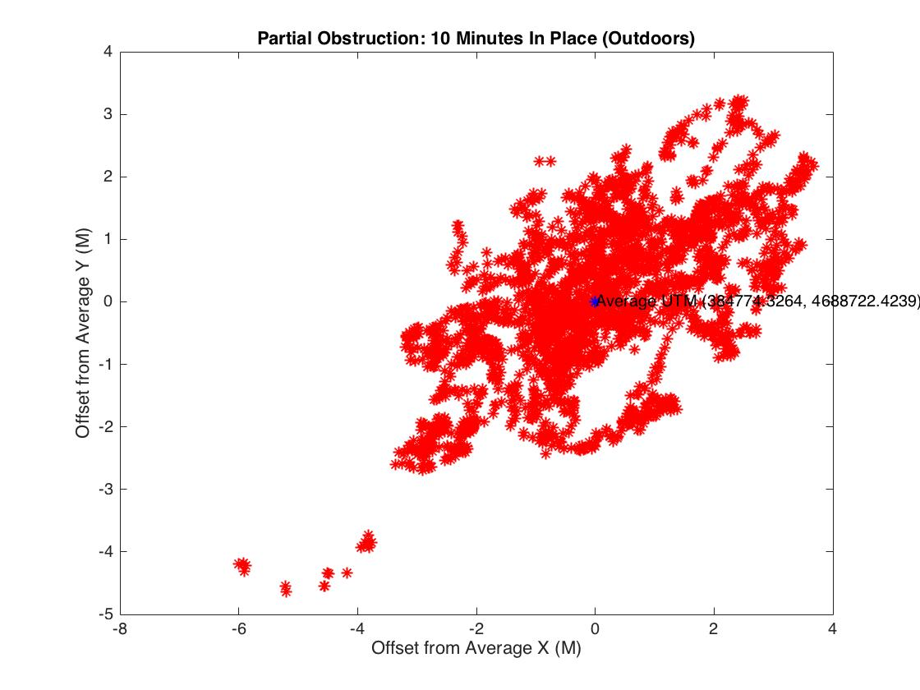
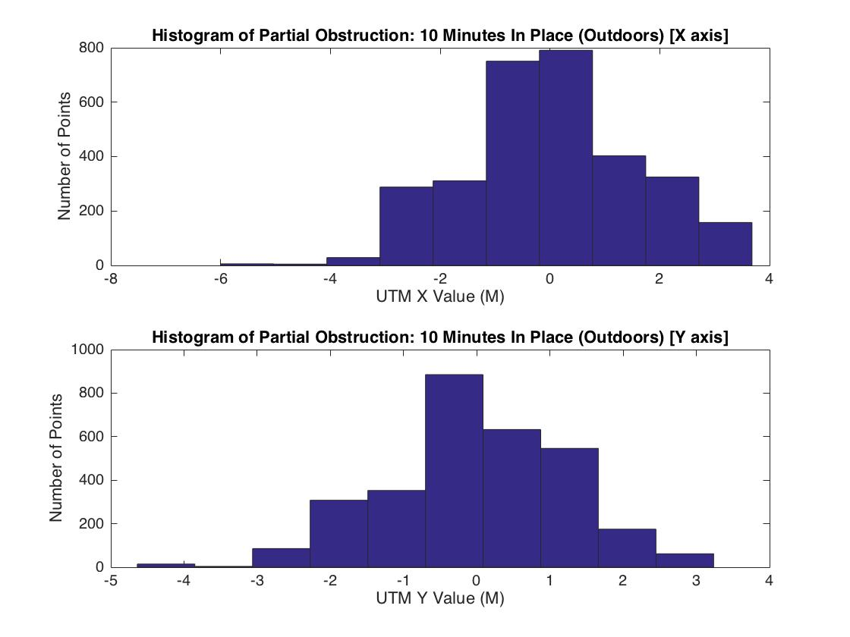
Partial Obstruction: 10 Min In Place
Roughly +3/-5 M N/S variation
Roughly +4/-6 M N/S variation
Gaussian Error

Slide 3
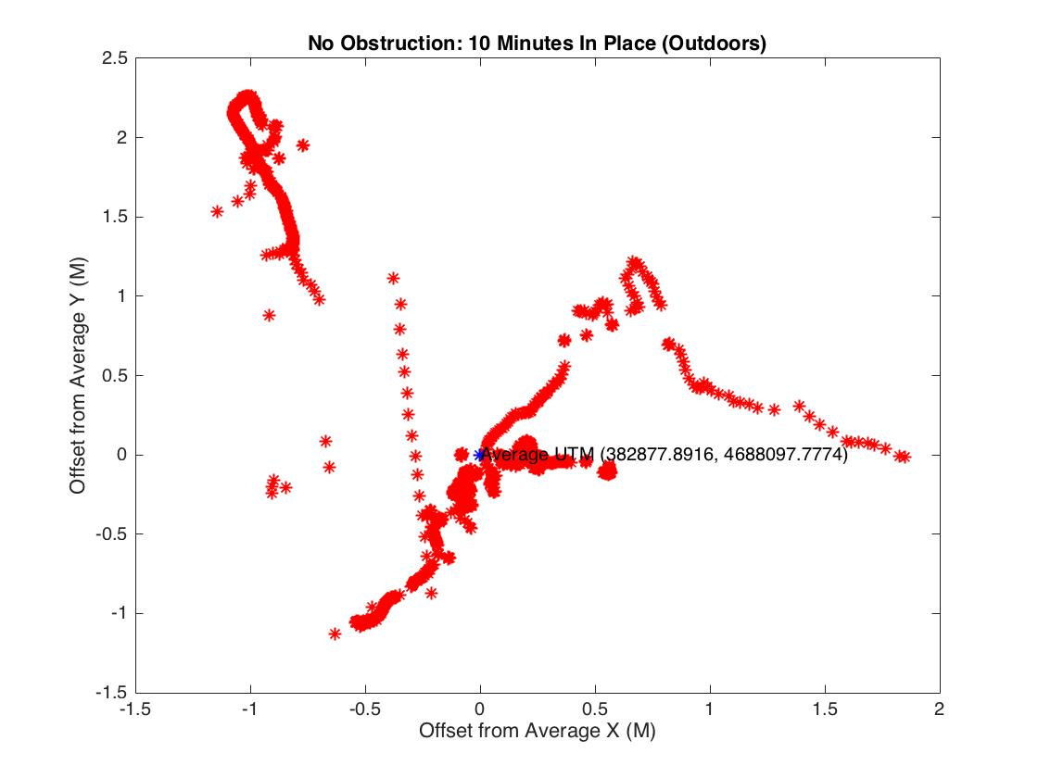
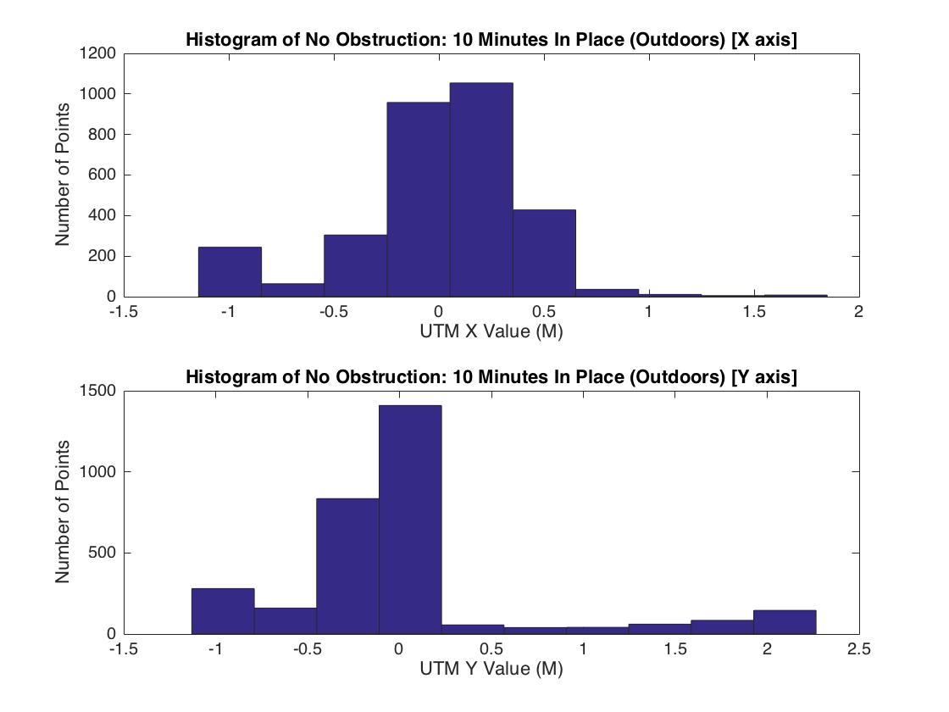
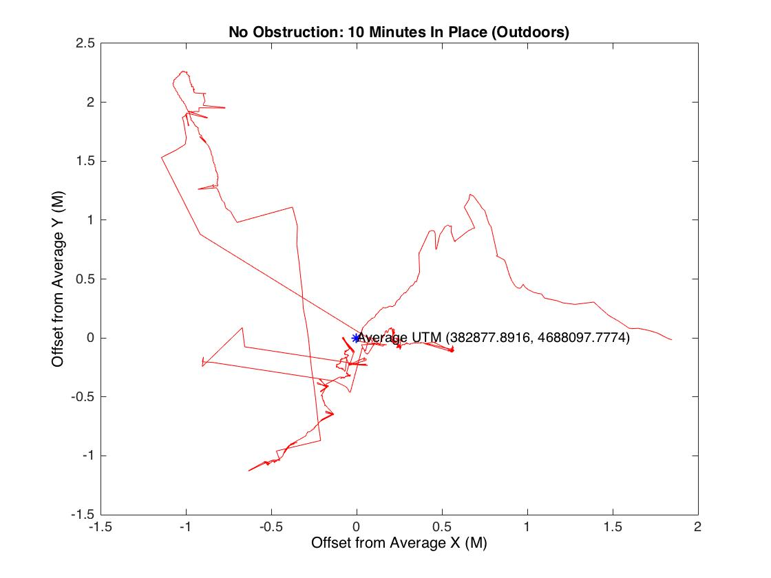
No Obstruction: 10 Min in Place
Roughly +2.5/-1 m N/S variation
Roughly +2/-1.5 m W/E variation
Gaussian N/S error

Slide 4
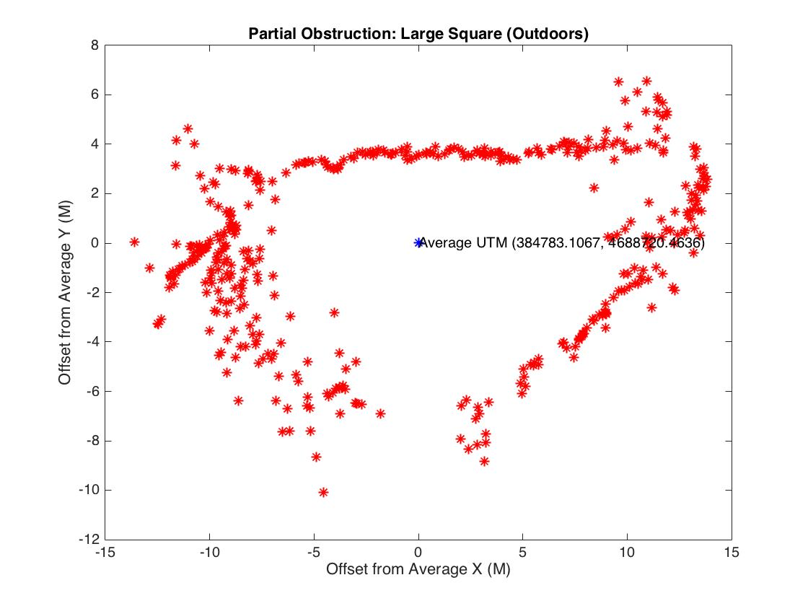
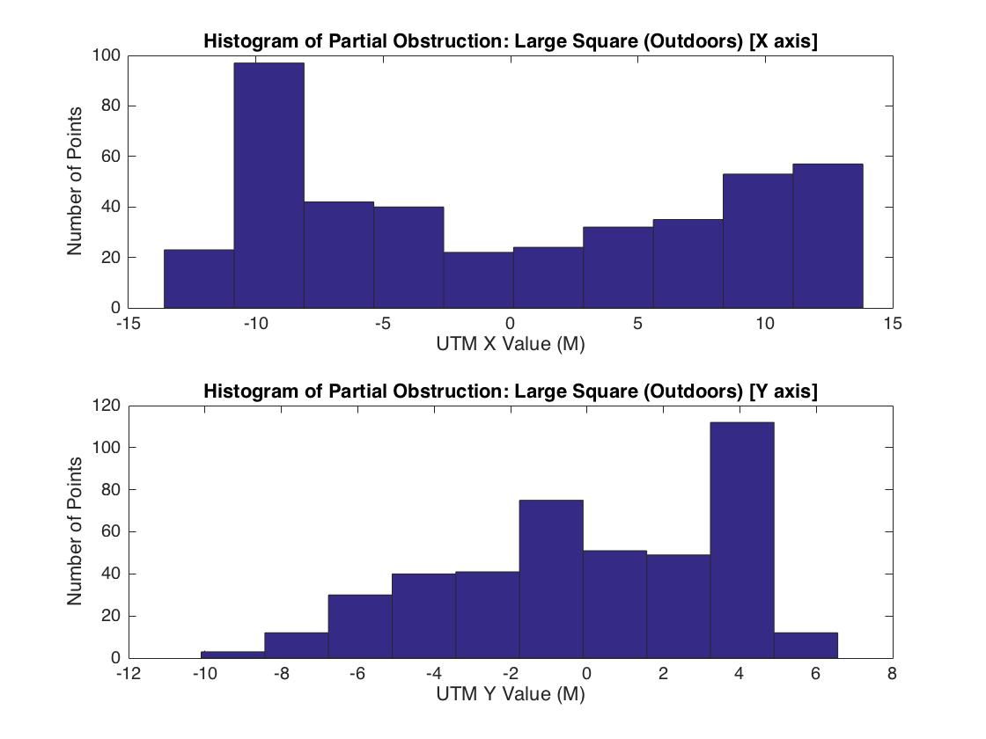
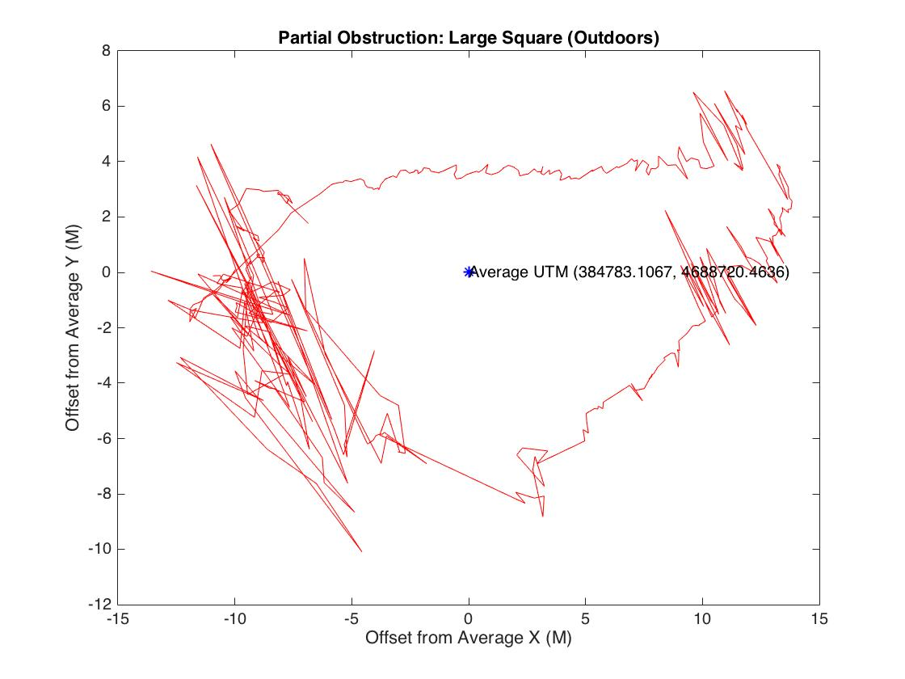
Partial Obstruction: Large Square
Large error readings to the west (corresponding to the location of the building)
Error is not Gaussian

Slide 5
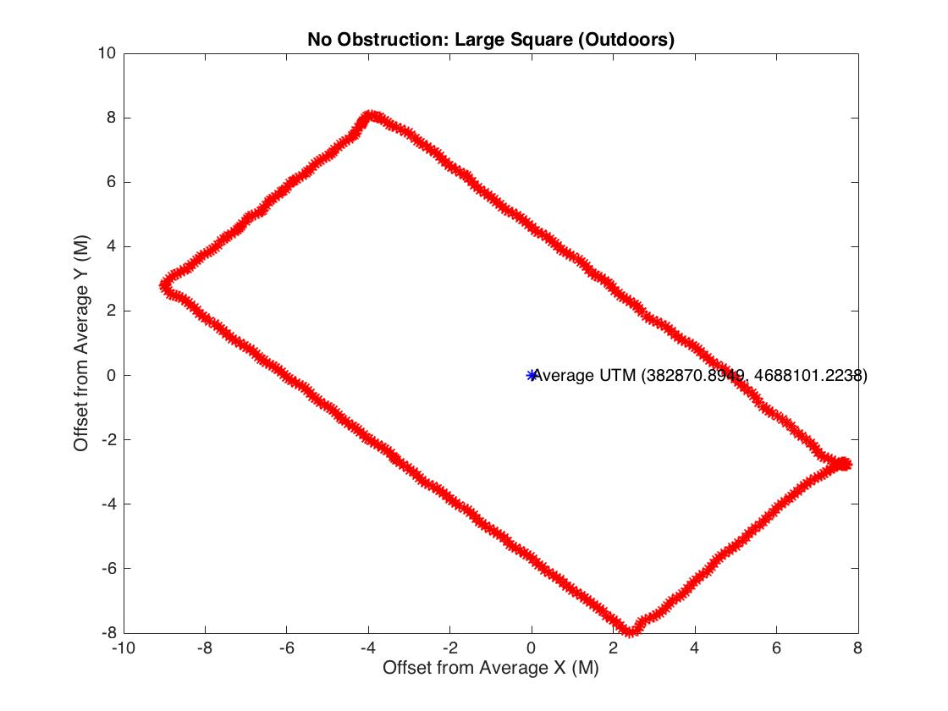
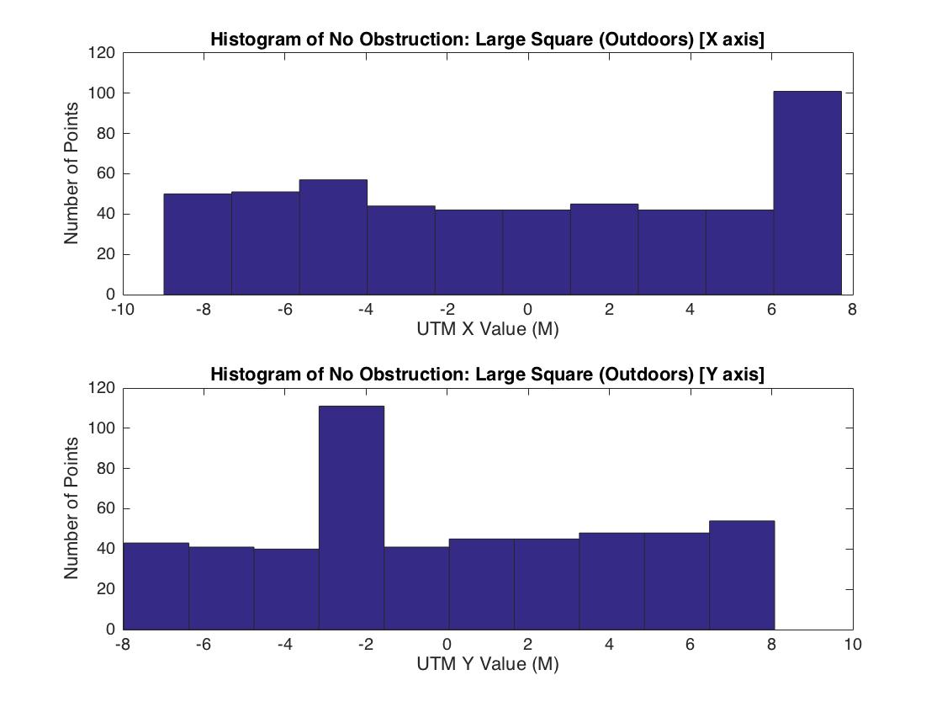
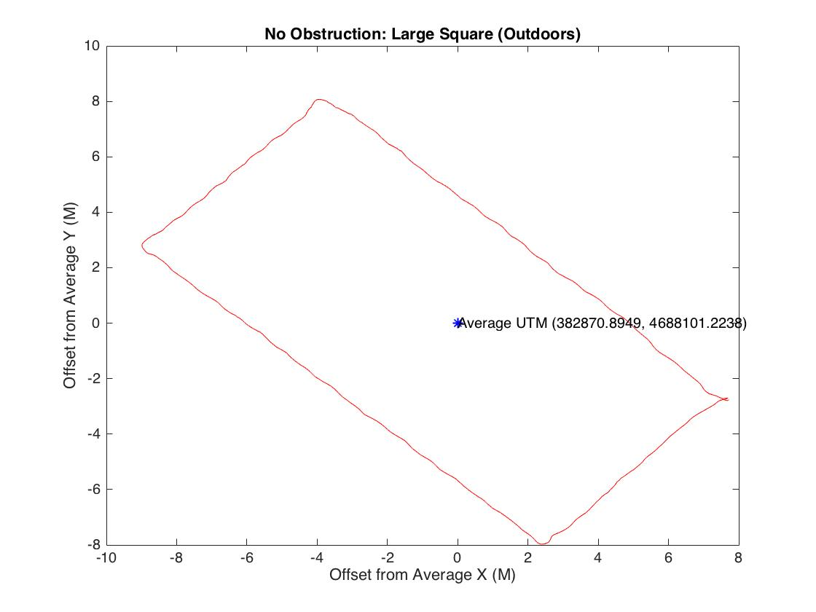
No Obstruction: Large Square
Very clean lines, very little variation.
Start/end position is within .1 m

Slide 6
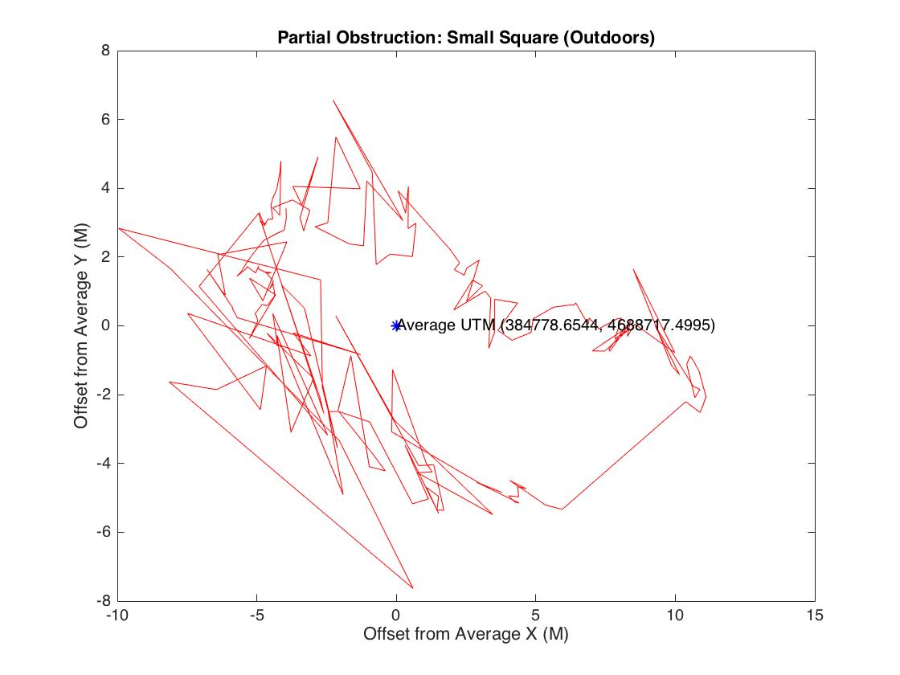
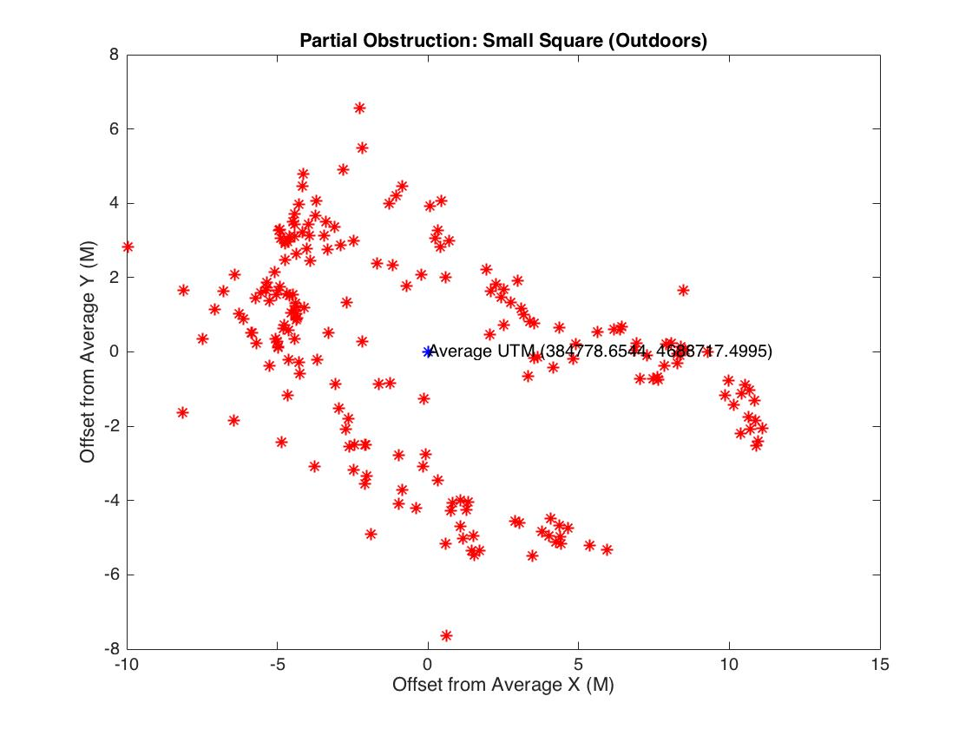
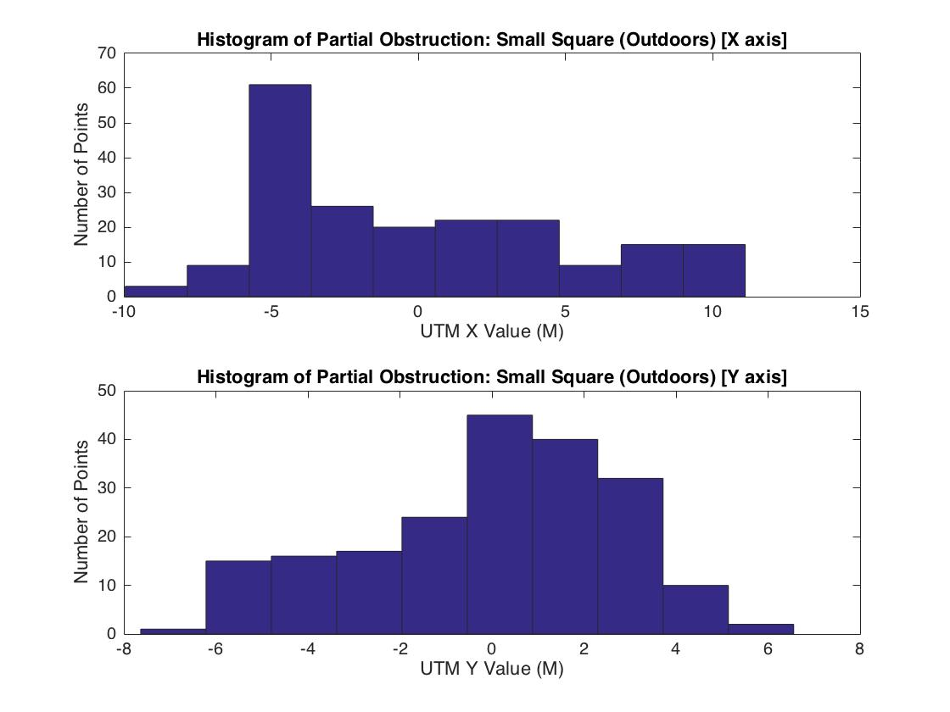
Partial Obstruction: Small Square
Large error readings to the west (corresponding to the location of the building)
Error is Gaussian in N/S direction (no obstructions)

Slide 7
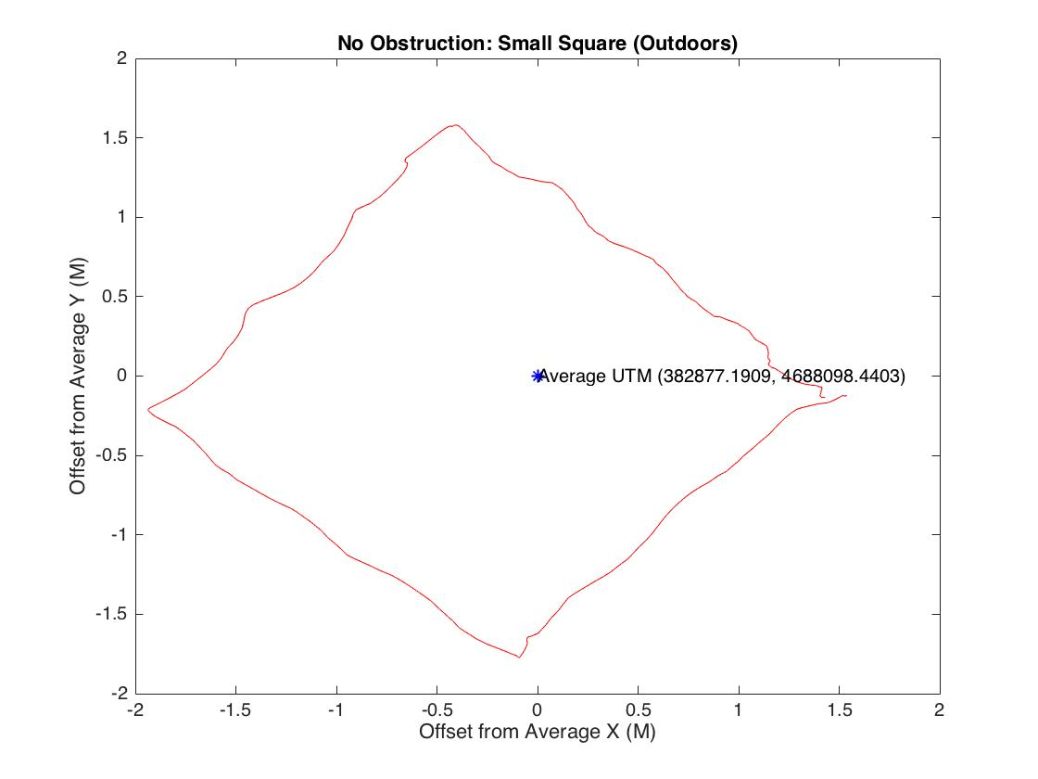
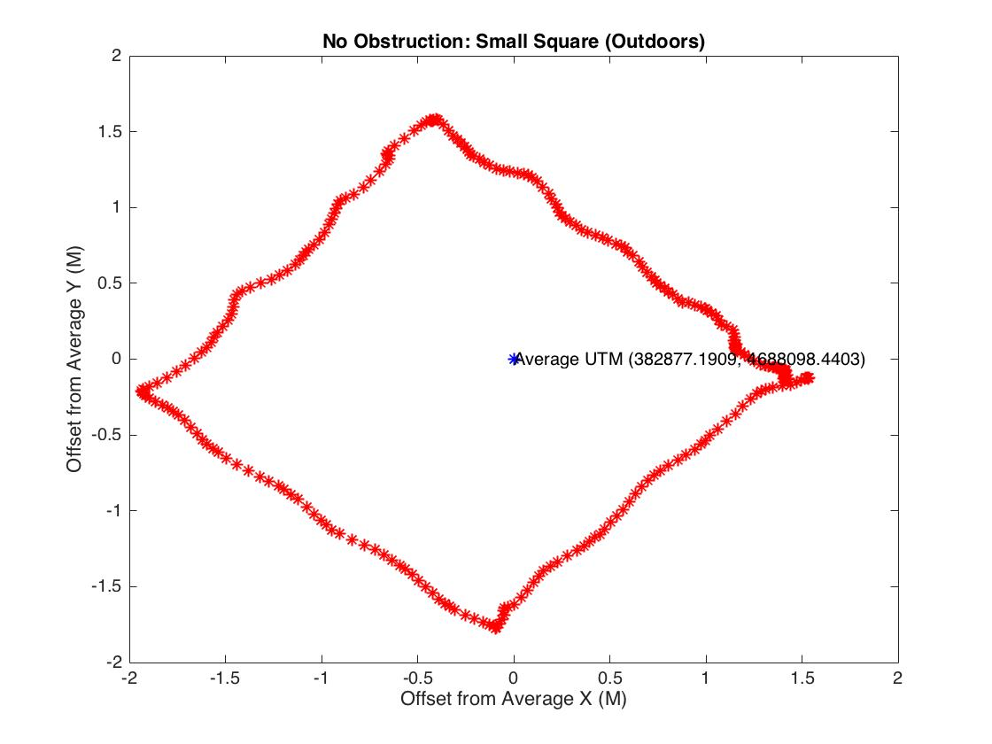
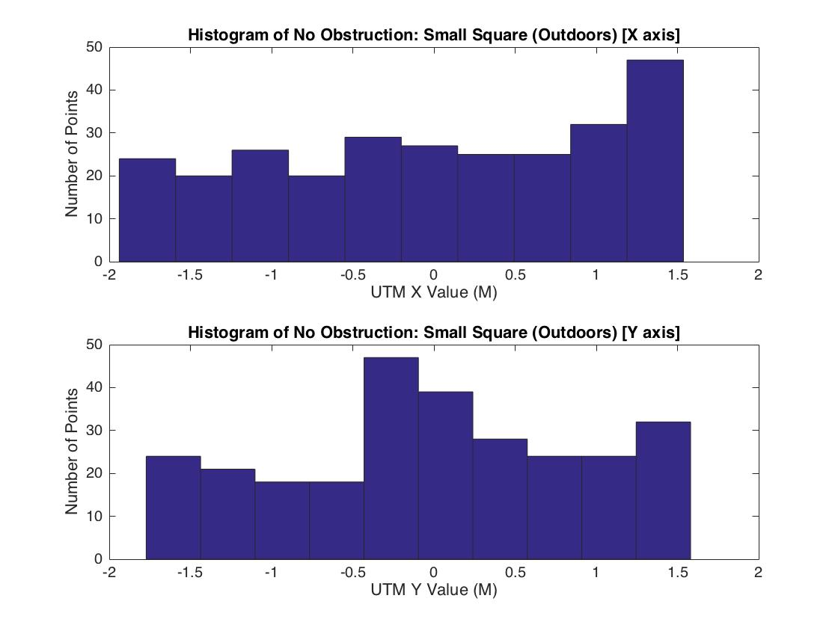
No Obstruction: small Square
Very clean lines, very little variation.
Start/end position is within .1 m

