Slide 1
RTK GPS Measurement Experiments
Andrew Tu
EECE 5698 Robotics Sensing and Navigation
Northeastern University

Slide 2
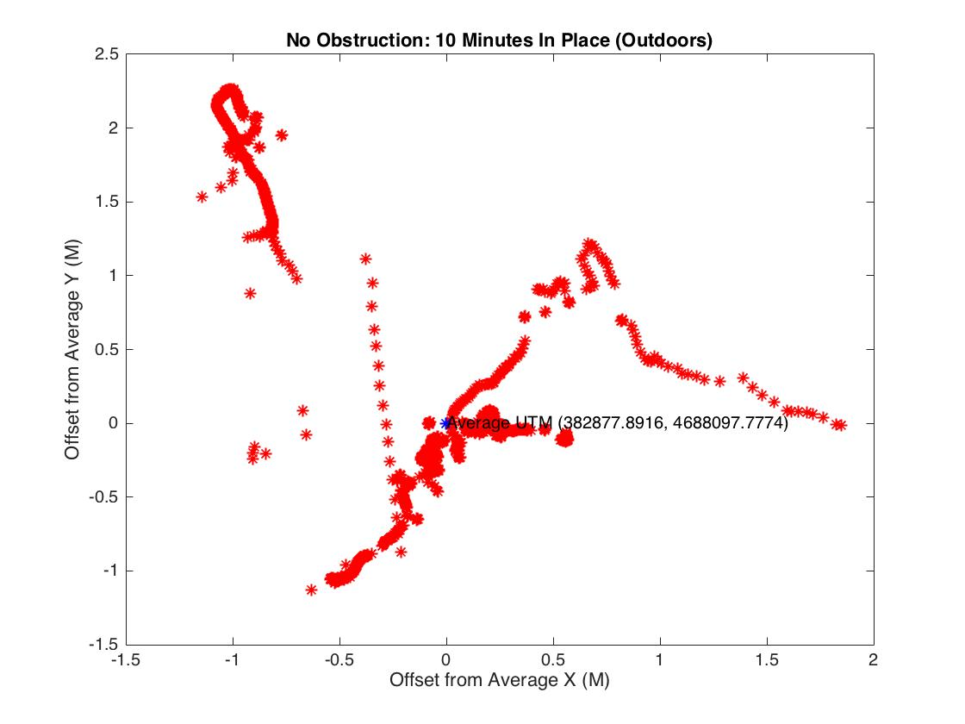
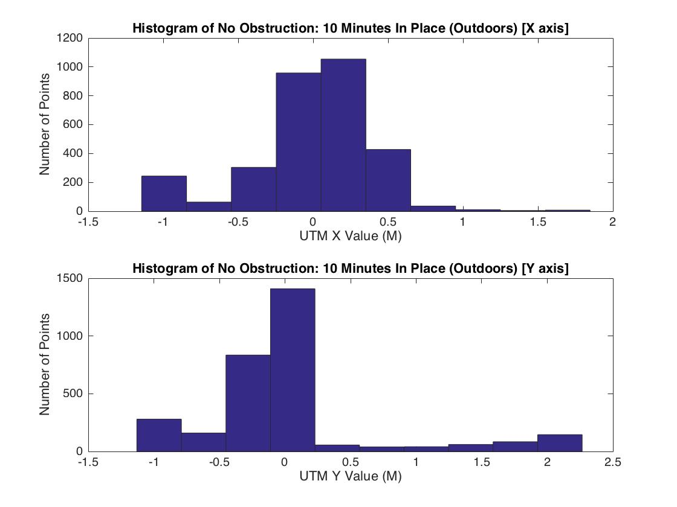
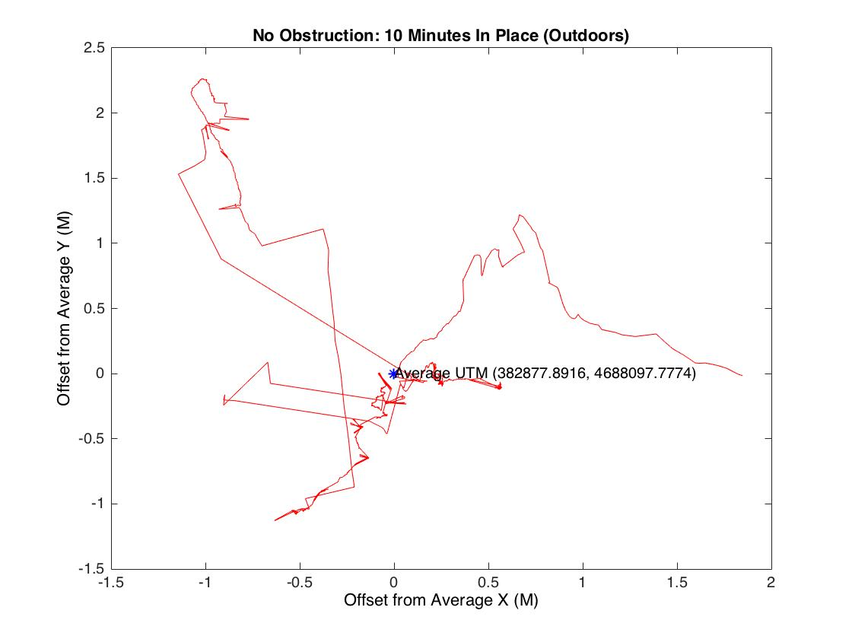
No Obstruction: 10 Min in Place
Roughly +2.5/-1 m N/S variation
Roughly +2/-1.5 m W/E variation
Gaussian N/S error

Slide 3
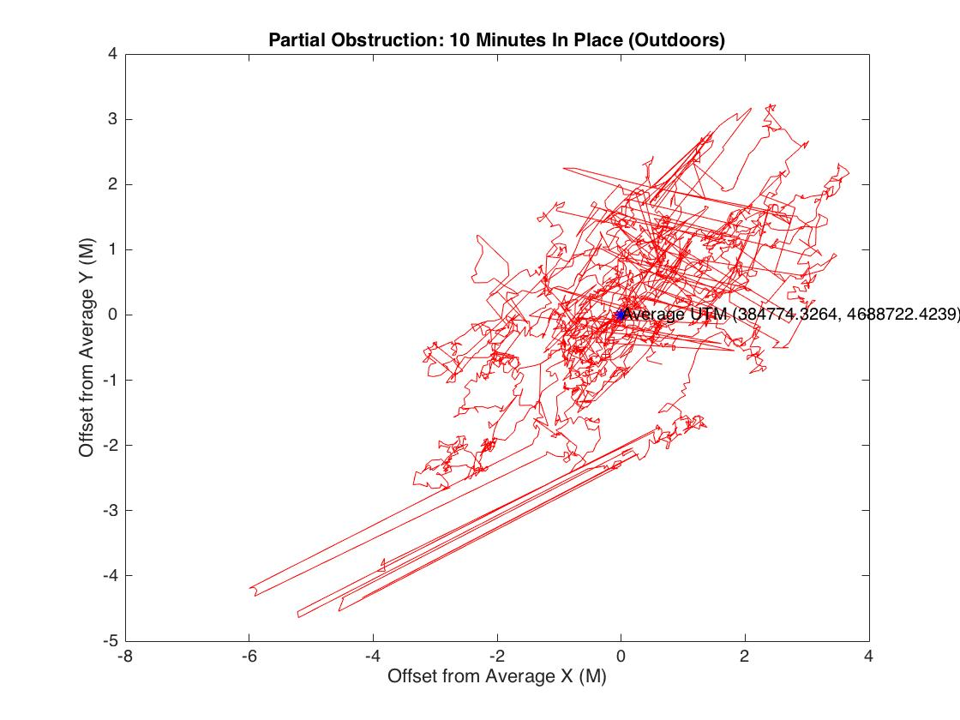
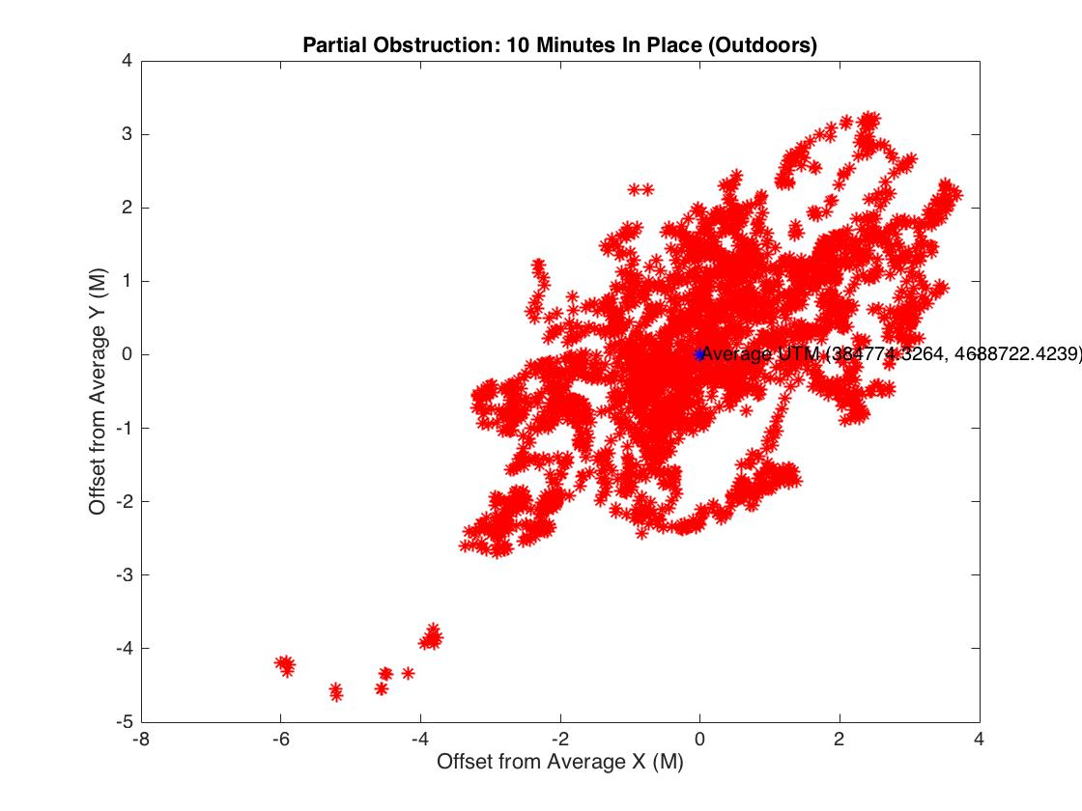
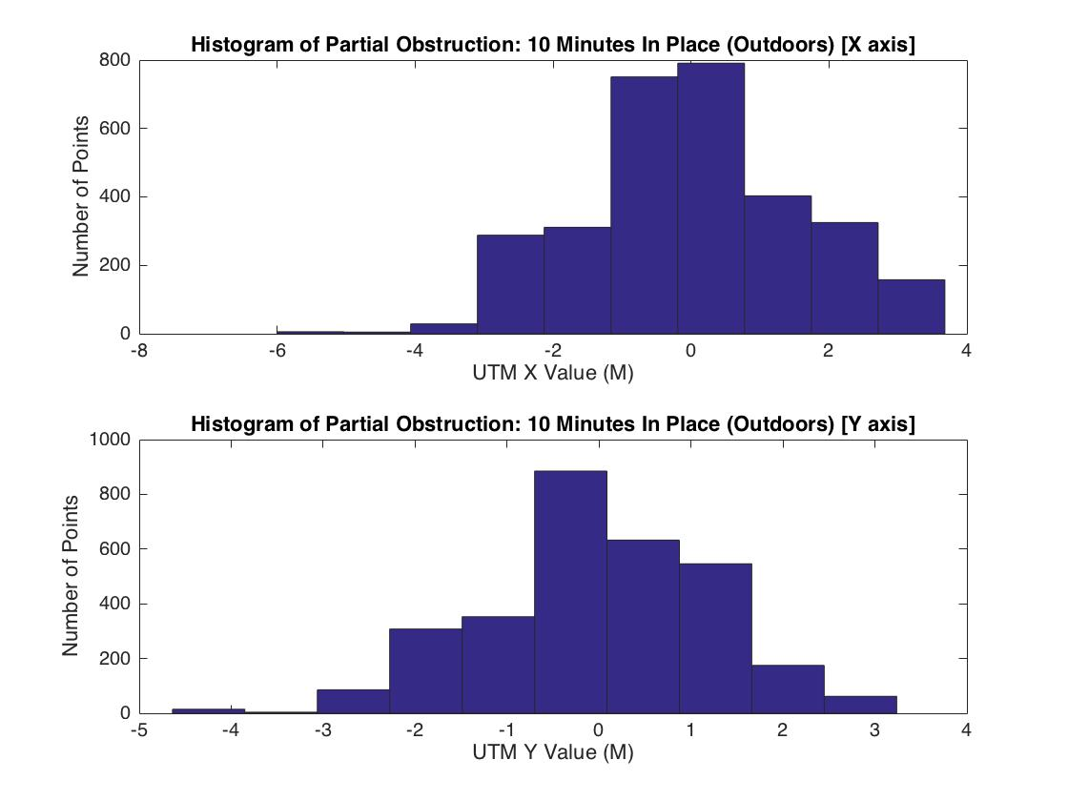
Partial Obstruction: 10 Min In Place
Roughly +3/-5 M N/S variation
Roughly +4/-6 M N/S variation
Gaussian Error

Slide 4
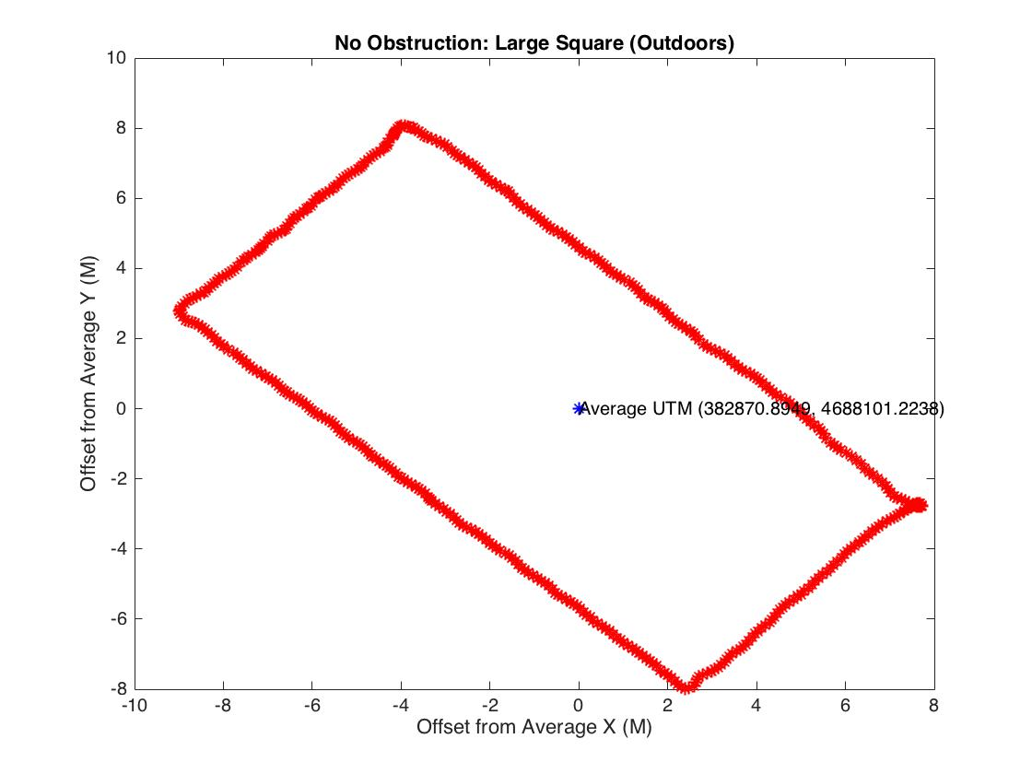
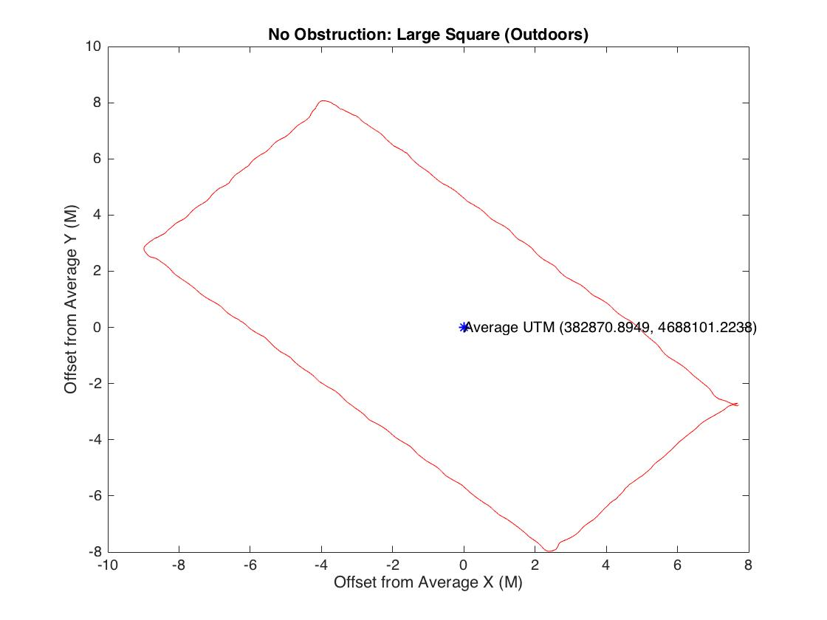
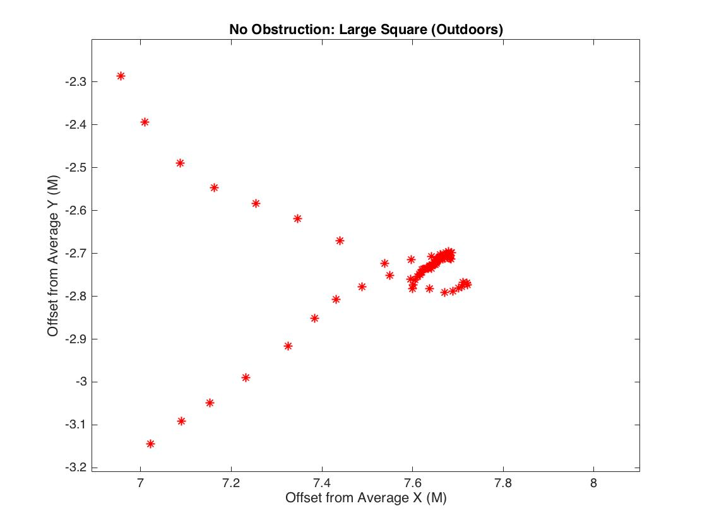
No Obstruction: Large Square
Very clean lines, very little variation.
Start/end position is within .05 m

Slide 5
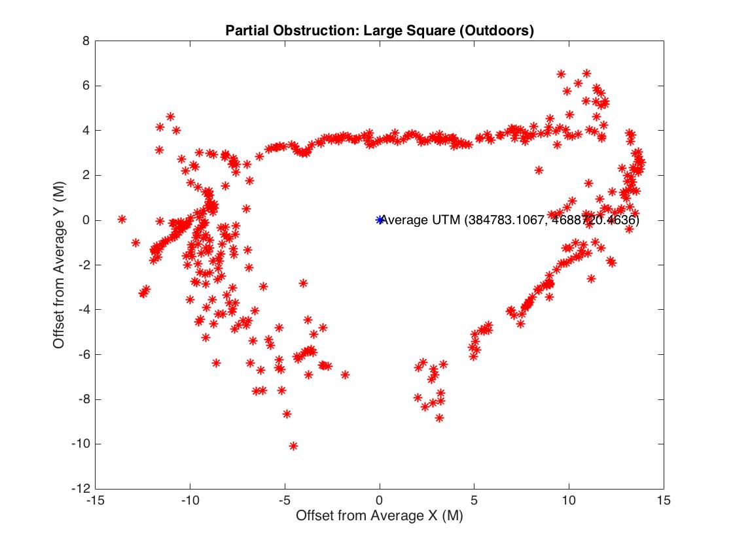
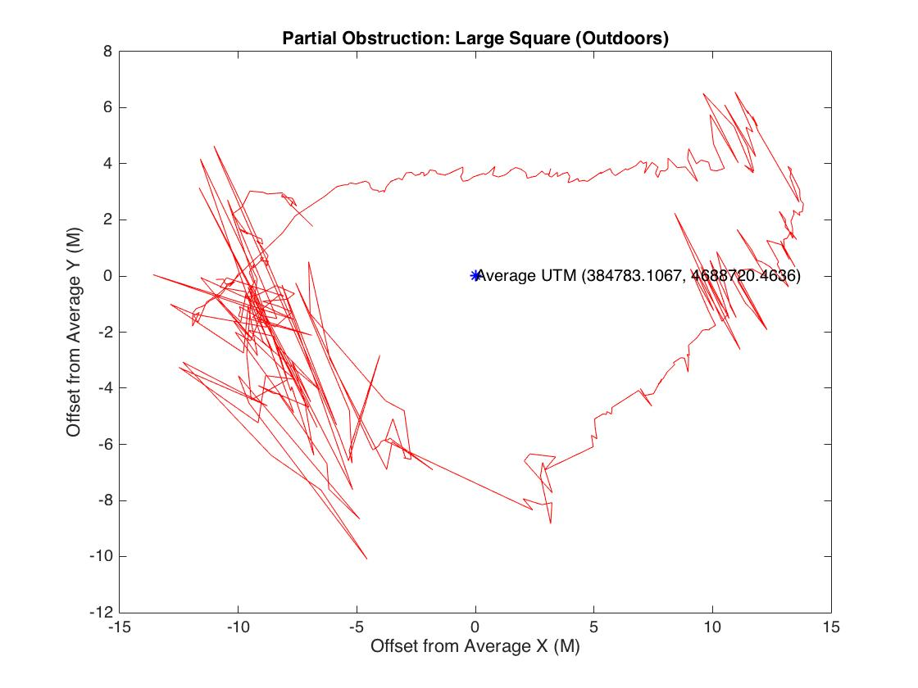
Partial Obstruction: Large Square
Large error readings to the west :
Roughly 5.6 meter spread
Side corresponds to the location of the building
3.8 meter difference from start and end point.
** Note: Because of the shape of the parking lot, actual path walked was a triangle, not a square.
This is reflected in our graph.
~5.6m

Slide 6
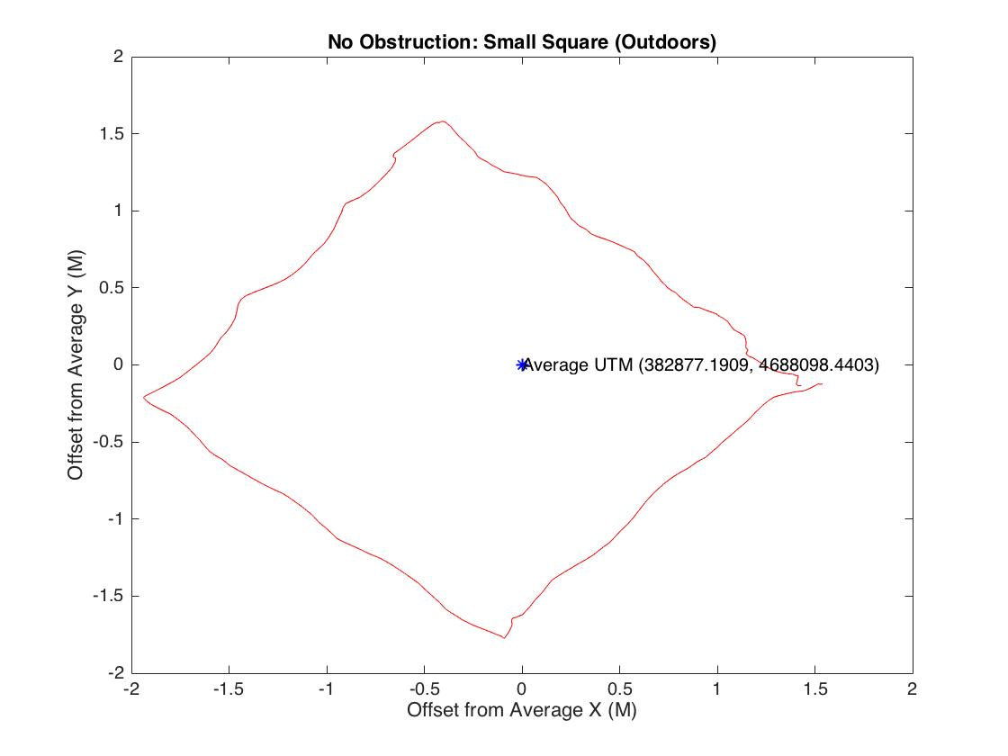
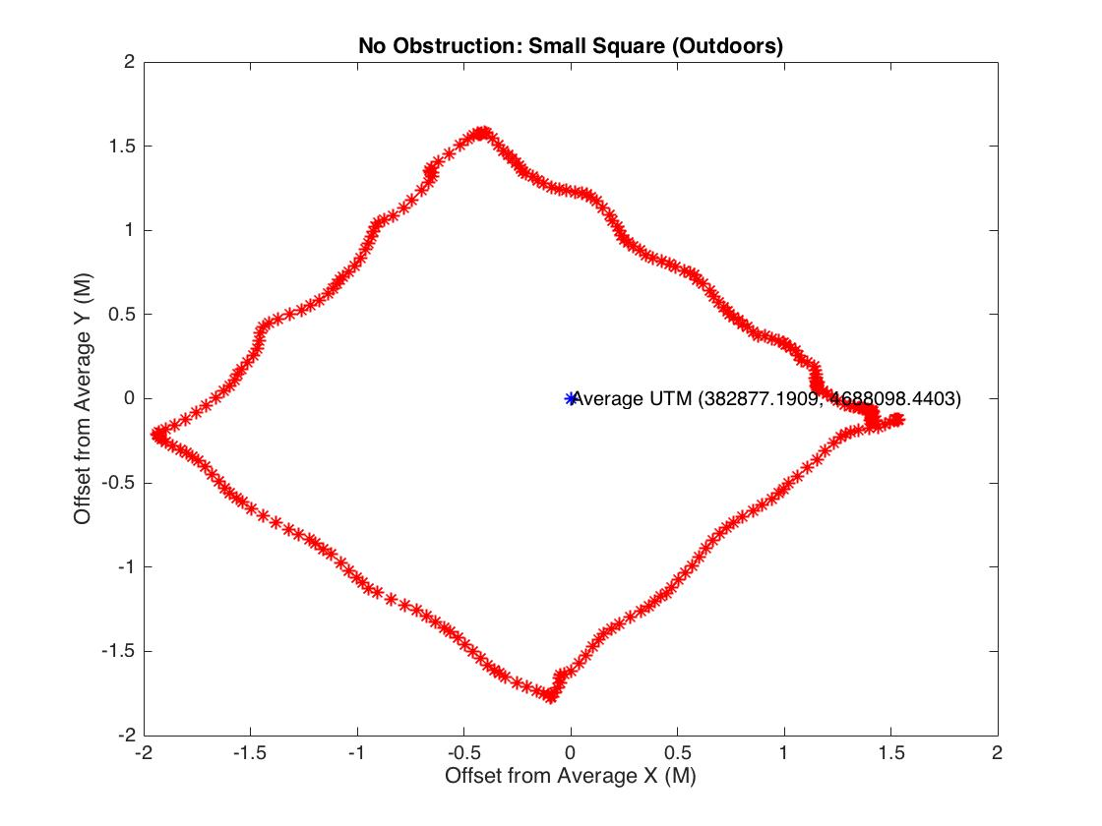
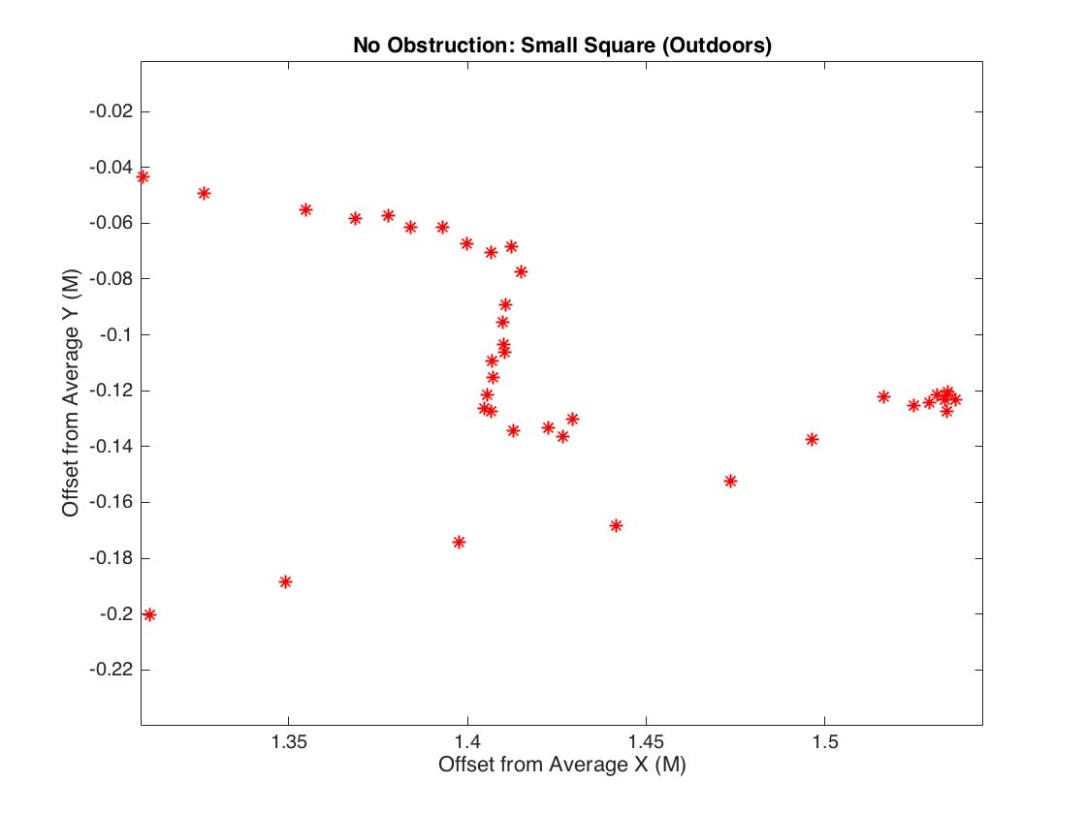
No Obstruction: small Square
Very clean lines, very little variation.
Start/end position is within .1 m

Slide 7
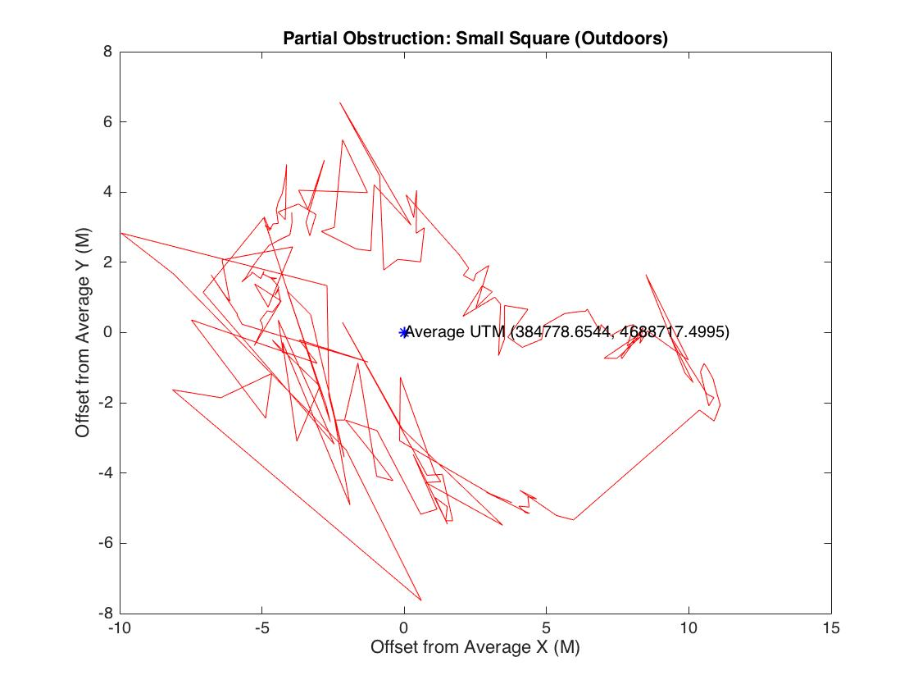
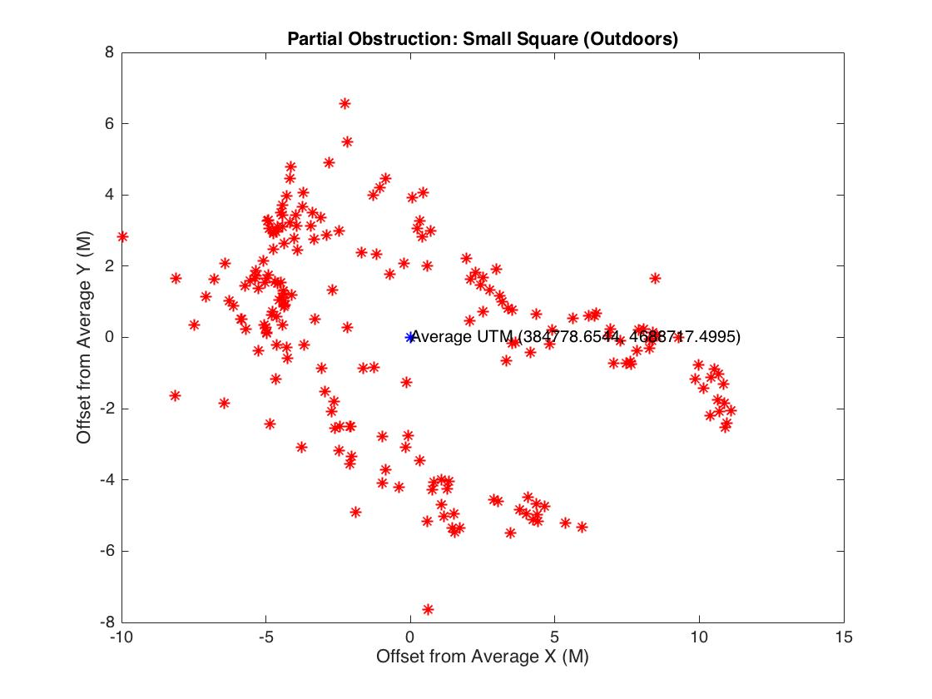
Partial Obstruction: Small Square
Large error readings to the west
Roughly 5.6 meter difference from start to end position

