Slide 1
GPS Measurement Experiments
Andrew Tu
EECE 5698 Robotics Sensing and Navigation
Northeastern University

Slide 2
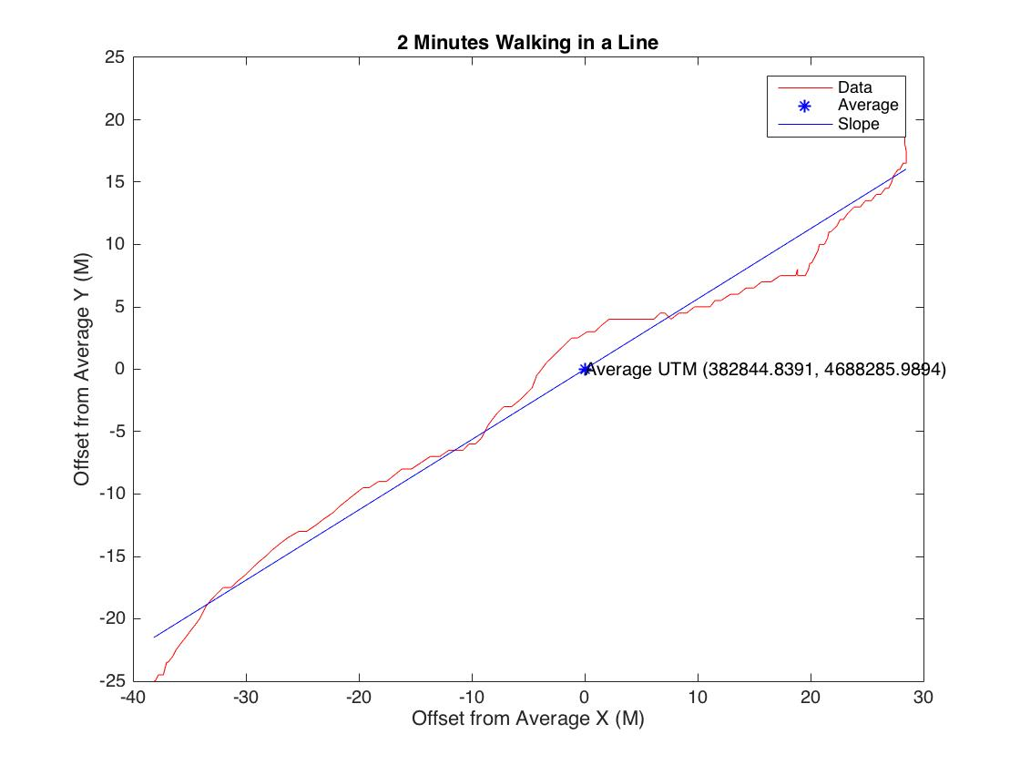
2 Min Walking in a Line

Slide 3
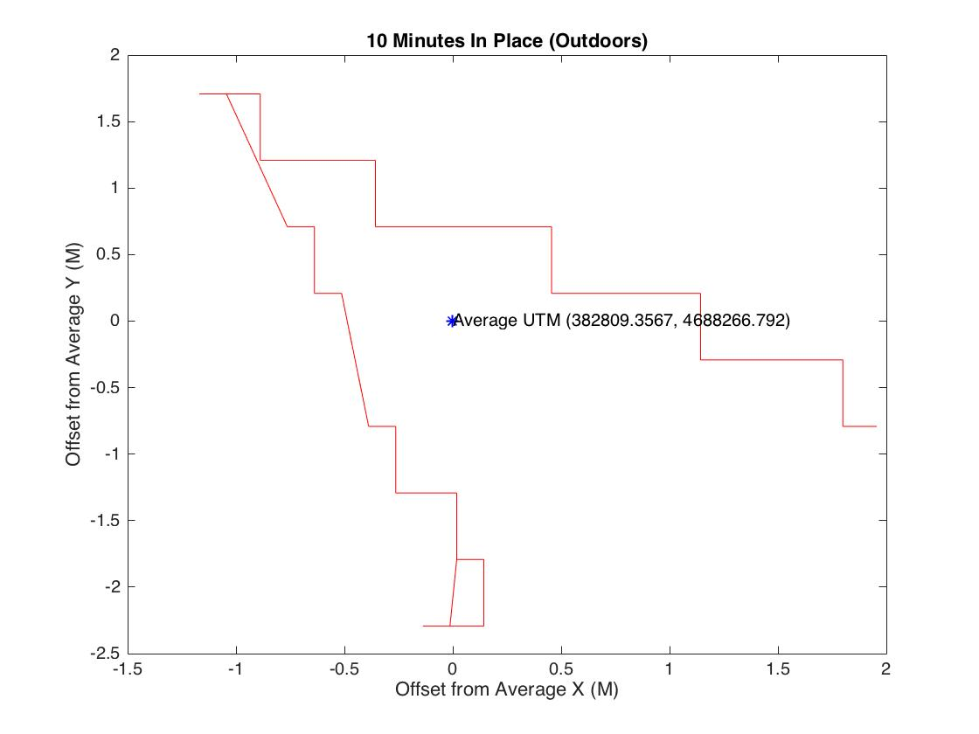
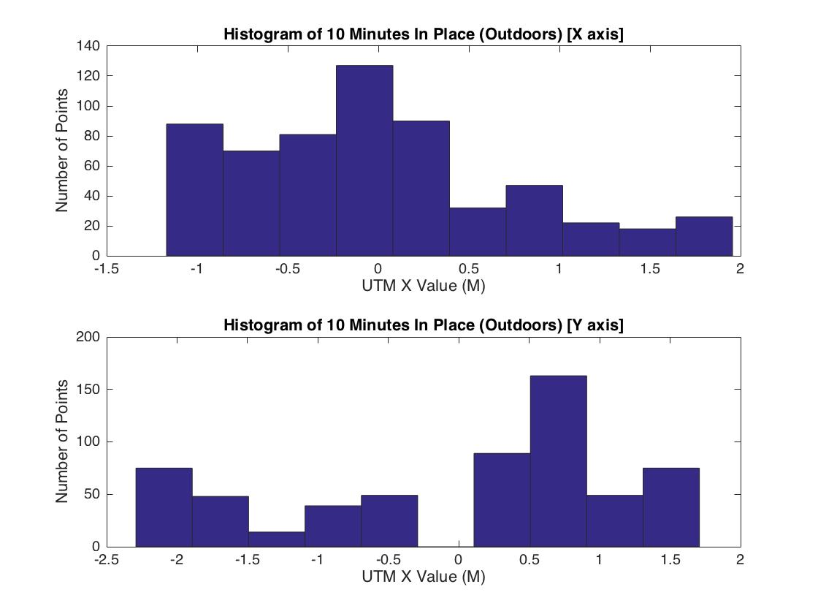
10 Min In Place outdoors

Slide 4
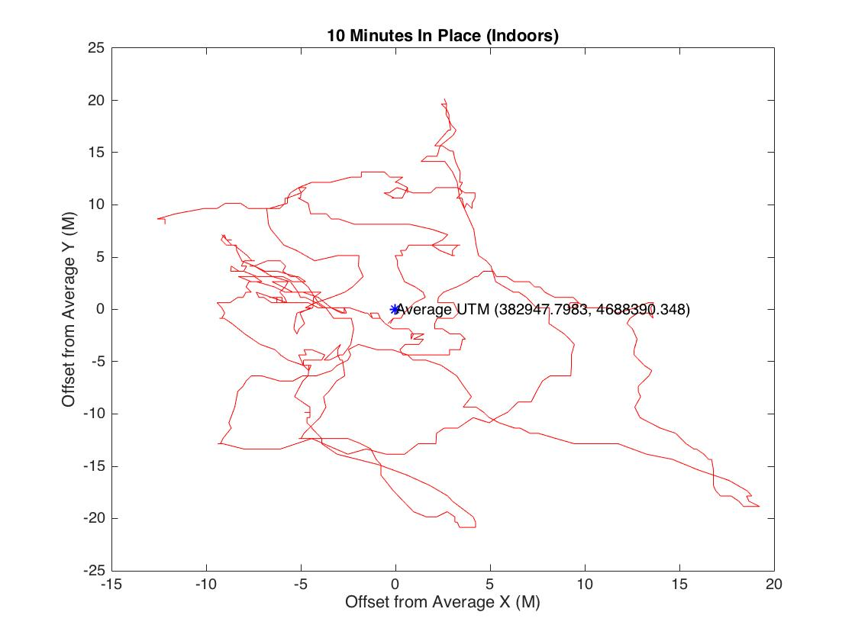
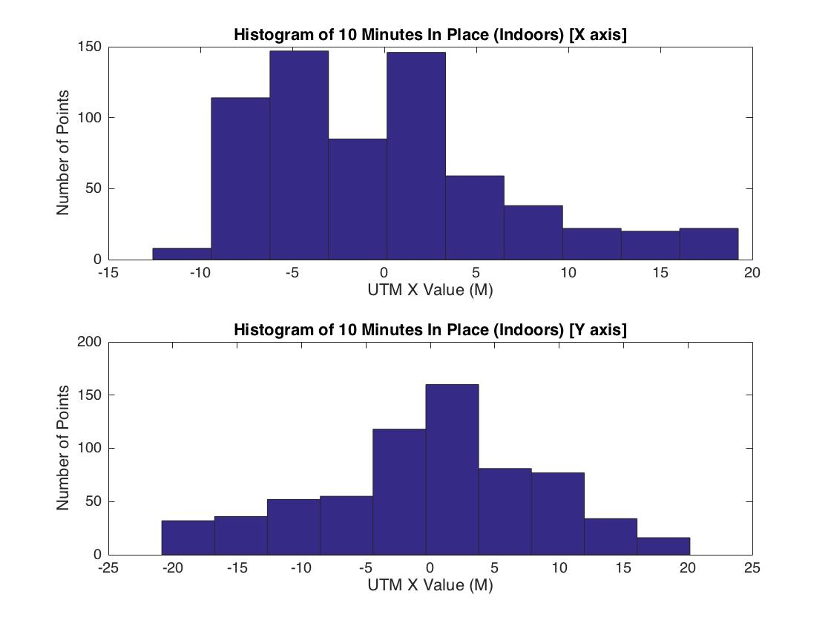
10 Min in Place Indoors

Slide 5
Variation is Significantly more Indoors

