Slide 1
ECMQV
On the improvement of ECDH
Marco Carolla

Slide 2
Index
How ECDH works
The problem with ECDH
ECDSA
On the improvement of ECDH: ECMQV
How to derive the session key
Session key with offline recipient
ECIES for ECMQV
The Integrated Encryption Scheme
The Augmented Encryption Scheme

Slide 3
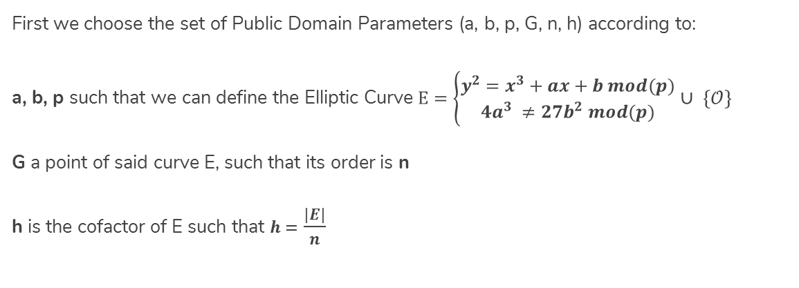
EC Protocols – Public Domain Parameter
First we choose the set of Public Domain Parameters (a, b, p, G, n, h) according to:
a, b, p such that we can define the Elliptic Curve $E=\left\{\begin{aligned}y^{2}=x^{3}+ax+b mod(p) \\ 4a^{3} ≠27b^{2} mod(p)\end{aligned}\right.$ $∪ \{𝒪\}$
G a point of said curve E, such that its order is n
h is the cofactor of E such that $h=$ $\frac{|E|}{n}$

Slide 4



ECDH - Key Agreement
Alice
Computes her private key $k_{A}^{−}∈\left[1, n−1\right]$
Then his public $K_{A}^{+}= k_{A}^{−}∙G$ $⇄$
Bob
Computes his private key $k_{B}^{−}∈\left[1, n−1\right]$
Then his public $K_{B}^{+}= k_{B}^{−}∙G$
Now they both exchange their public keys $K^{+}$
$$K_{A}^{S}{=k_{A}^{−}∙K}_{B}^{+}= k_{A}^{−}∙k_{B}^{−}∙G=k_{B}^{−}∙k_{A}^{−}∙G{=k_{B}^{−}∙K}_{A}^{+}=K_{B}^{S}$$

Slide 5

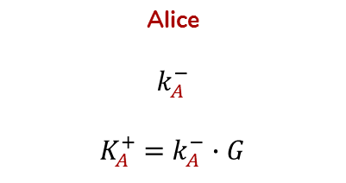



Man-in-the-Middle
Alice
$$k_{A}^{−}$$
$K_{A}^{+}$ = $k_{A}^{−}∙G$
Eve
$$k_{E}^{−}$$
$$K_{E}^{+}\text{= }k_{E}^{−}∙G$$
Bob
$$k_{B}^{−}$$
$$K_{B}^{+}\text{= }k_{B}^{−}∙G$$
$$⇄$$
$$K_{A,E}^{S}=k_{A}^{−}∙k_{E}^{−}∙G$$
$$⇄$$
$$K_{B, E}^{S}=k_{B}^{−}∙k_{E}^{−}∙G$$

Slide 6
Avoiding MitM
ECDH is weak to MitM because both parties have to authenticate each other before communicating.
Even with a prior authentication, the private keys used are usually Ephemeral! In order to avoid MitM attacks they should both re-authenticate each time these keys are re-calculated. Unfortunately ephemeral keys may change at each message to ensure the highest security. How to handle this case?
We can rely on recipient’s Digital Signature computed via ECDSA.

Slide 7
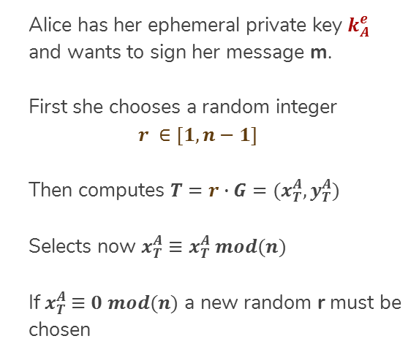
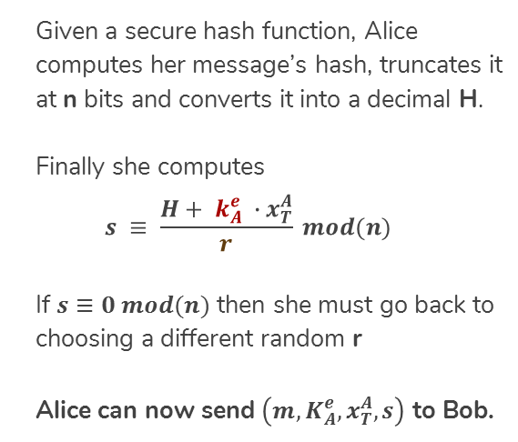
ECDSA - Signing
Alice has her ephemeral private key $k_{A}^{e}$ and wants to sign her message m.
First she chooses a random integer
$$r ∈[1, n−1]$$
Then computes $T=r∙G=(x_{T}^{A}, y_{T}^{A})$
Selects now $x_{T}^{A}≡x_{T}^{A} mod(n)$
If${ x}_{T}^{A} ≡0 mod(n)$ a new random r must be chosen
Given a secure hash function, Alice computes her message’s hash, truncates it at n bits and converts it into a decimal H.
Finally she computes
$$s ≡ \frac{H+ k_{A}^{e} ∙x_{T}^{A}}{r} mod(n)$$
If $s≡0 mod(n)$ then she must go back to choosing a different random r
Alice can now send $\left(m, K_{A}^{e},x_{T}^{A}, s\right)$ to Bob.

Slide 8
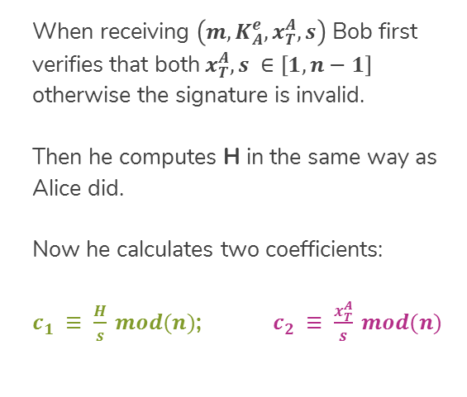
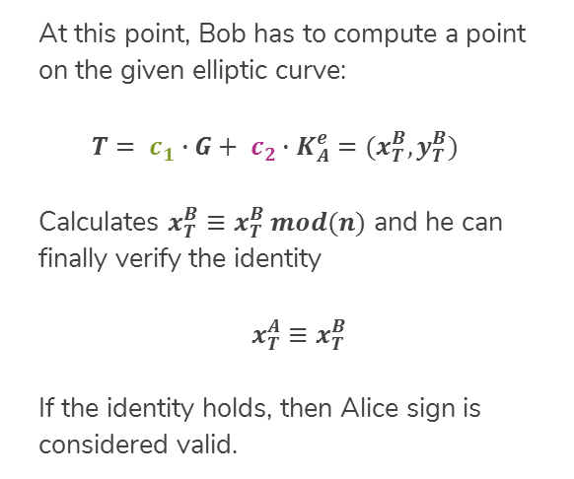
ECDSA - Verification
When receiving $\left(m, K_{A}^{e},x_{T}^{A}, s\right)$ Bob first verifies that both$x_{T}^{A}, s ∈\left[1, n−1\right]$ otherwise the signature is invalid.
Then he computes H in the same way as Alice did.
Now he calculates two coefficients:
$c_{1} ≡ \frac{H}{s} mod(n)$; $c_{2} ≡ \frac{x_{T}^{A}}{s} mod(n)$
At this point, Bob has to compute a point on the given elliptic curve:
$$T= c_{1}∙G+ c_{2}∙K_{A}^{e}=(x_{T}^{B}, y_{T}^{B})$$
Calculates $x_{T}^{B}≡x_{T}^{B} mod(n)$ and he can finally verify the identity
$x_{T}^{A}≡x_{T}^{B}$
If the identity holds, then Alice sign is considered valid.

Slide 9
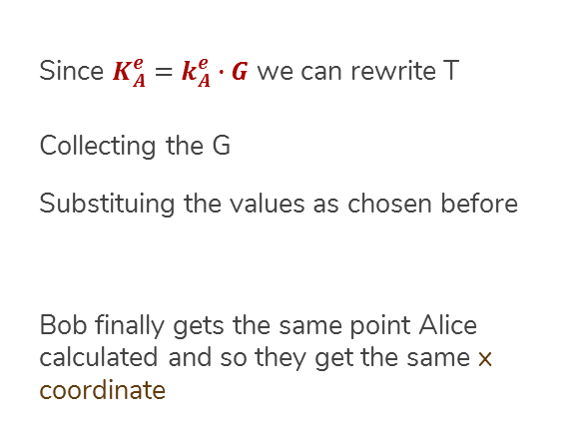
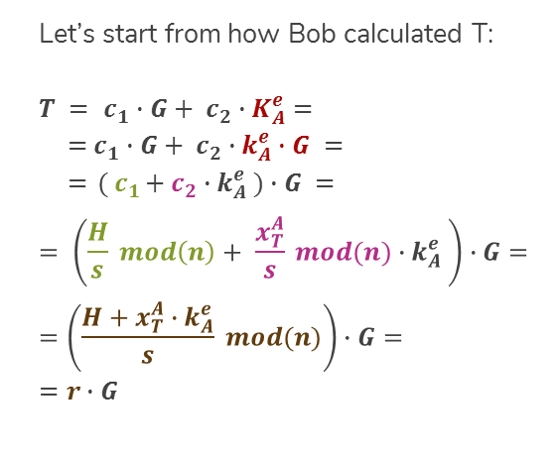
ECDSA - Correctness
Let’s start from how Bob calculated T:
$T = c_{1}∙G+ c_{2}∙K_{A}^{e}$ $=$
$={ c}_{1} ∙G+ c_{2}∙k_{A}^{e}∙G =$
$={ ( c}_{1}+ c_{2}∙k_{A}^{e} )∙G =$
$$= \left(\frac{H}{s} mod\left(n\right)+ \frac{x_{T}^{A}}{s} mod(n){∙k}_{A}^{e} \right)∙G=$$
$$=\left(\frac{H+x_{T}^{A}{∙k}_{A}^{e}}{s} mod(n)\right)∙G=$$
$$=r∙G$$
Since $K_{A}^{e}$ $=$ $k_{A}^{e}∙G$ we can rewrite T
Collecting the G
Substituing the values as chosen before
Bob finally gets the same point Alice calculated and so they get the same x coordinate

Slide 10
Why Signed ECDH fails in practice
Alice and Bob may now choose to communicate exchanging their Digital Signatures at each message but it costs much in terms of time and space resourses!
Every message would weight more thus slowing the communication down.
Moreover the Digital Signature must be recalculated each time (to avoid its decryption) hence requiring more time before each message is sent.
How to overcome these drawbacks while still ensuring a secure way to communicate?

Slide 11
What ECMQV is
The acronym of Elliptic Curve Menezes Qu Vanston, following the names of the mathematicians (along with Law and Solinas) who developed the protocol;
A protocol variation of ECDH (Elliptic Curve Diffie Hellman) to ensure an implicit authentication via a new Session Key. The key is now derived from both static and ephemeral keys.

Slide 12
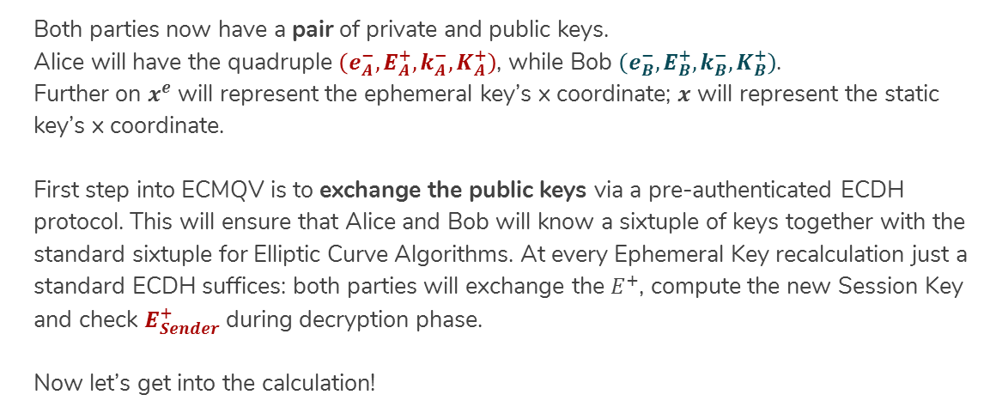
Parties parameters
Both parties now have a pair of private and public keys.
Alice will have the quadruple $\left(e_{A}^{−},E_{A}^{+},k_{A}^{−},K_{A}^{+}\right)$, while Bob $\left(e_{B}^{−},E_{B}^{+},k_{B}^{−},K_{B}^{+}\right)$.
Further on $x^{e}$ will represent the ephemeral key’s x coordinate; $x$ will represent the static key’s x coordinate.
First step into ECMQV is to exchange the public keys via a pre-authenticated ECDH protocol. This will ensure that Alice and Bob will know a sixtuple of keys together with the standard sixtuple for Elliptic Curve Algorithms. At every Ephemeral Key recalculation just a standard ECDH suffices: both parties will exchange the $E^{+}$, compute the new Session Key and check $E_{Sender}^{+}$ during decryption phase.
Now let’s get into the calculation!

Slide 13
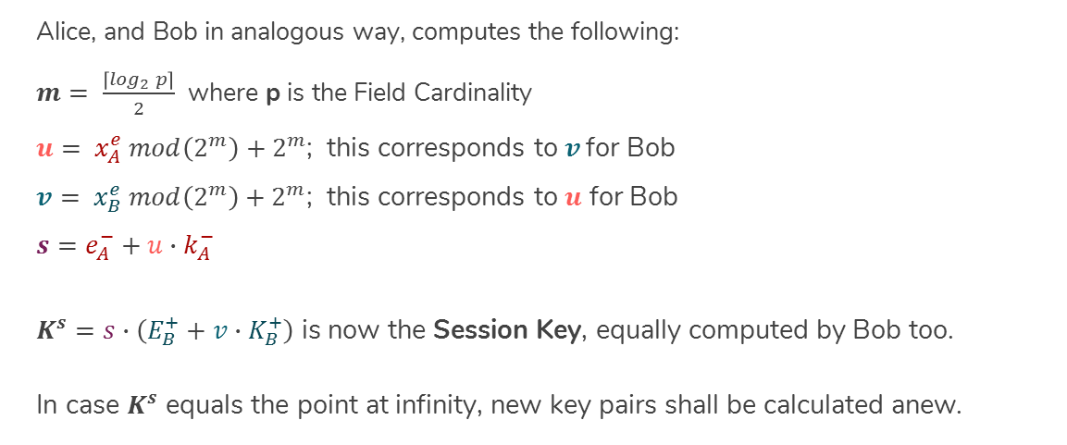
Session Key: derivation
Alice, and Bob in analogous way, computes the following:
$m= \frac{\left\lceil \log_{2} p\right\rceil }{2}$ where p is the Field Cardinality
$u= x_{A}^{e} mod\left(2^{m}\right)+2^{m}$; this corresponds to $v$ for Bob
$v= x_{B}^{e} mod\left(2^{m}\right)+2^{m}$; this corresponds to $u$ for Bob
$$s=e_{A}^{−}+u∙k_{A}^{−}$$
$K^{s}=s∙\left(E_{B}^{+}+v∙K_{B}^{+}\right)$ is now the Session Key, equally computed by Bob too.
In case $K^{s}$ equals the point at infinity, new key pairs shall be calculated anew.

Slide 14
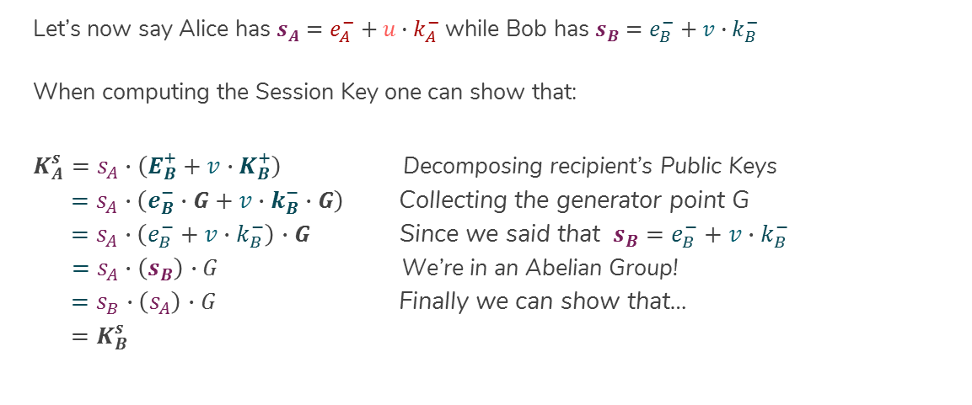
Session Key: correctness
Let’s now say Alice has $s_{A}=e_{A}^{−}+u∙k_{A}^{−}$ while Bob has $s_{B}=e_{B}^{−}+v∙k_{B}^{−}$
When computing the Session Key one can show that:
$K_{A}^{s}=s_{A}∙\left(E_{B}^{+}+v∙K_{B}^{+}\right)$ Decomposing recipient’s Public Keys
$=s_{A}∙\left(e_{B}^{−}∙G+v∙k_{B}^{−}∙G\right)$ Collecting the generator point G
$=s_{A}∙\left(e_{B}^{−}+v∙k_{B}^{−}\right)$ $∙G$ Since we said that $s_{B}=e_{B}^{−}+v∙k_{B}^{−}$
$=s_{A}∙\left(s_{B}\right)$ $∙G$ We’re in an Abelian Group!
$=s_{B}∙\left(s_{A}\right)$ $∙G$ Finally we can show that…
$=K_{B}^{s}$

Slide 15
ECMQV Strenghts
The ECMQV protocol allows Authentic Key Agreement to occur over an insecure channel whilst only requiring the same bandwidth as an unauthenticated ECDH;
Communication can occur even if one party is offline: since the impossibility in retriving its Public Ephemeral Key, its Static Public Key shall be used for computing the Session Key;
Message encryption is now up to the Session Key. We no longer require to perfom a Point Multiplication before each encryption.

Slide 16
How to use the Session Key
The protocol ECMQV let us derive the same Session Key for both parties in a communication, but how to use it?
Elliptic Curve Cryptography is supported by ECIES – Elliptic Curve Integrated Encryption Scheme and ECAES – Elliptic Curve Augmented Encryption Scheme.
ECIES is «Integrated» meaning that it’s a hybrid scheme which uses a Public Key Scheme to transport the Session Key to be used in a Simmetric Cypher.
ECAES is a stronger version of ECIES. While keeping all its properties, the Augmented version requires an additional cryptographic function: the MAC - Message Authentication Code

Slide 17
Key Derivation – Definition
«The Key Derivation Function has to be used to derive keying data from a shared secret bit string.» - ANSI X9.63
INPUT:
a bit string key;
a desired output length;
(Optional) a string to increase entropy
OUTPUT:
a bit string Symmetric Key

Slide 18
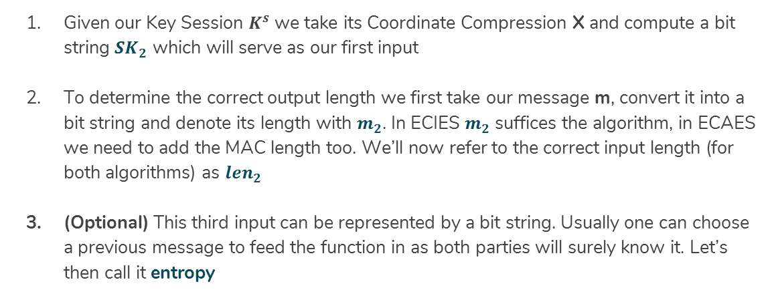
Key Derivation – Input Parameters
Given our Key Session $K^{s}$ we take its Coordinate Compression X and compute a bit string ${SK}_{2}$ which will serve as our first input
To determine the correct output length we first take our message m, convert it into a bit string and denote its length with $m_{2}$. In ECIES $m_{2}$ suffices the algorithm, in ECAES we need to add the MAC length too. We’ll now refer to the correct input length (for both algorithms) as ${len}_{2}$
(Optional) This third input can be represented by a bit string. Usually one can choose a previous message to feed the function in as both parties will surely know it. Let’s then call it entropy

Slide 19

Key Derivation – The algorithm
int i = 1;
String keyData = ‘’;
while$\left( \text{i}\text{ < }{len}_{2} \right)$
{
$counter={Pad}_{32}\left({Base}_{2}\left(i\right)\right);$
keyData = keyData + ${SHA}_{1}\left({SK}_{2}\text{ + }\text{counter}\text{ + }\text{entropy}\right)$;
i++;
}
return subString$\left(\text{keyData}\text{, } 0 → {len}_{2 }\right)$;

Slide 20
MAC – Definition
«This acts precisely like a standard hash function except that it has a secret key passed to it as well as a message to be hashed.» - Advances in Elliptic Curve Cryptography
INPUT:
a bit string data;
a bit string key;
OUTPUT:
A 160 bit MAC TAG string

Slide 21
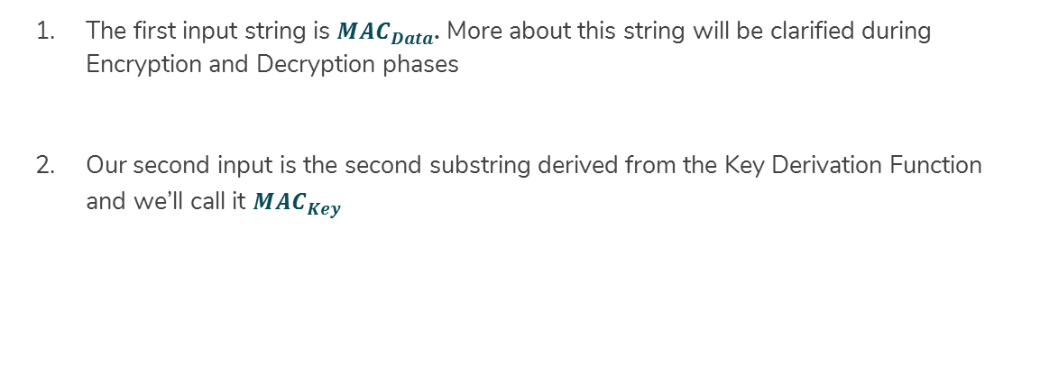
MAC – Input Parameters
The first input string is ${MAC}_{Data}$. More about this string will be clarified during Encryption and Decryption phases
Our second input is the second substring derived from the Key Derivation Function and we’ll call it ${MAC}_{Key}$

Slide 22

MAC – The algorithm
String $S_{5C}={Repeat}_{x64}\left({Pad}_{8}\left({Base}_{2}\left({5C}_{16}\right)\right)\right)$;
String $S_{36}={Repeat}_{x64}\left({Pad}_{8}\left({Base}_{2}\left({36}_{16}\right)\right)\right)$;
String ${Pad}_{Key}= {Pad}_{512}\left({MAC}_{Key}\right);$
String $K_{1}={Pad}_{Key} XOR{ S}_{5C}$;
String $K_{2}={Pad}_{Key} XOR S_{36}$;
String $Hash={SHA}_{1}\left(K_{1}+{MAC}_{Data}\right)$;
String $Output={SHA}_{1}\left(K_{2}+Hash\right)$;
return $Output$;

Slide 23
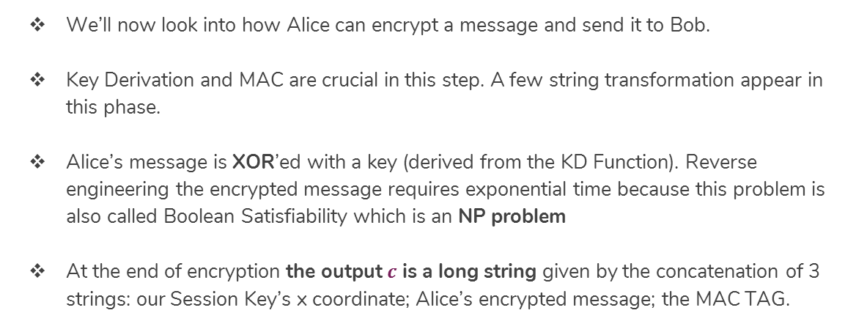
Encryption Phase – Definition
We’ll now look into how Alice can encrypt a message and send it to Bob.
Key Derivation and MAC are crucial in this step. A few string transformation appear in this phase.
Alice’s message is XOR’ed with a key (derived from the KD Function). Reverse engineering the encrypted message requires exponential time because this problem is also called Boolean Satisfiability which is an NP problem
At the end of encryption the output $c$ is a long string given by the concatenation of 3 strings: our Session Key’s x coordinate; Alice’s encrypted message; the MAC TAG.

Slide 24
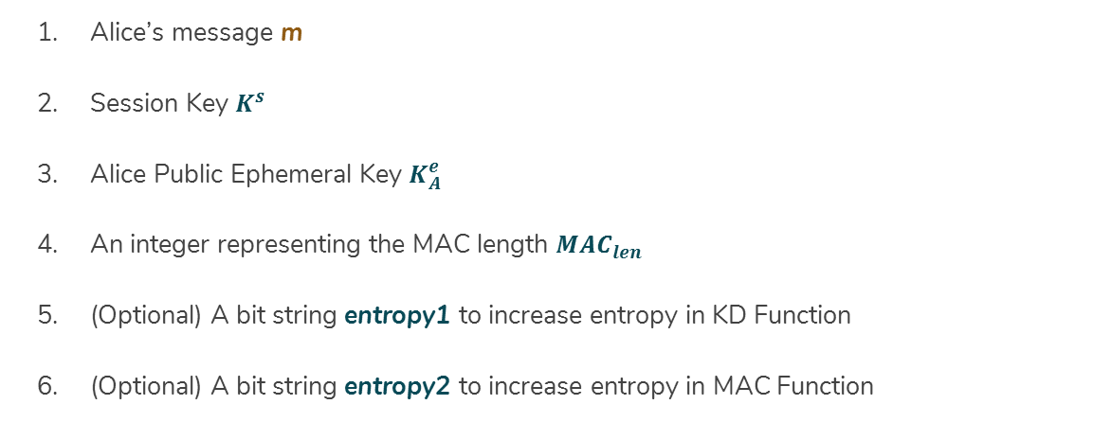
Encryption Phase – Input Parameters
Alice’s message m
Session Key $K^{s}$
Alice Public Ephemeral Key $K_{A}^{e}$
An integer representing the MAC length ${MAC}_{len}$
(Optional) A bit string entropy1 to increase entropy in KD Function
(Optional) A bit string entropy2 to increase entropy in MAC Function

Slide 25
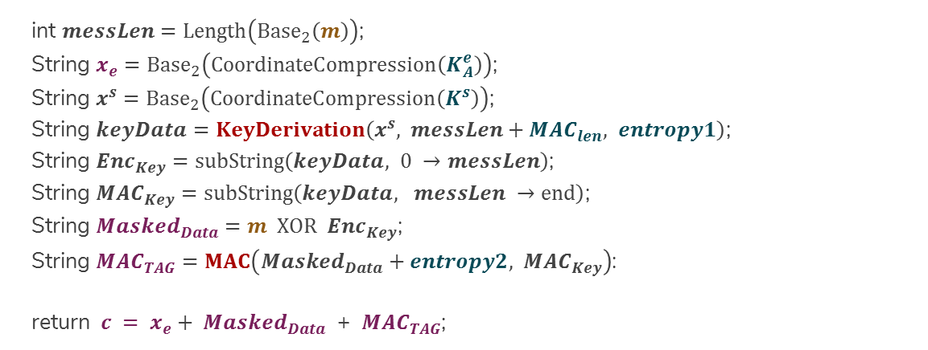
Encryption Phase – The Algorithm
int $messLen=Length\left({Base}_{2}\left(m\right)\right)$;
String $x_{e}={Base}_{2}\left(CoordinateCompression\left(K_{A}^{e}\right)\right)$;
String $x^{s}={Base}_{2}\left(CoordinateCompression\left(K^{s}\right)\right)$;
String $keyData=KeyDerivation\left(x^{s}, messLen+{MAC}_{len}, entropy1\right)$;
String ${Enc}_{Key}=subString\left(keyData, 0 →messLen\right)$;
String ${MAC}_{Key}=subString\left(keyData, messLen →end\right)$;
String ${Masked}_{Data}=m XOR { Enc}_{Key}$;
String ${MAC}_{TAG}=MAC\left({Masked}_{Data}+entropy2,{ MAC}_{Key}\right)$:
return ${ c = x}_{e} + {Masked}_{Data}$ + ${MAC}_{TAG}$;

Slide 26
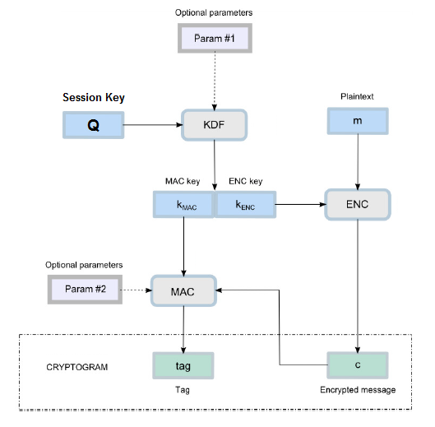
Encryption

Slide 27
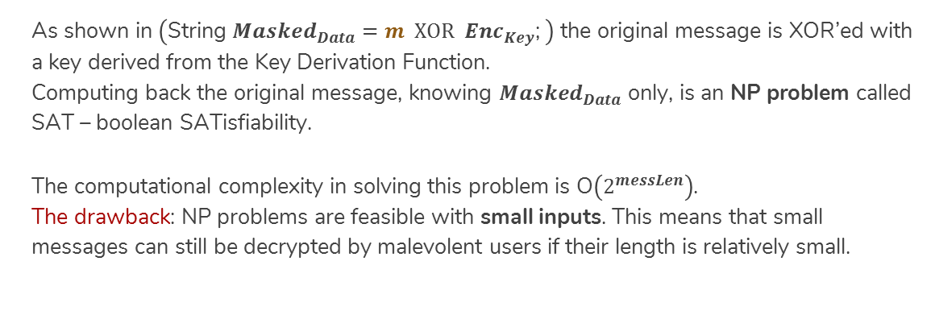
Encryption – The hardness (1)
As shown in $\left(\text{String} {Masked}_{Data}=m XOR { Enc}_{Key}\text{;} \right)$ the original message is XOR’ed with a key derived from the Key Derivation Function.
Computing back the original message, knowing ${Masked}_{Data}$ only, is an NP problem called SAT – boolean SATisfiability.
The computational complexity in solving this problem is O$\left(2^{messLen}\right)$.
The drawback: NP problems are feasible with small inputs. This means that small messages can still be decrypted by malevolent users if their length is relatively small.

Slide 28
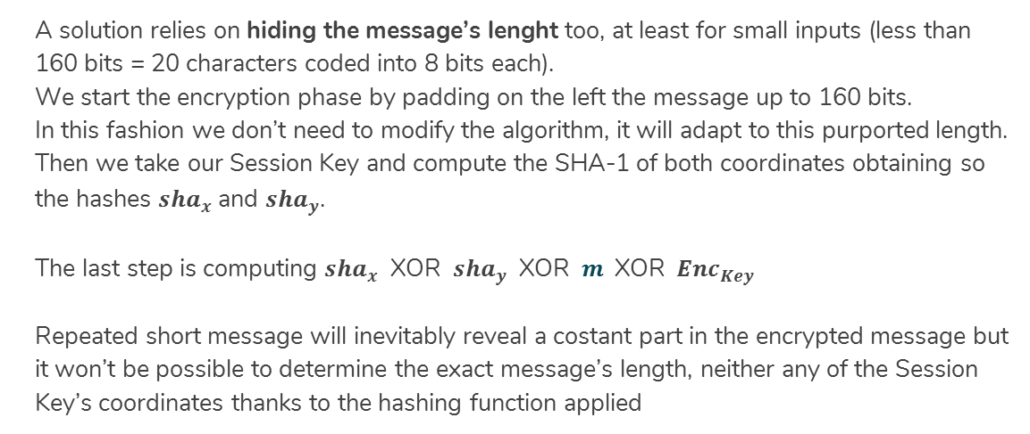
Encryption – The hardness (2)
A solution relies on hiding the message’s lenght too, at least for small inputs (less than 160 bits = 20 characters coded into 8 bits each).
We start the encryption phase by padding on the left the message up to 160 bits.
In this fashion we don’t need to modify the algorithm, it will adapt to this purported length.
Then we take our Session Key and compute the SHA-1 of both coordinates obtaining so the hashes ${sha}_{x}$ and ${sha}_{y}$.
The last step is computing ${sha}_{x}$ XOR ${ sha}_{y}$ XOR $m \text{XOR}{ Enc}_{Key}$
Repeated short message will inevitably reveal a costant part in the encrypted message but it won’t be possible to determine the exact message’s length, neither any of the Session Key’s coordinates thanks to the hashing function applied

Slide 29
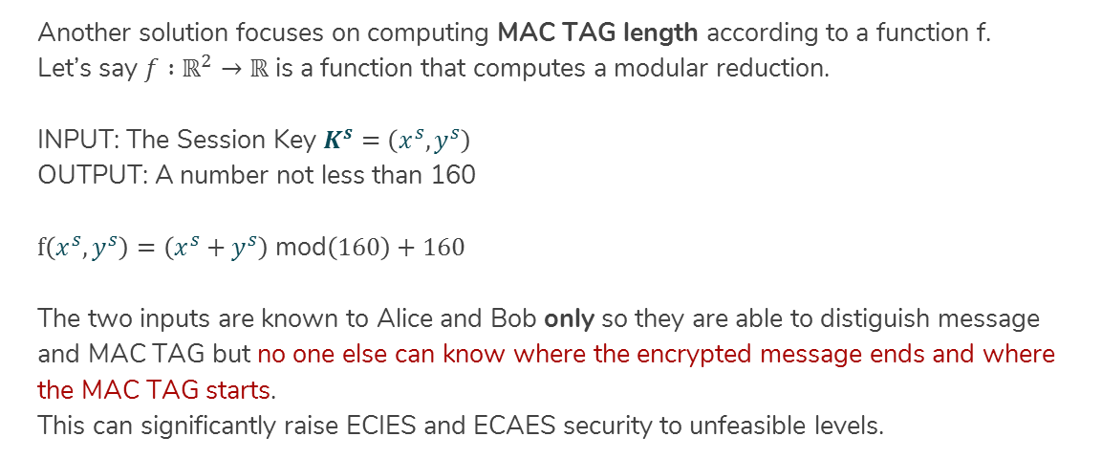
Encryption – The hardness (3)
Another solution focuses on computing MAC TAG length according to a function f.
Let’s say ${f :ℝ}^{2}→ℝ$ is a function that computes a modular reduction.
INPUT: The Session Key $K^{s}=\left(x^{s},y^{s}\right)$
OUTPUT: A number not less than 160
$f\left(x^{s},y^{s}\right)=\left(x^{s}+y^{s}\right)$ mod$\left(160\right)+160$
The two inputs are known to Alice and Bob only so they are able to distiguish message and MAC TAG but no one else can know where the encrypted message ends and where the MAC TAG starts.
This can significantly raise ECIES and ECAES security to unfeasible levels.

Slide 30
Decryption Phase – Definition
We’re into the final part of ECMQV message exchange via ECAES.
A complete Decryption Scheme would comprehend tests like Elliptic Curve Validation (robustness included), verify that Alice’s Ephemeral Key is the same sent in the encrypted message.
One single test is being reported: whether Bob is able to reproduce the same TAG as the one in the encrypted message. A positive test will let Bob complete the decryption otherwise the process is interrupted

Slide 31
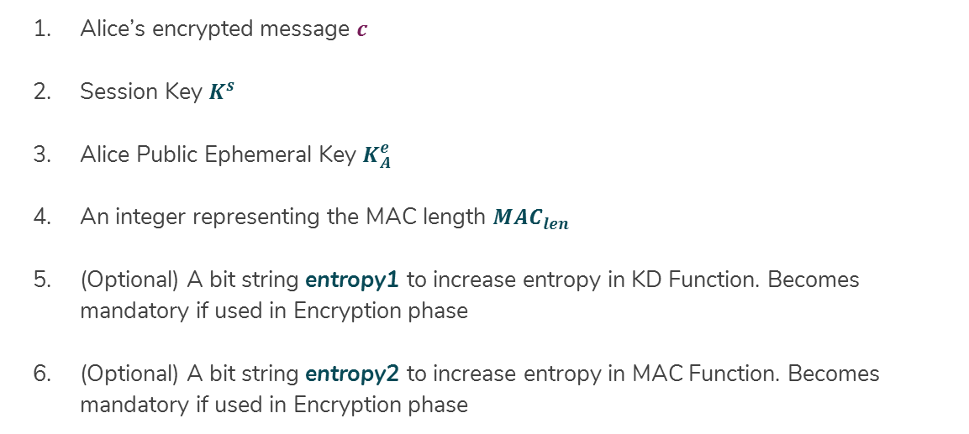
Decryption Phase – Input Parameters
Alice’s encrypted message $c$
Session Key $K^{s}$
Alice Public Ephemeral Key $K_{A}^{e}$
An integer representing the MAC length ${MAC}_{len}$
(Optional) A bit string entropy1 to increase entropy in KD Function. Becomes mandatory if used in Encryption phase
(Optional) A bit string entropy2 to increase entropy in MAC Function. Becomes mandatory if used in Encryption phase

Slide 32
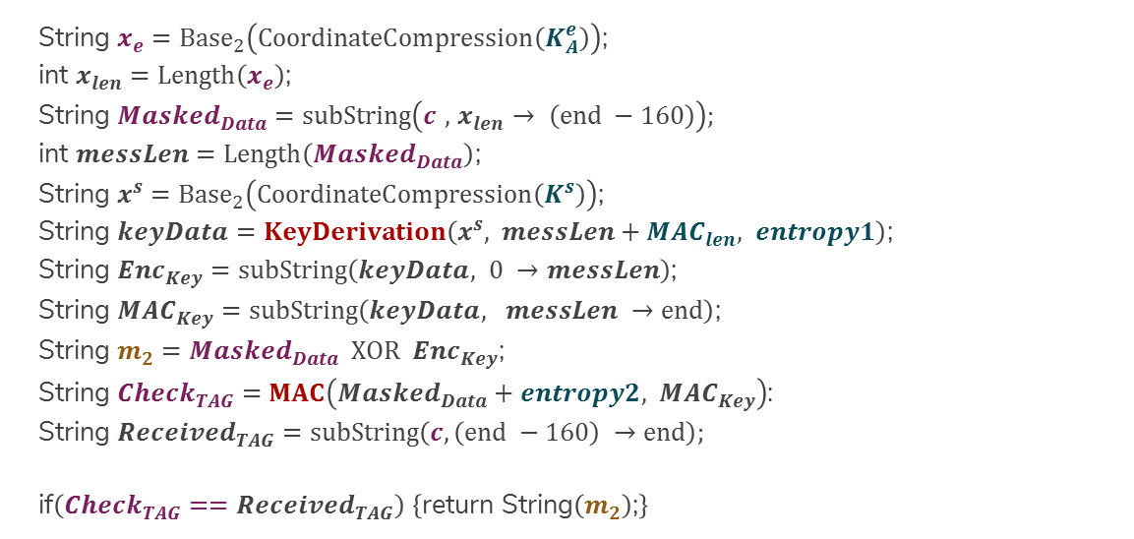
Decryption Phase – The Algorithm
String $x_{e}={Base}_{2}\left(CoordinateCompression\left(K_{A}^{e}\right)\right)$;
int $x_{len}=Length\left(x_{e}\right)$;
String ${Masked}_{Data}=subString\left(c , { x}_{len} → \left(end −160\right)\right);$
int $messLen=Length\left({Masked}_{Data}\right)$;
String $x^{s}={Base}_{2}\left(CoordinateCompression\left(K^{s}\right)\right)$;
String $keyData=KeyDerivation\left(x^{s}, messLen+{MAC}_{len}, entropy1\right)$;
String ${Enc}_{Key}=subString\left(keyData, 0 →messLen\right)$;
String ${MAC}_{Key}=subString\left(keyData, messLen →end\right)$;
String $m_{2}={Masked}_{Data} XOR { Enc}_{Key}$;
String ${Check}_{TAG}=MAC\left({Masked}_{Data}+entropy2,{ MAC}_{Key}\right)$:
String ${Received}_{TAG}=subString\left(c, \left(end −160\right) →end\right);$
if$\left({Check}_{TAG}=={Received}_{TAG}\right)$ $\left\{\text{return} \text{String}\left(m_{2}\right)\text{;}\right\}$

Slide 33
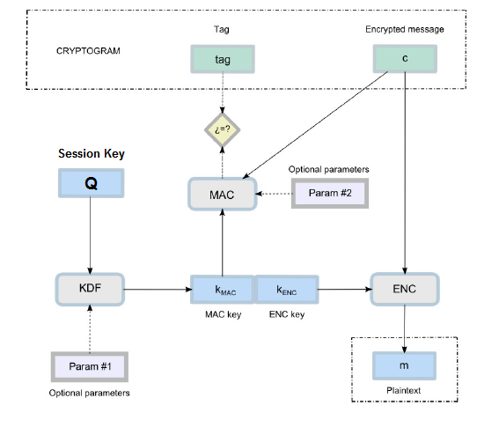

Slide 34
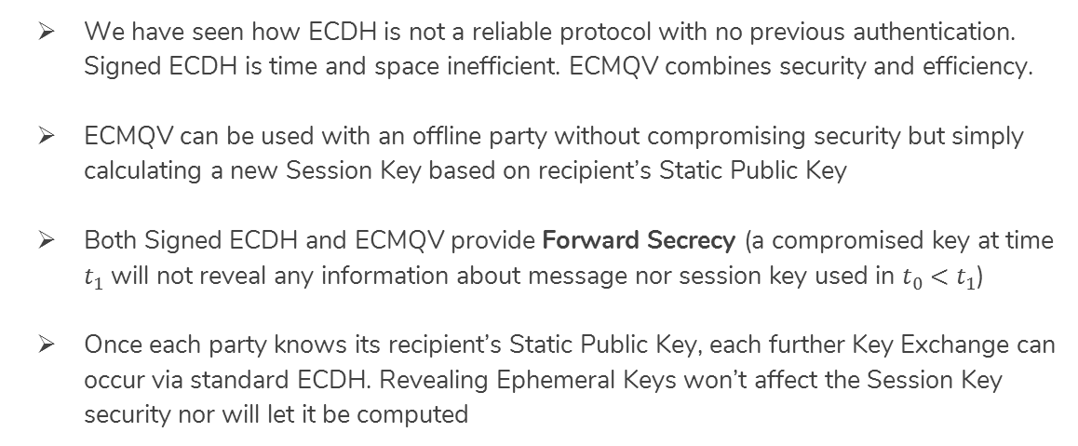
Conclusions (1)
We have seen how ECDH is not a reliable protocol with no previous authentication. Signed ECDH is time and space inefficient. ECMQV combines security and efficiency.
ECMQV can be used with an offline party without compromising security but simply calculating a new Session Key based on recipient’s Static Public Key
Both Signed ECDH and ECMQV provide Forward Secrecy (a compromised key at time $t_{1}$ will not reveal any information about message nor session key used in $t_{0}<t_{1}$)
Once each party knows its recipient’s Static Public Key, each further Key Exchange can occur via standard ECDH. Revealing Ephemeral Keys won’t affect the Session Key security nor will let it be computed

Slide 35
Conclusions (2)
ECAES’ Encryption is supported by a hard problem to solve without the correct key; and two mechanisms enabling to validate decryption’s correctness:
Validating the sender’s Public Ephemeral Key ensures the recipient on the Session Key correctness;
Validating the MAC TAG guarantees that the decrypted message is (or is not) the correct message sent. It is a redundacy element in our scheme.
ECIES doesn’t support the MAC TAG: a noisy channel might corrupt the message but the recipient would not be able to discover it!

