Slide 1
ECMQV
On the improvement of ECDH
Marco Carolla

Slide 2
Index
How ECDH works
The problem with ECDH
ECDSA
On the improvement of ECDH: ECMQV
How to derive the session key
Session key with offline recipient
ECIES for ECMQV
The Integrated Encryption Scheme
The Augmented Encryption Scheme

Slide 3
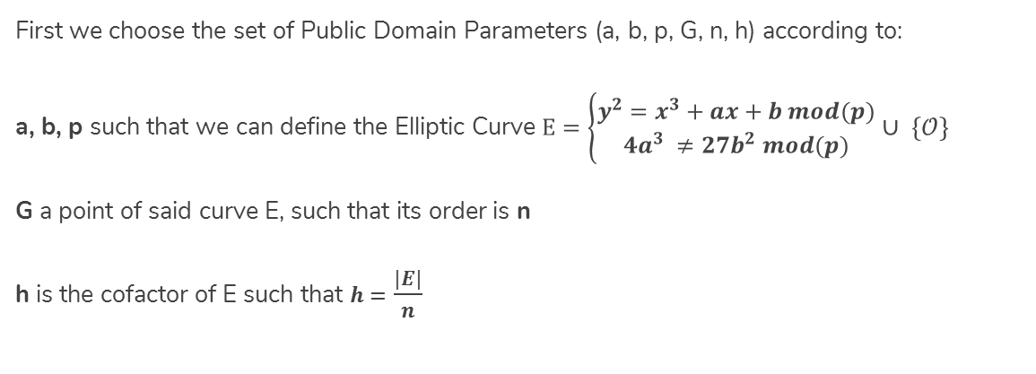
How ECDH works
First we choose the set of Public Domain Parameters (a, b, p, G, n, h) according to:
a, b, p such that we can define the Elliptic Curve $E=\left\{\begin{aligned}y^{2}=x^{3}+ax+b mod(p) \\ 4a^{3} ≠27b^{2} mod(p)\end{aligned}\right.$ $∪ \{𝒪\}$
G a point of said curve E, such that its order is n
h is the cofactor of E such that $h=$ $\frac{|E|}{n}$

Slide 4



Key Agreement
Alice
Computes her private key $k_{A}^{−}∈\left[1, n−1\right]$
Then his public $K_{A}^{+}= k_{A}^{−}∙G$ $⇄$
Bob
Computes his private key $k_{B}^{−}∈\left[1, n−1\right]$
Then his public $K_{B}^{+}= k_{B}^{−}∙G$
Now they both exchange their public keys $K^{+}$
$$K_{A}^{S}{=k_{A}^{−}∙K}_{B}^{+}= k_{A}^{−}∙k_{B}^{−}∙G=k_{B}^{−}∙k_{A}^{−}∙G{=k_{B}^{−}∙K}_{A}^{+}=K_{B}^{S}$$

Slide 5

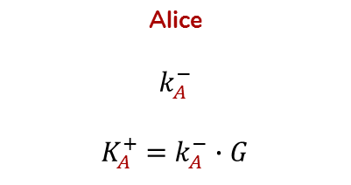



Man-in-the-Middle
Alice
$$k_{A}^{−}$$
$K_{A}^{+}$ = $k_{A}^{−}∙G$
Eve
$$k_{E}^{−}$$
$$K_{E}^{+}\text{= }k_{E}^{−}∙G$$
Bob
$$k_{B}^{−}$$
$$K_{B}^{+}\text{= }k_{B}^{−}∙G$$
$$⇄$$
$$K_{A,E}^{S}=k_{A}^{−}∙k_{E}^{−}∙G$$
$$⇄$$
$$K_{B, E}^{S}=k_{B}^{−}∙k_{E}^{−}∙G$$

Slide 6
Avoiding MitM
ECDH is weak to MitM because both parties have to authenticate each other before communicating.
Even with a prior authentication, the private keys used are usually Ephemeral! In order to avoid MitM attacks they should both re-authenticate each time these keys are re-calculated. Unfortunately ephemeral keys may change at each message to ensure the highest security. How to handle this case?
We can rely on recipient’s Digital Signature computed via ECDSA.

Slide 7
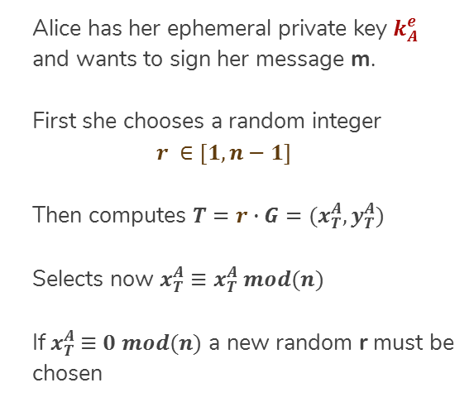
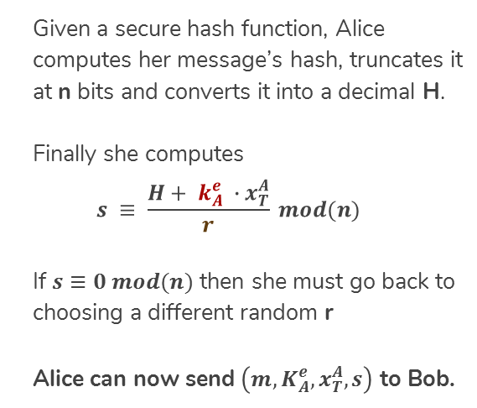
ECDSA - Signing
Alice has her ephemeral private key $k_{A}^{e}$ and wants to sign her message m.
First she chooses a random integer
$$r ∈[1, n−1]$$
Then computes $T=r∙G=(x_{T}^{A}, y_{T}^{A})$
Selects now $x_{T}^{A}≡x_{T}^{A} mod(n)$
If${ x}_{T}^{A} ≡0 mod(n)$ a new random r must be chosen
Given a secure hash function, Alice computes her message’s hash, truncates it at n bits and converts it into a decimal H.
Finally she computes
$$s ≡ \frac{H+ k_{A}^{e} ∙x_{T}^{A}}{r} mod(n)$$
If $s≡0 mod(n)$ then she must go back to choosing a different random r
Alice can now send $\left(m, K_{A}^{e},x_{T}^{A}, s\right)$ to Bob.

Slide 8
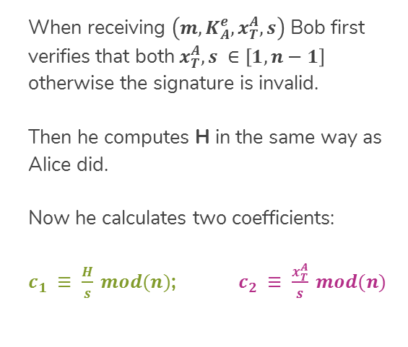
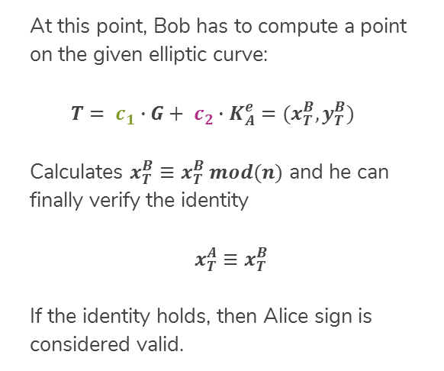
ECDSA - Verification
When receiving $\left(m, K_{A}^{e},x_{T}^{A}, s\right)$ Bob first verifies that both$x_{T}^{A}, s ∈\left[1, n−1\right]$ otherwise the signature is invalid.
Then he computes H in the same way as Alice did.
Now he calculates two coefficients:
$c_{1} ≡ \frac{H}{s} mod(n)$; $c_{2} ≡ \frac{x_{T}^{A}}{s} mod(n)$
At this point, Bob has to compute a point on the given elliptic curve:
$$T= c_{1}∙G+ c_{2}∙K_{A}^{e}=(x_{T}^{B}, y_{T}^{B})$$
Calculates $x_{T}^{B}≡x_{T}^{B} mod(n)$ and he can finally verify the identity
$x_{T}^{A}≡x_{T}^{B}$
If the identity holds, then Alice sign is considered valid.

Slide 9
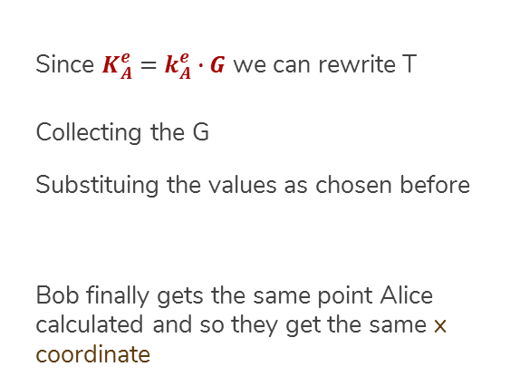
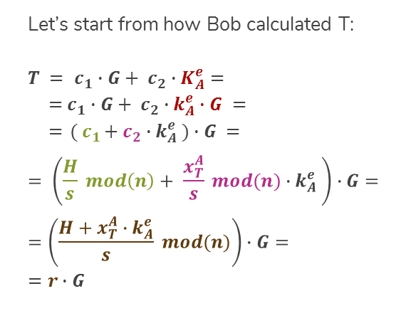
ECDSA - Correctness
Let’s start from how Bob calculated T:
$T = c_{1}∙G+ c_{2}∙K_{A}^{e}$ $=$
$={ c}_{1} ∙G+ c_{2}∙k_{A}^{e}∙G =$
$={ ( c}_{1}+ c_{2}∙k_{A}^{e} )∙G =$
$$= \left(\frac{H}{s} mod\left(n\right)+ \frac{x_{T}^{A}}{s} mod(n){∙k}_{A}^{e} \right)∙G=$$
$$=\left(\frac{H+x_{T}^{A}{∙k}_{A}^{e}}{s} mod(n)\right)∙G=$$
$$=r∙G$$
Since $K_{A}^{e}$ $=$ $k_{A}^{e}∙G$ we can rewrite T
Collecting the G
Substituing the values as chosen before
Bob finally gets the same point Alice calculated and so they get the same x coordinate

Slide 10
Why Signed ECDH fails in practice
Alice and Bob may now choose to communicate exchanging their Digital Signatures at each message but it costs much in terms of time and spacial resourses!
Every message would weight more thus slowing the communication down.
Moreover the Digital Signature must be recalculated each time so to avoid its decryption hence requiring more time before each message is sent.
How to overcome these drawbacks while still ensuring a secure way to communicate?

Slide 11
What ECMQV is
The acronym of Elliptic Curve Menezes Qu Vanston, following the names of the mathematicians (along with Law and Solinas) who developed the protocol;
A protocol variation of ECDH (Elliptic Curve Diffie Hellman) to ensure an implicit authentication via a new Session Key. The key is now derived from both static and ephemeral keys.

Slide 12
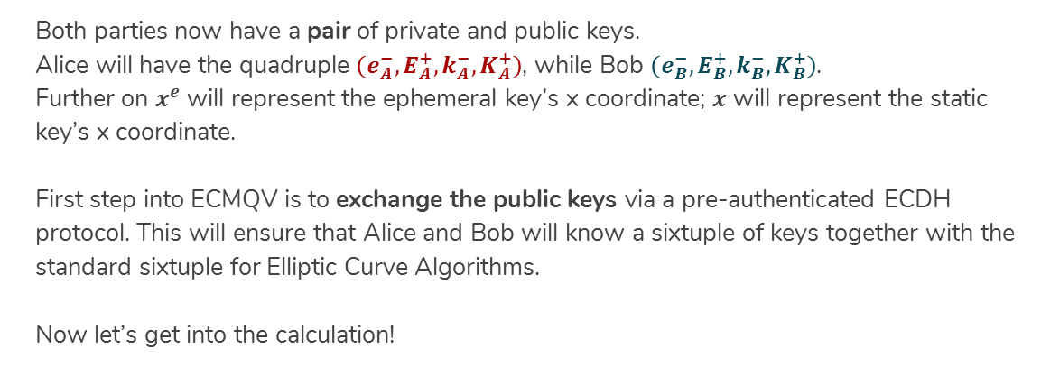
Parties parameters
Both parties now have a pair of private and public keys.
Alice will have the quadruple $\left(e_{A}^{−},E_{A}^{+},k_{A}^{−},K_{A}^{+}\right)$, while Bob $\left(e_{B}^{−},E_{B}^{+},k_{B}^{−},K_{B}^{+}\right)$.
Further on $x^{e}$ will represent the ephemeral key’s x coordinate; $x$ will represent the static key’s x coordinate.
First step into ECMQV is to exchange the public keys via a pre-authenticated ECDH protocol. This will ensure that Alice and Bob will know a sixtuple of keys together with the standard sixtuple for Elliptic Curve Algorithms.
Now let’s get into the calculation!

Slide 13
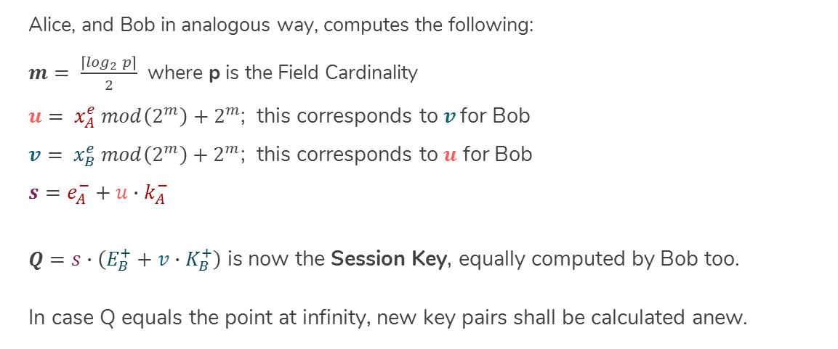
Session Key: derivation
Alice, and Bob in analogous way, computes the following:
$m= \frac{\left\lceil \log_{2} p\right\rceil }{2}$ where p is the Field Cardinality
$u= x_{A}^{e} mod\left(2^{m}\right)+2^{m}$; this corresponds to $v$ for Bob
$v= x_{B}^{e} mod\left(2^{m}\right)+2^{m}$; this corresponds to $u$ for Bob
$$s=e_{A}^{−}+u∙k_{A}^{−}$$
$Q=s∙\left(E_{B}^{+}+v∙K_{B}^{+}\right)$ is now the Session Key, equally computed by Bob too.
In case Q equals the point at infinity, new key pairs shall be calculated anew.

Slide 14
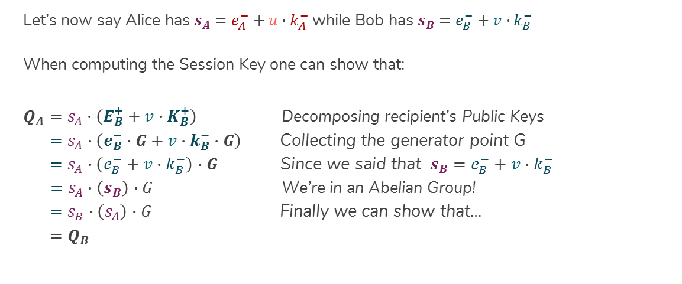
Session Key: correctness
Let’s now say Alice has $s_{A}=e_{A}^{−}+u∙k_{A}^{−}$ while Bob has $s_{B}=e_{B}^{−}+v∙k_{B}^{−}$
When computing the Session Key one can show that:
$Q_{A}=s_{A}∙\left(E_{B}^{+}+v∙K_{B}^{+}\right)$ Decomposing recipient’s Public Keys
$=s_{A}∙\left(e_{B}^{−}∙G+v∙k_{B}^{−}∙G\right)$ Collecting the generator point G
$=s_{A}∙\left(e_{B}^{−}+v∙k_{B}^{−}\right)$ $∙G$ Since we said that $s_{B}=e_{B}^{−}+v∙k_{B}^{−}$
$=s_{A}∙\left(s_{B}\right)$ $∙G$ We’re in an Abelian Group!
$=s_{B}∙\left(s_{A}\right)$ $∙G$ Finally we can show that…
${=Q}_{B}$

Slide 15
ECMQV Strenghts
The ECMQV protocol allows Authentic Key Agreement to occur over an insecure channel whilst only requiring the same bandwidth as an unauthenticated ECDH;
Communication can occur even if one party is offline: since the impossibility in retriving its Public Ephemeral Key, its Static Public Key shall be used for computing the Session Key;
Message encryption is now up to the Session Key. We no longer require to perfom a Point Multiplication before each encryption.

