Slide 1

Overview
Design Requirements
Database should track:
products
list products
create products
inventory
modify inventory
transactions
reviews
track most popular/least popular products
users
purchase history/offer email promotion to inactive users
off the beaten path

Slide 2
Analysis
Implementation Choices
During the design phase we first decided the type of ecommerce company we were going to be.
Once we had an identity established as an outdoor equipment company, we needed to populate our store with products.
From here we gathered details about:
Products we would sell
Categories we would include
Product Descriptions
Pricing
Brands
off the beaten path

Slide 3
Analysis
Implementation Choices
Once we had populated our store with awesome products aimed at both those new to the outdoors as well as experienced enthusiasts, we then focused on customer data retention.
Our primary focuses were:
Maintaining a purchase history
This enables customers to easily reorder something they liked
Make returns/exchanges with ease
Saved personal information for easy checkout including:
Shipping address
Phone number
Email
off the beaten path

Slide 4
Analysis
Implementation Choices
The next consideration during the analysis phase centered on how we would handle customer orders.
It was important to ensure we can provide a great experience from placing an order to delivery.
To accomplish this we track the following information:
OrderID
Quantities
Shipping information such as address, phone number.
Shipment information with tracking number that is forwarded to the customer via email. Shipment information included a timestamp at each checkpoint for accuracy and accountability.
off the beaten path

Slide 5
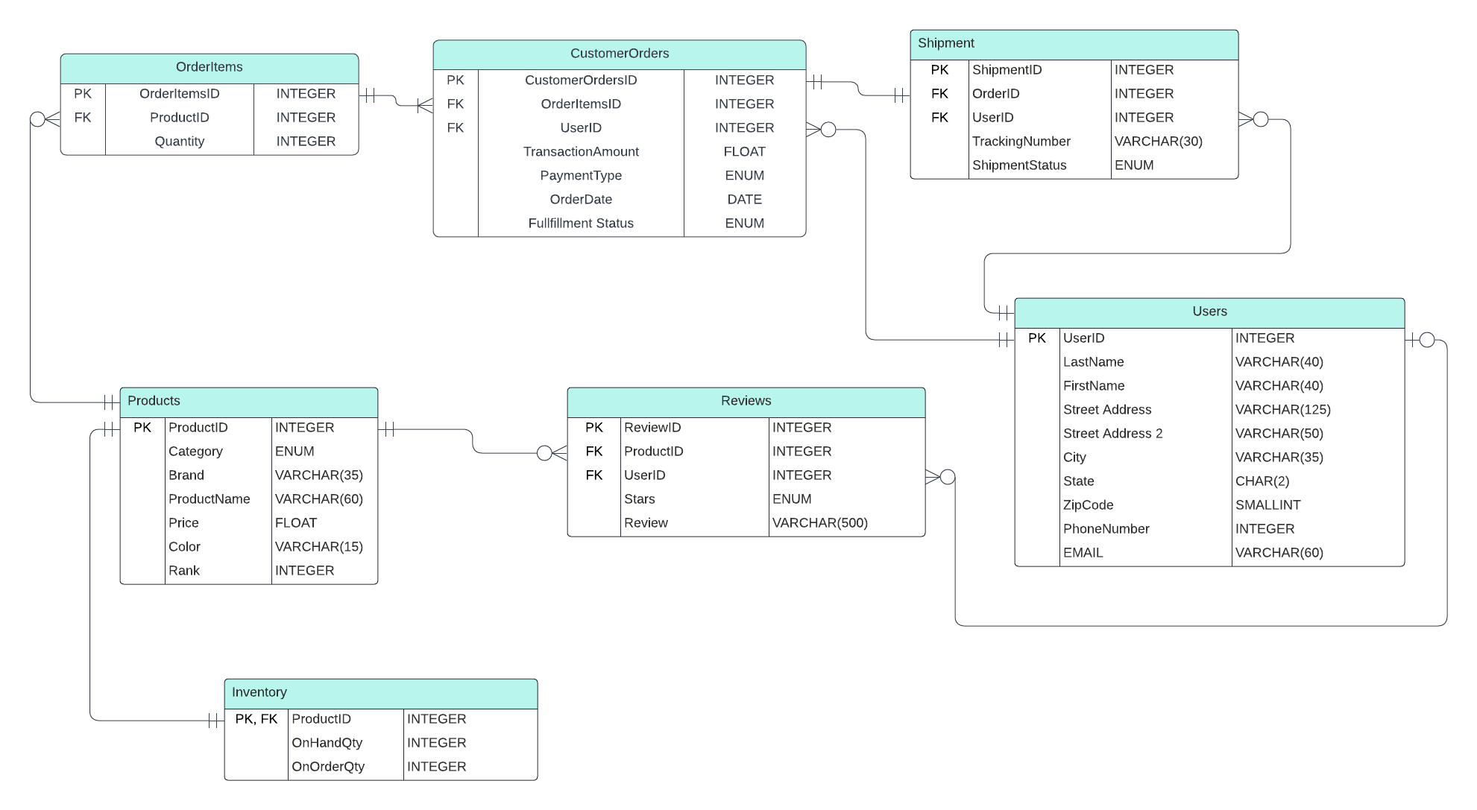
ERD
off the beaten path

